Slide 1
Classification of Breast Cancer Patients
Team Members
Robin Paul
Saurabh Jain

Slide 2
Goals
Unsupervised learning to find optimal clusters
PCA analysis to find most relevant genes

Slide 3
Data preparation and pre processing
Data downloaded from Kaggle, loaded and analyzed for features
80 patients
12553 proteins
Pre-processing
Dropping not required columns like symbol
Transposed the matrix as we wanted to classify patients and not proteins
Imputer strategy of median to fill missing values

Slide 4
Evaluation Criteria
Silhouette score
The Silhouette Coefficient is calculated using the mean intra-cluster distance (a) and the mean nearest-cluster distance (b) for each sample. The Silhouette Coefficient for a sample is (b - a) / max(a, b)
Homogeneity score
A clustering result satisfies homogeneity if all of its clusters contain only data points which are members of a single class.
Inertia
Sum of squared distances of samples to their closest cluster center.

Slide 5
Unsupervised Learning
 | Algorithm | n_clusters | n_init | max_iter | Silhouette Coefficient | Homogeneity score | Train Time(s)
0 | K Means Default | 3 (using inertia) | 10 | 300 | 0.1736 | 0.4138
1 | K Means Default Random protein | 3 | 10 | 300 | 0.1675 | 0.0463
2 | K Means Default with time | 3 | 10 | 300 | 0.176 | 0.412 | 1.406 s
3 | K Means Pipeline Standard Scaler | 3 | 10 | 300 | 0.1318 | 0.4444
4 | K Means Pipeline Normalizer | 3 | 10 | 300 | 0.1547 | 0.4005
5 | Affinity Propogation | 3 |  | 200 | 0.174 | 0.438
6 | DBSCAN | 1 |  | eps = 10 | NA | -0.000
7 | Mini Batch KMeans - Kmeans++ | 3 | 10 | 300 | 0.110 | 0.648 | 0.012 s
8 | GRIDSearch CV (3 cross fold) | 3 | 10 | 400 | 0.176046 | 0.62123
9 | RandomSearch CV | 5 | 12 | 316 | 0.138208 | 0.695911
10 | GRID Search CV Increased cluster | 8 | 20 | 300 | 0.106839 | 0.767446

Slide 6
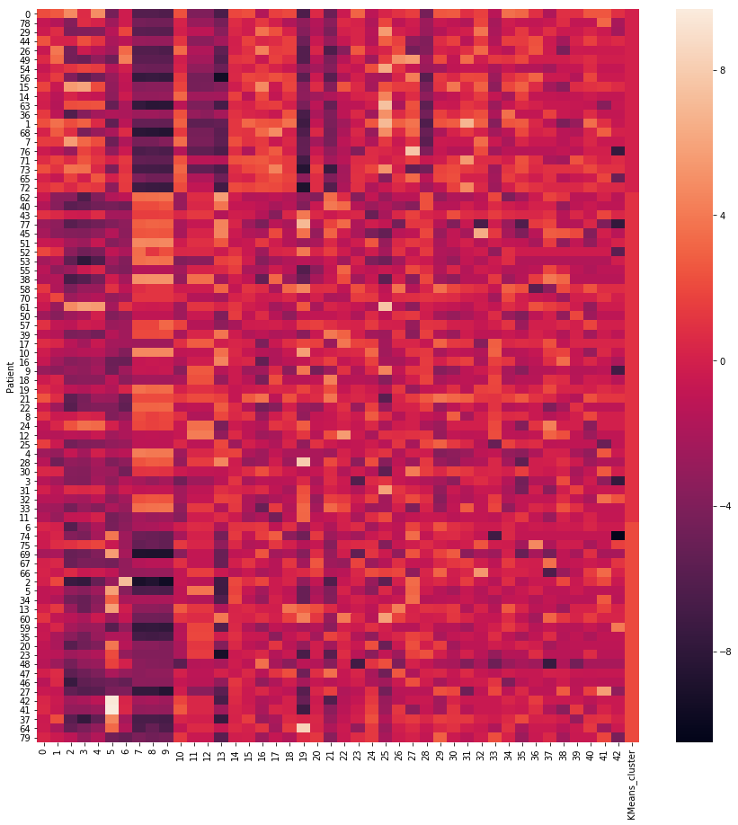
Heatmap – 3 clusters of size 34, 20, 26

Slide 7
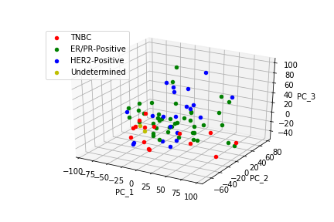
Classification of breast cancer subtypes
In this project, our objective is to classify breast cancer patients into three subtypes: ER⁺, HER2⁺ and TNBC.
PCA was carried out on the original dataset (Fig. 1).
Purity of TNBC cluster: 0.39, ER⁺ : 0. 83, HER2⁺ : 0.52
Number of components estimated = 5 higher than expected number of components = 3.
Fig. 1 – PCA plot of the original dataset.

Slide 8
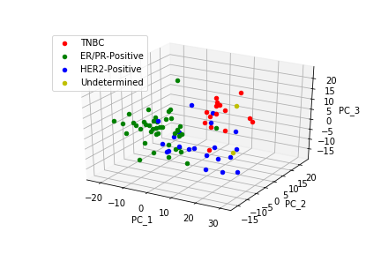
Lasso penalization for feature selection
Lasso penalization was carried out on the original dataset. Number of features reduced from 6912 to 36.
PCA was carried out as shown in Fig. 2.
Purity of TNBC cluster: 0.78, ER⁺ : 0. 86, HER2⁺ : 0.34
Number of components = Expected number of components = 3.
Fig. 2 – PCA plot after lasso penalization.

Slide 9
Computing significance of selected genes from Lasso penalization
Computed number of common genes between L1 penalized dataset and PAM50 (reference dataset).
Calculated statistical significance of common genes by computing binomial p-value = 6.52 × 10⁻⁶ < 0.05.

Slide 10
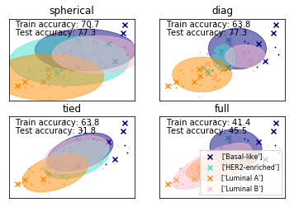
Gaussian Mixture Models
Combine data with PAM50 dataset for True labels
Gaussian mixture models + Imputer as median + StratifiedKFold as 4 + covariance_type as 'spherical', 'diag', 'tied', 'full’
Testing accuracy 77.3%

Slide 11
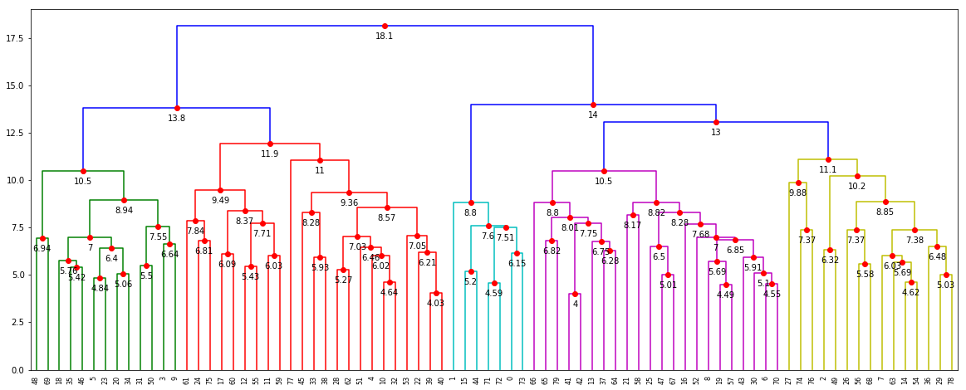
Dendogram

Slide 12
Conclusion
Using unsupervised learning, best number of clusters observed are 3. Using these clusters biologists can better study common patterns and work on those patients
Using PCA, able to identify 36 most important genes which will be most suitable for identifying breast cancer subtypes

Slide 13
Thank You

