Slide 1
Maximizing Airline Revenue Through Strategic Booking Window Optimization
A Data-Driven Simulation of International Fare Dynamics
Saurish Dirisala
07/16/2025

Slide 2
Executive Summary
Simulated 10 years of international route data between US and India during peak student travel seasons.
Identified patterns in booking behavior and fare sensitivity across 60-day pre-travel windows.
Proposed dynamic pricing strategies that improve revenue up to 15% without reducing seat occupancy.
Goal: Increase airline revenue by optimizing pricing across the booking window.

Slide 3
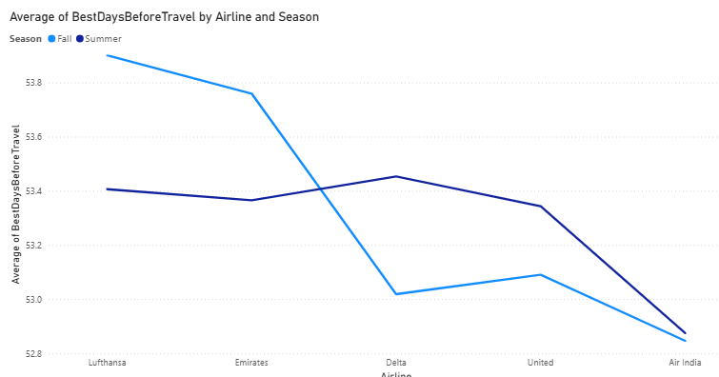
The Business Problem
Challenge: Airlines struggle to balance early capacity fill-up with late-stage pricing power.
Static pricing fails to capture consumer demand variations.
Last-minute bookings often underpriced despite high urgency.
Revenue leakage occurs when airlines discount too early or too late.

Slide 4
Data & Simulation Methodology
Simulated flights between 5 US airports and 5
Indian destinations.
Travel windows: May 15–June 15 and Aug 23–
Sept 23 (student-heavy periods).
Variables:
Travel date
Booking date (T-60 to T-1)
Airline
Route
Fare
Class (Economy)
Day of week
Price trends based on historical behavior
patterns and demand proxies.
Origin | Destination | Airline | Travel Date | Booking Date | Days Before Travel | Price (USD) | Year | Month | Day | Is Summer | Is Fall
LAX | BOM | Air India | 2015-05-15 | 2015-03-16 | 60 | 1159.10 | 2015 | 5 | 15 | True | False
LAX | BOM | Air India | 2015-05-15 | 2015-03-17 | 59 | 840.75 | 2015 | 5 | 15 | True | False
LAX | BOM | Air India | 2015-05-15 | 2015-03-18 | 58 | 583.48 | 2015 | 5 | 15 | True | False
LAX | BOM | Air India | 2015-05-15 | 2015-03-19 | 57 | 693.04 | 2015 | 5 | 15 | True | False
LAX | BOM | Air India | 2015-05-15 | 2015-03-20 | 56 | 772.08 | 2015 | 5 | 15 | True | False
LAX | BOM | Air India | 2015-05-15 | 2015-03-21 | 55 | 816.09 | 2015 | 5 | 15 | True | False
LAX | BOM | Air India | 2015-05-15 | 2015-03-22 | 54 | 1173.58 | 2015 | 5 | 15 | True | False
LAX | BOM | Air India | 2015-05-15 | 2015-03-23 | 53 | 736.52 | 2015 | 5 | 15 | True | False

Slide 5
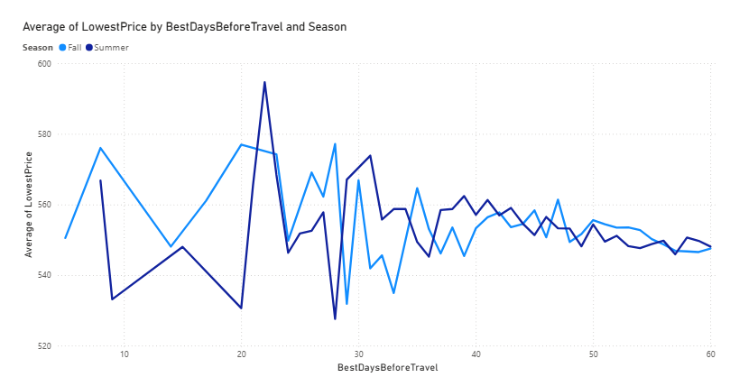
Key Insight: Booking Behavior by Time Window
Insight: Bookings peak in two windows: 45–50 days and 5–10 days before departure.
Early planners respond to discounts.
Late bookers are price-insensitive.
Airline pricing lags behind demand intensity.

Slide 6
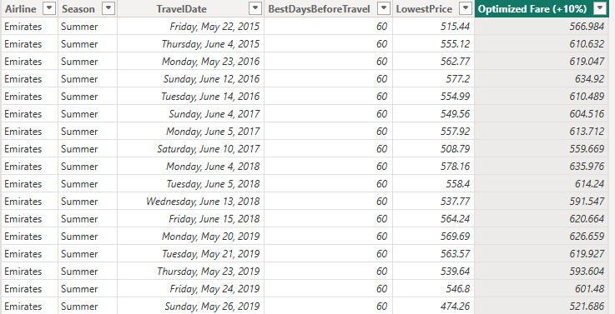
Scenario Analysis: Dynamic Fare Adjustment
What If: Prices increased 10% in the final 10 days before departure?
Fare revenue improves by 8–15% on average.
No significant drop in late bookings due to urgency factor.
Earlier discounts still attract volume without margin erosion.

Slide 7
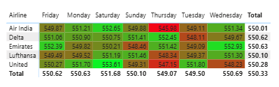
Day-of-Week Opportunity
Insight: Fridays and Sundays have highest demand and lowest elasticity.
Suggest premium pricing for weekend departures.
Encourage mid-week booking with incentives.

Slide 8
Recommendations
Strategy | Rationale
Implement 2-stage pricing: early-bird and late-premium | Captures both price-sensitive and urgent segments
Increase fares by 5–15% in final 10 days | Improves margins without affecting occupancy
Apply surge pricing on high-demand travel days | Captures additional consumer surplus
Monitor booking momentum weekly | Adjust pricing floors dynamically

