Slide 1
Review: Probability
Random variables, events
Axioms of probability
Atomic events
Joint and marginal probability distributions
Conditional probability distributions
Product rule, chain rule
Independence and conditional independence

Slide 2
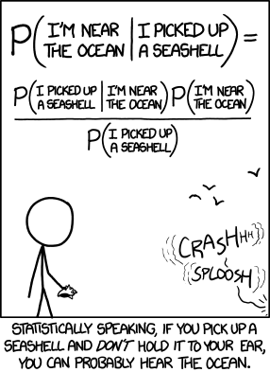
Bayesian inference, Naïve Bayes model
http://xkcd.com/1236/

Slide 3
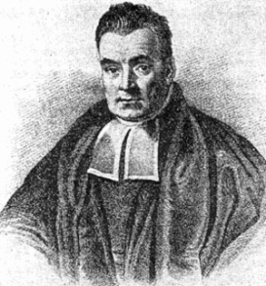
Bayes Rule
Rev. Thomas Bayes (1702-1761)
The product rule gives us two ways to factor a joint probability:
Therefore,
Why is this useful?
Can update our beliefs about A based on evidence B
P(A) is the prior and P(A|B) is the posterior
Key tool for probabilistic inference: can get diagnostic probability from causal probability
E.g., P(Cavity = true | Toothache = true) from P(Toothache = true | Cavity = true)
Notes:
A: some unobservable aspect of the world that we are trying to predict (query variable)
B: observable evidence

Slide 4
Bayes Rule example
Marie is getting married tomorrow, at an outdoor ceremony in the desert. In recent years, it has rained only 5 days each year (5/365 = 0.014). Unfortunately, the weatherman has predicted rain for tomorrow. When it actually rains, the weatherman correctly forecasts rain 90% of the time. When it doesn't rain, he incorrectly forecasts rain 10% of the time. What is the probability that it will rain on Marie's wedding?

Slide 5
Bayes Rule example
Marie is getting married tomorrow, at an outdoor ceremony in the desert. In recent years, it has rained only 5 days each year (5/365 = 0.014). Unfortunately, the weatherman has predicted rain for tomorrow. When it actually rains, the weatherman correctly forecasts rain 90% of the time. When it doesn't rain, he incorrectly forecasts rain 10% of the time. What is the probability that it will rain on Marie's wedding?

Slide 6
Law of total probability

Slide 7
Bayes Rule example
Marie is getting married tomorrow, at an outdoor ceremony in the desert. In recent years, it has rained only 5 days each year (5/365 = 0.014). Unfortunately, the weatherman has predicted rain for tomorrow. When it actually rains, the weatherman correctly forecasts rain 90% of the time. When it doesn't rain, he incorrectly forecasts rain 10% of the time. What is the probability that it will rain on Marie's wedding?

Slide 8
Bayes rule: Example
1% of women at age forty who participate in routine screening have breast cancer. 80% of women with breast cancer will get positive mammographies. 9.6% of women without breast cancer will also get positive mammographies. A woman in this age group had a positive mammography in a routine screening. What is the probability that she actually has breast cancer?

Slide 9
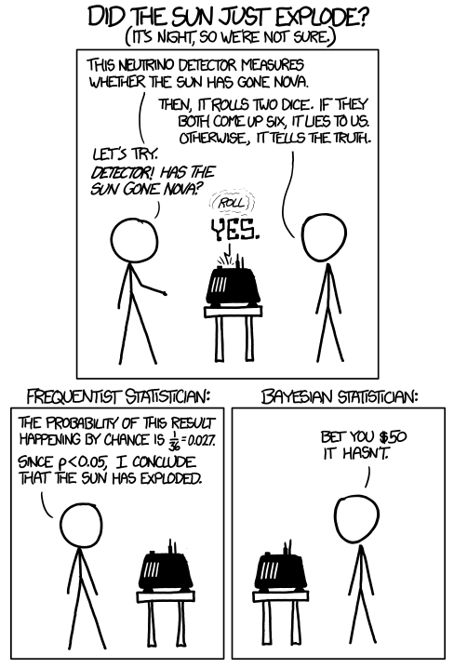
https://xkcd.com/1132/
See also: https://xkcd.com/882/
Notes:
P(Nova|Yes) = P(Yes|Nova)P(Nova)/P(Yes) = (35/36)(eps)/P(Yes)
P(not Nova|Yes) = P(Yes|Not Nova)P(Not Nova)/P(Yes) = (1/36)(1-eps)/P(Yes)
P(Not Nova|Yes) / P(Nova|Yes) = (1/36)(1-eps) / ((35/36) eps) = (1 – eps)/(35 eps)

Slide 10

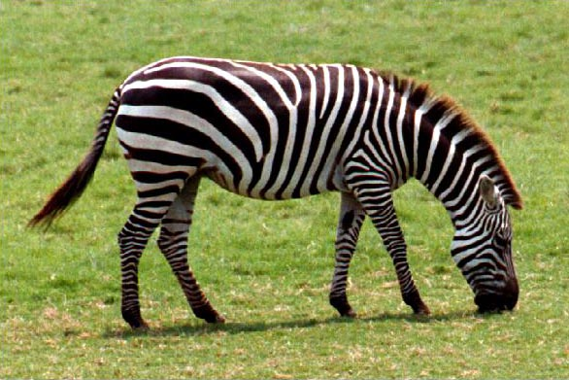
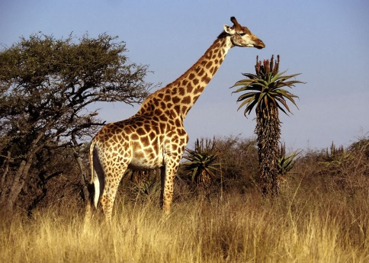
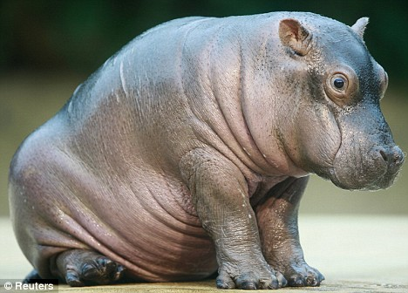
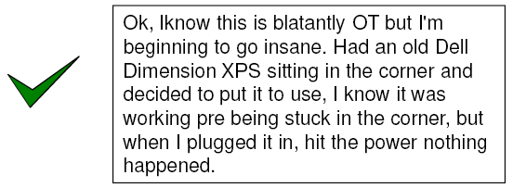
Probabilistic inference
Suppose the agent has to make a decision about the value of an unobserved query variable X given some observed evidence variable(s) E = e
Partially observable, stochastic, episodic environment
Examples: X = {spam, not spam}, e = email message X = {zebra, giraffe, hippo}, e = image features
Notes:
Expected loss of a decision: P(decision is correct) * 0 + P(decision is wrong) * 1

Slide 11
Bayesian decision theory
Let x be the value predicted by the agent and x* be the true value of X.
The agent has a loss function, which is 0 if x = x* and 1 otherwise
Expected loss for predicting x:
What is the estimate of X that minimizes the expected loss?
The one that has the greatest posterior probability P(x|e)
This is called the Maximum a Posteriori (MAP) decision
Notes:
Expected loss of a decision: P(decision is correct) * 0 + P(decision is wrong) * 1

Slide 12
MAP decision
Value x of X that has the highest posterior probability given the evidence E = e:
Maximum likelihood (ML) decision:
posterior
likelihood
prior

Slide 13
Naïve Bayes model
Suppose we have many different types of observations (symptoms, features) E₁, …, E_{n} that we want to use to obtain evidence about an underlying hypothesis X
MAP decision:
If each feature E_{i} can take on k values, how many entries are in the (conditional) joint probability table P(E₁, …, E_{n} |X = x)?

Slide 14
Naïve Bayes model
Suppose we have many different types of observations (symptoms, features) E₁, …, E_{n} that we want to use to obtain evidence about an underlying hypothesis X
MAP decision:
We can make the simplifying assumption that the different features are conditionally independent given the hypothesis:
If each feature can take on k values, what is the complexity of storing the resulting distributions?

Slide 15
Naïve Bayes model
Posterior:
MAP decision:
posterior
prior
likelihood

Slide 16
Case study: Text document classification
MAP decision: assign a document to the class with the highest posterior P(class | document)
Example: spam classification
Classify a message as spam if P(spam | message) > P(¬spam | message)

Slide 17
Case study: Text document classification
MAP decision: assign a document to the class with the highest posterior P(class | document)
We have P(class | document) ∝ P(document | class)P(class)
To enable classification, we need to be able to estimate the likelihoods P(document | class) for all classes and priors P(class)

Slide 18
Naïve Bayes Representation
Goal: estimate likelihoods P(document | class) and priors P(class)
Likelihood: bag of words representation
The document is a sequence of words (w₁, …, w_{n})
The order of the words in the document is not important
Each word is conditionally independent of the others given document class

Slide 19
Naïve Bayes Representation
Goal: estimate likelihoods P(document | class) and priors P(class)
Likelihood: bag of words representation
The document is a sequence of words (w₁, …, w_{n})
The order of the words in the document is not important
Each word is conditionally independent of the others given document class

Slide 20
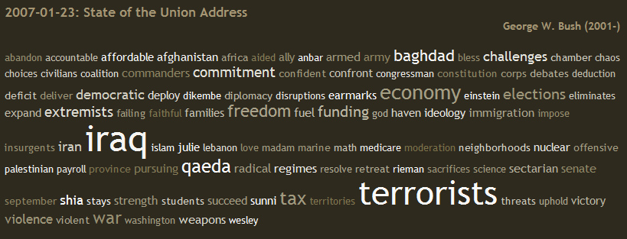
Bag of words illustration
US Presidential Speeches Tag Cloud http://chir.ag/projects/preztags/

Slide 21
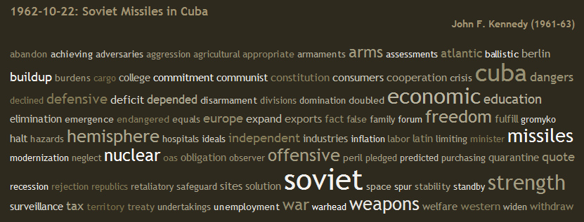
Bag of words illustration
US Presidential Speeches Tag Cloud http://chir.ag/projects/preztags/

Slide 22
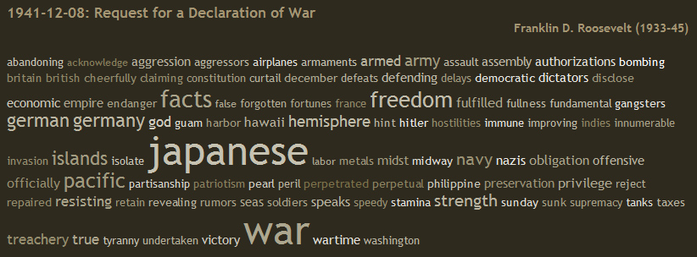
Bag of words illustration
US Presidential Speeches Tag Cloud http://chir.ag/projects/preztags/

Slide 23
Naïve Bayes Representation
Goal: estimate likelihoods P(document | class) and P(class)
Likelihood: bag of words representation
The document is a sequence of words (w₁, … , w_{n})
The order of the words in the document is not important
Each word is conditionally independent of the others given document class
Thus, the problem is reduced to estimating marginal likelihoods of individual words P(w_{i} | class)

Slide 24
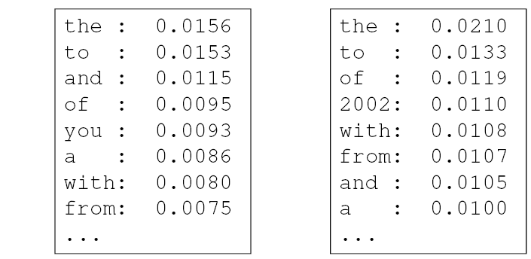
Parameter estimation
Model parameters: feature likelihoods P(word | class) and priors P(class)
How do we obtain the values of these parameters?
prior
P(word | spam)
P(word | ¬spam)
spam: 0.33
¬spam: 0.67

Slide 25
Parameter estimation
Model parameters: feature likelihoods P(word | class) and priors P(class)
How do we obtain the values of these parameters?
Need training set of labeled samples from both classes
This is the maximum likelihood (ML) estimate, or estimate that maximizes the likelihood of the training data:
# of occurrences of this word in docs from this class
P(word | class) =
total # of words in docs from this class
d: index of training document, i: index of a word

Slide 26
Parameter estimation
Parameter estimate:
Parameter smoothing: dealing with words that were never seen or seen too few times
Laplacian smoothing: pretend you have seen every vocabulary word one more time than you actually did
# of occurrences of this word in docs from this class
P(word | class) =
total # of words in docs from this class
# of occurrences of this word in docs from this class + 1
P(word | class) =
total # of words in docs from this class + V
(V: total number of unique words)

Slide 27
Summary: Naïve Bayes for Document Classification
Naïve Bayes model: assign the document to the class with the highest posterior
Model parameters:
Likelihood
of class 1
Likelihood
of class K
prior
P(w₁ | class₁)
P(w₂ | class₁)
…
P(w_{n} | class₁)
P(w₁ | class_{K})
P(w₂ | class_{K})
…
P(w_{n} | class_{K})
P(class₁)
…
P(class_{K})
…

Slide 28
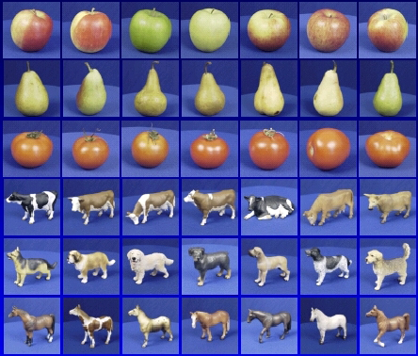

Learning and inference pipeline
Learning
Training Labels
Training Samples
Features
Training
Learned model
Learned model
Inference
Features
Prediction
Test Sample

Slide 29
Review: Bayesian decision making
Suppose the agent has to make decisions about the value of an unobserved query variable X based on the values of an observed evidence variable E
Inference problem: given some evidence E = e, what is P(X | e)?
Learning problem: estimate the parameters of the probabilistic model P(X | E) given a training sample {(x₁,e₁), …, (x_{n},e_{n})}

