Slide 1

PeoplePulse on AWS
From a git push to a running app on Amazon EKS: architecture, delivery pipeline and day-to-day operations
Saket Saurabh · October 2026 · us-west-1
Notes:
Introduce PeoplePulse: a small employee-records product used as a vehicle to build a complete, production-shaped delivery path on AWS. The talk covers why it exists, how it is built, how a change travels from VS Code to EKS, and how it is run and paid for.

Slide 2



Why PeoplePulse exists
People + Pulse
the live heartbeat of an organisation's workforce data
One source of truth
Records in PostgreSQL with unique, validated emails, not scattered files
Employee data often lives in spreadsheets and CSV files: copied, emailed, out of date
PeoplePulse gives one trusted place to view, search, add and update employee records
It also serves as a reference project: the same path a real product takes from laptop to cloud
Self-service insight
Dashboard with head-count, salary and city/department breakdowns, plus a REST API
Production-grade delivery
Every change tested, versioned, approved and deployed by a pipeline
Notes:
The name: People plus Pulse, a live view of the workforce. Two purposes: a useful small product (one place for employee records instead of spreadsheets) and a reference implementation of the full DevOps lifecycle on AWS.

Slide 3





What the product does
Live dashboard
Search and filter
Full record management
Totals, active vs inactive, average salary and salary range
By name, email, role, department, city, status and salary
Add, edit and delete employees with validation
CSV export
REST API + Swagger
Protected writes
Download the filtered view for reporting
/records, /records/stats, /departments, /health
Optional API key for POST, PUT, PATCH and DELETE
Notes:
Front end: React 19 + Vite served by nginx. Back end: FastAPI with Pydantic validation and SQLAlchemy over PostgreSQL. The same API also runs on a CSV file for quick local work. More than 120 automated test cases cover the API, both storage backends and configuration.

Slide 4
How the project grew, step by step
1
2
3
4
5
API + CSV
Local Kubernetes
PostgreSQL
AWS with Terraform
Cost governance
FastAPI, pytest, Docker image, GitHub Actions CI
Minikube, Jenkins in Docker, React UI
Real database, safe concurrent seeding
VPC, EKS, RDS, ECR, ALB, IAM
Owner tags, aws:createdBy, budget alerts
Both paths live in one repository. Jenkinsfile deploys to Minikube for local work; Jenkinsfile.aws deploys to EKS. Same images, same Helm chart, different values file.
Notes:
Each step built on the last. Steps 1-3 run entirely on the laptop. Step 4 moved to AWS with everything defined in Terraform. Step 5 added cost visibility, because a cloud environment is only sustainable if you know what it costs and who created it.

Slide 5
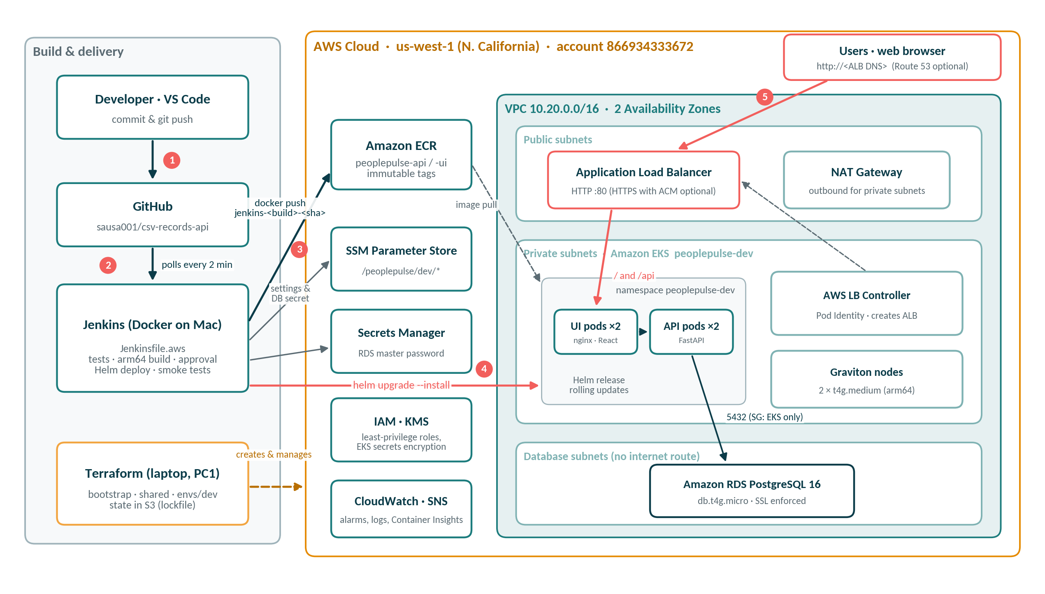
End-to-end architecture on AWS
Notes:
Read the numbers in order. 1: developer pushes to GitHub. 2: Jenkins, running in Docker on the Mac, polls GitHub. 3: Jenkins tests and builds arm64 images and pushes them to ECR with an immutable tag. 4: Jenkins reads settings from SSM and the database password from Secrets Manager, then runs helm upgrade into EKS. 5: users reach the app through the Application Load Balancer. Terraform, run from the laptop with profile PC1, creates and manages everything in the AWS box. The database sits in subnets with no internet route; only the EKS cluster security group can reach port 5432.

Slide 6




How a request travels
Browser
ALB
nginx UI pod
FastAPI pod
RDS PostgreSQL
http://<ALB>
public subnets
serves React, proxies /api
validation + logic
SSL, private subnet
One entry point. The ALB is created by the AWS Load Balancer Controller from a Kubernetes Ingress, so routing lives in the Helm chart.
Two replicas of each tier, spread over two Availability Zones, updated one pod at a time.
The UI never talks to the database. nginx forwards /api to the API service; only API pods hold the DB secret.
Health is checked at every hop: ALB target health, Kubernetes readiness probes and /health, which reports storage = postgresql.
Notes:
Walk the request left to right. The key design point is separation: the UI tier is stateless and public-facing through the ALB, the API tier holds the only credentials, and the database has no internet route at all.

Slide 7
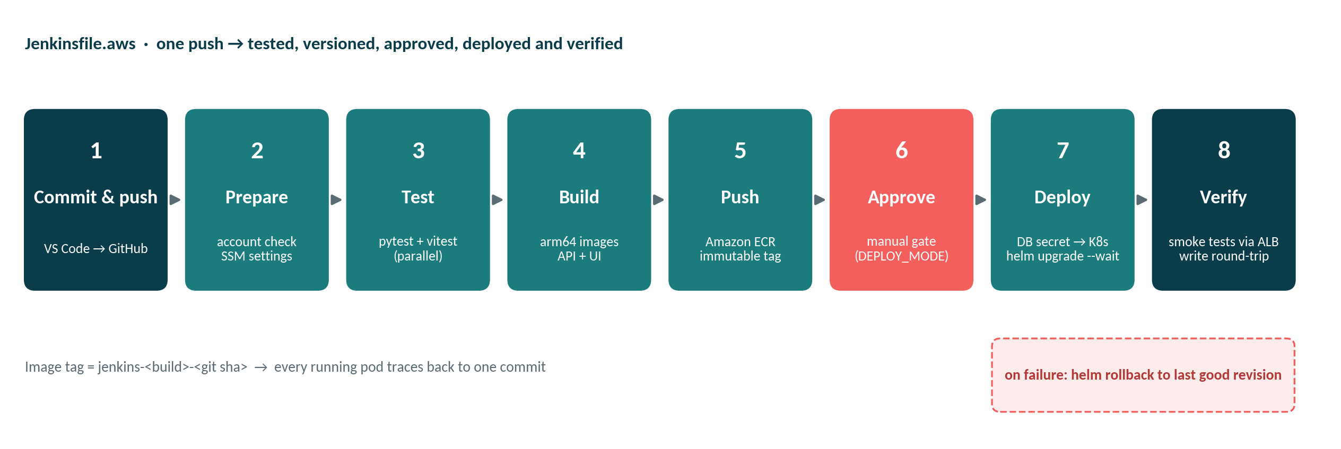
From source to production: the pipeline
8
pipeline stages, all in Jenkinsfile.aws
0
secrets in Git: they come from Jenkins credentials and Secrets Manager
1
command to roll back any release: helm rollback
Notes:
A push to main is picked up within two minutes. Prepare verifies the AWS account is 866934333672 and loads environment settings from SSM Parameter Store, so nothing account-specific is hard-coded. Tests run in parallel inside Docker build stages. Images are built for arm64 because both the Mac and the Graviton nodes are ARM. The image tag combines the Jenkins build number and git commit, and ECR refuses to overwrite a tag. A manual approval gate protects the environment. Deploy turns the RDS password from Secrets Manager into a Kubernetes secret and runs helm upgrade with --wait. Smoke tests go through the real ALB, including a create-read-delete round trip, and a failure triggers helm rollback.

Slide 8



Infrastructure as code with Terraform
Folder | Creates | Lifetime
bootstrap | S3 bucket for Terraform state: versioned, encrypted, private | Once, kept
shared | ECR repositories (api, ui), Jenkins IAM user and group | Kept, a few cents a month
envs/dev | VPC, EKS + nodes, RDS, ALB controller identity, SSM settings, alarms, budget | Created and destroyed daily
modules/ | network · eks · rds: reusable for UAT and PROD | Shared code
Locked to one account
allowed_account_ids = 866934333672 in every provider
Tagged by default
Project, Environment, Owner on every resource
Safe shared state
~70 resources in envs/dev · about 20 minutes to create and 15 to destroy
S3 backend with lockfile: no DynamoDB needed
Notes:
Splitting state into three roots means the expensive environment can be destroyed every evening without touching the image registry or the state bucket. Modules keep UAT and PROD a copy of envs/dev with different variables.

Slide 9
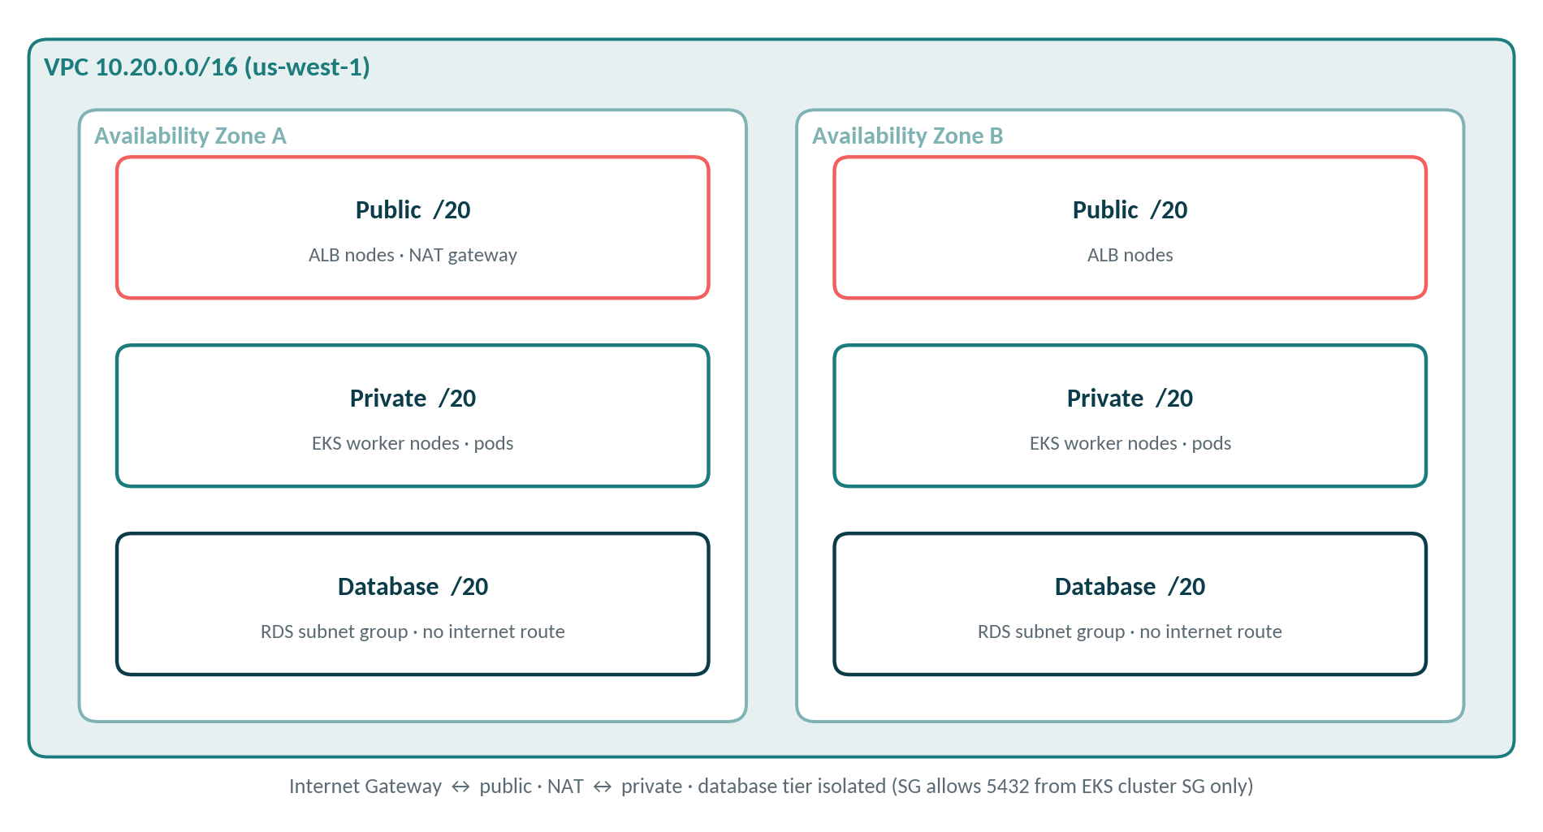
Network design: three tiers in two zones
Public: only the ALB and the NAT gateway
Private: EKS nodes and pods; outbound through NAT
Database: RDS with no internet route at all
Kubernetes API: public endpoint limited to one /32 IP, private endpoint for nodes
One NAT gateway for DEV to save cost; one per zone for PROD
Notes:
us-west-1 offers two Availability Zones to most accounts, so the VPC spans both. The /16 is split into /20 blocks per tier per zone. Database subnets have no route to the internet and the RDS security group allows 5432 only from the EKS cluster security group.

Slide 10



Security built in, not bolted on
Right account, every time
Least-privilege IAM
No secrets in Git
Terraform allowed_account_ids and a pipeline check refuse any other account
Jenkins can push to ECR and edit only its namespace through an EKS access entry
RDS password managed by AWS in Secrets Manager; pods read it from a K8s secret
Encryption everywhere
Tight network edges
Trusted images
KMS for EKS secrets, SSL forced on RDS, encrypted S3 state
DB isolated, EKS API limited to one IP, security groups per tier
Immutable ECR tags, scan on push, IMDSv2-only nodes
Notes:
Two AWS accounts are configured on the laptop, so the first control prevents deploying to the wrong one. The deploy user cannot touch anything outside the peoplepulse-dev namespace. The database password never leaves AWS: RDS generates and rotates it, Jenkins copies it into a Kubernetes secret at deploy time without printing it.

Slide 11
Kubernetes runtime and data layer
Amazon EKS + Helm
Amazon RDS PostgreSQL 16
One Helm chart, two values files: minikube and aws-dev
2 API + 2 UI replicas, rolling updates, readiness probes
Graviton t4g.medium nodes (arm64): cheaper, same arch as the Mac
Add-ons: VPC CNI, CoreDNS, Pod Identity, CloudWatch observability
Load balancer controller gets AWS rights via Pod Identity
db.t4g.micro in private database subnets
Master password generated and stored by RDS in Secrets Manager
SSL enforced; case-insensitive unique email index
First start seeds 12 sample employees, guarded by an advisory lock so replicas never race
Automated backups; deletion protection ready for PROD
Notes:
The advisory lock solved a real bug: two API replicas starting together on an empty database both tried to create the table. Now schema creation and seeding happen in one transaction holding a Postgres advisory lock.

Slide 12


Observability and cost governance
Who spent what
Owner, Project, Environment tags plus AWS aws:createdBy, all active in Cost Explorer
Early warning
$100 monthly budget: email at 80% actual and 100% forecast; CloudWatch alarms for DB, nodes and ALB 5xx
Pay only while working
terraform destroy each evening; recreate in about 25 minutes
Notes:
These are estimates for us-west-1; Cost Explorer has the real numbers. The EKS control plane and NAT gateway cost money even when idle, which is why the environment is destroyed after each working session. Tags make cost visible per person in a shared account.

Slide 13



Running it day to day
Create
Deploy
Verify
Roll back
Destroy
terraform apply
(envs/dev) ≈ 20 min
git push → Jenkins
→ approve
kubectl, /api/health,
CloudWatch
helm rollback
peoplepulse <rev>
helm uninstall →
terraform destroy
export AWS_PROFILE=PC1
aws eks update-kubeconfig --name peoplepulse-dev --region us-west-1
kubectl -n peoplepulse-dev get pods,ingress
helm -n peoplepulse-dev history peoplepulse
Notes:
The ALB is not managed by Terraform, so helm uninstall must run before terraform destroy, otherwise the VPC cannot be deleted. Every Helm revision is kept, so rollback is one command and takes about a minute.

Slide 14
Local lab and cloud, side by side
 | Local (Minikube) | Cloud (AWS)
Pipeline | Jenkinsfile | Jenkinsfile.aws
Image registry | Docker Hub | Amazon ECR (immutable)
Cluster | Minikube on Docker Desktop | Amazon EKS, Graviton nodes
Database | PostgreSQL StatefulSet | Amazon RDS PostgreSQL 16
Entry point | NodePort | Application Load Balancer
Secrets | Jenkins credential | AWS Secrets Manager
Cost | Free | ≈ $7 per day while running
Notes:
Same source, same images, same Helm chart. Only the values file and the pipeline differ, which is what makes the local lab a faithful rehearsal for the cloud.

Slide 15
Problems hit and how they were solved
Problem | Cause | Fix
Terraform plan failed: for_each with unknown values | Security group IDs only exist after apply | Map with fixed keys: { eks_cluster = sg-id }
Replicas crashed on first start | Two pods raced to create the table | Schema + seed inside a Postgres advisory lock
Commands hit the wrong AWS account | Two profiles plus a stray default | Profile PC1, default removed, account lock in Terraform
Jenkins could not reach Docker | Socket owned by root group | Container started with --group-add 0
nginx failed to render config | Template permissions in image | COPY --chmod=0755 in the Dockerfile
Notes:
Each issue left a permanent fix in code or configuration, so it cannot come back.

Slide 16


What comes next
HTTPS on a real domain
UAT and PROD
GitOps
Route 53 + ACM already in Terraform; set domain_name
Copy envs/dev; multi-AZ RDS, NAT per zone, deletion protection
Argo CD syncing the Helm chart from Git
Autoscaling
Security scanning
Second cloud
HPA for pods, Karpenter for nodes
Trivy and SonarQube stages in the pipeline
Azure AKS with the same chart and images
Notes:
The first two items are mostly configuration because the Terraform and Helm code already supports them.

Slide 17
One push. Tested, versioned, deployed, and switched off when idle.
Questions?
Notes:
Close on the outcome: a small product with a complete, secure and cost-aware delivery path on AWS, reproducible from code in about half an hour.

