Slide 1
Context-Aware Testing System
An AI-Driven Automated Testing Framework

Slide 2
Overview
• Adaptive testing system based on real-time context
• Uses AI for test case generation
• Automates testing based on user behavior and system conditions

Slide 3
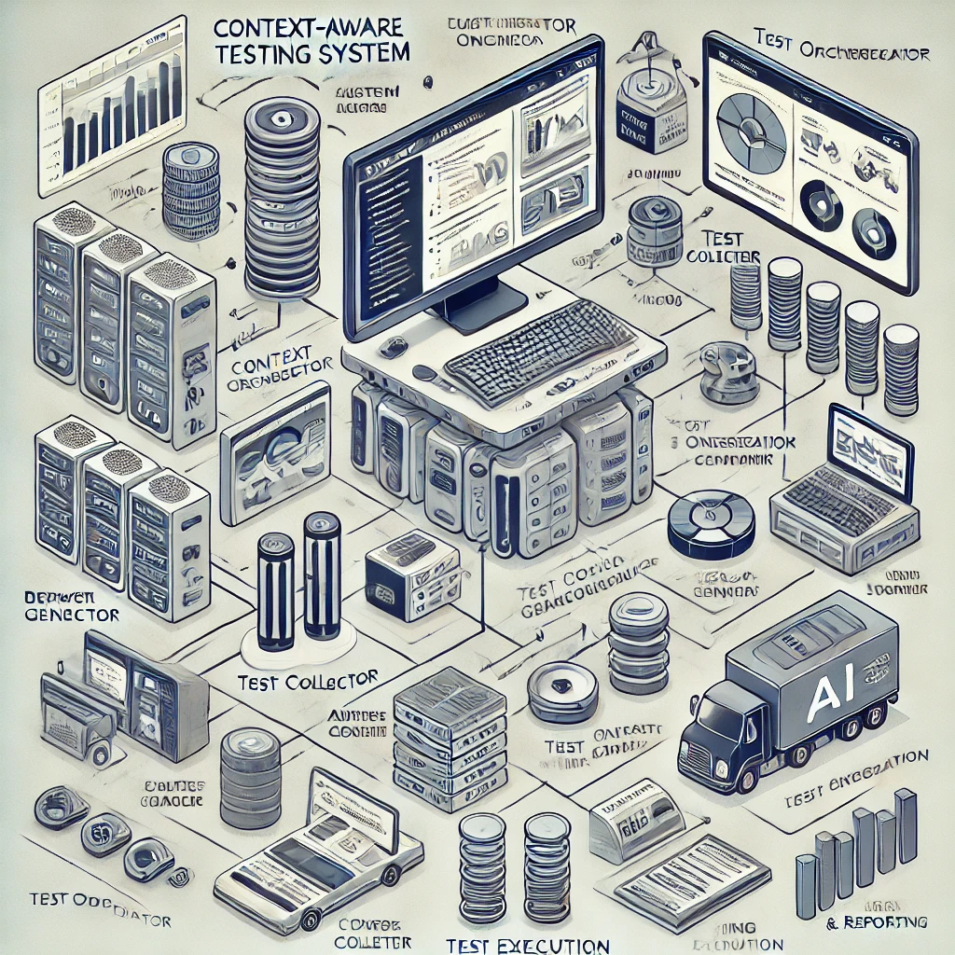
System Architecture

Slide 4
Key Components
• Context Collector: Gathers user and system data
• AI-Powered Test Generator: Creates adaptive test cases
• Test Orchestrator: Manages test execution
• Execution Engine: Runs tests and logs results
• Logging & Reporting: Stores test data for analysis

Slide 5
Benefits of Context-Aware Testing
• Reduces manual test effort
• Increases test accuracy with AI-generated cases
• Adapts to real-world conditions
• Enhances test coverage and automation efficiency

