Slide 1
Microsoft Fabric — SDLC & CI/CD Overview
Automated deployment across Dev → UAT → Prod
Digital Realty Demo
• Fabric Workspaces as environments
• Git Integration for version control
• Deployment Pipelines for promotion
• REST APIs for automation
Core Flow
Dev workspace builds assets
Git captures supported items
Deployment pipeline promotes changes
APIs orchestrate end-to-end automation
Digital Realty — Fabric CI/CD Workshop

Slide 2
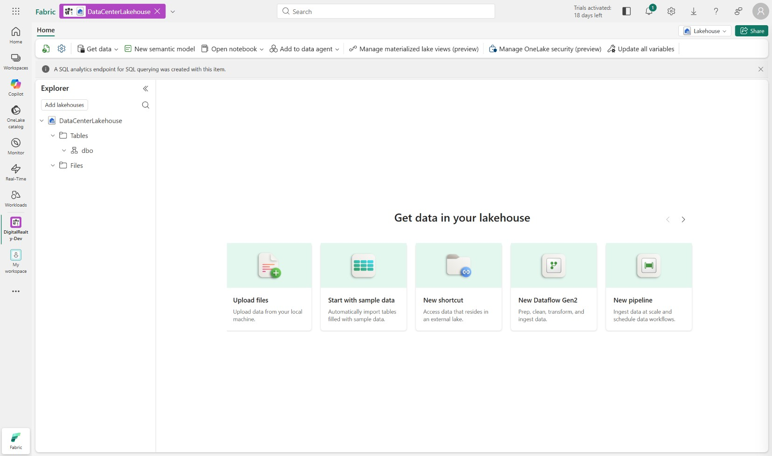
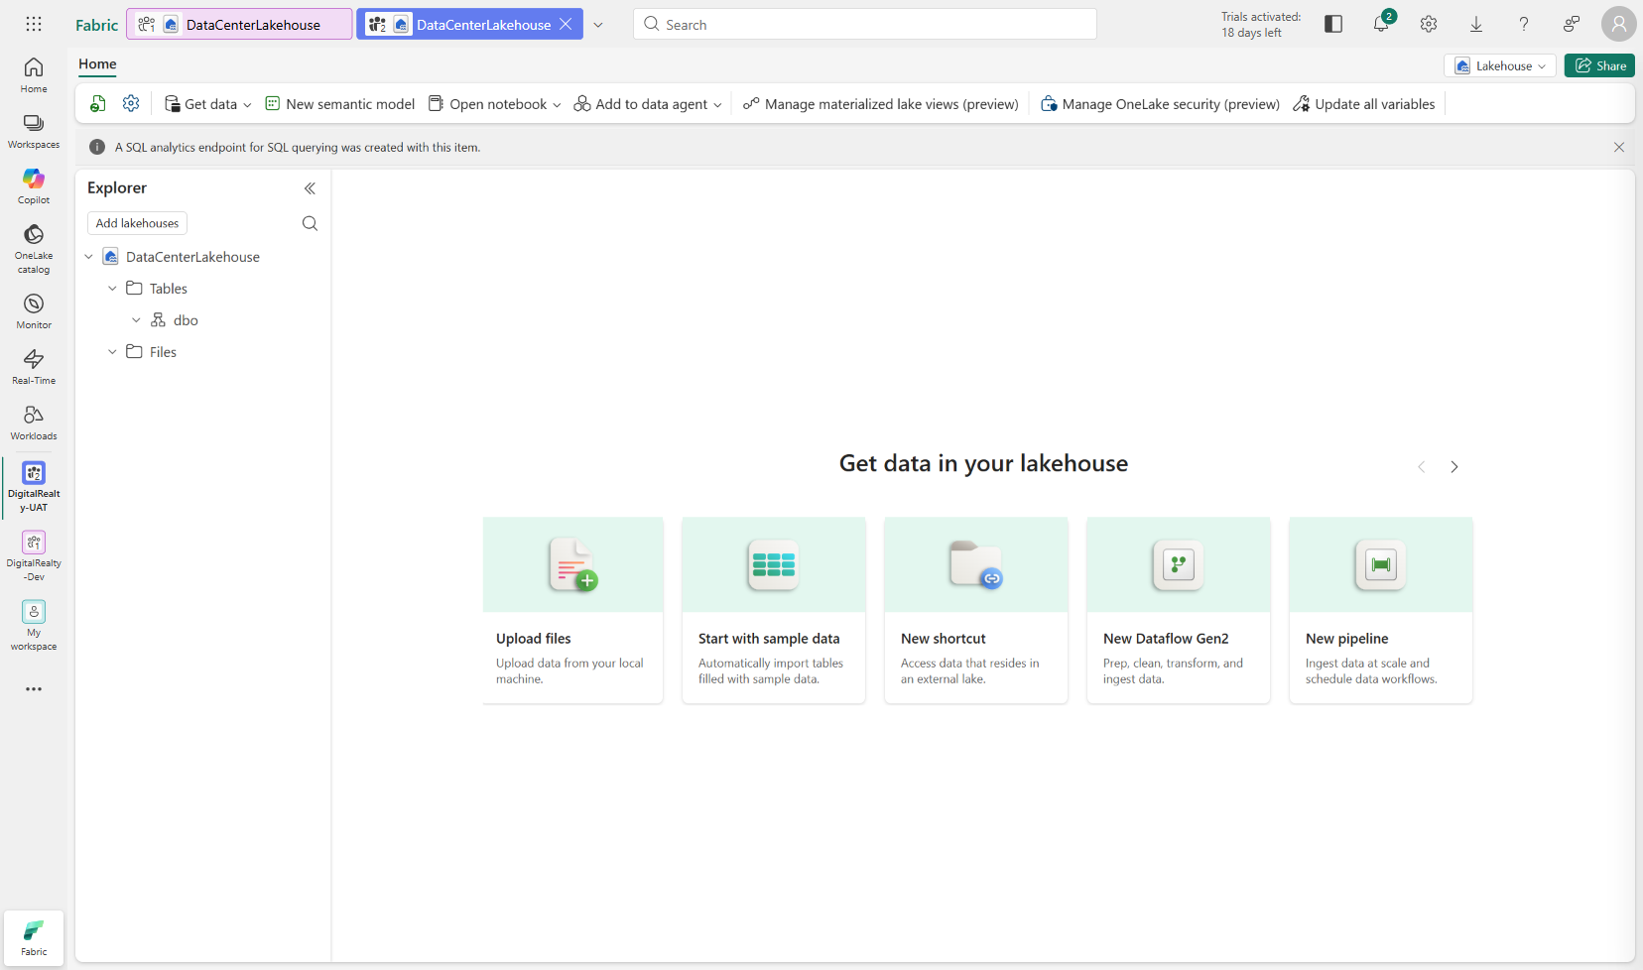
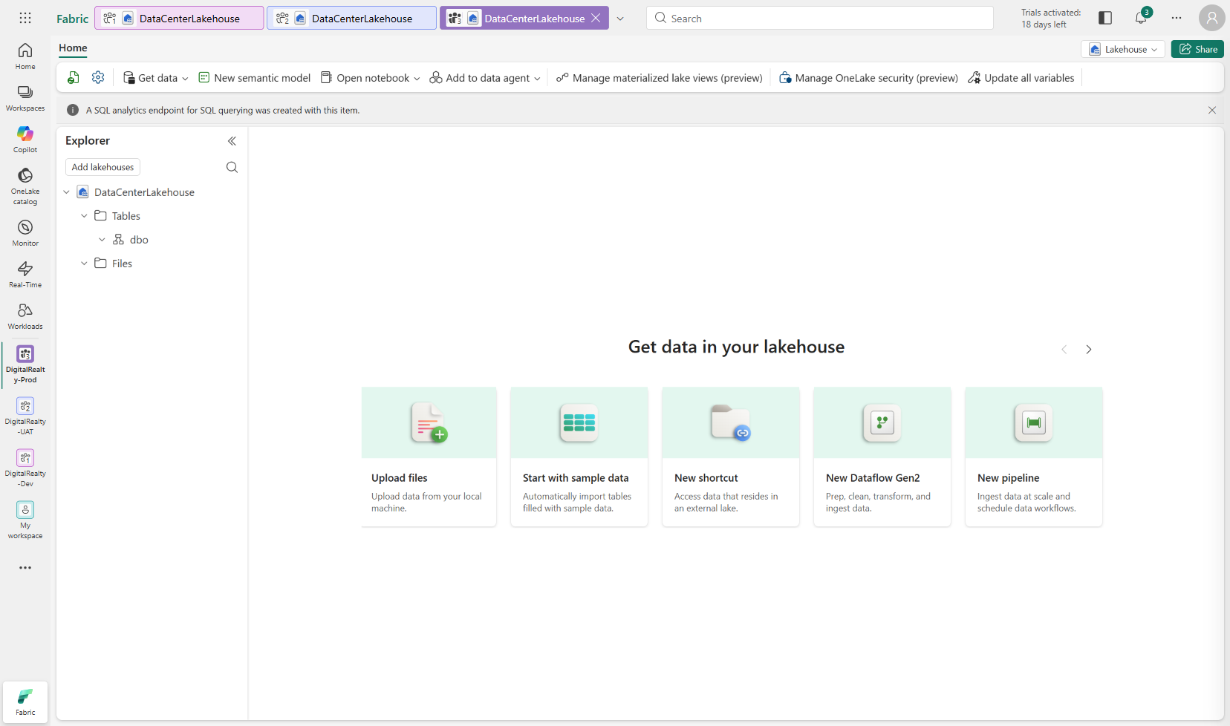
Environment Setup — 3 Workspaces
Dev → UAT → Prod with DataCenterLakehouse
Dev Workspace
UAT Workspace
Prod Workspace
Digital Realty — Fabric CI/CD Workshop

Slide 3
What Git Integration Tracks
✅ Tracked
❌ Not Tracked
• ✅ Notebooks
• ✅ Data Pipelines
• ✅ Semantic Models
• ✅ Reports/Dashboards
• ✅ Spark Job Definitions
• ✅ ML Models
• ❌ Lakehouse Tables
• ❌ Table Schemas & DDL
• ❌ Views & Stored Procedures
• ❌ Data Files
• ❌ SQL Endpoint Objects
Source: Microsoft Learn — Lakehouse Git Integration

Slide 4
The Schema Gap
Gap
Dev Lakehouse
Tables + schema
Created in workspace
Git
Artifacts only
No table metadata
UAT Lakehouse
Empty / missing tables
Schema must be rebuilt
Schema changes made in Dev Lakehouse do NOT propagate through Git or Deployment Pipelines
Result: promoted environments receive notebooks and pipelines, but not the underlying lakehouse schema.

Slide 5
The Solution — Schema-as-Code
Dev / UAT / Prod
Lakehouse schema applied
History recorded
Migration Scripts in Git
SQL + PySpark files
CI/CD Pipeline
GitHub Actions / Azure DevOps
Migration Runner Notebook
Idempotent execution engine
• Version-controlled SQL & PySpark migration scripts
• Idempotent migration runner notebook
• Automated CI/CD pipeline (Azure DevOps or GitHub Actions)
• Audit trail via _migration_history table

Slide 6
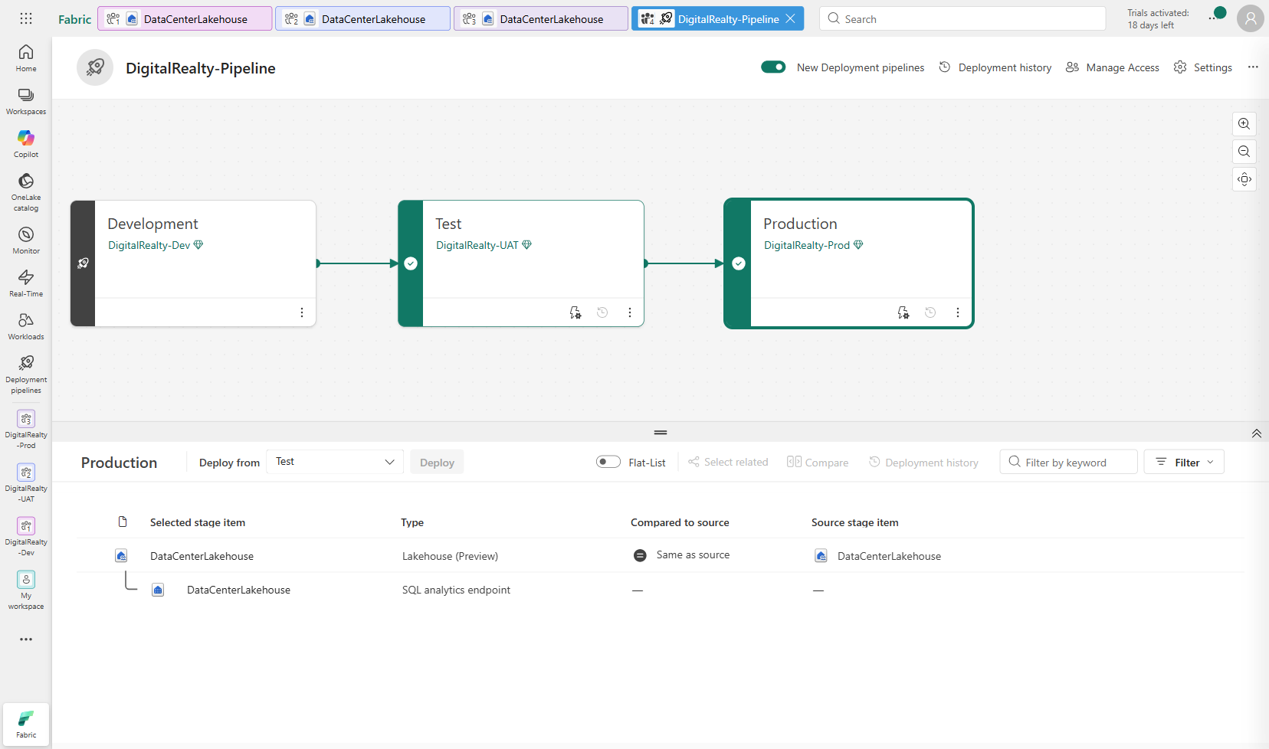
Deployment Pipeline — Dev → UAT → Prod
DigitalRealty-Pipeline with all stages configured
Pipeline deploys supported artifacts • Schema requires Schema-as-Code pattern
Digital Realty — Fabric CI/CD Workshop

Slide 7
Demo Roadmap
• 1. Environment Setup (3 workspaces + Deployment Pipeline)
• 2. Standard CI/CD Flow (notebooks through Git)
• 3. The Problem (tables don't propagate)
• 4. Schema-as-Code Solution (migration scripts + runner)
• 5. CI/CD Pipeline Automation (Azure DevOps + GitHub Actions)
• 6. REST API Deep Dive (live API calls)
Let's see it in action! →

