Slide 1
GHAS → Azure DevOps
Automated Vulnerability Tracking
Seamless integration between GitHub Advanced Security and Azure DevOps Work Items
Learfield Customer Demo
Powered by Azure Logic Apps | Bicep IaC | GitHub Webhooks

Slide 2
The Problem
⚠️ Security vulnerabilities detected in GHAS go untracked
🔄 Manual process: Open GHAS → Go to ADO → Create work item → Link back
⏱️ Time-consuming and error-prone — developers skip it
🔗 No traceability between security alerts and dev work
❌ Work items stay open even after vulnerabilities are fixed
📊 Security team lacks visibility into remediation progress
"We need this to happen automatically. When GHAS finds something, ADO should know about it instantly. No human in the loop."
— Customer Feedback (Learfield)

Slide 3
The Solution: Azure Logic App
🔔 GitHub webhook triggers on every GHAS alert
⚡ Azure Logic App processes the event in real-time
📋 ADO work item created automatically with full metadata
✅ Auto-closes work item when vulnerability is resolved
🏷️ Deduplication via tags — no duplicate work items
GitHub GHAS ──webhook──▶ Azure Logic App ──REST API──▶ Azure DevOps (Code Scanning, Dependabot, Secret Scanning) (Consumption tier) (Work Items + Tags)
Supports all 3 GHAS alert types • Infrastructure as Code (Bicep) • Zero ongoing maintenance

Slide 4
Architecture Overview
┌─────────────────┐ ┌──────────────────────────────┐ ┌─────────────────────┐ │ GitHub Repo │ │ Azure Logic App │ │ Azure DevOps │ │ │ │ │ │ │ │ GHAS Alerts: │─────▶│ 1. Receive Webhook │─────▶│ Query existing WIs │ │ • Code Scanning │ POST │ 2. Parse alert metadata │ WIQL │ (dedup check) │ │ • Dependabot │ │ 3. Normalize fields │ │ │ │ • Secret Scan │ │ 4. Check: create or close? │ │ Create new Issue │ │ │ │ 5. Dedup via GHAS tag │ PATCH │ OR close existing │ │ Webhook fires │ │ 6. Create / Close WI │ │ with comment │ └─────────────────┘ └──────────────────────────────┘ └─────────────────────┘
Work Item Fields: Title, Description (HTML), Severity tag, Repo, Branch, File:Line, Hyperlink to GHAS alert
Tag format: GHAS-{owner}-{repo}-{alertNumber} — enables deduplication and auto-close lookup

Slide 5
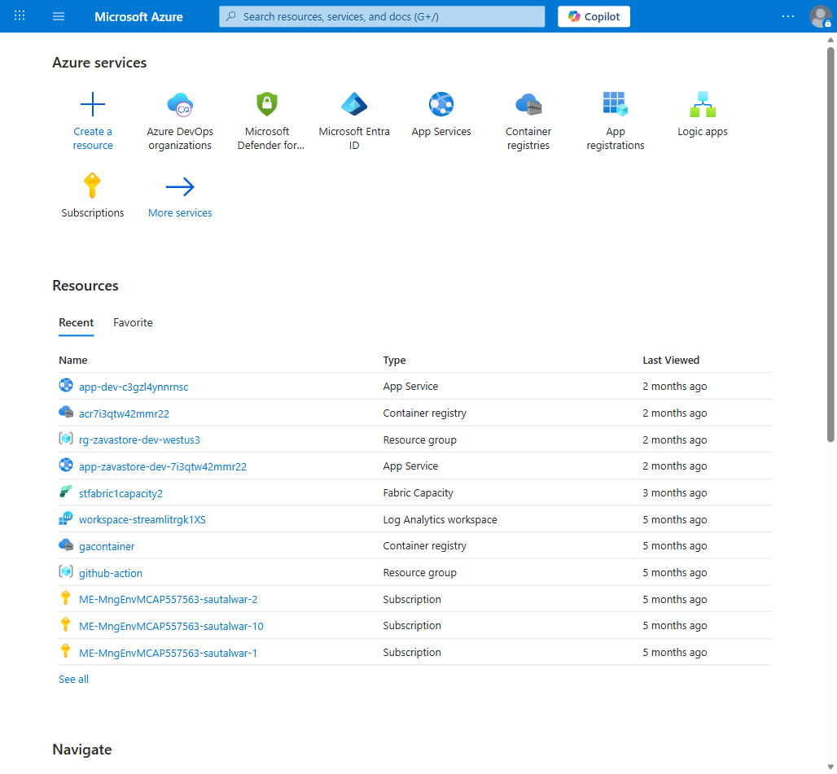
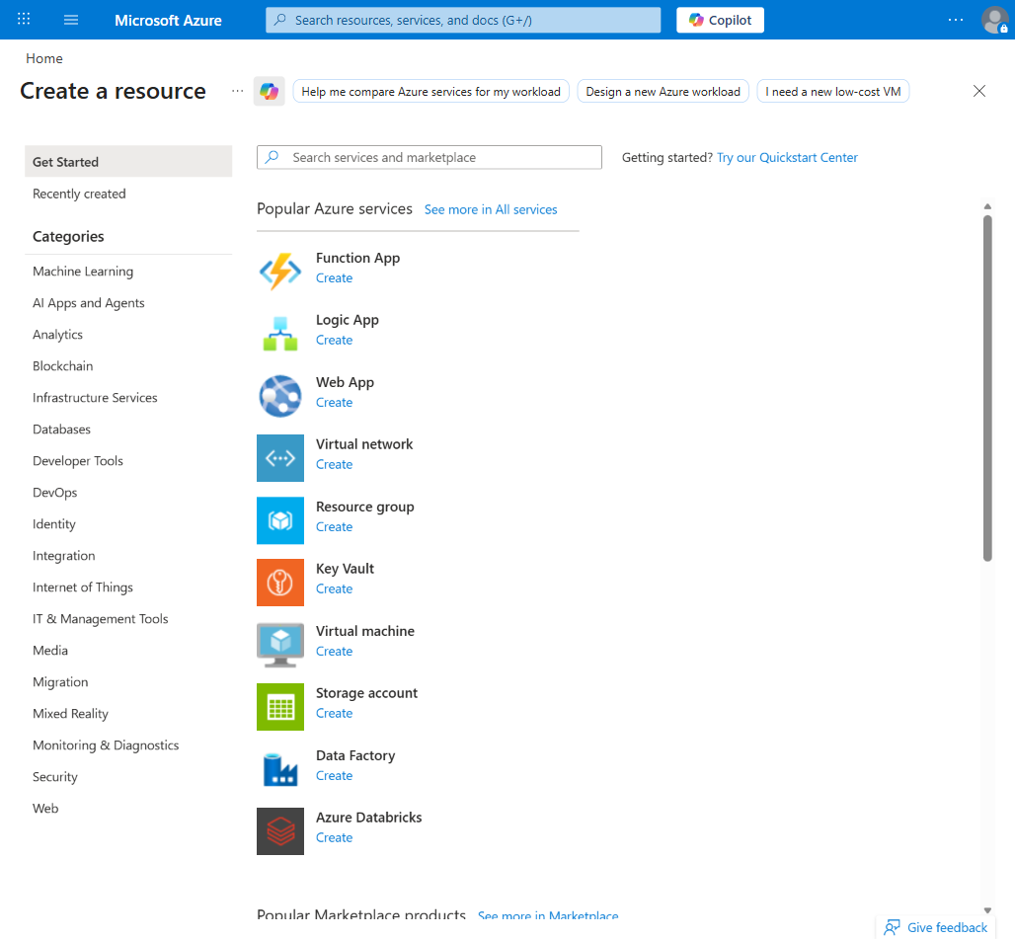
Step 1: Create Logic App in Azure Portal
Azure Portal Home
Search & Select Logic App

Slide 6
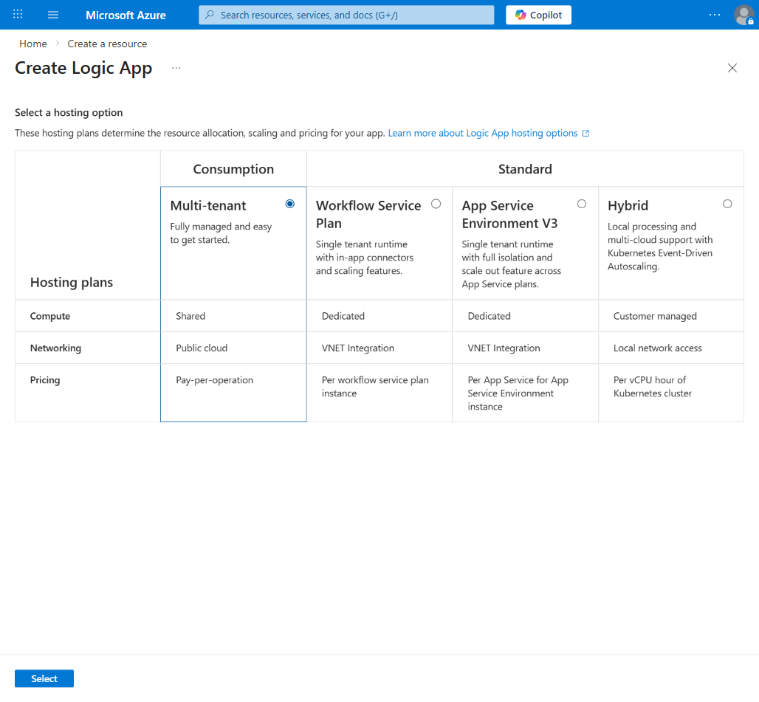
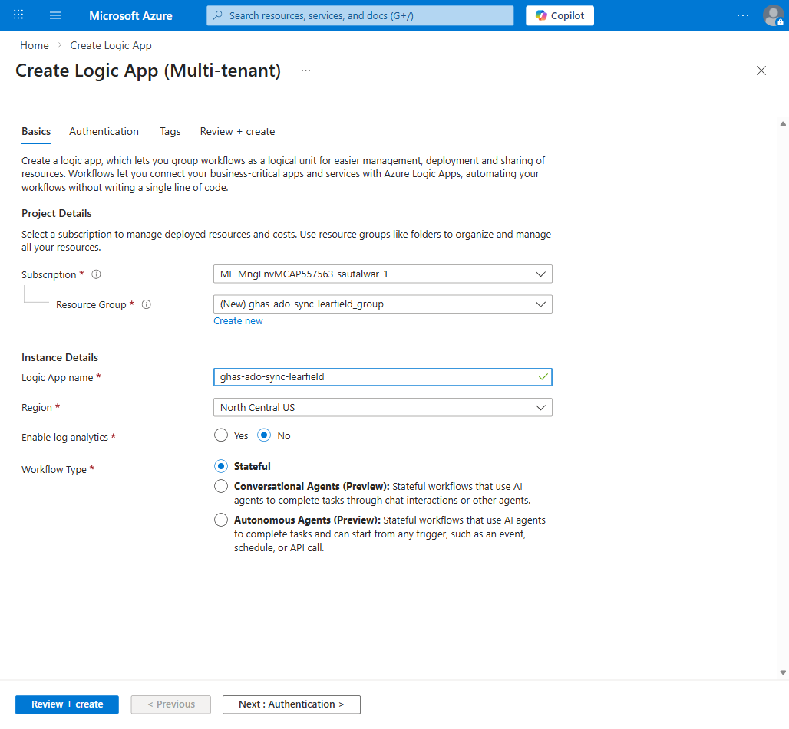
Step 2: Configure Logic App (Consumption)
Select Consumption Plan
Configure Basics

Slide 7
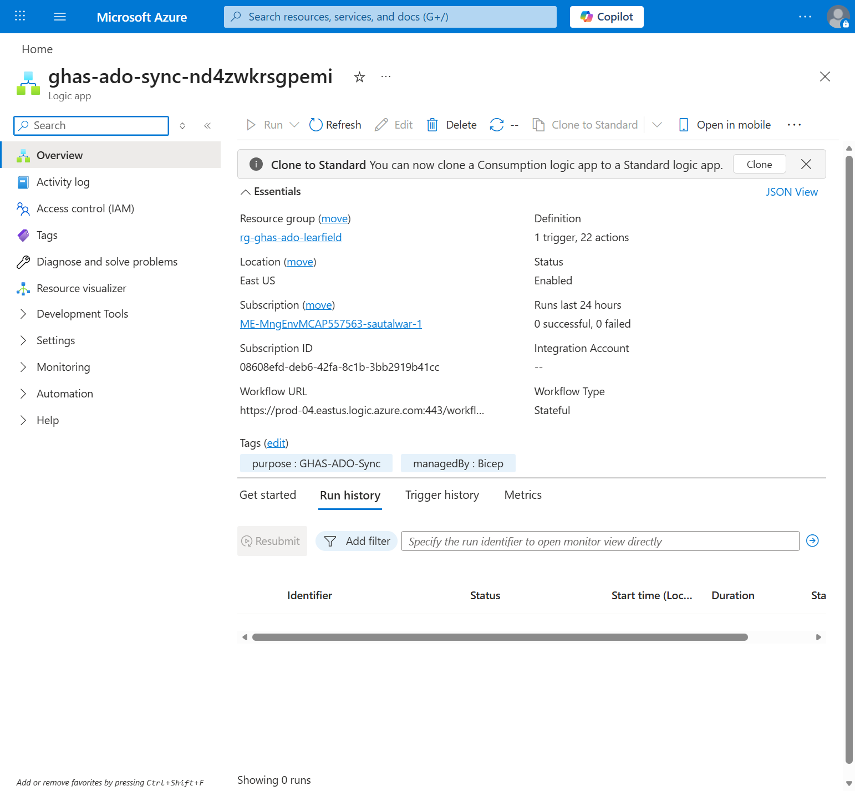
Step 3: Logic App Deployed
Logic App Overview — Status: Enabled, 1 Trigger, 22 Actions

Slide 8
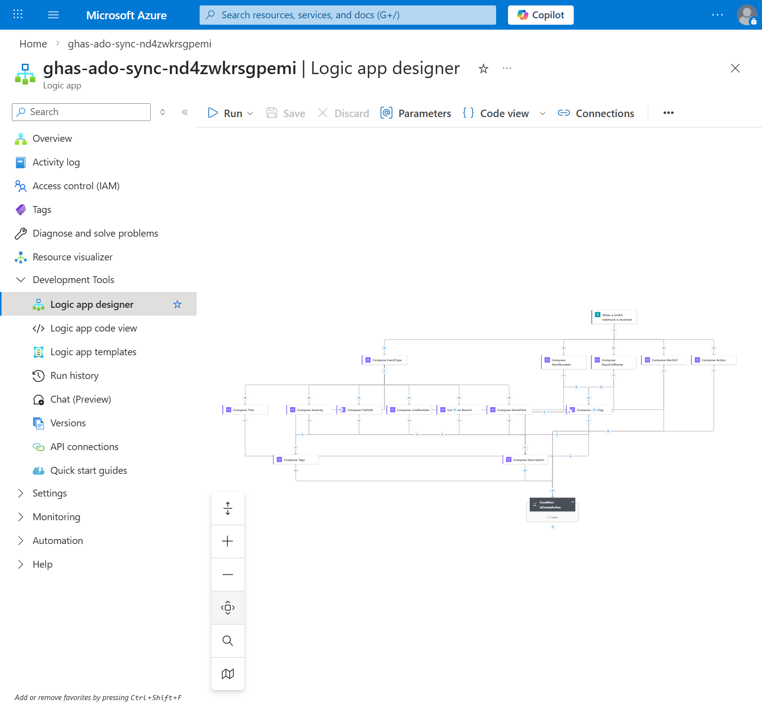
Workflow Designer: Full Flow
14 Compose actions normalize metadata → Condition routes to Create or Close path

Slide 9
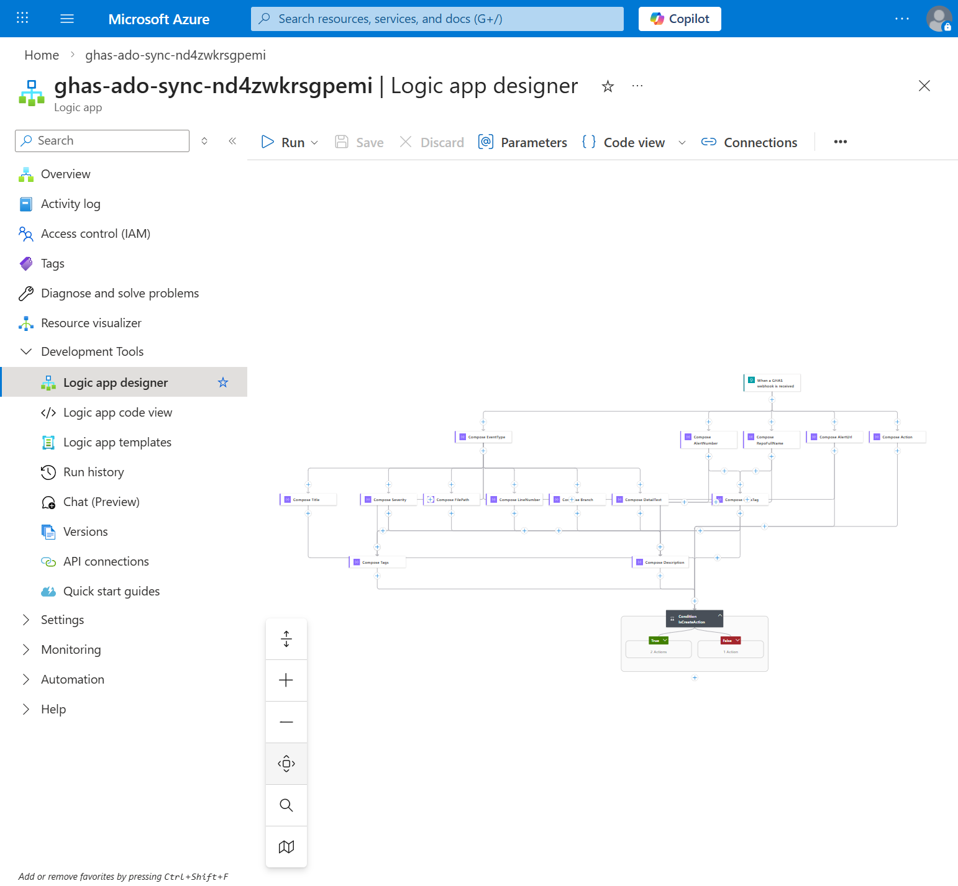
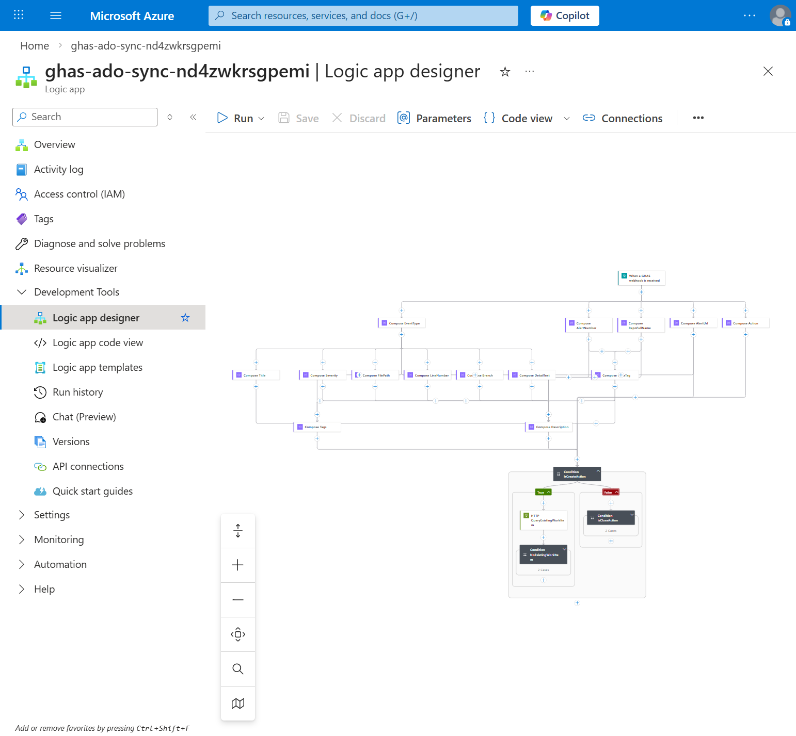
Workflow: Create vs Close Branches
Condition: Is action "created"?
True: Create WI | False: Close WI

Slide 10
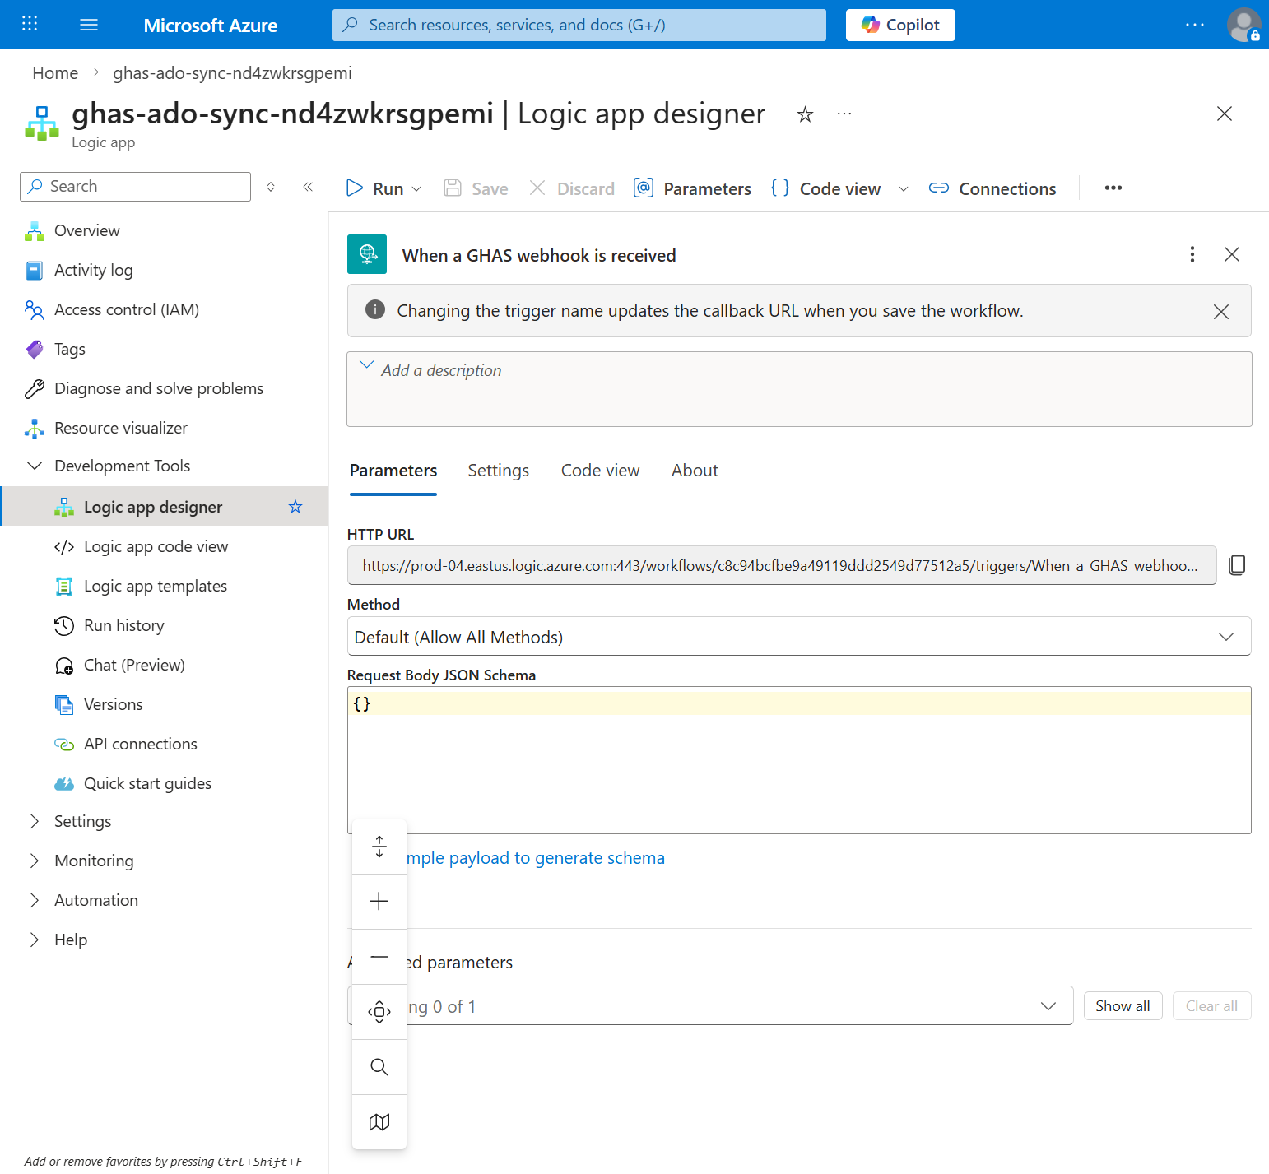
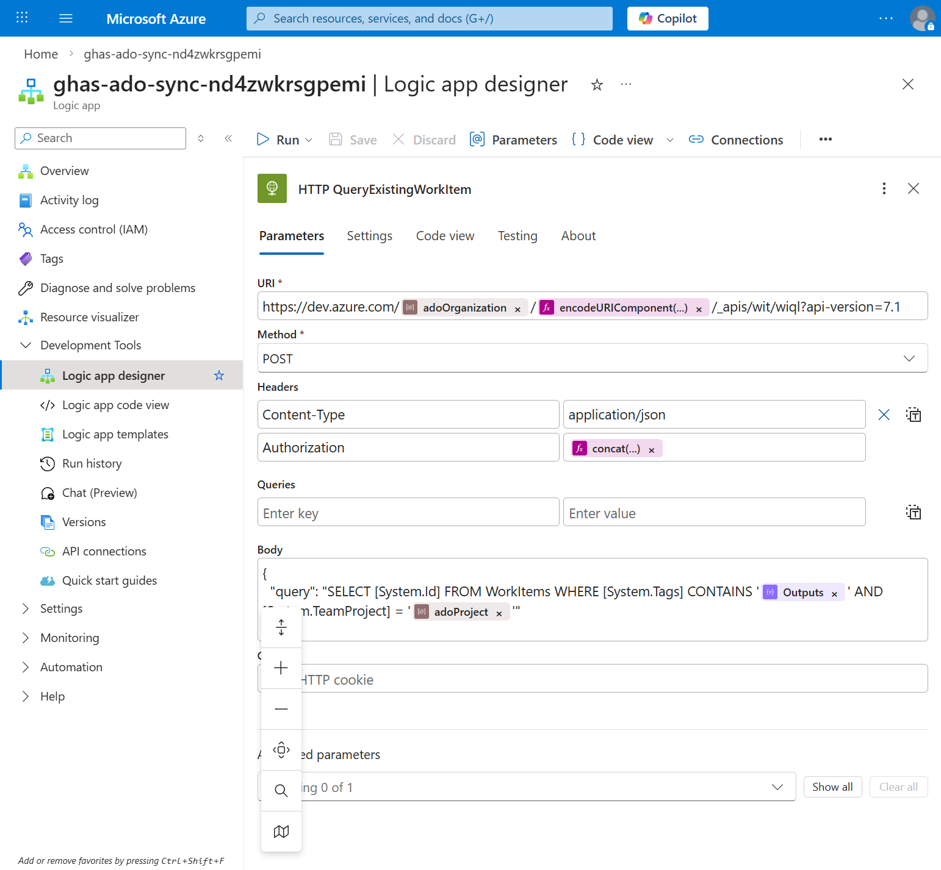
Webhook Trigger & ADO Integration
HTTP Trigger (Webhook URL)
WIQL Query for Deduplication

Slide 11
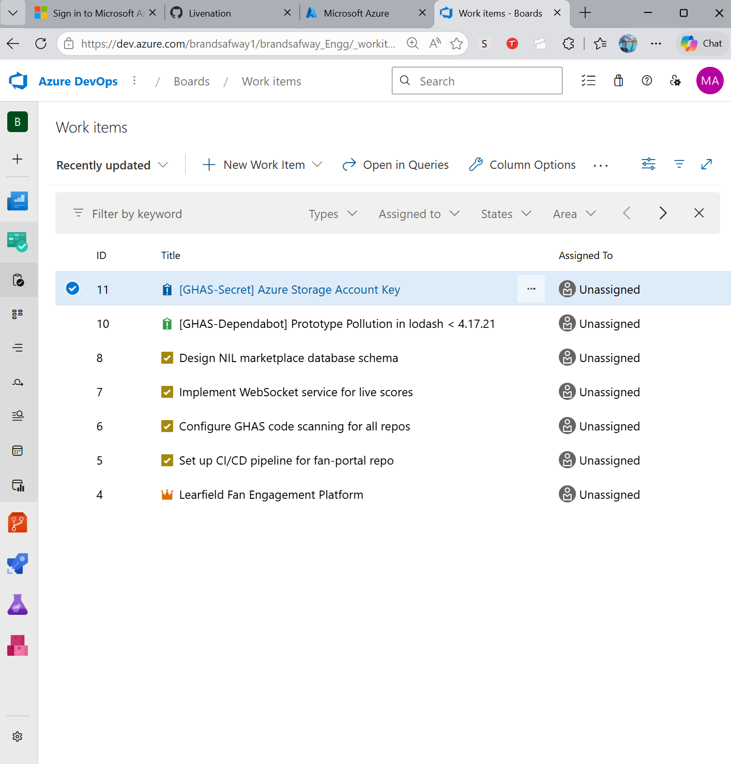
Live Demo: Work Items Auto-Created in ADO
ADO Board showing GHAS-created issues (#10, #11) alongside seeded Learfield demo data

Slide 12
End-to-End Test Results
✅ Code Scanning Alert → Created WI #9: [GHAS-CodeScan] SQL Injection vulnerability
Tags: GHAS, CodeScanning, high, GHAS-learfield-corp-fan-portal-42
✅ Dependabot Alert → Created WI #10: [GHAS-Dependabot] Prototype Pollution in lodash
Tags: GHAS, Dependabot, critical, GHAS-learfield-corp-fan-portal-7
✅ Secret Scanning Alert → Created WI #11: [GHAS-Secret] Azure Storage Account Key
Tags: GHAS, SecretScanning, critical, GHAS-learfield-corp-fan-portal-3
✅ Auto-Close: Sent "fixed" webhook → WI #9 transitioned to "Done" automatically
History comment: "Auto-closed by GHAS-ADO Sync: Vulnerability marked as fixed"
✅ Deduplication: Duplicate webhooks do NOT create duplicate work items

Slide 13
Work Item Metadata — Auto-Populated
Field
Source
Example
Title
Alert type + rule description
[GHAS-CodeScan] SQL Injection vulnerability
Description
HTML with full details
Severity, repo, branch, file, line, alert link
Tags
GHAS + type + severity + dedup tag
GHAS, CodeScanning, high, GHAS-org-repo-42
Hyperlink
Alert URL from webhook
https://github.com/org/repo/security/...
State
Created → To Do / Fixed → Done
Automatic lifecycle management
All 3 GHAS alert types supported:
• Code Scanning — rule ID, severity, file path, line number
• Dependabot — package name, advisory summary, manifest path
• Secret Scanning — secret type, always tagged as critical

Slide 14
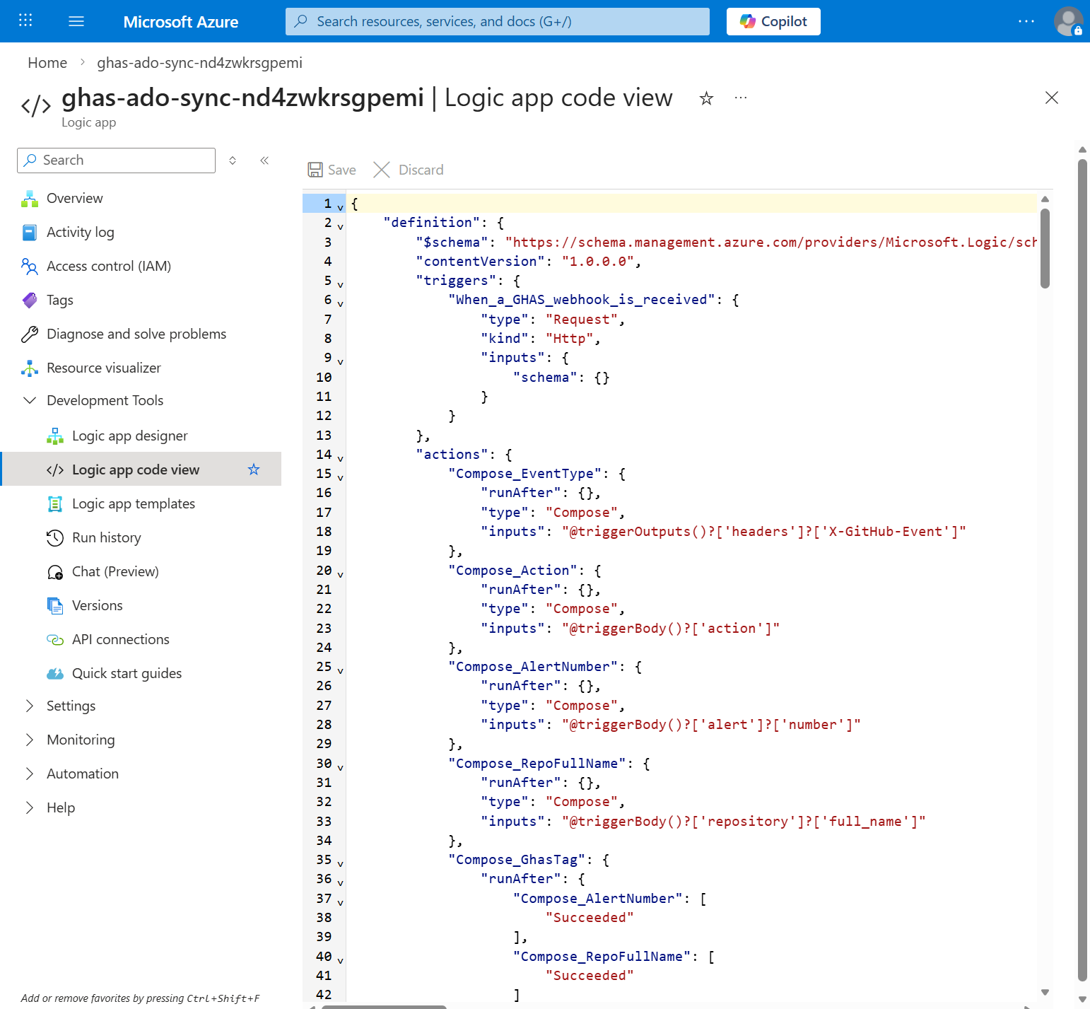
Infrastructure as Code (Bicep)
📁 Repository Structure:
infra/main.bicep
infra/modules/logic-app.bicep
infra/workflows/ghas-to-ado.json
infra/parameters.json
scripts/deploy.ps1
scripts/setup-webhooks.ps1
🚀 One-command deploy:
az deployment group create \
--template-file infra/main.bicep
🔄 Repeatable & version-controlled
🔒 PATs stored as parameters, not hardcoded

Slide 15
Value Delivered
⏱️ Time Saved
Eliminates manual work item creation — saves 5-10 min per vulnerability
🔗 Full Traceability
Every GHAS alert linked to an ADO work item with hyperlink back
🤖 Zero Human Effort
No developer action needed — Logic App handles everything
✅ Auto-Close
Work items automatically transition to Done when vulnerabilities are resolved
🛡️ No Duplicates
Tag-based deduplication prevents duplicate work items
📊 Security Visibility
Security team sees all vulnerabilities on the ADO board
🏗️ Production-Ready IaC
Bicep templates for repeatable, auditable deployment

Slide 16
Next Steps
1️⃣ Connect real GitHub repos to the webhook
2️⃣ Add HMAC signature verification for security
3️⃣ Configure alert routing to specific teams/areas
4️⃣ Add Slack/Teams notifications for critical alerts
5️⃣ Set up monitoring & alerting on the Logic App
6️⃣ Extend to auto-assign based on code ownership
Resources
📂 GitHub Repo:
github.com/sautalwar/ghas-ado-logic-app
☁️ Azure Resource Group:
rg-ghas-ado-learfield
📋 ADO Project:
dev.azure.com/brandsafway1/brandsafway_Engg

Slide 17
Thank You
GHAS + Azure Logic Apps + Azure DevOps
Automated security vulnerability tracking — from detection to resolution
Questions?

