Slide 1
JANSAARTHI
Goal-Oriented Administrative Compliance Platform
Hybrid Knowledge Base + LLM-Powered Topological DAG Timeline
Live Prototype Link: https://jan-saarthi.vercel.app/

Slide 2
1. Problem Statement: Compliance Labyrinth
Navigating Municipal & Federal Certifications
• Fragmented Regulation: Citizens must obtain 10+ certificates (FSSAI, GST, Trade, Shop Act, Fire NOC) across different local offices.
• Hidden Topological Dependencies: Certain approvals depend strictly on others (e.g. FSSAI needs a Current Account, which needs a PAN Card). Submitting in the wrong sequence leads to expired timelines.
• High Failure Rates: Up to 40% of small business applications face delays or stalls due to zoning violations or paper mismatches.
The Cost of Non-Compliance
• Time Inflation: Average of 30-45 extra days wasted per setup.
• Resource Leakage: Financial overhead for agents, brokers, or correction fees.
• Zoning Stalls: Leasing property in locations legally prohibited from specific business categories (e.g. food units, chemical storage).

Slide 3
2. Solution Overview: Smart Administrative Planner
Pillar 01: Structured Knowledge Base
High-Fidelity expert rules
Built-in, verified templates mapped to specific domains (e.g., bakeries, pharmacies, salons) ensuring absolute accuracy of municipal licensing policies.
Pillar 02: LLM Semantic Planner
Powered by Gemini Pro
Dynamic step generator mapping any arbitrary user request (e.g. Aadhaar updates) into a structured compliance path in a single-roundtrip API call.
Pillar 03: Interactive Timeline DAG
State-driven execution
Milestones locked and unlocked dynamically. Checking off document requirements resolves parent nodes and propagates changes downstream.

Slide 4
3. Product Architecture
Frontend
React & Vite
• Tailwind CSS styling
• Framer Motion animations
• Dynamic state persistence
• High legibility dark theme
Backend
Flask REST API
• Modular blueprint architecture
• DAG validation routing
• SQLAlchemy ORM integration
• Robust transaction logger
Database
Postgres / SQLite
• Relational schemas
• Journey tracking tables
• Cascading step dependencies
• Dynamic schema fallback
AI Reasoning
Gemini Developer API
• gemini-flash-latest model
• Unified prompt engineering
• Structured JSON output
• Instant fail-safe fallback

Slide 5
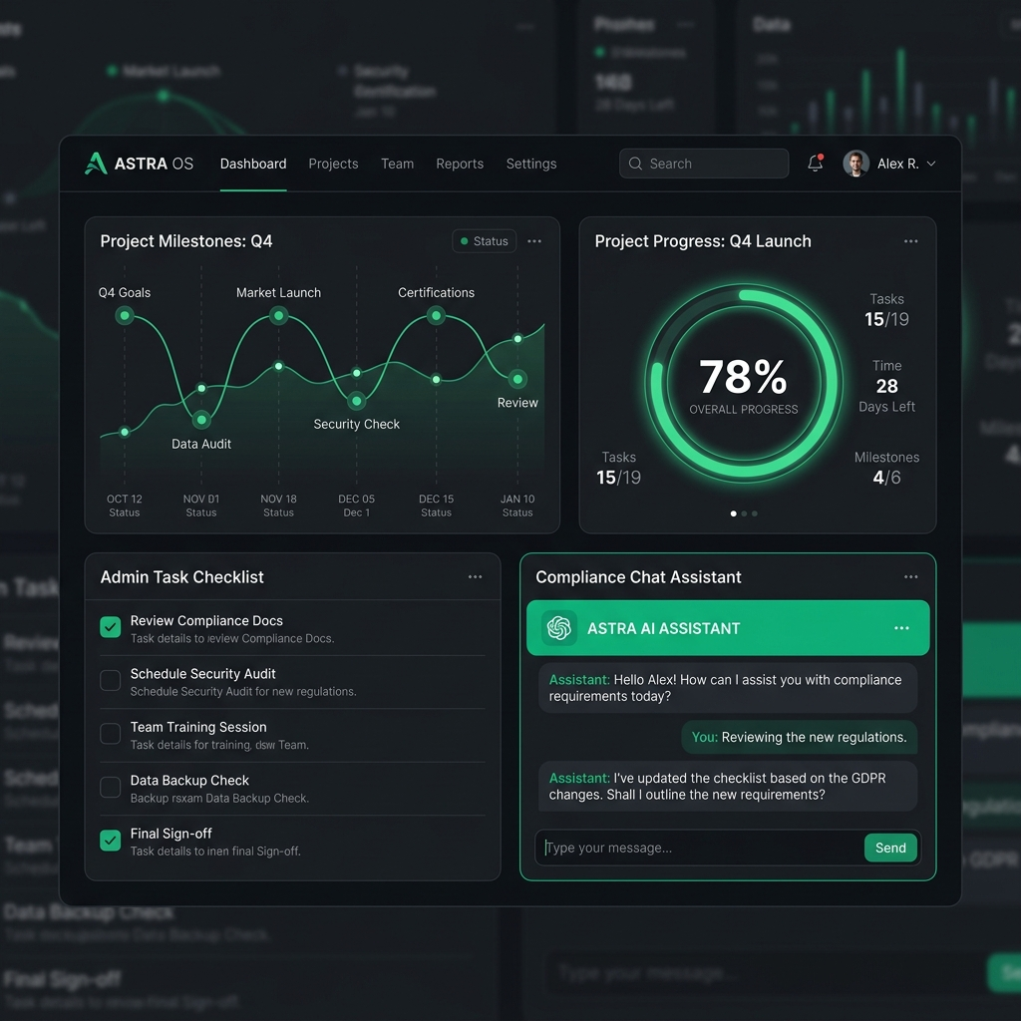
4. Key Screenshots: Visual Interface
Platform UI Highlights
• Clean Dark Mode Dashboard: Maximizes visual structure and focus using carefully chosen, high-legibility standard Tailwind zinc shades.
• Topological Milestones: Clear visual icons representing PENDING (yellow circle), LOCKED (lock pad), and COMPLETED (green check) nodes.
• AI Chat Widget: Context-sensitive floating card rendered in a gorgeous matching emerald-tinted color scheme.

Slide 6
5. UI/UX Prototype: Interactive Flow
Phase 01
Submit Goal
User submits plain-language request (e.g. 'I want to renew Aadhaar').
Phase 02
Dynamic DAG
Vite loader handles transition. Platform prints live timeline graph.
Phase 03
Interactive Check
Checking requirements triggers database update to unlock next step.
Phase 04
Contextual AI
Chatbot reads active step to provide localized legal and fee support.

Slide 7
6. Team Details
Sautik Samui
Lead System Architect & AI Integration Engineer
• Engineered the Flask REST backend API, implementing dynamic schema handling and fallback routes.
• Integrated Google Gemini Developer APIs, creating a single-roundtrip prompt structure for fast reasoning.
• Built the cascading DAG dependency resolver and database model schema updates.
UI/UX & Product Design
Frontend Developer & Product Lead
• Designed the high-fidelity dark-mode interface using Tailwind CSS and Framer Motion micro-animations.
• Implemented local session persistence and loading spinners to optimize the goal submit flow.
• Ensured responsive layouts and mobile timeline viewport scaling.

