Slide 1
Character Recognition using EasyOCR & BLIP-2 on handwritten medical prescription collection
Problem Statement: Due to rapid influx of incoming patients coupled with insurmountable pressure, sometimes the handwriting of an attending doctor gets heavily affected. Extracting meaningful information from images containing text is challenging due to noise, handwriting, and variable layouts. With applying advanced character recognition method, we can reduce the likelihood of wrong medication
Objective: To evaluate how well a multimodal approach combining OCR and image captioning models can interpret and align textual content from images.
Approach:
Step 1: Used EasyOCR for extracting raw text from images.
Step 2: Applied BLIP-2 to generate context-aware captions using visual and textual cues.
Step 3: Compared outputs using multiple metrics to assess semantic and lexical alignment.
Step 4: Conducted outlier and correlation analysis for deeper insights.

Slide 2
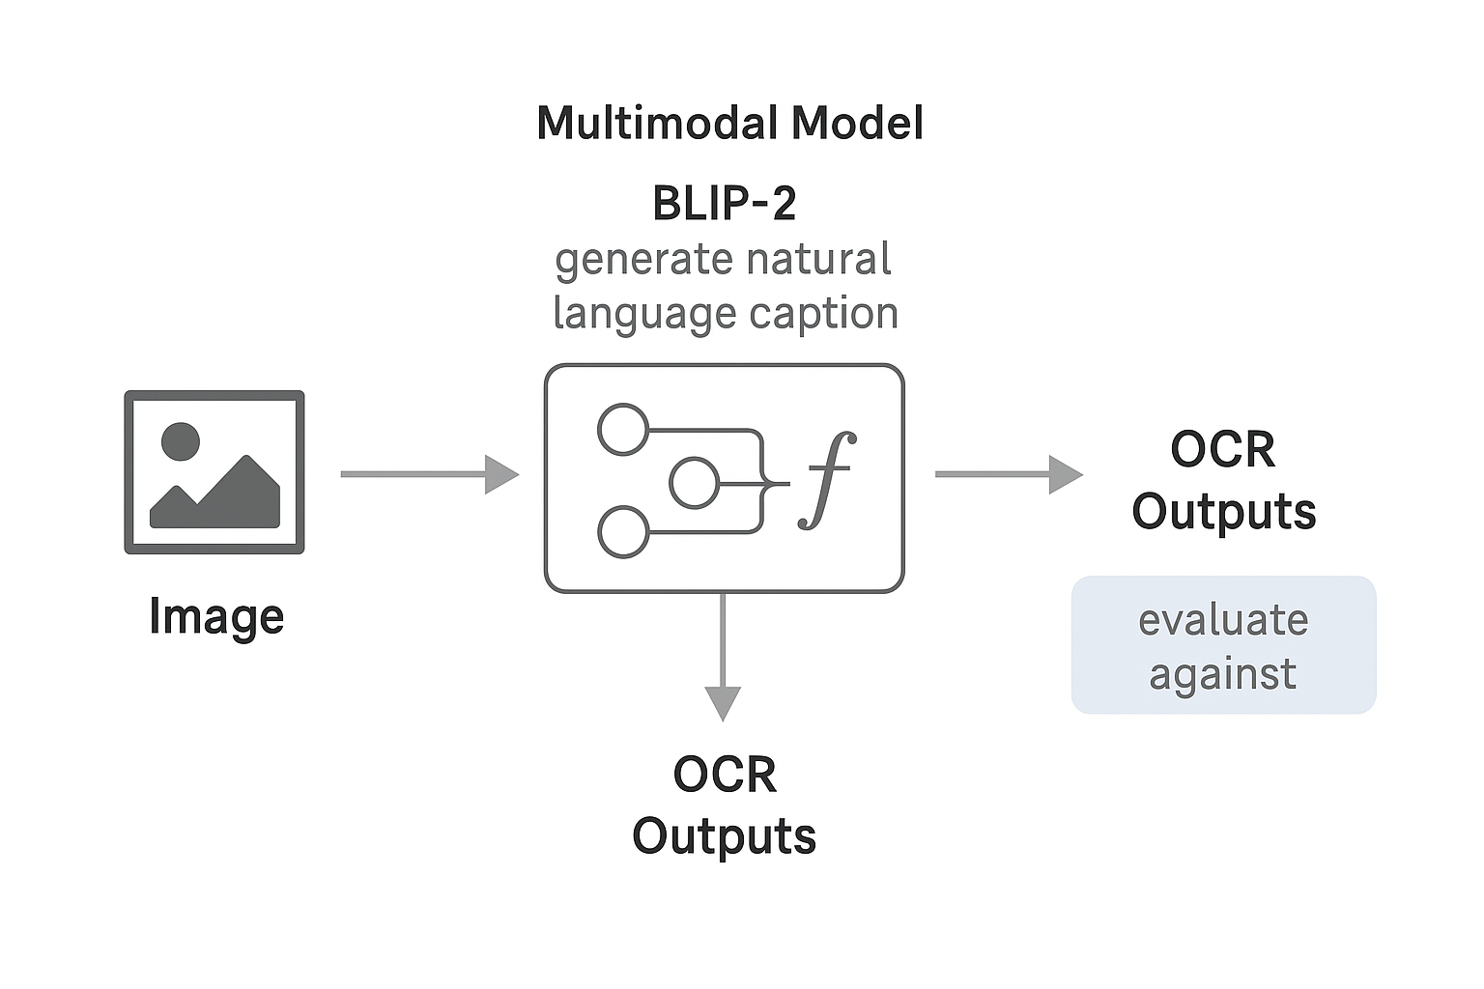
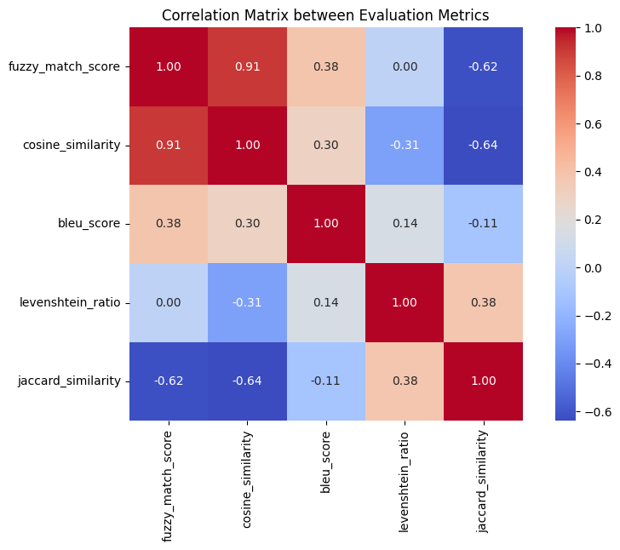
Model Architecture and flow

Slide 3
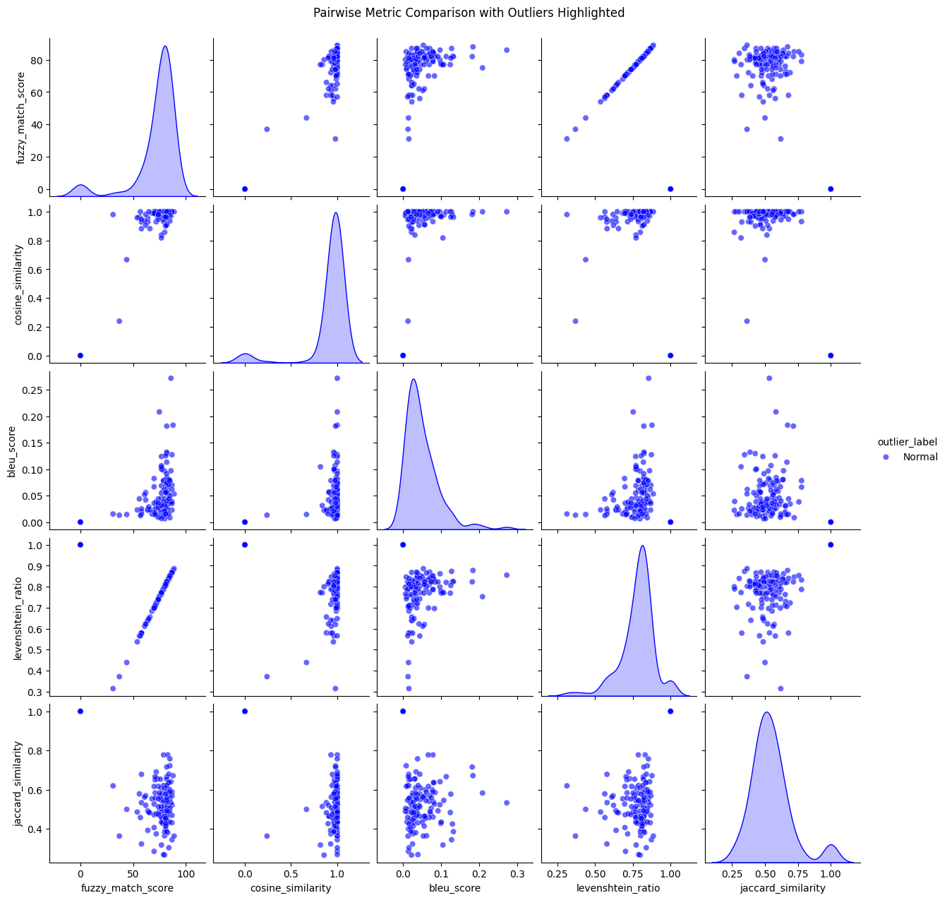
Evaluation and Key Insight
Key Results:
Avg Fuzzy Score: 72.57, Cosine: 0.91
Avg Bleu: 0.04, Levenshtein: 0.77, Jaccard: 0.54
BLEU was lowest, indicating lexical variation.
Levenshtein and jaccard offered moderate alignment.
Key Insight:
Fuzzy Match Score exhibited the lowest performance among all metrics.
Cosine Similarity, Levenshtein Ratio, and Jaccard Similarity were higher, suggesting better alignment between texts.
Outliers: Certain images consistently showed low similarity across multiple metrics.
Overall, Easy OCR and BLIP-2 achieved reasonable agreement in text recognition performance
Metrics used: fuzzy-match score, Cosine similarity, Bleu Score, Levenshtein Ratio, Jaccard Similarity

