Slide 2
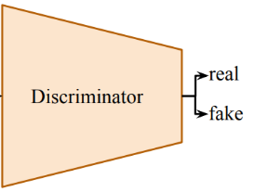


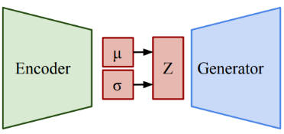





Discriminator-2
$$p_{1}$$
$$p_{2}$$
.
.
$$p_{n}$$
Generator-1
Generator-2
$$y_{1}^{^}$$
$$y_{2}^{^}$$
.
.
$$y_{n}^{^}$$
e
$$q_{1}$$
$$q_{2}$$
.
.
$$q_{n}$$
$$y_{1}$$
$$y_{2}$$
.
.
$$y_{n}$$
$$y_{1}$$
$$y_{2}$$
.
.
$$y_{n}$$
Discriminator-1

