Slide 1

CNN Based Stock Market Prediction
SEASONS OF CODE
UNDER THE GUIDANCE OF:
SHIVPRASAD KATHANE
PRESENTED BY:
SAUTRIK CHAUDHURI
ROLL NO. - 213040032

Slide 2

Table of Contents
OUR DISCUSSION POINTS
Introduction
Main Idea
Project Overview
Future Scope
CNN BASED STOCK MARKET PREDICTION

Slide 3
Introduction
Stock Market prediction is extremely valuable in various areas. Prediction of future market fluctuation has hence been a important part of research
Previously, machine learning models like random forests, SVMs, linear discriminant analysis etc. have been used for predicting market fluctuations.
Challenges - to understand important features in the historical market data
CNN for stock market prediction: CNNs can automatically extract important features and hence, our model is not limited to hand engineered technical indicators like Rate of Change or Volume.
CNN BASED STOCK MARKET PREDICTION

Slide 4
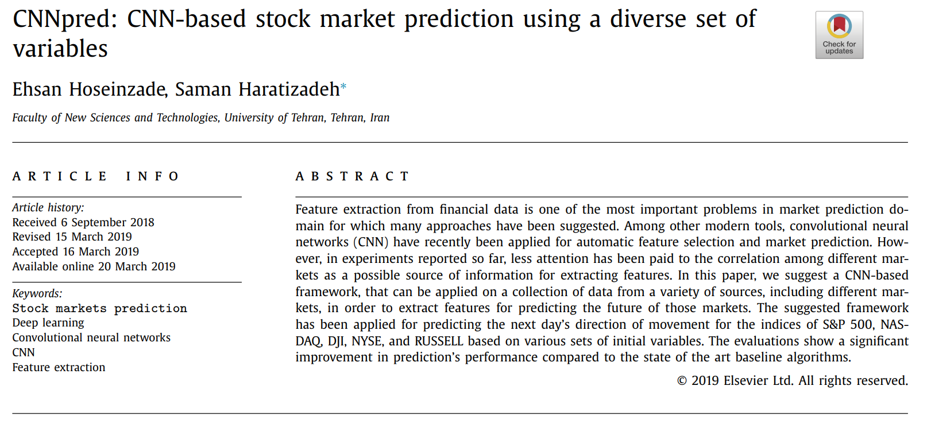
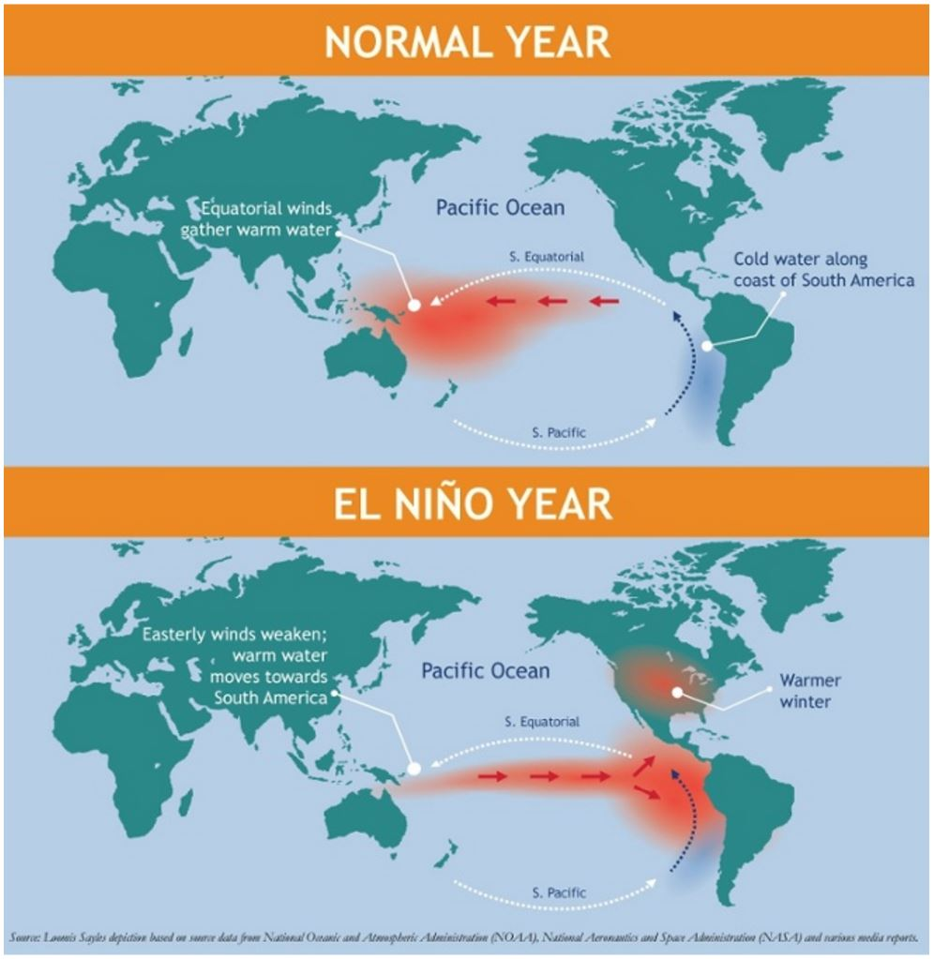
Main Idea
IMPLEMENTATION OF A PAPER
The paper on ‘CNNpred: CNN-based stock market prediction using a diverse set of variables’ was used a reference for our model
Source: sciencedirect.com
Uses CNN for predicting market fluctuations (positive or negative)
CNN BASED STOCK MARKET PREDICTION
Input variables: 82 feature variables from 5 markets – S&P 500 index, NASDAQ Composite, Dow Jones Industrial Average, NYSE Composite, and RUSSELL 2000.
Output variable: Binary output (1 if change is positive, 0 if change is negative)

Slide 5
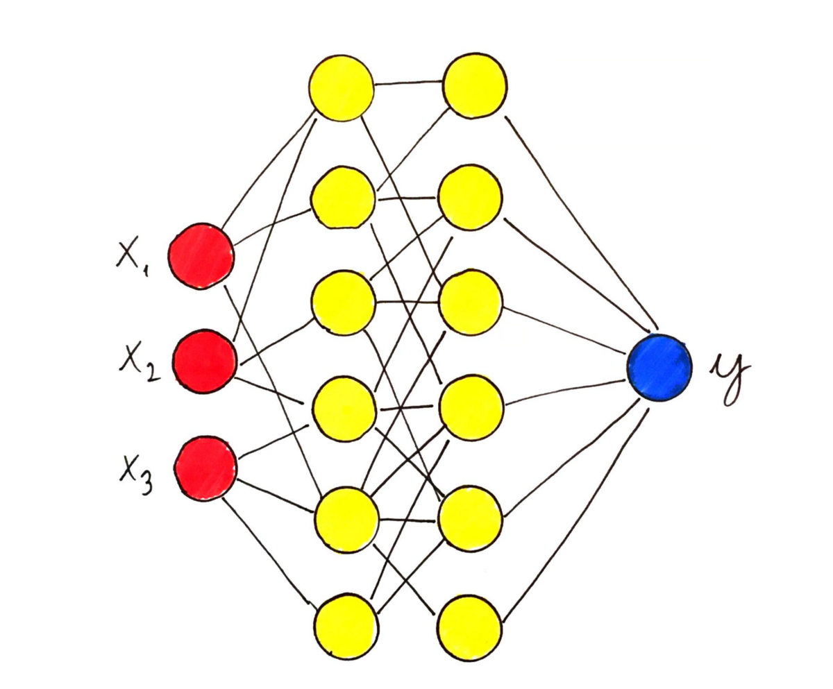
Project Overview
Brief Timeline of my work
Week 1 to 3: Basic understanding of Time Series Modelling, Machine Learning and Deep Learning techniques
Week 5: Understanding of CNN
Week 6: Reading the paper and understanding the methodology
CNN BASED STOCK MARKET PREDICTION
Week 7: Implementation of the paper
Week 8 and 9: Formulating a model and improving model performance
Week 10: Checking for robustness in new markets (NIFTY50)
Source: satimagingcorp.com
Source: towardsdatscience.com

Slide 6
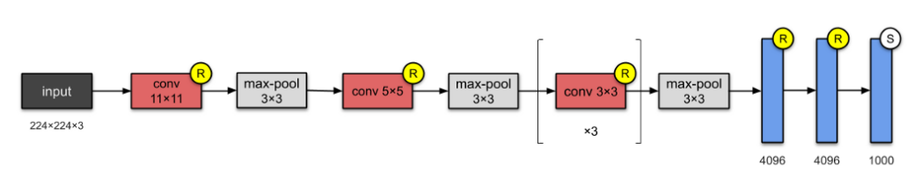
Future Scope
The model can be further improved by better tuning of hyperparameters.
The HTML interface can be further improved for better user experience.
CNNs can be used in a variety of other applications including my M.Tech project on Flood Risk Analysis of Mumbai using Twitter data
CNN BASED STOCK MARKET PREDICTION
AlexNet CNN architecture
Source: towardsdatscience.com
Source: thenextweb.com

Slide 7
Thank You
CNN BASED STOCK MARKET PREDICTION

