Slide 1


21CSC101P / OODP
QUIZZIFY
Project Development Presentation
TEAM MEMBERS
Sautrik Roy [RA251103010052] SHIVAANI M [RA2511003010066]
Ashwin Kumar N [RA2511003010033] Ayush Agarwal [RA2511003010012]

Slide 2
INTRODUCTION
2
Platform Overview
What is Quizzify?
Core Workflow
An intelligent, AI-powered Quiz Management System that auto-generates assessments from uploaded documents (PDF / PPTX).
User uploads a document → Content is extracted → Quiz is forged automatically → Student takes the quiz and gets instant results.
Key Features
Technology Stack
Real-time leaderboards · Result analytics · AI-powered Forge engine · Secure, auth-protected accounts.
Backend Integration: C++ Core Architecture Frontend Interface: Javascript & Interactive UI Components

Slide 3
OODP FEATURES UTILIZED
3
Core Concepts Applied
Encapsulation
User and QuizResult classes bundle related attributes with specialized methods, keeping internal states hidden from external interference.
Abstraction
Complex backend AI generation and C++ database operations are hidden behind simple frontend Javascript endpoints.
Inheritance
The system leverages hierarchical data models where specialized components extend base identity traits.
Polymorphism
Methods are designed to dynamically handle varying data types, enabling seamless processing of both PDF and PPTX formats uniformly.

Slide 4
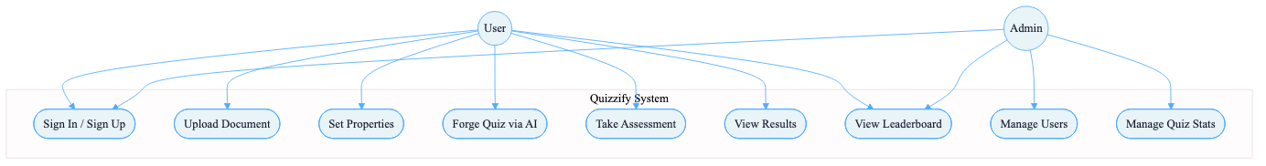
UML DIAGRAM — SYSTEM INTERACTIONS
4
Use Case Diagram

Slide 5
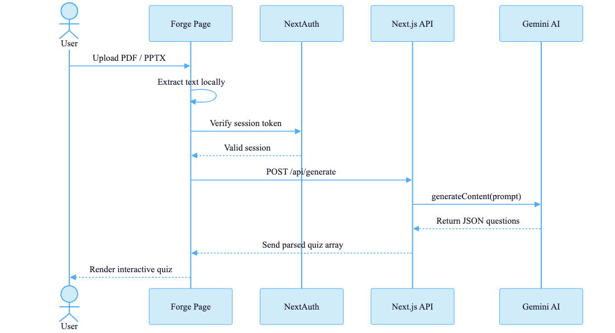
UML DIAGRAM — DATA FLOW MAP
5
Sequence Diagram

Slide 6
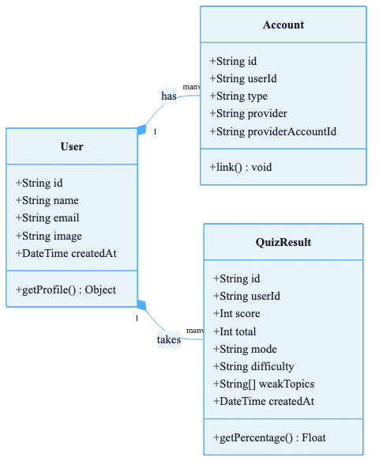
UML DIAGRAM — ENTITY ARCHITECTURE
6
Class Diagram

Slide 7
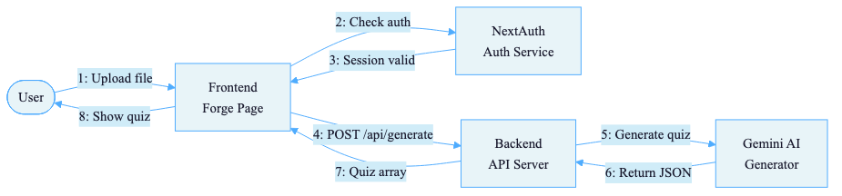
UML DIAGRAM — OBJECT MESSAGING
7
Collaboration Diagram

Slide 8
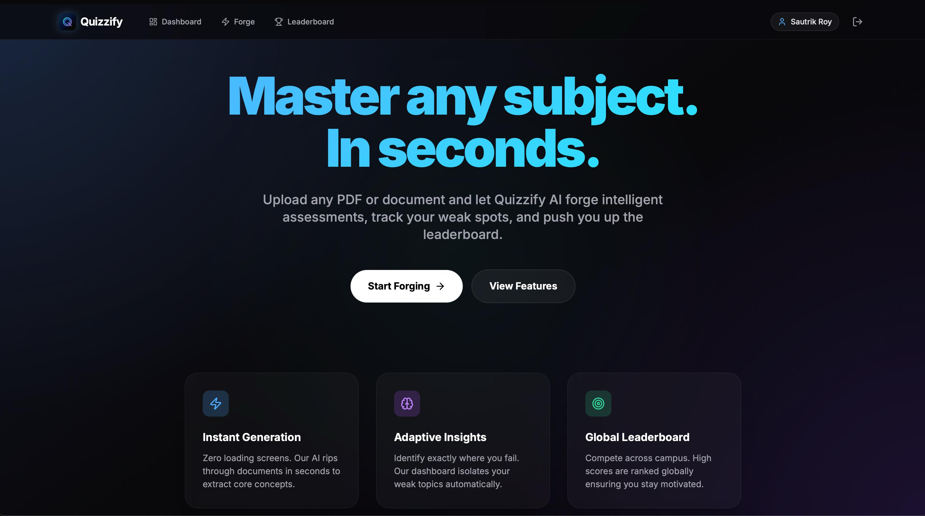
USER INTERFACE
8
Landing Page Interface

Slide 9
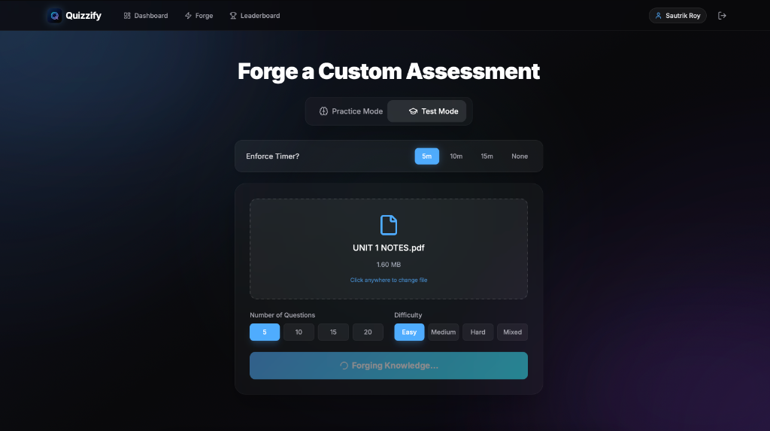
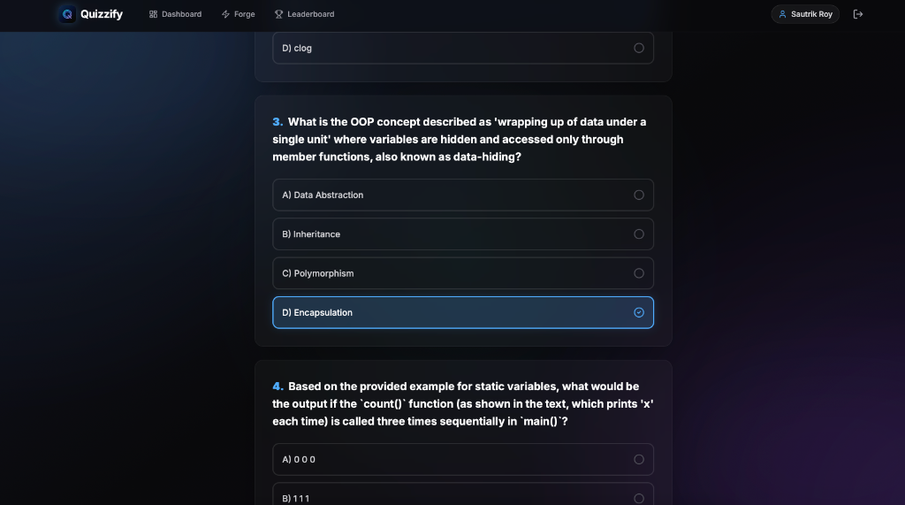
USER INTERFACE
9
Input & Output Screens
INPUT: Document Upload
OUTPUT: Active Quiz Generation

Slide 10
CONCLUSION
10
Summary & Future Scope
✦
Quizzify demonstrates the robust capabilities of mapping Object-Oriented paradigms into real-world applications.
✦
The C++ backend guarantees high performance, while Javascript on the frontend ensures a seamless user experience.
✦
AI automation dramatically decreases time spent crafting educational assessments.
✦
Future scope involves further integration of specialized models and real-time collaboration features.

Slide 11
THANK YOU
We appreciate your time. Open for questions.

