Slide 1
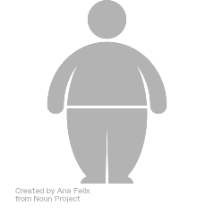





Easy-to-use and interpretable
AI-based calculator predicting
five year-weight trajectories
after bariatric surgery
A multiple international cohort SOPHIA study

Slide 2

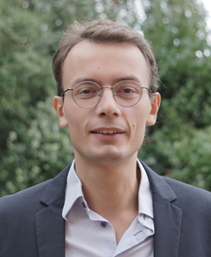


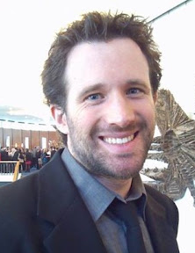


<number>
François Pattou
Pierre Bauvin
Philippe Preux
Patrick Saux
Julien Teigny
...and also Violeta Raverdy, Hélène Verkindt, Maxence Debert, Tomy Soumphonphakdy (and many more!)

Slide 3





<number>
Bariatric surgery
Outcome
Total Weight Loss (%TWL)
→ between preop and follow-up visits
(1, 3, 12, 24, 60 months)
→continuous %outcome
Roux-en-Y Gastric Bypass
(RYGB)
Sleeve
Gastrectomy (SG)
Adjustable Gastric Band
(AGB)

Slide 4


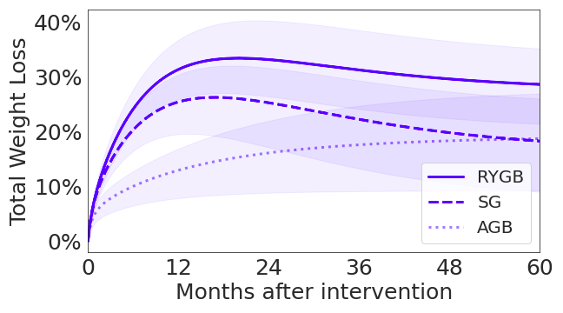
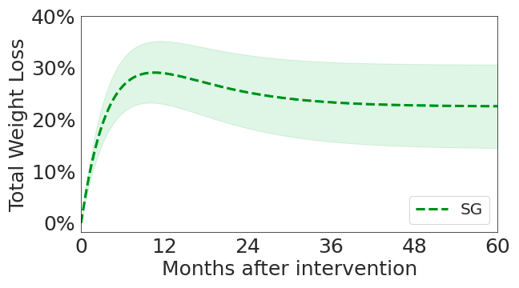
<number>
Derivation cohorts
ABOS
BAREVAL
Prospective cohort Retrospective study
N=1147 (first intervention)
> 500 baseline attributes
N=348
SG only

Slide 5




<number>
Machine Learning Model
Data cleaning
LASSO
Regression Tree
MAD, IQR
Feature
selection
Validation
Preprocessing
Calibration

Slide 6
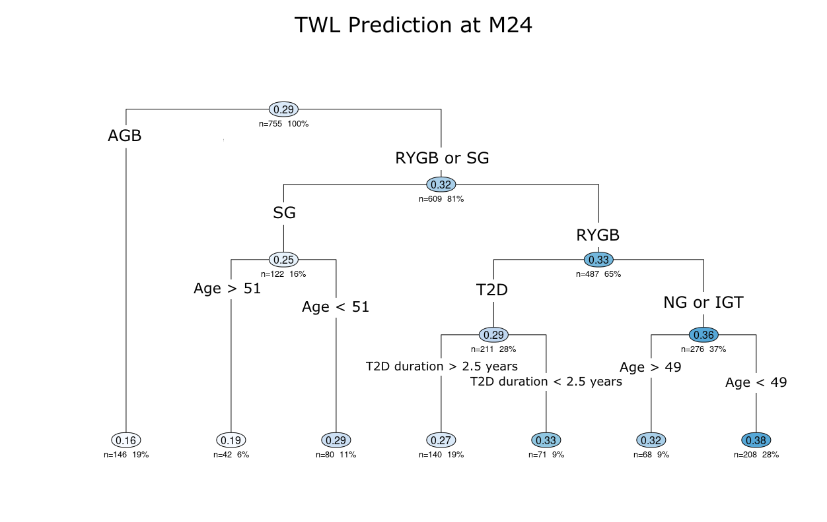
<number>
Weight loss predictive model
7 selected variables (among > 500)
Weight
Height
Type of intervention
Age
Type II diabetes
Diabetes duration
Smoking

Slide 7











<number>
Validation: 10 cohorts in Europe, Asia and America

Slide 8
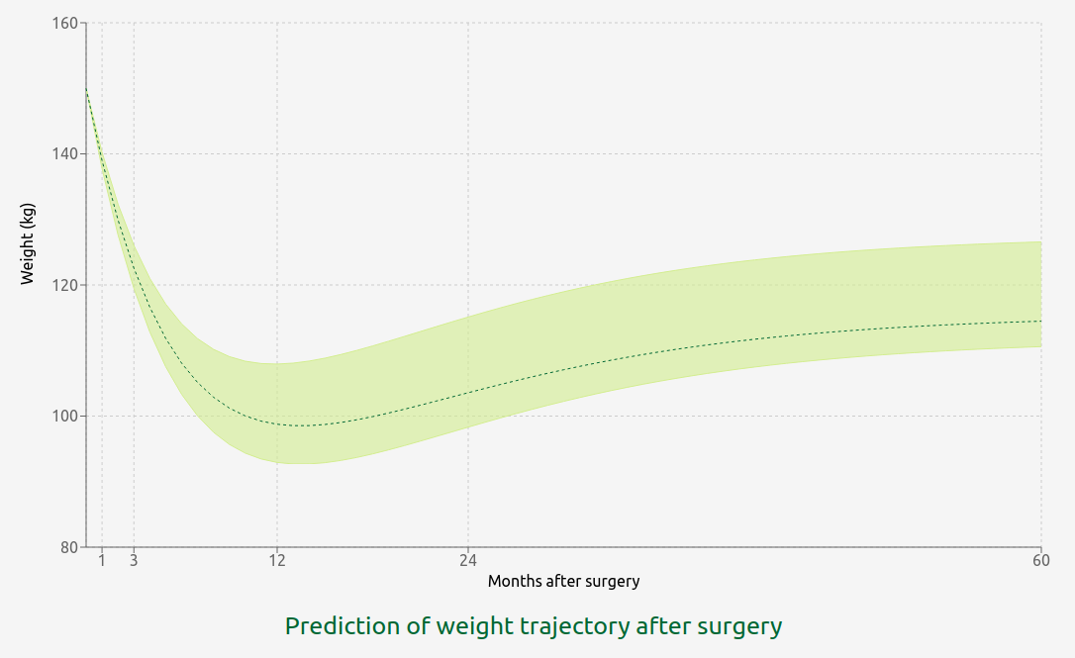
<number>
Use case: patient support

Slide 9
<number>
#1: patient looses less than expected
Patient is on track
(weight is consistent with IQR)

Slide 10
<number>
#2: patient has unrealistic expectations
Patient at preop visit
Expected weight at M24
not consistent with IQR

Slide 11

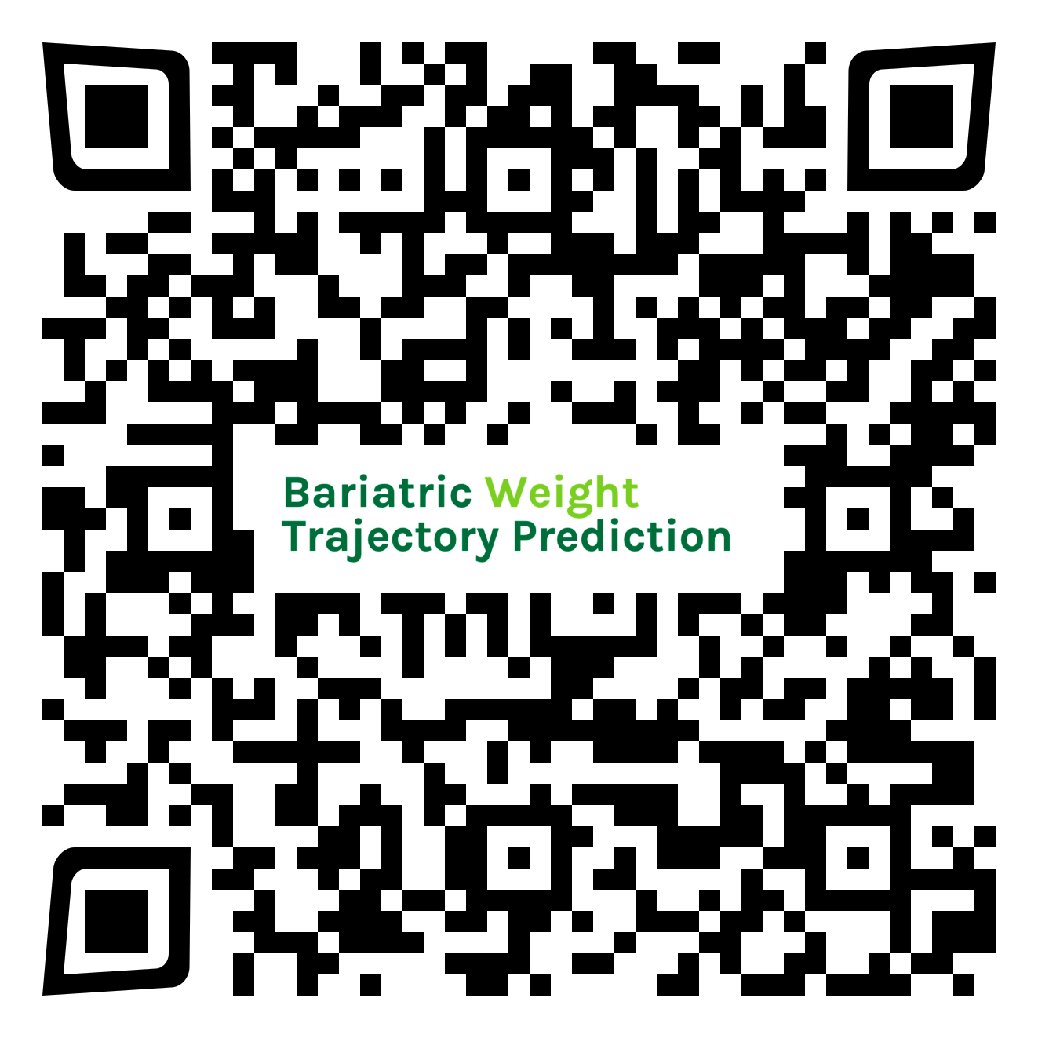
<number>
https://bwtp.univ-lille.fr/

Slide 12
<number>
Appendix

Slide 13
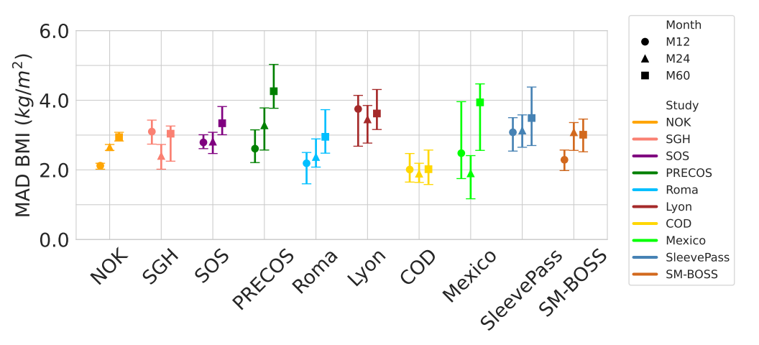
<number>
Validation

Slide 14
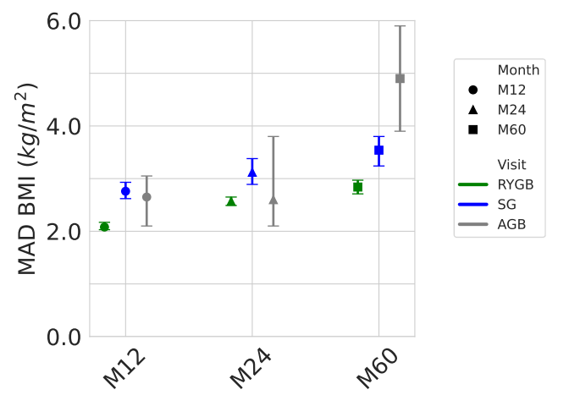
<number>
Validation

