Slide 1
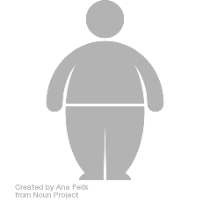





Easy to use and Interpretable Model Based on Artificial Intelligence for Predicting 5-Year Weight Trajectories After Bariatric Surgery

Slide 2

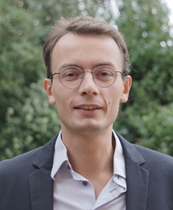


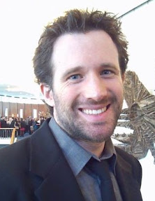


<number>
François Pattou
Pierre Bauvin
Philippe Preux
Patrick Saux
Julien Teigny
...and also Violeta Raverdy, Hélène Verkindt, Maxence Debert, Tomy Soumphonphakdy (and many more!)

Slide 3





<number>
Bariatric surgery
Outcome
Total Weight Loss (%TWL)
→ between preop and follow-up visits
(1, 3, 12, 24, 60 months)
→continuous %outcome
Roux-en-Y Gastric Bypass
(RYGB)
Sleeve
Gastrectomy (SG)
Adjustable Gastric Band
(AGB)

Slide 4


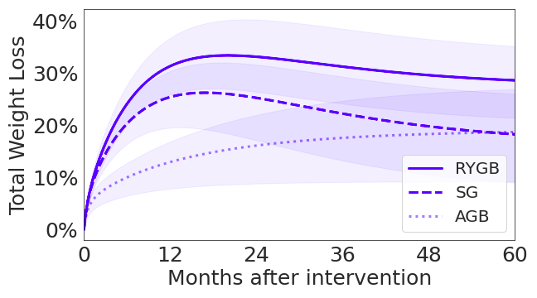
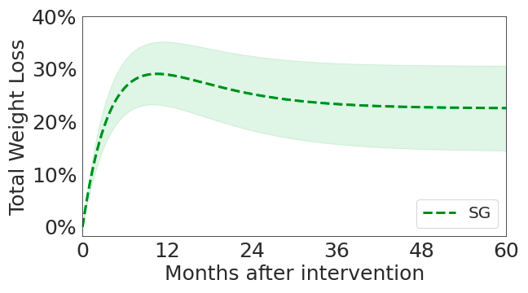
<number>
Derivation cohorts
ABOS
BAREVAL
Prospective cohort Retrospective study
N=1147 (first intervention)
> 500 baseline attributes
N=348
SG only

Slide 5





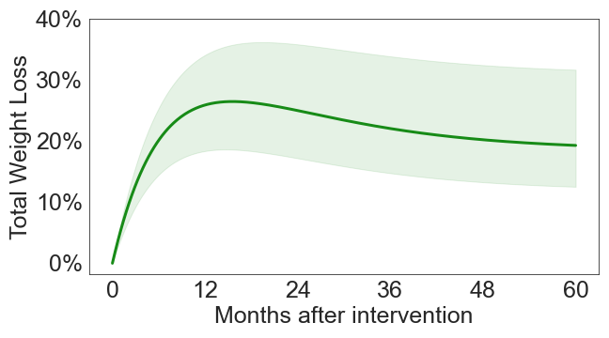
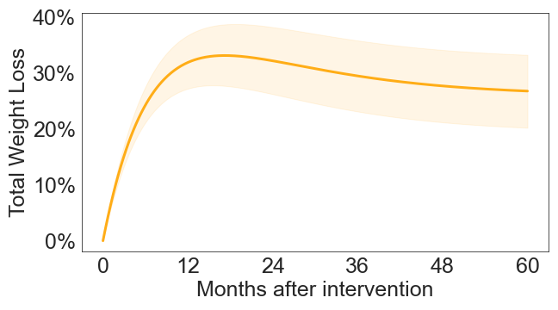
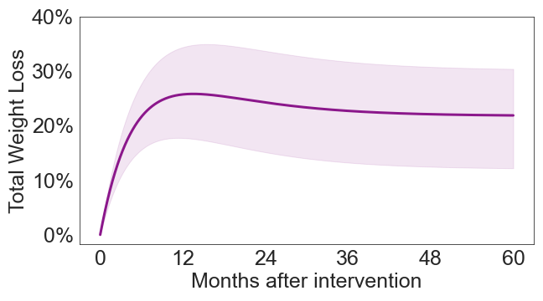
<number>
Validation cohorts
PRECOS
NOK
SOS
N=237
RYGB, SG, AGB
N=5,888
RYGB, SG, AGB
N=642
RYGB, AGB

Slide 6




<number>
Weight Loss Predictive Model
Data cleaning
LASSO
Regression Tree
RMSE, IQR
Feature
selection
Validation
Preprocessing
Calibration

Slide 7
<number>
Preprocessing
Date adjustment: patients do not come exactly on schedule!
Linear interpolation of weights.
Example: exact M3 (3 months postop), delayed M12 (13 months).
Proxy M12 weight =
9/10 x M12 weight + 1/10 x M3 weight.

Slide 8
<number>
Feature selection
Least Absolute Shrinkage and Selection Operator.
Linear model + penalization:
Select relevant attributes, discard the others.
Tuned by cross-validation on ABOS.
From 1370 baseline attributes to only 8:
preop weight, height, age, intervention, age of first diet, smoking habit, T2D status and duration.

Slide 9
<number>
Calibration
Regression Tree trained with the CART algorithm.
Recursively split population to minimize dispersion within subgroups → stratification of patients
Fit a simple (constant) %TWL prediction model for each final subgroup.
Captures nonlinear, conditional dependencies, yet remains interpretable.

Slide 10
<number>
Validation
Root Mean Squared Error (RMSE)
bias + variance of predicted outcomes.
The lower, the better.
Inter Quartile Range (IQR) of prediction errors
Typical dispersion of weight trajectories.

Slide 11
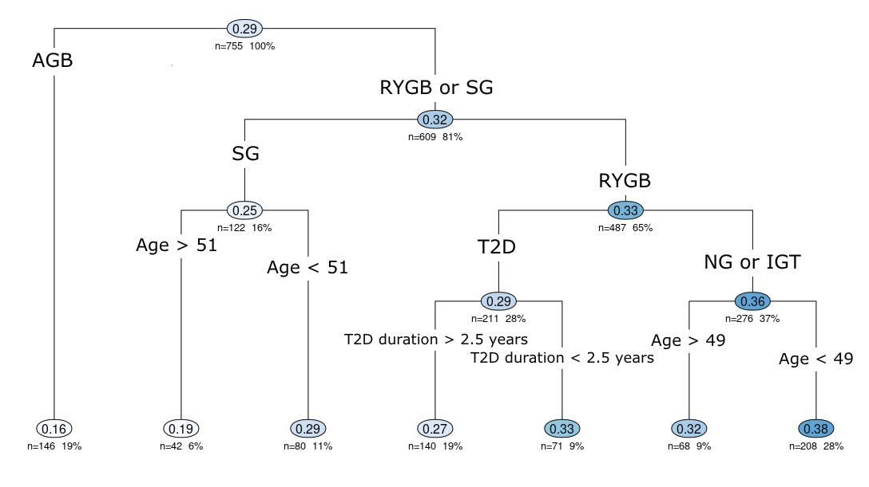
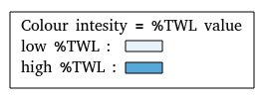
<number>
%TWL Prediction at M24

Slide 12
<number>
Validation results
 | RMSE in kg/m2 (bootstrap CI)
 | M12 | M24 | M60
ABOS+Montpellier (derivation, n=1151) | 3.7 (3.4 - 4.0) | 4.5 (4.3 - 4.8) | 5.2 (4.9 - 5.7)
ABOS+Montpellier (validation, n=230) | 3.9 (3.5 - 4.2) | 4.7 (4.0 - 5.4) | 4.8 (3.9 - 5.7)
PRECOS (n=237) | 3.9 (3.5 - 4.3) | 4.7 (4.3 - 5.2) | 6.1 (5.7 - 6.6)
NOK (n=5,888) | 3.3 (3.3 - 3.4) | 4.1 (4.1 - 4.3) | 4.7 (4.5 - 4.8)
SOS (n=642) | 4.6 | 4.7 | 4.1
Existing literature models | 3.8 - 6.1 | 4.9 - 7.0 | 5.4

Slide 13
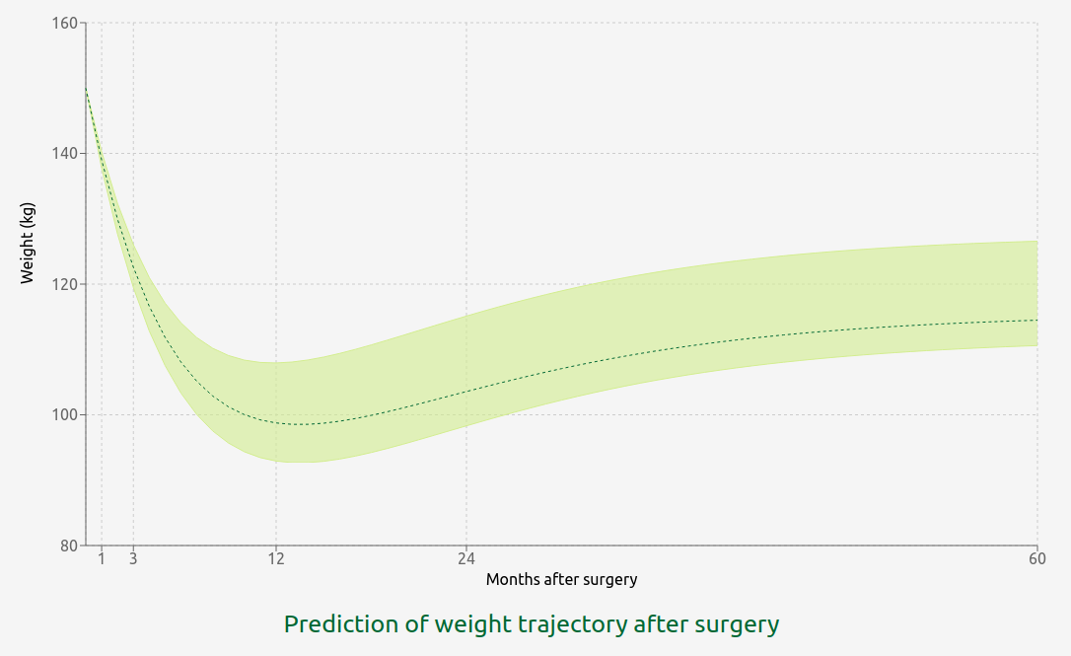
<number>
Use case: patient support

Slide 14
<number>
#1: patient looses less than expected
Patient is on track
(weight is consistent with IQR)

Slide 15
<number>
#2: patient has unrealistic expectations
Patient at preop visit
Expected weight at M24
not consistent with IQR

Slide 16

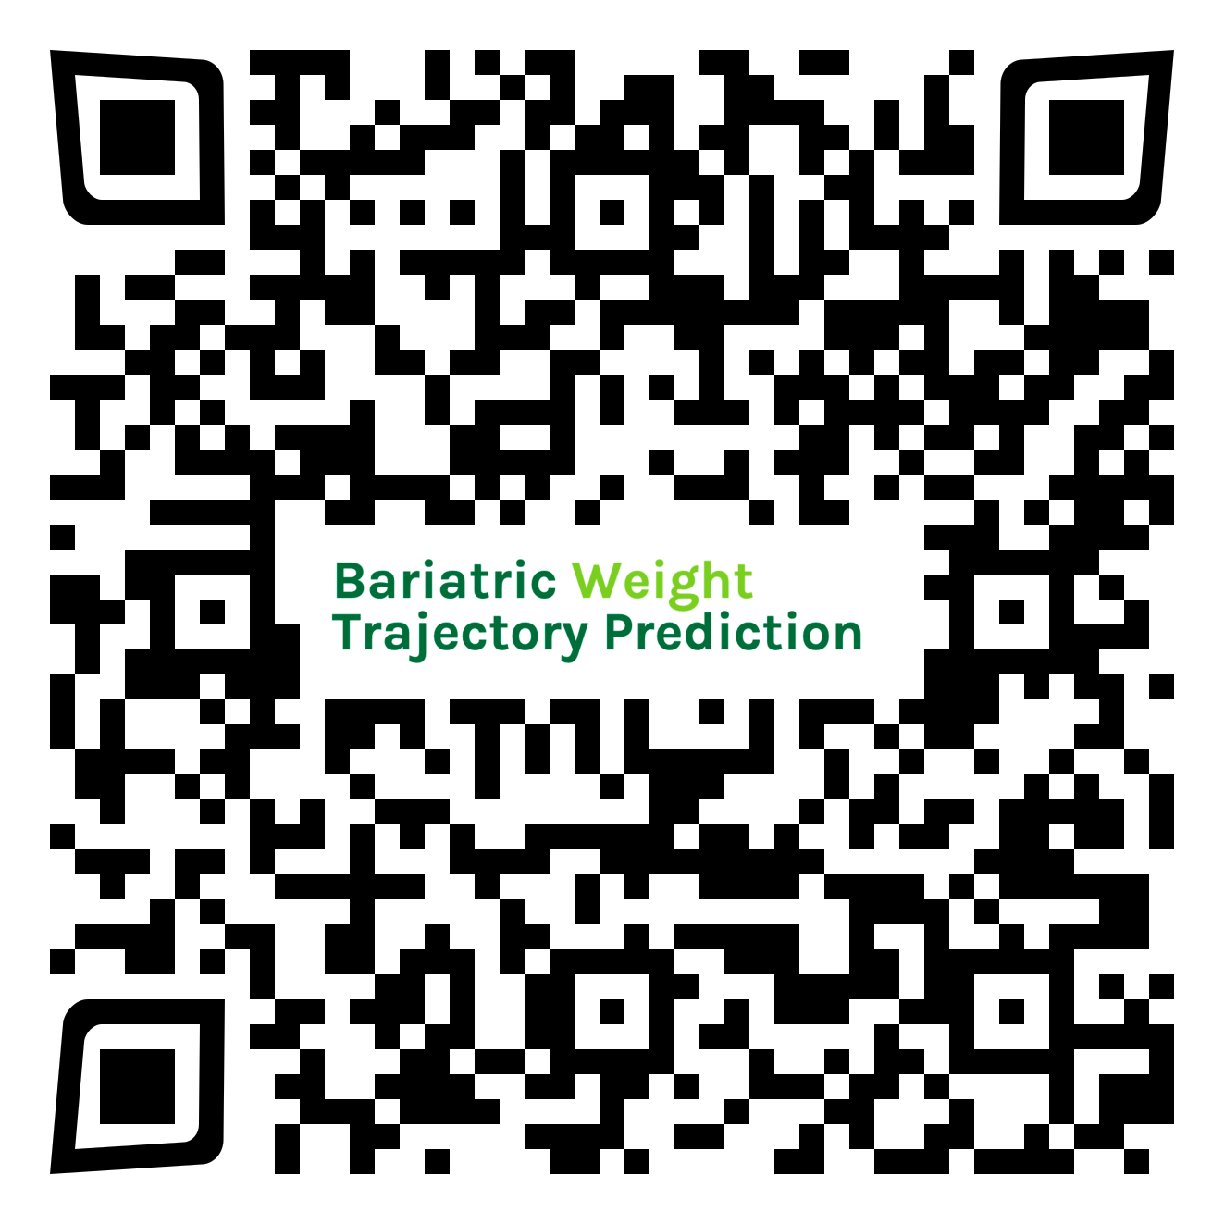
<number>
https://bwtp.univ-lille.fr/

Slide 17
<number>
Appendix

Slide 18
<number>
Validation results
Implementation of literature models in ABOS
Model | Month | Intervention | n | RMSE (kg/m2)
Cottam2 | 12 | SG | 232 | 4.8
Velazquez1 | 12 | RYGB | 741 | 4.0
Wise | 12 | RYGB | 686 | 4.7
Goulard | 12 | SG | 232 | 5.9
Seyssel1 | 12 | RYGB | 744 | 4.0
Janik | 12 | SG | 232 | 5.1
Baltasar2 | 24 | RYGB + SG + GB | 1098 | 7.0
Baltasar3 | 24 | RYGB | 684 | 5.3
Baltasar4 | 24 | SG | 191 | 7.5
Velazquez2 | 24 | RYGB | 684 | 5.0
Seyssel2 | 24 | RYGB | 684 | 5.1
Seyssel3 | 60 | RYGB | 398 | 5.9

