Slide 1
Methods to encourage students to appreciate how personal information can be found and used to escalate privilege
Dr. Nick Savage
School of Computing, University of Portsmouth

Slide 2
Relation to Guidance?
Information and risk
Utility of information
Classification of information
Information/data lifecycle
Risk and hazard
Impact, harm and consequence
Risk taking, human error, malicious drivers

Slide 3
Personal Information Leakage
Web Foundations
Lectures (CIA, phishing, impersonation, shoulder surfing, tailgating, dumpster diving, trojans, quid pro quo, baiting and pretexting)
1000 word literature review on “Mitigating personal information exposure on the web”
Practical/Seminar worksheet

Slide 4
Personal Information Leakage
System Security
AY2016-17
You are to find out as much information as possible about Nick - be clear regarding what you know to be true (what you have evidence for) and where you have made assumptions.
Using what you know you should score 2 facts as vulnerabilities that you feel could be used to change your marks in this assignment. You should indicate why you feel they are vulnerabilities, how they could be exploited and how they can be mitigated.
AY2014-15
You are to find out as much information as possible about Nick - be clear regarding what you know to be true (what you have evidence for) and where you have made assumptions.
Using what you know you should state 3 guesses at Nick’s password (the word or phrase that his password is based on).
State why you guess them and also state how you would mutate the password. You should also state how many mutated passwords you can generate in 30 minutes.

Slide 5
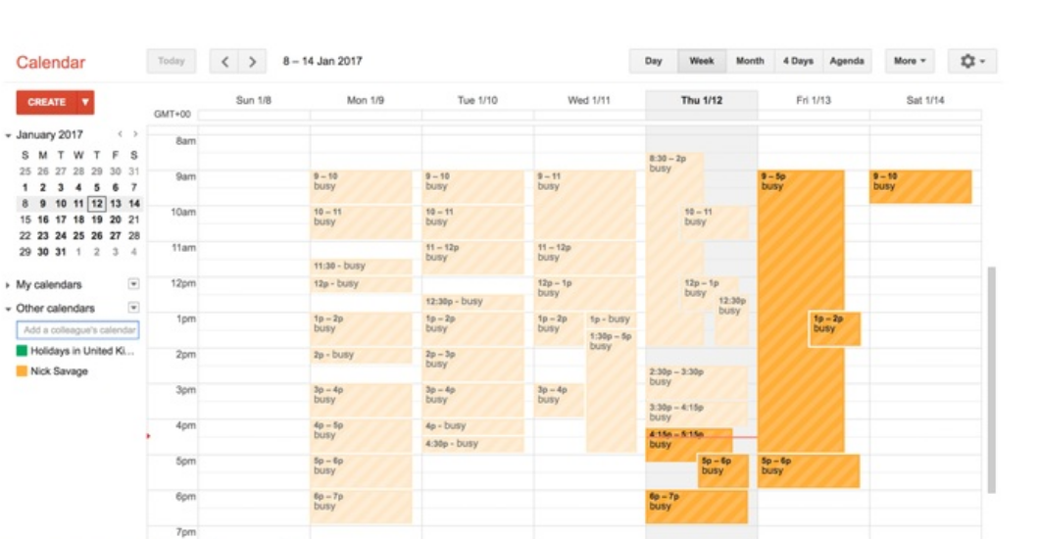

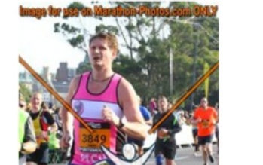
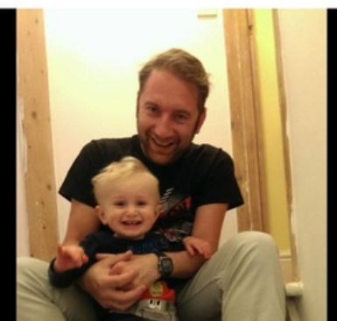

Slide 6
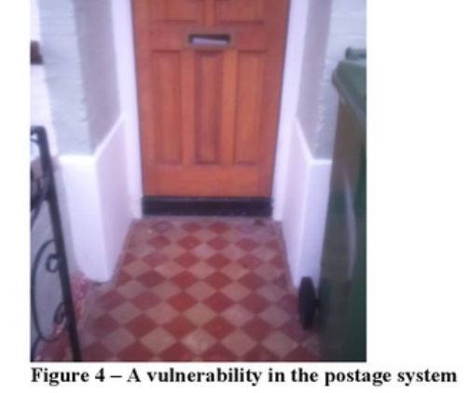
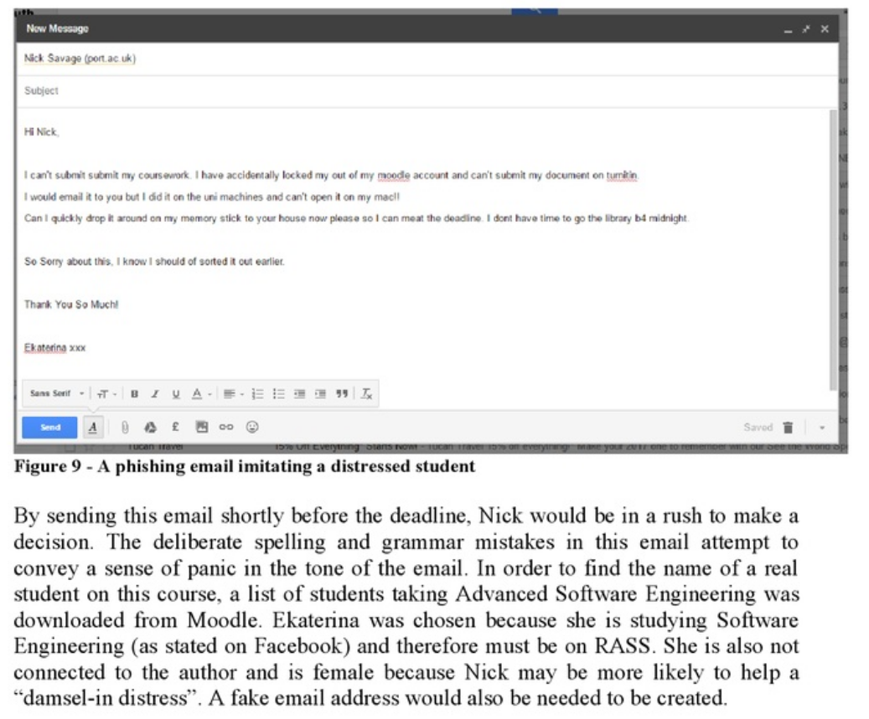
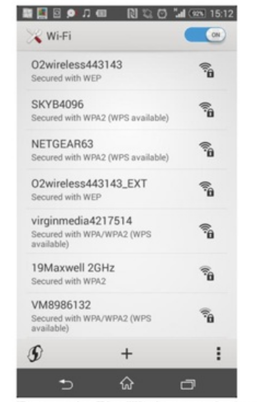
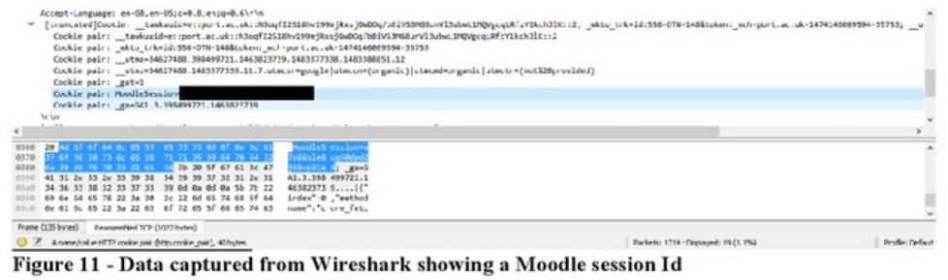

Slide 7
