Slide 1



Slide 2
Cyber-security: Internet simulation tutorial
Noam Weingarten
Fostering Teaching Excellence of Cyber Security in Computer Science, 2nd meeting,
University of Southampton,
14 June 2017

Slide 3
The students
Level 6, Cyber Security Short-Course
Level 5, BSc Computer Science: Client Server Architecture
Level 4, BSc Computer Science: Computer Systems Fundamentals
Students from variety of employments
Students from variety of countries
Students from variety of ages and experiences

Slide 4
The aim
Give students a deep-level appreciation of internets.
Enable students to demonstrate and experience Cyber Security vulnerabilities and attacks, while in a safe environment.
Engage students in learning activities
Stop students from being passive receivers of lecturer’s experience.

Slide 5
The event
Students split into networks.
Students allocated roles; Clients, Servers, Switch & Routers.
Clients send requests to Servers by completing packet templates, with headers.
Switch (& Routers) directing packets accordingly.
Servers processing requests and responding by completing packet templates.
Lecturer only interferes to; be the DNS, diagnose networking issues, simulate issues or attacks.

Slide 6
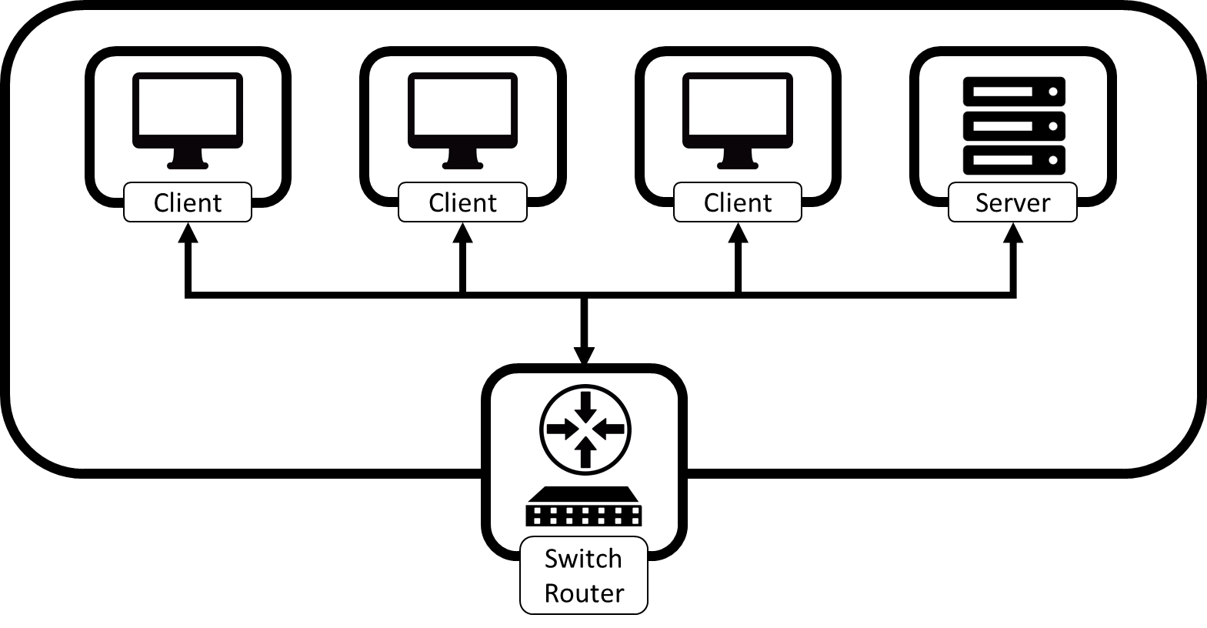

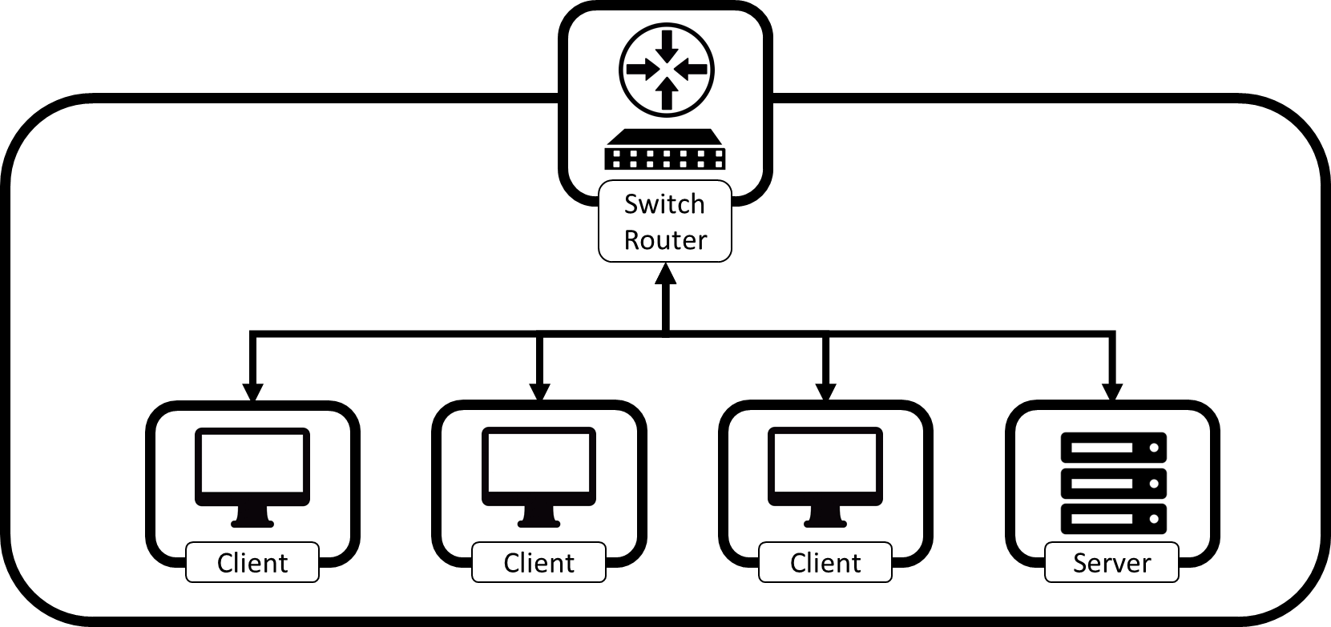
Complete Network - Reality
DNS

Slide 7
Complete Network - Reality
DNS

Slide 8
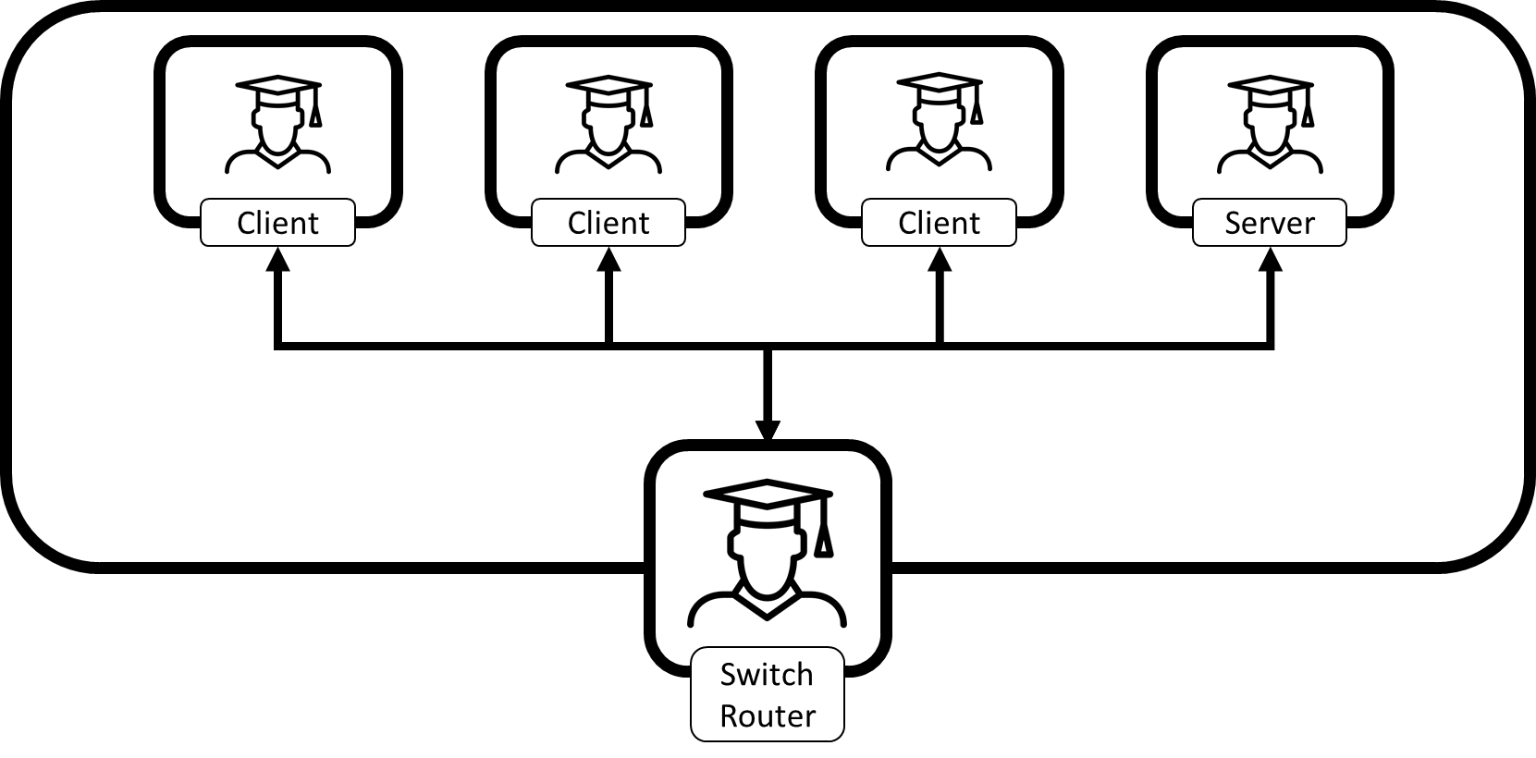
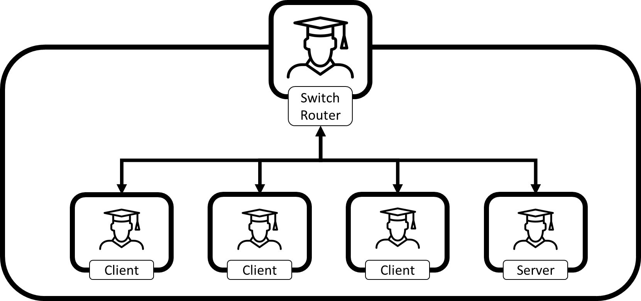
Complete Network - Tutorial
DNS

Slide 9
Packets of data
Source IP:
Hostname of Destination *:
Destination IP **:
Time Stamp: (hh:mm)
Sequence number:
Contents of Packet:
Size of packet (in characters):

Slide 10
DNS Table:
Server hostname: | IP Address:
Echo.Bat.wmin.ac.uk | 1.30.2.2
Echo.Mole.wmin.ac.uk | 1.209.4.2
Echo.Rabbit.wmin.ac.uk | 1.120.3.2
Echo.Mouse.wmin.ac.uk | 1.115.1.2
Network IP Address: | Domain:
1.30.2.0 | Bat.wmin.ac.uk
1.209.4.0 | Mole.wmin.ac.uk
1.120.3.0 | Rabbit.wmin.ac.uk
1.115.1.0 | Mouse.wmin.ac.uk

Slide 11
The outcome (1)
Students need about 20’ to get into it – then they love it. You can see them writing frantically, then trying to establish with their friends why the requests are not working – diagnosing network issues.
They see it as a fun game.
Students are very engaged

Slide 12
The outcome (2)
Students do identify issues.
Lecturer can relate issues to genuine networking or security issues – this provides a macroscopic view of what is going on at the scale of data packets .
Transferrable to; Networking, Client Server Architecture, Cyber Security

Slide 13
The outcome (3)
Student gain appreciation of Cyber Security concepts:
Confidentiality
Integrity
Availability

Slide 14
Confidentiality – plain text
Source IP: | 1.115.1.4
Hostname of Destination *: | echo.mouse.wmin.ac.uk
Destination IP **:
Time Stamp: (hh:mm) | #####
Sequence number: | 1
Contents of Packet: | V | E | N | T | I |  | D | O | U | B | L | E |  | C | H | O
Size of packet (in characters): | 16
Source IP: | 1.115.1.4
Hostname of Destination *: | echo.mouse.wmin.ac.uk
Destination IP **:
Time Stamp: (hh:mm) | #####
Sequence number: | 2
Contents of Packet: | C | O | L | A | T | E |  | F | R | A | P | P | U | C | I | N
Size of packet (in characters): | 16
Source IP: | 1.115.1.4
Hostname of Destination *: | echo.mouse.wmin.ac.uk
Destination IP **:
Time Stamp: (hh:mm) | #####
Sequence number: | 3
Contents of Packet: | O |  | W | I | T | H |  | 1 | 0 |  | E | X | T | R | A
Size of packet (in characters): | 15
Source IP: | 1.115.1.4
Hostname of Destination *: | echo.mouse.wmin.ac.uk
Destination IP **:
Time Stamp: (hh:mm) | #####
Sequence number: | 4
Contents of Packet: | S | H | O | T | S |  | E | S | P | R | E | S | S | O
Size of packet (in characters): | 14

Slide 15
Integrity – missing packets
Source IP: | 1.115.1.4
Hostname of Destination *: | echo.mouse.wmin.ac.uk
Destination IP **:
Time Stamp: (hh:mm) | #####
Sequence number: | 1
Contents of Packet: | V | E | N | T | I |  | D | O | U | B | L | E |  | C | H | O
Size of packet (in characters): | 16
Source IP: | 1.115.1.4
Hostname of Destination *: | echo.mouse.wmin.ac.uk
Destination IP **:
Time Stamp: (hh:mm) | #####
Sequence number: | 2
Contents of Packet: | C | O | L | A | T | E |  | F | R | A | P | P | U | C | I | N
Size of packet (in characters): | 16
Source IP: | 1.115.1.4
Hostname of Destination *: | echo.mouse.wmin.ac.uk
Destination IP **:
Time Stamp: (hh:mm) | #####
Sequence number: | 4
Contents of Packet: | S | H | O | T | S |  | E | S | P | R | E | S | S | O
Size of packet (in characters): | 14

Slide 16
Integrity – packet sequencing
Source IP: | 1.115.1.4
Hostname of Destination *: | echo.mouse.wmin.ac.uk
Destination IP **:
Time Stamp: (hh:mm) | #####
Sequence number: | 1
Contents of Packet: | V | E | N | T | I |  | D | O | U | B | L | E |  | C | H | O
Size of packet (in characters): | 16
Source IP: | 1.115.1.4
Hostname of Destination *: | echo.mouse.wmin.ac.uk
Destination IP **:
Time Stamp: (hh:mm) | #####
Sequence number: | 3
Contents of Packet: | O |  | W | I | T | H |  | 1 | 0 |  | E | X | T | R | A
Size of packet (in characters): | 15
Source IP: | 1.115.1.4
Hostname of Destination *: | echo.mouse.wmin.ac.uk
Destination IP **:
Time Stamp: (hh:mm) | #####
Sequence number: | 2
Contents of Packet: | C | O | L | A | T | E |  | F | R | A | P | P | U | C | I | N
Size of packet (in characters): | 16
Source IP: | 1.115.1.4
Hostname of Destination *: | echo.mouse.wmin.ac.uk
Destination IP **:
Time Stamp: (hh:mm) | #####
Sequence number: | 4
Contents of Packet: | S | H | O | T | S |  | E | S | P | R | E | S | S | O
Size of packet (in characters): | 14

Slide 17
Integrity – packet tampering
Source IP: | 1.115.1.4
Hostname of Destination *: | echo.mouse.wmin.ac.uk
Destination IP **:
Time Stamp: (hh:mm) | #####
Sequence number: | 1
Contents of Packet: | V | E | N | T | I |  | D | O | U | B | L | E |  | C | H | O
Size of packet (in characters): | 16
Source IP: | 1.115.1.4
Hostname of Destination *: | echo.mouse.wmin.ac.uk
Destination IP **:
Time Stamp: (hh:mm) | #####
Sequence number: | 2
Contents of Packet: | C | O | L | A | T | E |  | F | R | A | P | P | U | C | I | N
Size of packet (in characters): | 16
Source IP: | 1.115.1.4
Hostname of Destination *: | echo.mouse.wmin.ac.uk
Destination IP **:
Time Stamp: (hh:mm) | #####
Sequence number: | 3
Contents of Packet: | O
Size of packet (in characters): | 15
Source IP: | 1.115.1.4
Hostname of Destination *: | echo.mouse.wmin.ac.uk
Destination IP **:
Time Stamp: (hh:mm) | #####
Sequence number: | 4
Contents of Packet:
Size of packet (in characters): | 14

Slide 18
Availability – DOS attacks
DNS

Slide 19
Contacts:
Presenter and designer of this learning session:
N.Weingarten@westminster.ac.uk
The Cyber-security Research Group:
A.Michalas@westminster.ac.uk

Slide 20
THANK YOU

