Slide 1
Community of Practice
Cyber Security in Computing Science Degrees

Slide 2
Schedule
13:00-13:20 - Intro to CoP & Icebreaker
13:20-13:40 - Intro to Domain
13:40-14:00 - What do you need?
14:00-14:20 - What can you bring to the next meeting?
14:20-14:40 - Finish and what’s next

Slide 3
Community of Practice
Foundation: build relationships
Connect
Communicate and share
Capture and diffuse existing knowledge
Encourage collaborative processes between groups
Generate new knowledge to help people transform their practice.
Learn & develop practice
Take action as a community
Create knowledge

Slide 4
Community of Practice
Inquire
Identify the audience, purpose, goals and vision for the community
Design
Define the activities, technologies, group processes and roles that will support the community’s goals
Protoype
Pilot the community with a select group of key stakeholders to gain commitment, test assumptions, refine the strategy and establish a success story
Launch!
Grow...

Slide 5
Icebreaker

Slide 6
How we got here...

Slide 7
CPHC
Membership open to Professors and Heads of Computing Departments in UK Universities—there are currently around 800 individual CPHC members/107 UK universities
Formed in 1993 -from the pre-1992 universities (the Conference of Professors of Computer Science) and the former polytechnics (the Heads of Computing in Polytechnics).
Promote public education in Computing and its applications / provide a forum for those responsible for management/research in university computing departments.

Slide 8
In the beginning
Experts/employers thought cybersecurity an obvious priority
Industry demanded usable skills but couldn’t articulate further
Little thought on the security concepts computing science graduates needed
Course designers and Lecturers treated cybersecurity as an optional module
Students weren’t interested – WIIFM?
Existing curriculum appealed to the cool factor – forensics; ethical hacking …
Notes:
This was a real eye opener for us in the profession and my advisory council careers group. We really thought that all we had to do was tell people what we know and they would just embrace it. By the end of the day, everyone on the room agreed that security was important. But how much security was relevant within particular courses or subject areas had not yet been considered. We realised that there was so much work ahead of us.

Slide 9
Process...
2014-2015
Series of inclusive workshops

Slide 10

Defining outcomes
BigTent
BCS, IET, Comptia, Tech Partnership, CPHC – 40 universities
BIS, OCSIA (Cabinet Office) ; GCHQ
(ISC)²; IISP, ISACA, BCS, IET
Guidelines for : Curriculum, Apprenticeships, Occupational Standards
Workbased Learning/Apprenticeships
Undergraduate University /Higher Learning Apprenticeships
Training
Notes:
This is the background that took us into the next phase of workshops with the CPHC- where we worked with the support of the Cabinet Office and the Department for Business Innovation and Skills to invite as many stakeholders as could come to help us understand : what security concepts should be important to computing science graduates. I think of this as being a bit of a watershed moment. Everyone in the room including over 40 universities; four accreditation bodies had been looking at this. This helped to align the effort.
The outcome was a set of documented guidelines that we believed we would have to campaign hard to secure recognition for, but because we had invited them all into the tent the recognition had become a part of the process.

Slide 11
Cybersecurity in Comp. Sci: a resource
Resource created for:
Course designers
Accreditors
Contains:
Supplementary accreditation guidance
Cybersecurity themes, concepts & principles
Learning outcomes

Slide 12
Guidelines vs. curriculum
Balanced calls between a defined curriculum and high -level approach
We chose a high-level approach
We outline core concepts, principles and learning outcomes
More resources in the references
Purposely flexible
Course designers can apply the most appropriate areas, or combination thereof for their programmes
Leave the curricula and teaching methods up to the individual universities

Slide 13
Themes and core concepts
Cybersecurity architecture and operations
Service continuity and reliability
Security architecture
People, Process and Technology
Control
Defence in depth
Operational fundamentals of technical controls
Testing and monitoring
Usability, awareness and behaviour
Information and risk
Utility & value of information & data
Classification of information
Information/data life cycle
Attributes of information, data and systems
Information systems
Risk and hazard
Impact, harm and consequence
Information risk process
Risk taking, human error, naïveté, malicious drivers
Cybersecurity management
Managing information protection in organisations
Organisational culture, accountability and employee expectations
Compliance
Policy and strategy
Assessment, analysis and management of risk
Security as an ethical issue within IT practice
Balance of opportunity and security – and trade-offs required
Threat and attacks
Threats
Vulnerabilities
Attack vectors (routes of attack) on information and the systems that process, store and transmit information
Typical targets
Social engineering; mind-sets of hackers
Targeted attacks
Secure systems and products
Systems and software design, build and testing
Software and systems Development Lifecycle
Vulnerability and misuse
Security within quality assurance
Systems hardening
Usability; security requirements for functional design
Communications, remote access/control and connectivity

Slide 14
How the themes fit together…
Cybersecurity
architecture
and operations
Cybersecurity
management
Information
and risk
Threats
and attacks
Secure systems
and products

Slide 15
Process...
2014-2015
2016
Series of inclusive workshops
Roadshow of 9 workshops, 66 Universities and 115 academics

Slide 16
Drivers for Change
Updates on BCS accreditation criteria
Feedback from Industrial Advisory Boards and other industry bodies indicate that there was a skills gap in graduates with cyber security knowledge.
Market research
Inclusion of cybersecurity but not full degree
Student employability

Slide 17
Cybersecurity changes to BCS Guidelines – relevant criteria
Core requirements for accreditation of honours programmes (and generalist masters programmes)
Computing-related cognitive abilities
2.1.6 Recognise the legal, social, ethical and professional issues involved in the exploitation of computer technology and be guided by the adoption of appropriate professional, ethical and legal practices; and
2.1.9 Knowledge and understanding of information security issues in relation to the design, development and the use of information systems

Slide 18
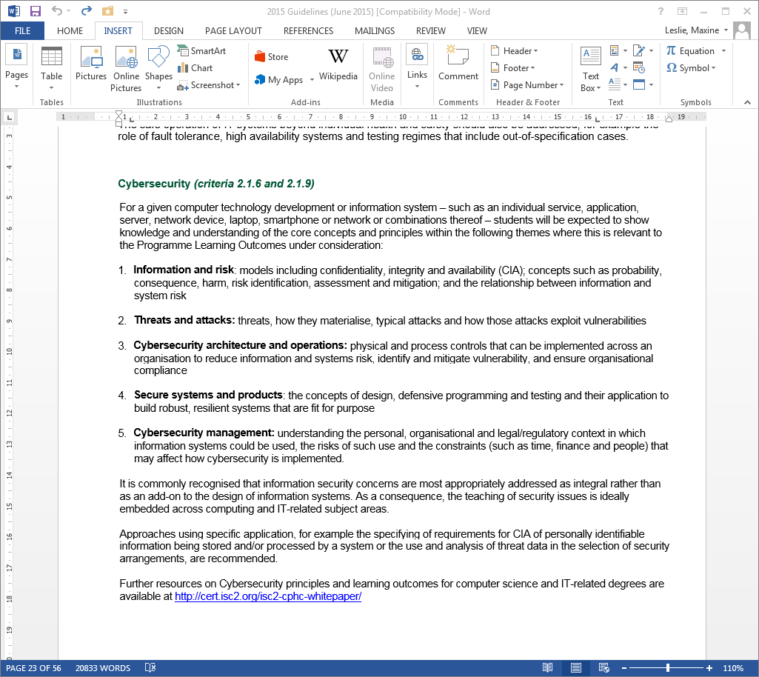
Cybersecurity changes to BCS Guidelines
From:
BCS Guidelines on course accreditation
(June 2015) page 23

Slide 19
Impact?
Embedded within existing modules?
Topic areas that will be core?
Staged change over time?
Resources?
Development of teaching staff?
What does success look like?

Slide 20
Process...
2014-2015
2016
2017
Series of inclusive workshops
Roadshow of 9 workshops, 66 Universities and 115 academics
Communities of Practice
Roadshow identified a huge wish list….

Slide 21
What do you need?

Slide 22
What can you bring to the next meeting?

