Slide 1


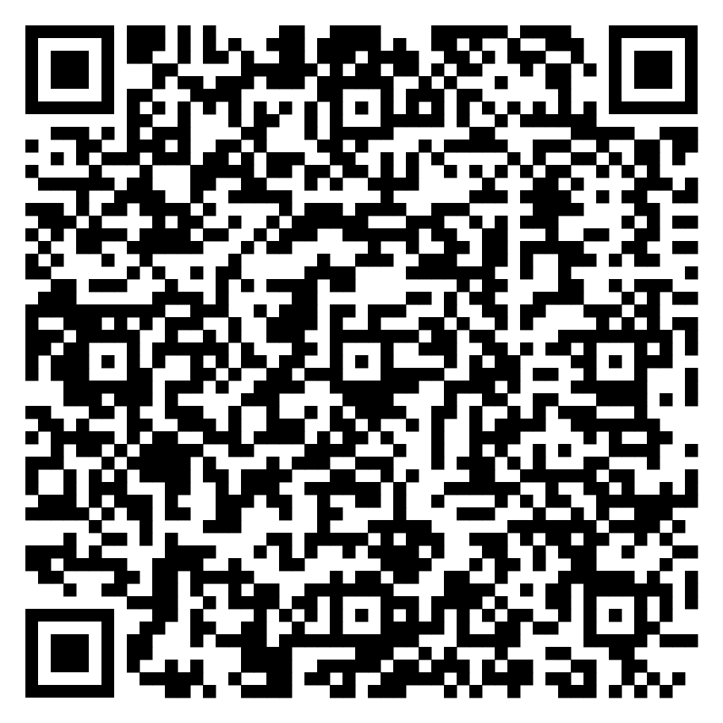
MTA_Team

Slide 2

Introduction
Avoid burnout
Aplicable for corporate & not only
Benefits

Slide 3
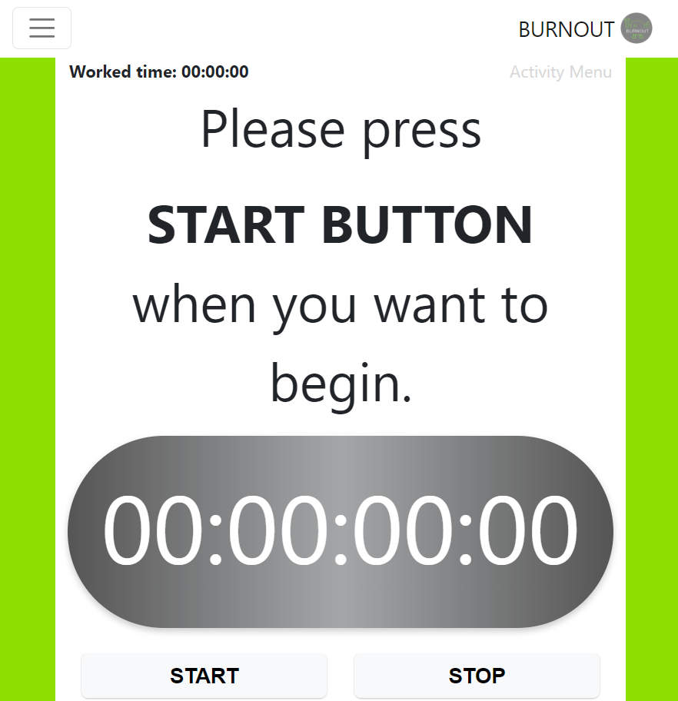
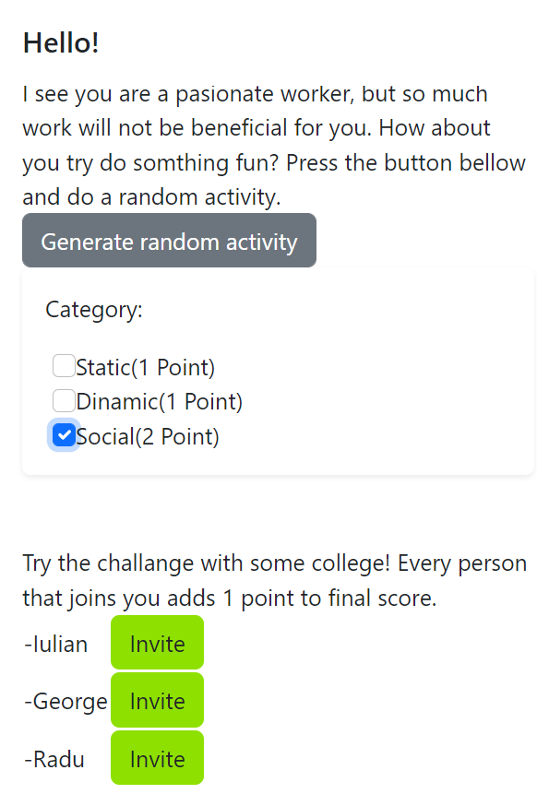

Slide 4
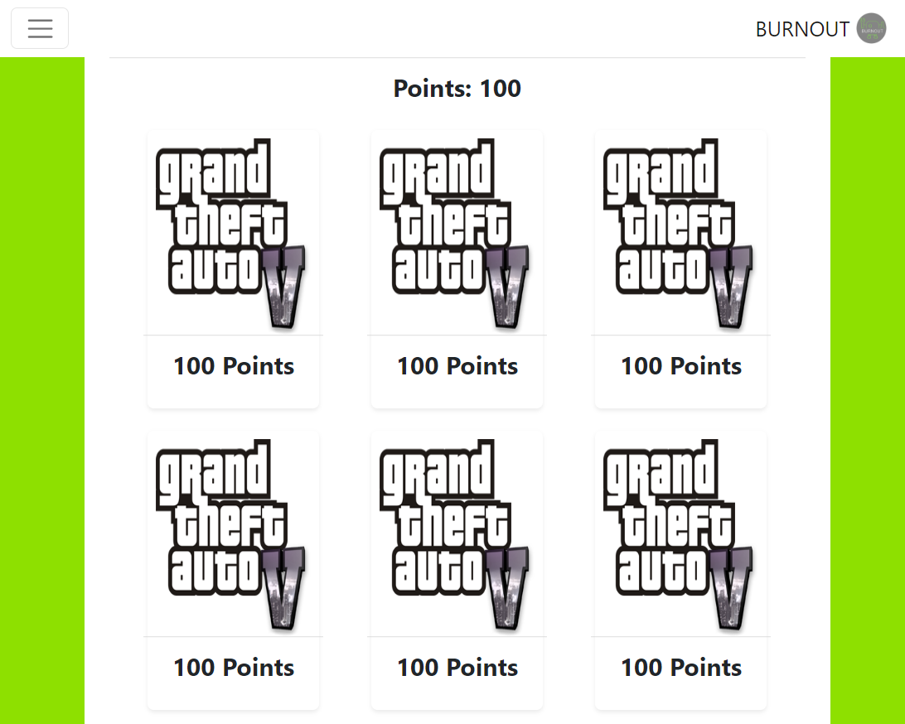
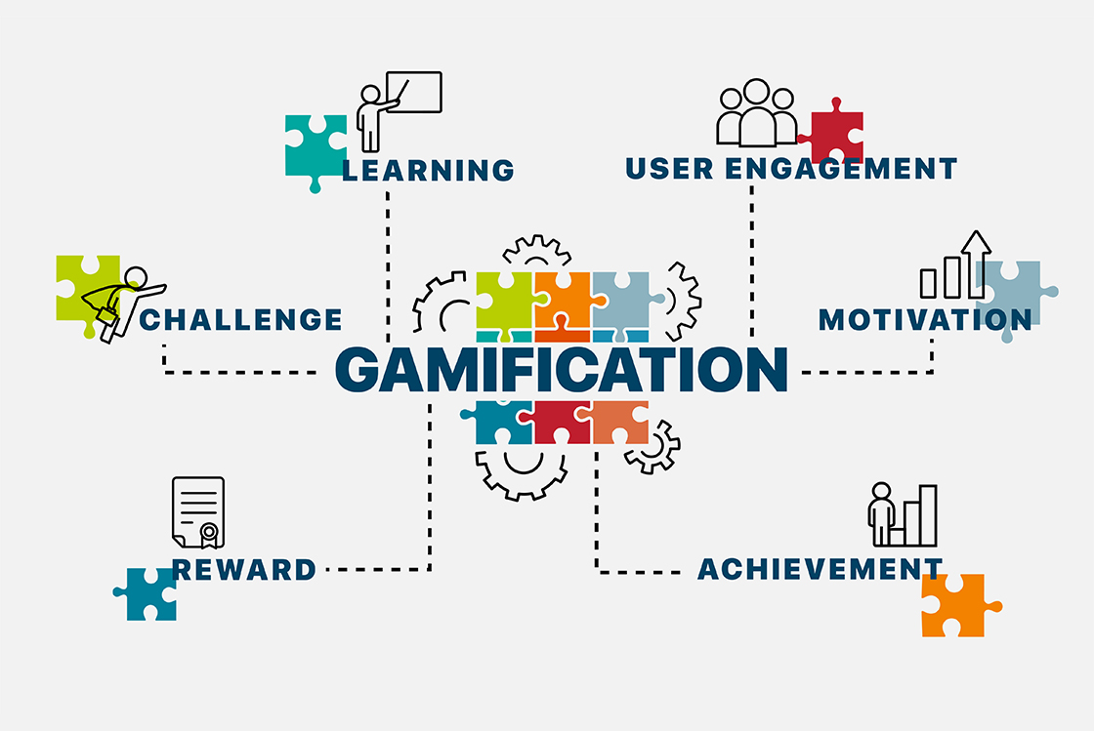
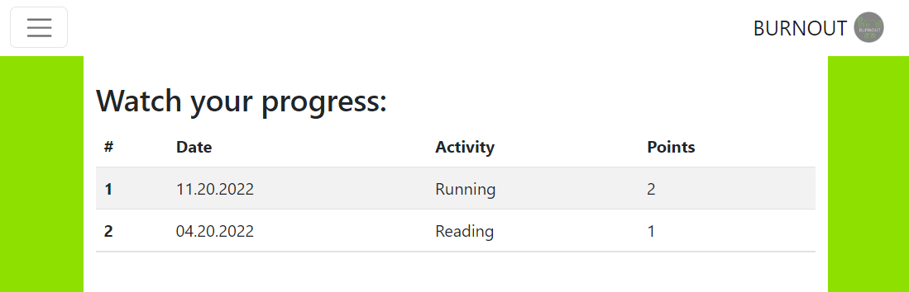

Slide 5

What does our application do exactly
Time management
Regulars Breaks
A break = a challenge
Team Challenges
https://youtu.be/UJiwIxTTaYM

Slide 6



How we implemented the solution:
Backend: , REST Api
Frontend: Angular

Slide 7

Thank You
Your health above all.

