Slide 1
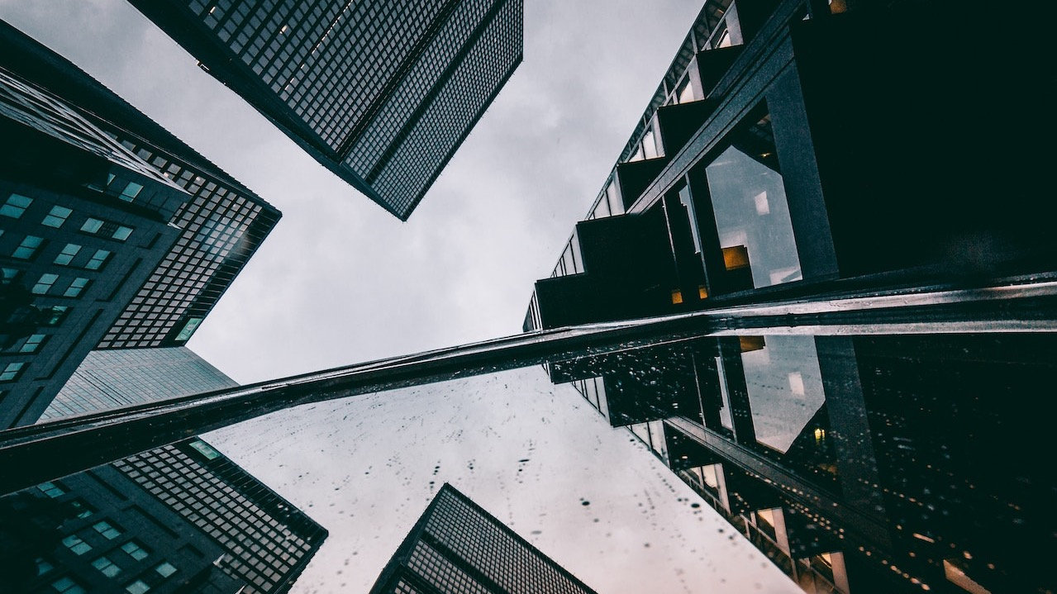

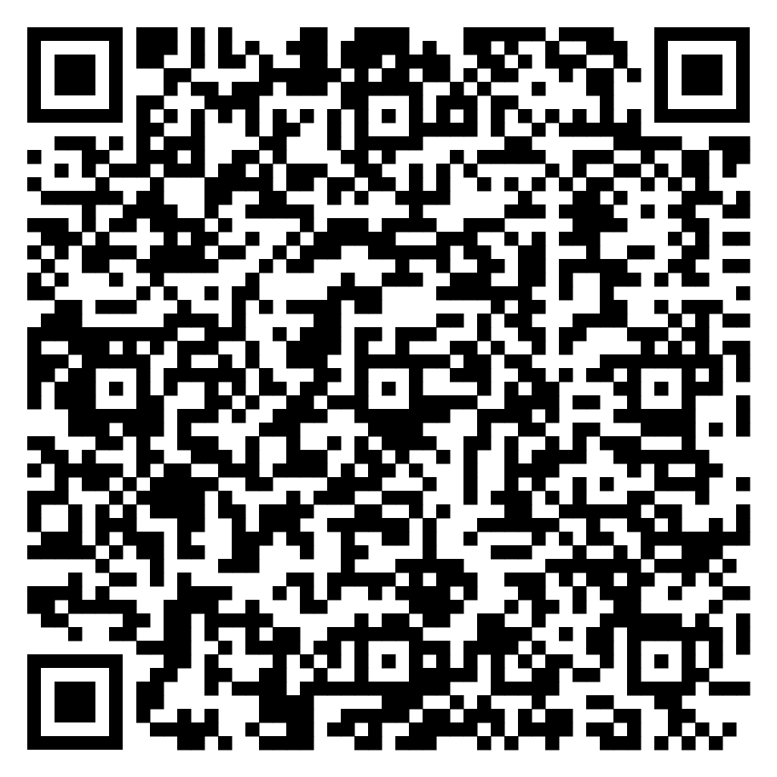
Download app:
MTA_Team

Slide 2

Introduction
Avoid burnout
Aplicable for corporate & not only
Benefits

Slide 3
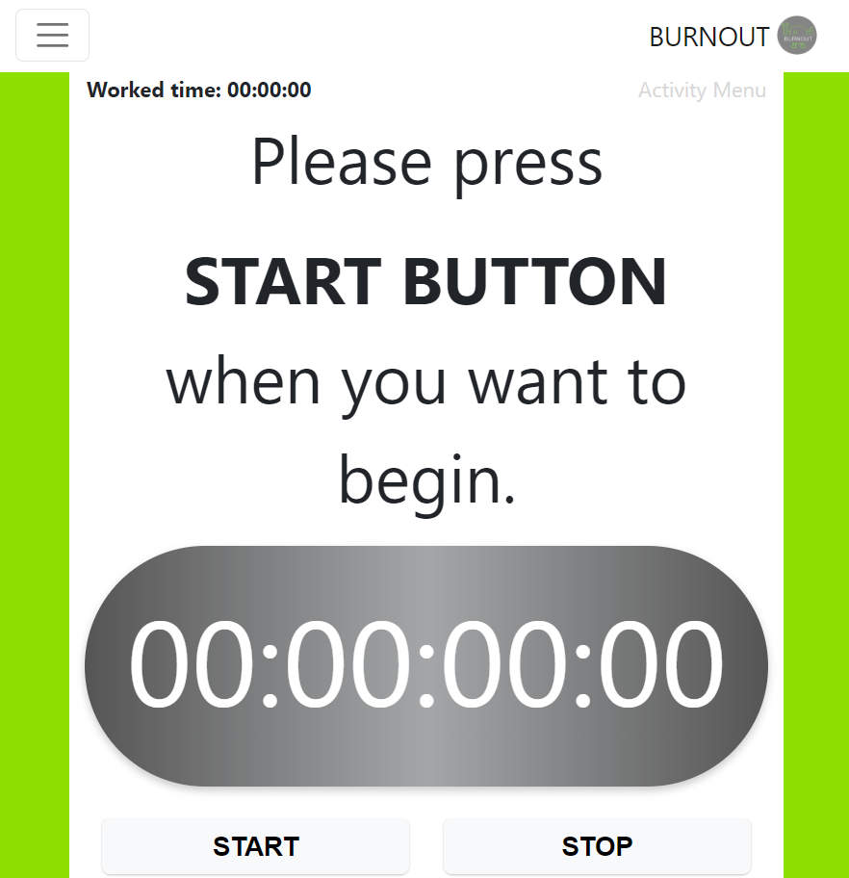
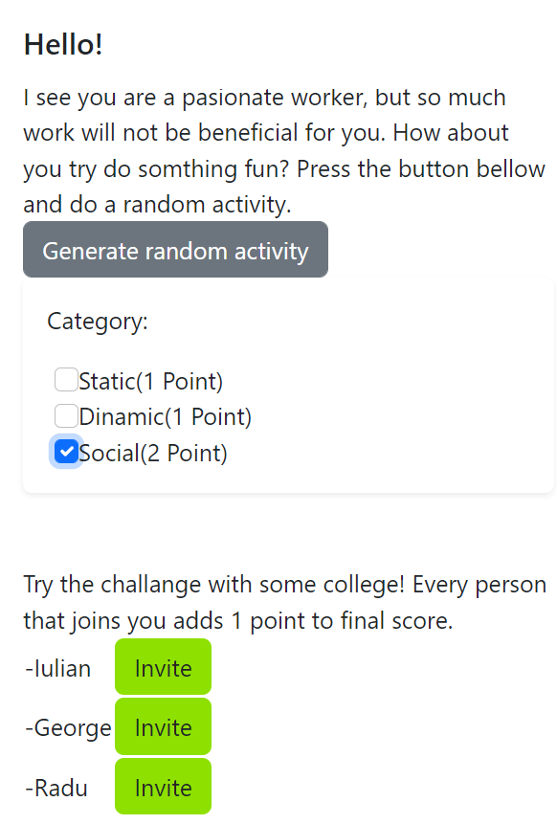

Slide 4
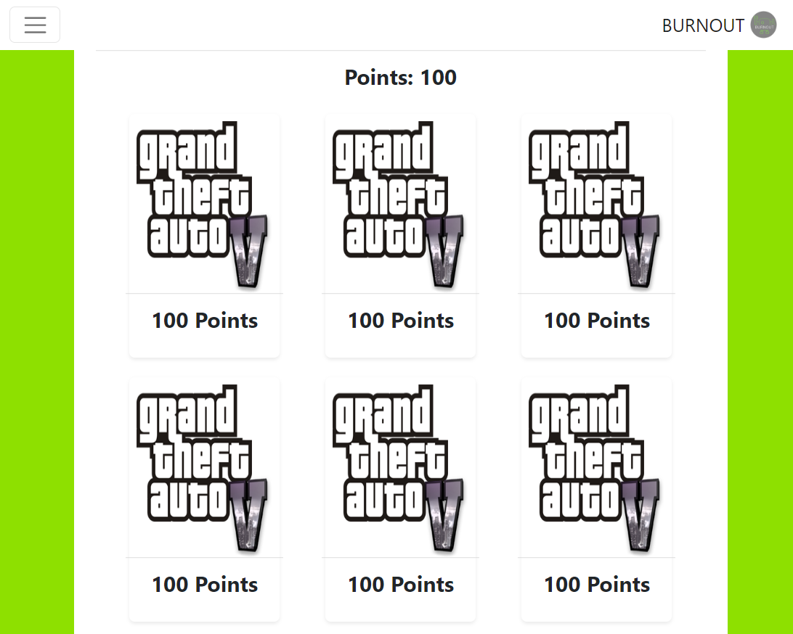
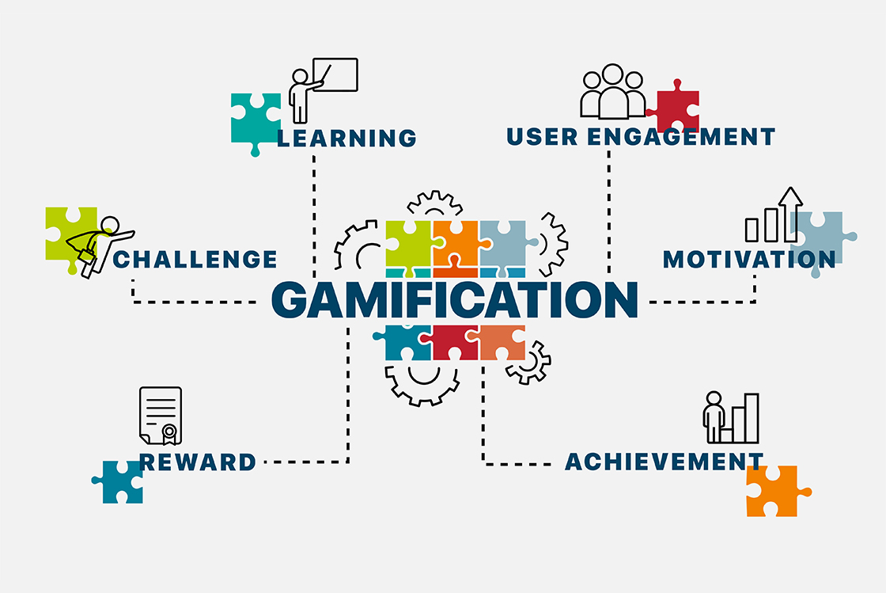


Slide 5
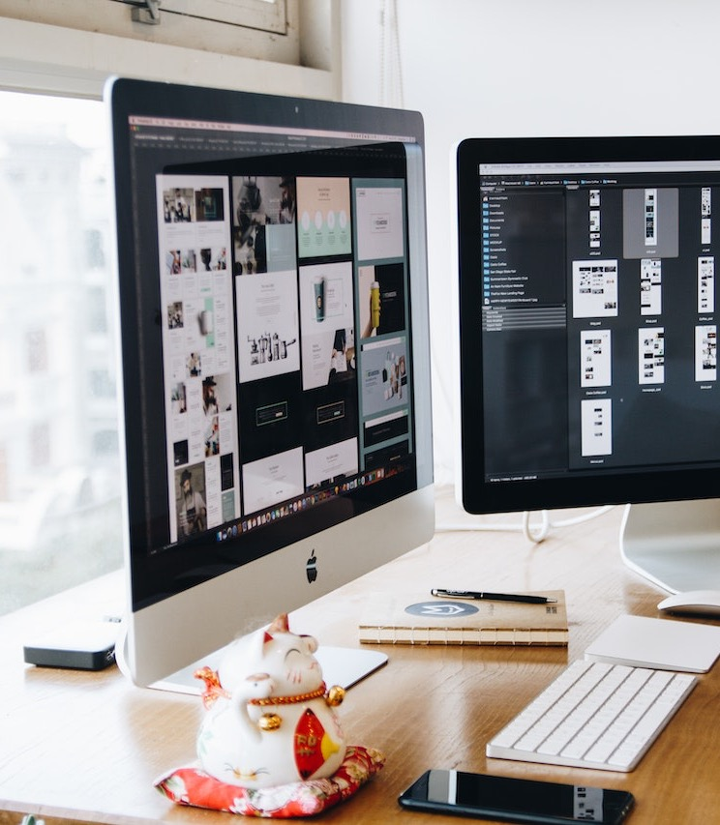
What does our application do exactly
Time management
Regulars Breaks
Game mechanics
Team challenges
https://youtu.be/UJiwIxTTaYM

Slide 6
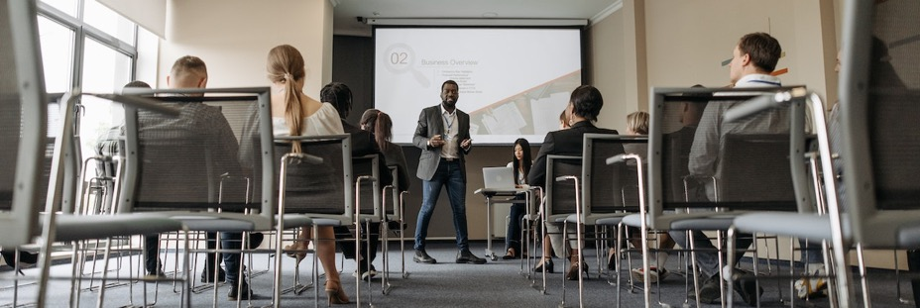




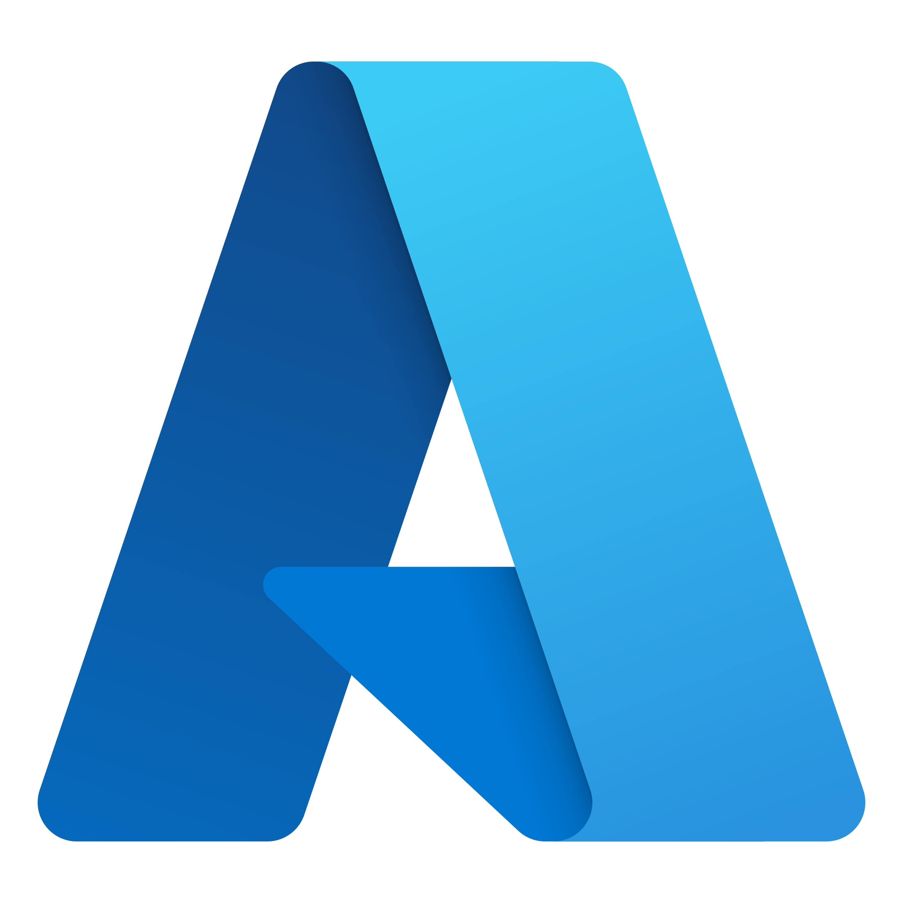

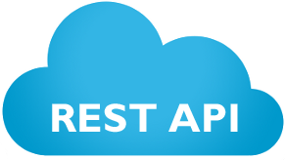

How we implemented the solution:

Slide 7

Thank You
Your health above all.

