Slide 1


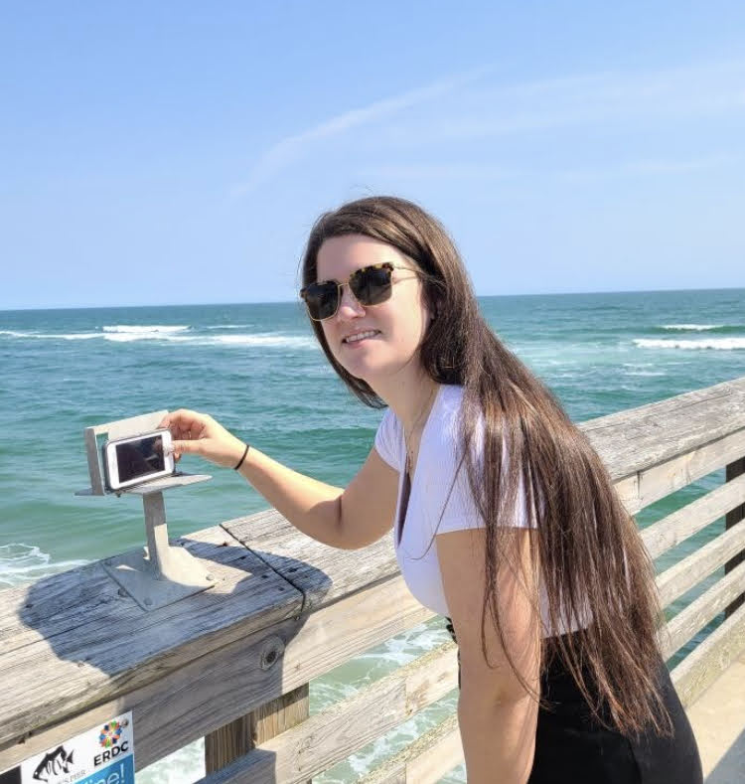
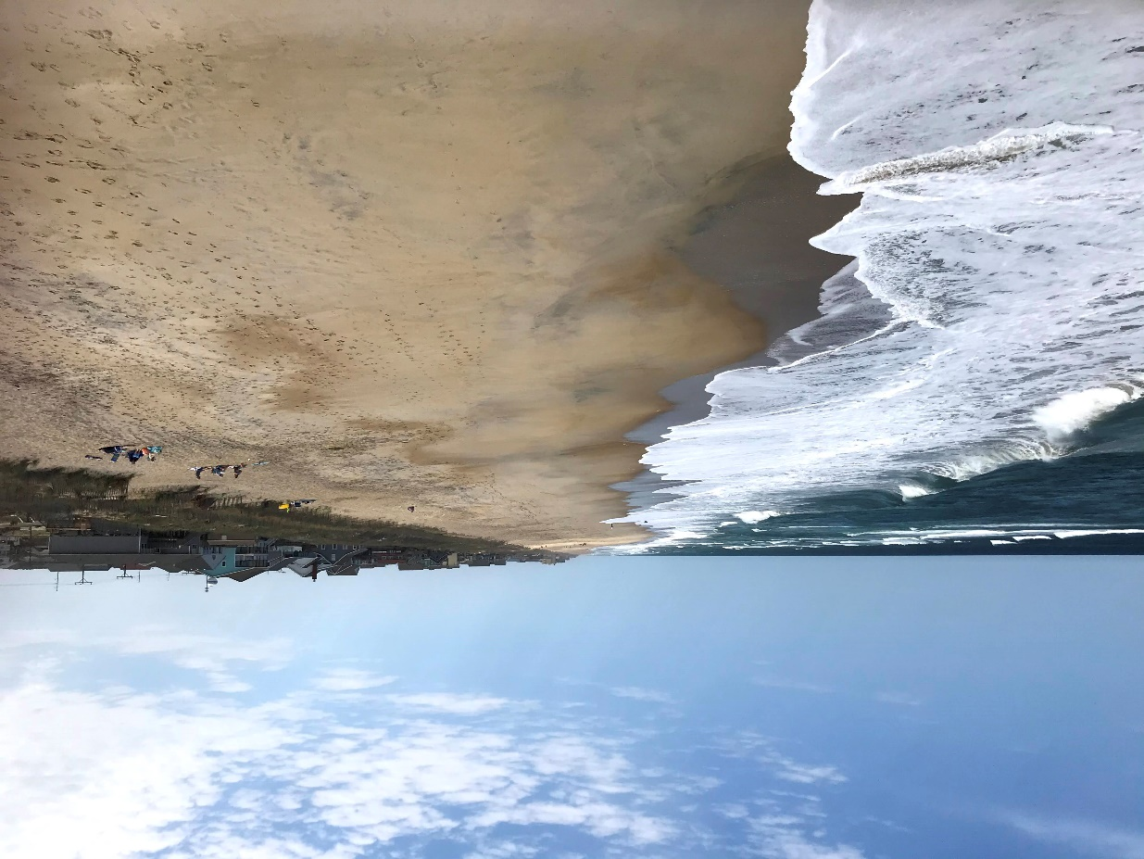
1
We need your photo!
To start, open your camera and scan this:
2
Place your phone on the metal mount, snap your photo and submit!
3
We track the change in the shoreline
over time using the public’s photos!
QR CODE
Share on social media using #CoastSnapXX
Or
Stay engaged at: insert website
or CoastSnap App
What is CoastSnap?
CoastSnap harnesses the power of the public to record short and long-term beach erosion and recovery. Photos you upload are reviewed by researchers from the U.S. Army Corps of Engineers Coastal & Hydraulics Laboratory (Field Research Facility in Duck, NC). You can view submitted images on the (insert website).
How does it work?
Images are analyzed using markers along the beach to precisely measure shoreline location on any given day. These photos can be compiled to produce time-lapse videos that capture shoreline position and beach width as it evolves through time.
Why (insert beach)?
The shape, location and nature of (insert beach) makes it susceptible to shifting sands and shoreline changes. CoastSnap will help us better understand these processes and contributing factors.
Partnered
with:
Notes:
2nd panel could be screenshot of phone screen from QR co, arrow to "take" or box,then panel 3 is zoomed out of someone actively taking photo

