Slide 1
Bulk RNA-seq: From Reads to Results
Designing experiments and reading the output
Savannah Mwesigwa | 20 November 2026
Notes:
Welcome.
No bioinformatics experience needed. Everything runs in RStudio on a laptop, and all the material stays with you afterward.
The part I most want to land is the design section. Most of what makes RNA-seq data analyzable is decided at the bench, before anything is sequenced, and some of it cannot be fixed afterward by any amount of statistics.
We will also find a real problem in a published dataset that the authors did not report.

Slide 2
What happens in this hour
Minutes | What | Where
0 - 5 | Background: what RNA-seq measures | Slides
5 - 20 | Designing the experiment | Slides
20 - 30 | Counts, normalization, the statistics | Slides
30 - 55 | A worked analysis, start to finish | RStudio
55 - 60 | Questions
You do not need to follow along live. Everything is in the repository and stays yours.
Notes:
Say the shape of the hour out loud so nobody is wondering what they joined.
The design section gets the most time deliberately. It is the part you control and the part that cannot be fixed later.
Then read out the box, and mean it. Over Zoom, the thing that derails a session is six people quietly stuck on an error while the rest move on. Nobody has to keep up. The document is public and runs on any laptop.
Questions in chat at any point - someone is watching it.

Slide 3
Today's dataset
Human NK cells from healthy donors
Five conditions, three biological replicates each
Public data: GEO accession GSE191074
NK alone
NK + PGE2
NK + K562
NK + AML
blasts
NK + blasts
+ K562
15 samples. Every condition appears once in each replicate batch.
Notes:
NK cells from healthy donors, split five ways, three biological replicates each.
These five arms are not a list of treatments. Each one answers a specific question:
NK alone is the baseline. NK plus PGE2 asks whether the soluble factor alone suppresses NK cells. NK plus K562 is the positive control - K562 is the classic NK target, so this asks whether the response works at all. NK plus AML blasts asks whether blasts activate NK cells. And the last arm is the key experiment: K562 normally triggers a response, so can blasts suppress it?
Worth pointing out as an example of good design before we get to the design section.
Also flag: later today we find something in this data the authors did not report.

Slide 4
What RNA-seq measures
More RNA in the cell means more reads
We count reads landing in each gene
One question drives everything today
Which genes changed between conditions?
Cells
RNA
Sequencer
Counts
Notes:
If a gene is switched on, the cell makes more of its RNA. More RNA means more fragments get sequenced, so more reads land on that gene.
A read count is therefore a rough proxy for how active a gene was. Rough is carrying weight there - several things other than biology change that number, and separating those out is most of what today is about.

Slide 5
Library preparation
polyA selection
keeps mRNA only
Fragment
Copy to cDNA
Ribo-depletion
removes rRNA, keeps the rest
Attach adapters
Amplify
About 85% of cellular RNA is ribosomal, which is why selection exists.
Use the same prep for every sample in a comparison.
Notes:
Most RNA in a cell is ribosomal, which is structural and usually not what you want. Two ways to deal with it.
polyA selection grabs RNA with a polyA tail, which is mostly mRNA. Clean, cheap, standard. Loses anything without a tail, and performs badly on degraded RNA.
Ribo-depletion removes ribosomal RNA specifically and keeps everything else, including non-coding RNA. More expensive, better for degraded or FFPE samples.
Adapters, in the right-hand column, are short known sequences attached to each fragment so the sequencer can grab hold of it.
Why this is on a design slide: your prep decides what you can detect at all. Want long non-coding RNA and ran polyA selection? It is not recoverable.
And use one prep across a comparison. Mixing preps creates differences that have nothing to do with biology.

Slide 6
The RNA-seq workflow
AT THE BENCH
THE PIPELINE
THE ANALYSIS
Experimental design
Quality control
Normalization
Library prep
Align to genome
Sample checks
Sequencing
Count per gene
Differential expression
Pathway analysis
Bold = covered today. Greyed = automated or out of scope.
Adapted from Conesa et al., Genome Biology 2016 (CC BY 4.0)
Notes:
The whole landscape, so you can see where today sits.
At the bench: design, library prep, sequencing. Design and prep are yours, and the next section is almost entirely about design because that is where the irreversible decisions are.
The pipeline: quality control, alignment, counting. This lab runs nf-core/rnaseq. Worth understanding, but you will not operate it. Default output paths are in the appendix.
The analysis: normalization, checking the samples, testing for differences. That is the second half of today.
The greyed boxes are not unimportant - they are either automated or need more time than we have. Pathway analysis is a session of its own.

Slide 7
What else bulk RNA-seq can answer
Question | What it tells you | What it needs
Differential expression | Which genes change | 3+ replicates per group
Gene set / pathway | Which processes change | A ranked gene list
Alternative splicing | Which isoforms change | Paired-end, deeper coverage
Allele-specific expression | Cis effects, imprinting | Genotypes for each donor
Gene fusions | Fusion transcripts | Paired-end, dedicated callers
Deconvolution | Cell type proportions | A reference signature
eQTL mapping | Variants driving expression | Genotypes + hundreds of samples
Today is the first row. Several of the others need decisions made before sequencing.
Notes:
Keep this fast - twenty seconds. It is a menu, not a lesson.
The third column is the point. Paired-end reads means sequencing both ends of each fragment, which you have to ask for up front. Splicing and fusions need it. Splicing also needs more depth. Allele-specific expression and eQTL need genotypes for every donor, so they have to be planned from the start.
Deconvolution is worth a mention for this lab - estimating what mixture of cell types produced a bulk sample. Same machinery as the contamination check later.
None of these can be retrofitted. If you want one, say so at the design stage.

Slide 8
Experimental design
Everything here happens at the bench
No analysis can fix these afterward
Notes:
This is the section that matters most.
Some decisions arrive at the analysis stage already baked in, and a few cannot be undone by any statistical method.
Five things: what counts as a replicate, how many you need, what confounding is, how to avoid it, and what comparison you are actually running.

Slide 9
What counts as a replicate
Three biological replicates
One donor, three wells
Donor 1
Donor 2
Donor 3
Donor 1
n = 3
n = 1
Only biological replicates support a claim about biology
Three wells from one donor share everything about that donor
Few donors available? Make it paired, and model the donor
Notes:
This distinction causes more confusion than anything else in experimental design.
A biological replicate is an independent instance of what you are studying: a different donor, animal, or separately started culture.
A technical replicate is the same material measured twice. It tells you how reproducible the machine is, which with modern sequencing is very, so they are almost always unnecessary.
Here is the trap on the right. Three wells from the same donor, treated separately, feel like three replicates. Statistically they are closer to one, because they share that donor entirely. Analyze them as three and the p-values are too optimistic, and the result may not replicate.
Third bullet is the real-world case. Donor material is often scarce. The answer is not to pretend wells are donors. It is to make the design paired - every donor sees every condition - and tell the model about the donor. Each donor then acts as their own control, which is far more powerful than extra wells.
If you have several wells per donor per condition, sum them, or ask us about modelling the correlation properly. What you must not do is feed them in as if independent.

Slide 10
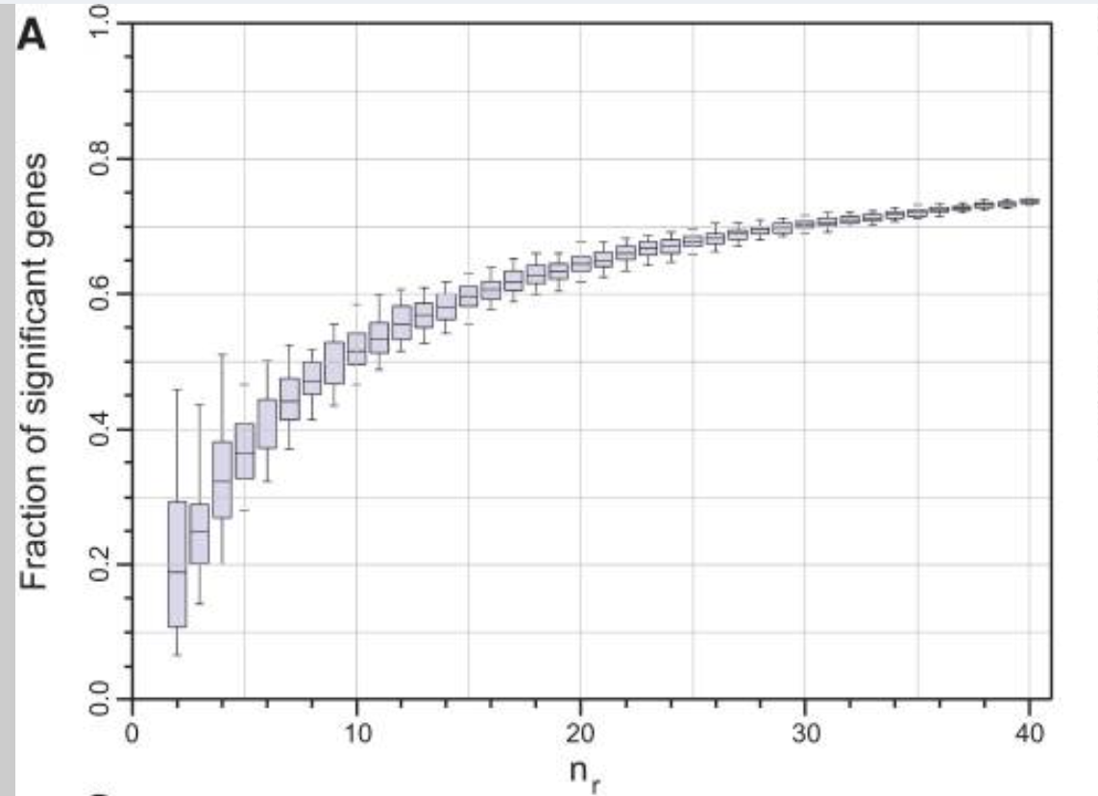
How many replicates?
Three per group is the practical minimum
Two cannot separate real change from noise
3 to 6 replicates nearly doubles what you find
Spend a fixed budget on samples, not depth
20-30M reads per sample is plenty for
standard differential expression
Schurch et al., RNA 2016 (CC BY 4.0)
Notes:
Three is the floor. Below three you cannot estimate variability at all, and without that there is no test. With two, if the numbers differ you cannot tell whether that is the treatment or noise.
The figure comes from a study that sequenced 48 biological replicates of yeast, then asked what happens if you use only some of them. Y-axis is the fraction of genes detected as significant.
Read the numbers off: about 25% at three replicates, 42% at six, 52% at ten, 73% at forty. So detection improves steeply at first and with diminishing returns after, but it never really plateaus. Going from three to six nearly doubles what you find.
That is a more honest message than "three is enough". Three is where the statistics start working, and it finds roughly a third of what forty finds.
Two caveats. The y-axis is the fraction of all genes called significant - this is yeast wild-type against a deletion mutant, where a lot genuinely changes. And it is yeast: human donors vary far more, so the equivalent human curve would be lower and shallower. Human experiments need more replicates, not fewer.
On budget: deeper sequencing measures the same biological sample more precisely, but your uncertainty is dominated by variation between individuals. More depth does not reduce that. More samples does.

Slide 11
Confounding
All controls processed Monday. All treated samples processed Tuesday.
Monday
Tuesday
Control 1 Control 2 Control 3
Treated 1 Treated 2 Treated 3
Day and treatment now carry identical information
A difference could be the drug, or could be Tuesday
No statistical method can separate them
Notes:
The most damaging design error, and easy to make because it feels organized.
Twelve samples. Tidy to do all the controls on Monday and all the treated ones on Tuesday. Same person, same protocol.
What goes wrong is that "control" and "Monday" are now the same variable. If the reagent lot changed, the incubator ran warm, or the cells were a passage older, that difference lands entirely on one group.
At the analysis stage we see a difference between groups and cannot tell you whether it is the treatment or the day. Nothing in the data distinguishes them. The information is not there.
Say this plainly: contamination can usually be worked around, batch effects can be modelled if the structure exists, confounding has no fix.
Same applies to sequencing runs, extraction kits, operators, and anything else that lines up perfectly with your conditions.

Slide 12
Blocking and balance
Process one of each condition in every batch.
Monday
Tuesday
Control 1 Treated 1
Control 2 Treated 2
The day effect now hits both groups equally
It can be estimated and removed
Record which batch each sample came from
In our dataset this gave 25% more significant genes
Notes:
Spread each condition across every batch, so whatever varies between days affects all groups equally. The day effect becomes something that can be estimated and subtracted, rather than something tangled up with the treatment.
This costs nothing. Same samples, same reagents, same number of days. Only the grouping changes.
One requirement: write down which batch each sample came from. A model can only use structure it is told about. Block properly but lose the record and the benefit goes with it.
Concretely: in the dataset we use today, replicates were processed in matched sets. Telling the model about that took one word in the formula and gave about 25% more significant genes from identical data. We will see that number later.

Slide 13
Draw your samples as a grid
Two groups
Paired or blocked
Control
Treated
Control
Treated
Donor 1
Donor 2
Donor 3
Two factors, or an interaction
Confounded: nothing can be estimated
Vehicle
Drug
Vehicle
Drug
Wild type
Wild type
Knockout
Knockout
Every factor is an axis. Empty cells are comparisons you cannot make.
Notes:
A usable procedure: before you start, draw the grid. One axis per factor, one dot per sample. Then check every cell has something in it.
Top left: two groups. One factor, two levels, three samples each.
Top right: paired or blocked. Rows are donors or batches, and every donor appears in both conditions. Much more powerful than two independent groups, because each donor is their own control and donor-to-donor variation drops out. If you can design it this way, do.
Bottom left: two factors. Genotype and drug. All four cells filled, so you can ask about each factor separately and also whether the drug behaves differently in the knockout - that is the interaction. Flag this: interactions need substantially more samples than main effects, and this is the most common reason an experiment comes back underpowered. Three per group is usually not enough.
Bottom right is the same experiment, confounded. Wild type only ever got vehicle, knockout only ever got drug. Two cells empty. You cannot separate genotype from drug, because no sample exists where one varies and the other does not.
That is the Monday-Tuesday slide again, as a picture. Confounding is unfilled cells.
The formulas for each of these are in the appendix.

Slide 14
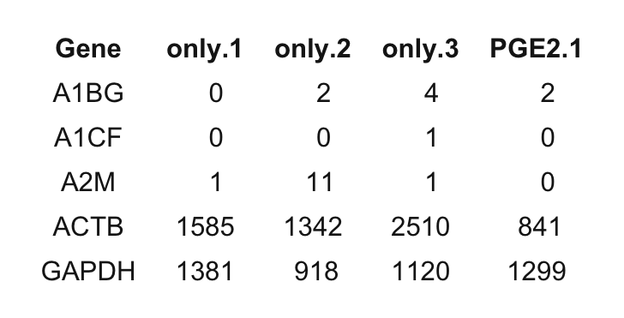
The count matrix
Rows are genes, columns are samples
Here: 35,598 genes by 15 samples
Each number is a raw read count
Not expression yet, just counts
Notes:
The object everything downstream is built on. Genes down the side, samples across the top, a read count in every cell.
Point at one cell: that number is how many reads landed in that gene in that sample. Not a concentration, not a fold change, not normalized.
35,000 rows sounds like a lot, but most are near zero in any given experiment - genes not expressed in this cell type. Those get filtered out before testing.
If you get one file from a sequencing core, this is usually it. Alongside it should go a sample sheet saying what each column is: condition, batch, donor, sex, anything else that varied.

Slide 15
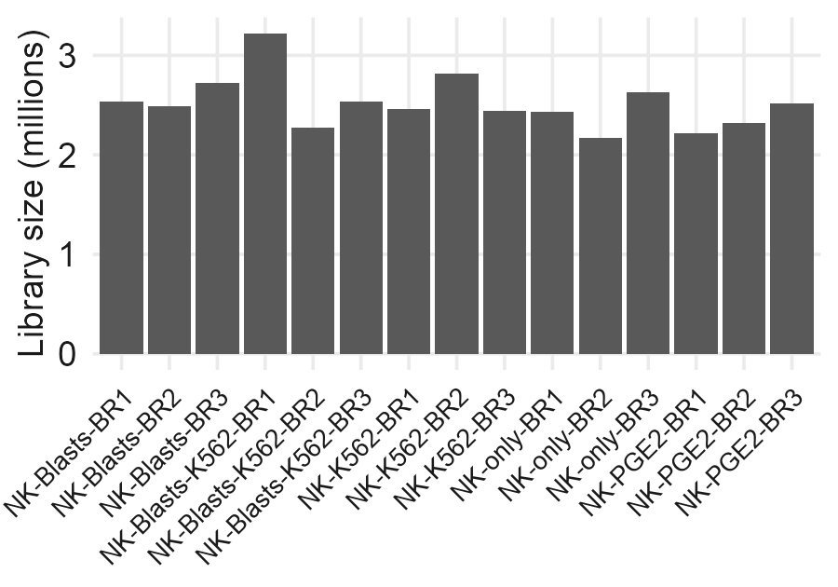
Why raw counts are not comparable
Deeper-sequenced samples get bigger numbers
Longer genes collect more reads
Neither of these is biology
Both must be handled before comparing
Notes:
Two problems, and they are different from each other.
Sequencing depth: if one sample got thirty million reads and another fifteen, every gene in the first looks twice as high. That is the machine.
Gene length: a gene twice as long produces roughly twice as many fragments at the same expression level, so you cannot compare gene A to gene B by raw count.
These matter in different situations. Comparing the same gene across samples needs only the depth fix. Comparing different genes within a sample needs the length fix too.
The bar chart is our real data - say the range out loud, since the axis will be small on screen.

Slide 16
CPM, RPKM, FPKM and TPM
 | Depth | Length | Use it for
Raw counts | no | no | DE testing - the tool corrects depth itself
CPM | yes | no | Filtering, QC plots
RPKM / FPKM | yes | yes | Legacy, avoid
TPM | yes | yes | Genes within a sample
Never hand DESeq2 a TPM table.
A count of 5 is noisy; a count of 5,000 is not. That is information the model uses. Normalize first and every gene looks equally reliable.
Notes:
These all make counts comparable, and differ in what they fix.
CPM divides by library size only. Fixes depth, not length. Good for filtering and plots.
RPKM and FPKM divide by depth and gene length. FPKM is the paired-end version. Real flaw: the totals differ between samples, so the same number means different things in different samples.
TPM does the same two divisions in the opposite order, which fixes that. Every sample sums to the same total. Formulas are in the appendix.
Now the top row, which looks contradictory with the previous slide. We just said raw counts are biased by depth, and here raw counts are what you use for testing.
Resolution: DESeq2 and edgeR do correct for depth. They do it internally, as part of the model, and they need the raw numbers to do it. You hand over the count and the library size and the tool uses both.
Pre-divide and you have thrown away the library size and handed over a decimal that no longer records how many reads backed it. A CPM of 10 could be 5 reads out of 500,000 or 500 out of 50 million. The tool cannot tell, so it trusts both equally. They are not equally trustworthy.
So: do not correct for depth yourself. Hand over counts and let the model do it.

Slide 17
Normalization
 | Sample A | Sample B
Gene A | 250,000 | 700,000
Gene B | 250,000 | 100,000
Gene C | 250,000 | 100,000
Gene D | 250,000 | 100,000
Total reads | 1,000,000 | 1,000,000
Red = gene A. Same library size, bigger slice.
Only gene A changed, but B, C and D look 2.5-fold down. Both libraries are the same size, so CPM does not fix this.
Size factors assume the median gene does not change, so increases and decreases balance out.
Notes:
Subtler than depth, and the reason normalization is not just dividing by the total.
Both samples got exactly one million reads. In sample B, gene A has been switched on hard and now takes 70% of the library.
Genes B, C and D have not changed at all in the cell. But the library is a fixed size, so they get a smaller slice: 250,000 down to 100,000. A 2.5-fold apparent drop, entirely artefactual.
And here is the part that makes it click: CPM does not help. Both libraries are one million, so dividing by library size changes nothing. Depth correction is the wrong tool because depth is not the problem.
What size factors do: notice that most genes moved down by the same factor, conclude the composition shifted rather than everything genuinely decreasing, and rescale.
Now the assumption, which is worth being precise about. It is not that few genes change. DESeq2 uses the median ratio across genes, so it tolerates a great deal of change as long as increases and decreases roughly balance. Thirty percent of genes up and thirty percent down is fine.
What breaks it is a one-directional shift. Myc amplification genuinely raises most of the transcriptome. The method cannot distinguish "everything went up" from "everything else got squeezed", so it silently normalizes the real effect away. That is when you need spike-ins.
Two different situations worth separating. A few dominant genes - globin in whole blood can be 50 to 80 percent of reads, immunoglobulin in plasma cells 30 to 50 - and normalization handles those fine, because the median gene is still unchanged. A global shift is the one that defeats it.
And the quantity that matters is how much of the library changed hands, not how many genes. One gene going from 1 percent to 40 percent squeezes everything else by 40 percent. One gene going from 1 to 2 percent does nothing anyone would notice.
If you expect one transcript to dominate, say so at the design stage.

Slide 18
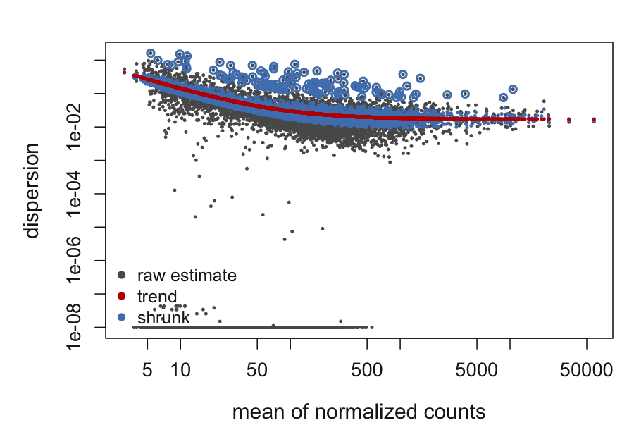
Estimating variance from three replicates
Sometimes three replicates land close by luck
That gene then looks implausibly consistent
Genes at similar levels behave similarly
So borrow information across all genes
This is the key idea in the whole field
Grey = that gene alone. Red = the trend. Blue = what the model uses.
Notes:
If one statistical idea survives the hour, this is it.
To test whether a gene changed you need to know how much it varies between replicates. With three, that estimate is terrible.
Specifically: sometimes three replicates land almost on top of each other purely by chance. That gene then looks measured with near-perfect precision, and any group difference looks hugely significant. Every one of those is a false positive waiting to happen.
The solution every tool uses: you have twenty thousand genes, and genes at similar expression levels tend to have similar variability. So pull each gene estimate toward the overall trend.
On the figure: each dot is a gene, and every gene appears twice. Grey is its own noisy estimate, red is the trend across all genes, blue is the final value the model uses.
Point at the grey dots strung along the bottom. Those are the unlucky ones - replicates that landed almost identically. Shrinkage pulls them all the way up to the blue band. That jump is the whole idea in one picture.
The circled blue points above the line are the opposite: genes genuinely more variable than the trend. Those are deliberately not shrunk down, because being conservative about noisy genes is safer.
This is why RNA-seq works with three replicates, and why you should not analyze it with a t-test per gene in a spreadsheet.

Slide 19
Adjusted p-values
At p < 0.05, about 1,000 genes look significant by chance
Even if nothing is happening at all
So we report adjusted p-values instead
In DESeq2 output the column is padj
Never filter on the raw pvalue column
padj < 0.05 means about 5% of the genes you call significant are expected to be wrong.
Notes:
Every gene is tested separately, so twenty thousand tests on one dataset.
A p-value of 0.05 means a one in twenty chance of seeing this by accident. Twenty thousand tests, and roughly a thousand genes clear that bar with nothing going on.
So we adjust. The standard method controls the false discovery rate: rather than asking about each test individually, it controls the proportion of the final list that is wrong.
Read the box out. Five percent of a list of a thousand is fifty genes that are not real. Not zero. That is why you validate the ones you care about.
Two columns in DESeq2 output, pvalue and padj. Always padj. A paper reporting raw p-values across twenty thousand genes is worth being suspicious of.

Slide 20
Now the analysis
Switching to RStudio
Nothing to install, nothing to keep up with
Notes:
Switch to RStudio now.
Repeat the framing: I am driving. Have it open if you like, but nobody needs to keep up. The document is public, it runs on any laptop, and it is yours.
Order: check the samples first, then a clean comparison, then whether what we found in the checks actually mattered, then whether the design was worth it.
Everything is pre-computed, so nothing takes more than a few seconds.

Slide 21
What to take away
Block and balance. Confounding has no fix afterward.
Three biological replicates minimum, and more beats deeper
Record batch, donor and sex in the sample sheet
Look at the samples before looking at the results
Use counts, not TPM
Blocking gave 25% more genes here, from one word
Notes:
Six things.
Spread conditions across batches, days and operators. The one that cannot be fixed afterward, and it costs nothing to get right.
Three biological replicates is the floor. Spare budget goes on samples before reads.
Write down the structure and keep it with the data. A model can only use what it is told about.
Run the sample checks before getting attached to a result. Sex genes and marker panels take five minutes and we found real contamination with them today.
Counts, not TPM.
And the number worth remembering: one word in the formula, 25% more significant genes, identical data. That is what a well-designed experiment buys you.

Slide 22
Data credit
All data from GEO accession GSE191074
Generated and deposited by the study authors
Reused here under public data reuse terms
Rothfuss C, Baumann T, Donakonda S, et al. Two-layered immune escape in AML is overcome by Fc-gamma receptor activation and inhibition of PGE2 signaling in NK cells. Blood 2025;145(13):1395-1406.
The contamination shown today is a normal technical feature of co-culture work, not a criticism.
Notes:
None of this data is ours. It was generated, paid for and deposited by another group, and made public so others can reuse it. Worth saying out loud, because it is the reason a tutorial like this is possible.
Their finding, which we recovered blind in the analysis, is that AML blasts produce PGE2 which raises cAMP in NK cells and shuts down their cytokine production. CREM is the marker of that, and it came out third in our ranked list.
Say the last line. The carryover is normal in co-culture work and not a criticism.

Slide 23
Where to go next
Everything from today
github.com/savannahmwesigwa/bulk-rnaseq-course
The practical, readable
savannahmwesigwa.github.io/bulk-rnaseq-course
DESeq2 vignette
bioconductor.org/packages/DESeq2
Design matrices guide
f1000research.com/articles/9-1444
nf-core/rnaseq docs
nf-co.re/rnaseq
Bioconductor support
support.bioconductor.org
Talk to us at the design stage. Or run it yourself: the data and the code are in the repository.
Notes:
The repository has everything from today. The second link is the practical rendered as a web page, so it can be read without running anything.
The DESeq2 vignette is the best next thing to read - written for biologists, walks through a complete analysis.
The design matrices guide is the one to bookmark given the first half of today. Paired samples, time courses, interactions - where most people get stuck.
And the box. A conversation before reagents are ordered is worth more than anything that can be done after the fact. But also: this is all runnable, the data is public, and nothing about it requires us.

Slide 24
Questions
gushijima@mdanderson.org
github.com/savannahmwesigwa/bulk-rnaseq-course
savannahmwesigwa.github.io/bulk-rnaseq-course
Notes:
Leave this up during questions so the links stay on screen.
If the room is quiet, seed it: ask whether anyone has an experiment coming up and what the design looks like. That usually starts something.

