Slide 1


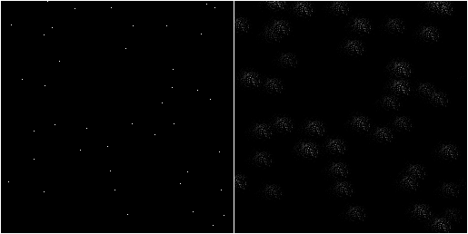
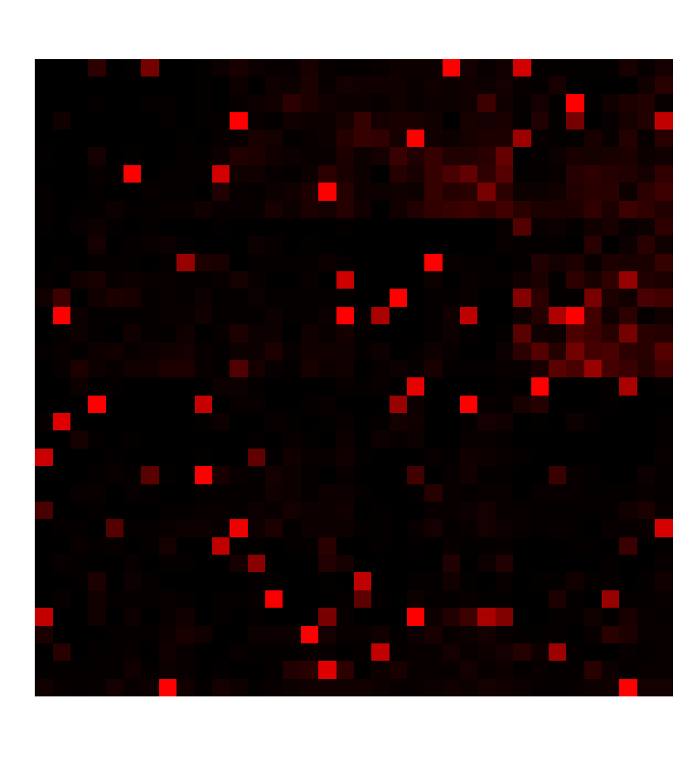
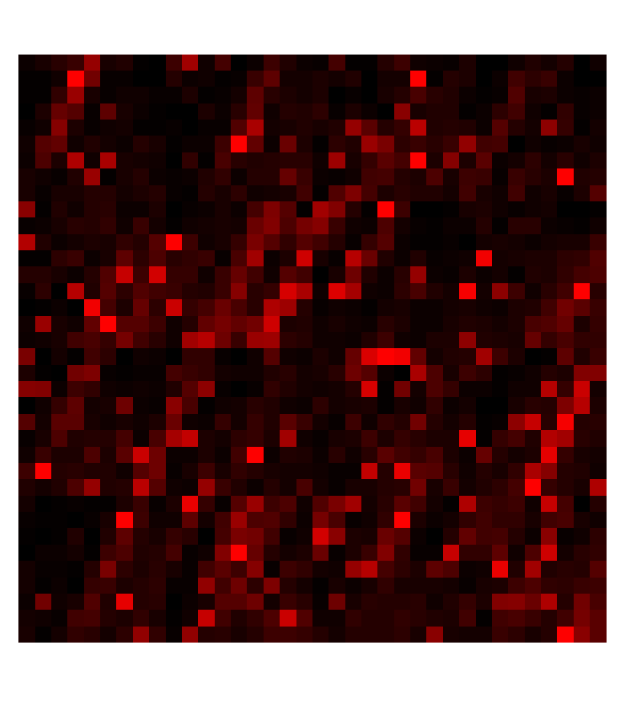
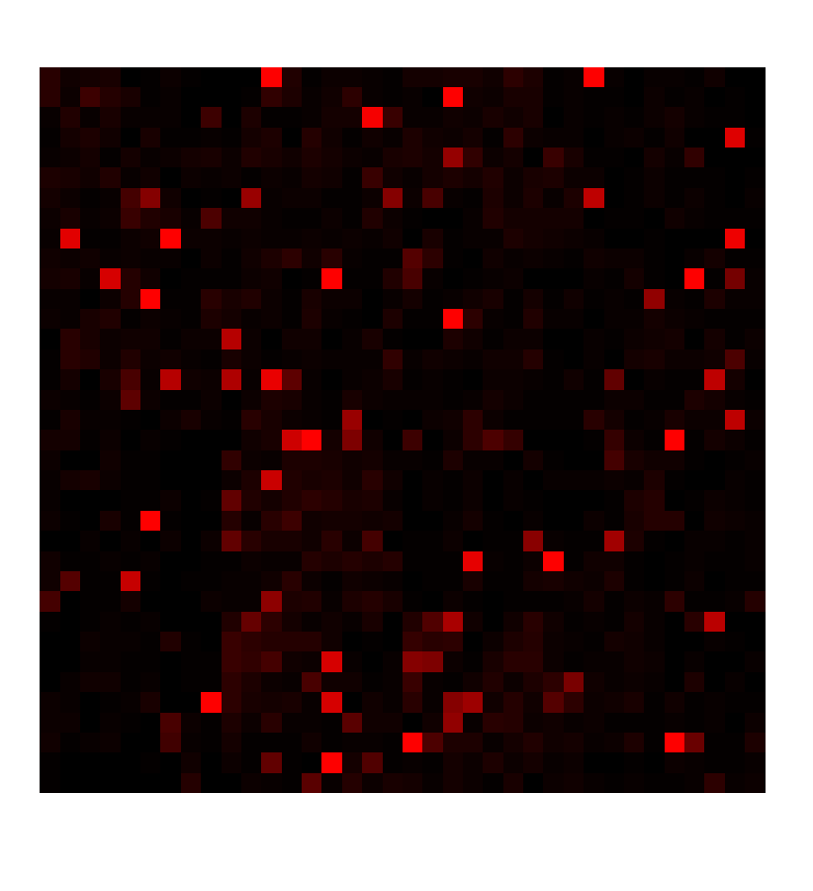
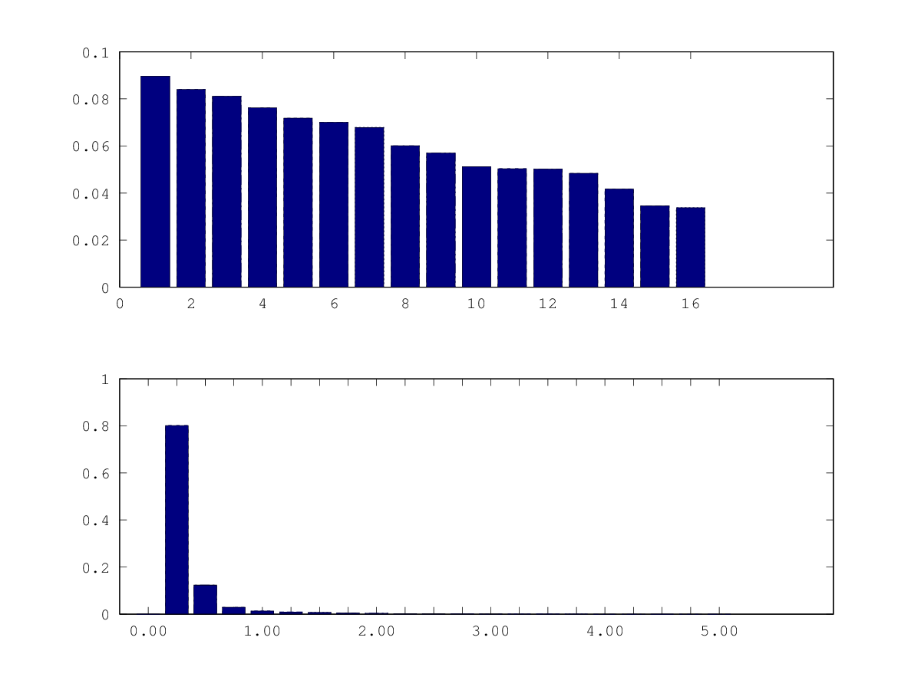
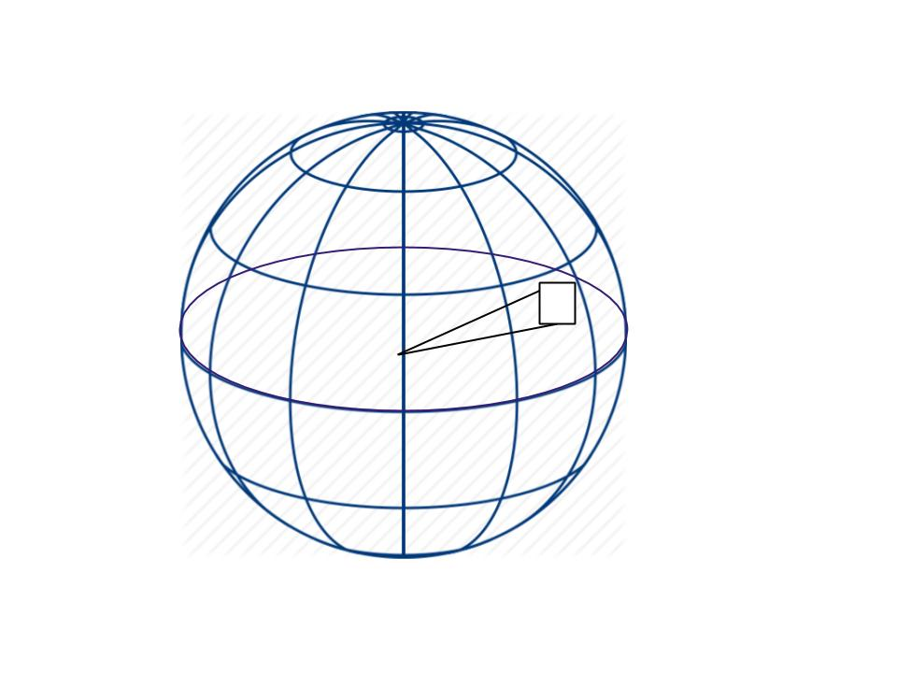
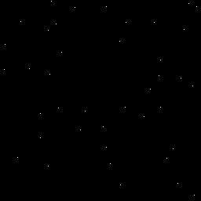
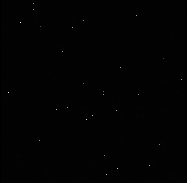
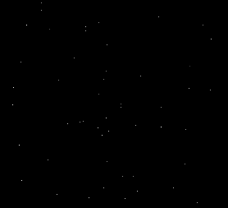
Can a Machine Learn Transformations?
Application to Star Fields
UNCLASSIFIED
Savanna Smith Space Vehicles Scholar RVSWT Arthur Edwards
Background
Machine learning (deep learning) has been very successful classifying static images using labeled data. We want to explore whether a biologically inspired cortical algorithm can use unlabelled data to learn transformations, and to predict future motion.
Purpose
The goal of this research is to train a model to:
sparsely reconstruct accurately star-field frames from a minimum of learned features.
predict the next frame in a sequence regardless of the direction and speed the view is changing throughout the star field.
Methods
Locally Competitive Algorithm (1) (captured in petavision (2)) for reconstruction and prediction.
Neurons compete to represent features.
Cost function favors using minimal set of features to reconstruct original input data.
Our data consists of movies showing motion of simulated star fields.
First layer neurons see four frames at a time.
Ultimate question: Will the algorithm encode motion?
Preliminary Results
Learned dictionary elements
Features appear to include motion.
Feature activations
Original Prediction
Discussion
Algorithm successfully reconstructs individual frames.
Preliminary evidence of motion encoding
Future Work
Introduce multiple layers in neural network
Interframe motion of stars across multiple pixels (How robust is motion-encoding?)
Look further into the future. How many frames can we predict reliably?
Anomaly detection. Can we detect targets from their motion? (SSA?)
Acknowledgments
Grateful thanks to Dr. G. Kenyon of Los Alamos National Laboratory and Dr. P. Schultz of the New Mexico Consortium for invaluable guidance, and for hosting me at the NMC. All simulations performed on NMC high performance workstations.
References
C. Rozell, D. Johnson, R. Baraniuk, B. Olshausen, “Locally Competitive Algorithms For Sparse Approximation,” Image Processing, 2007. ICIP 2007, IEEE International Conference
https://petavision.github.io/
Reconstruction
coefficients
Coefficients => very sparse reconstruction
Generated random 9096 star phi and theta values (0-2π) with random magnitudes that follow a Gaussian distribution (8.5,2).
Created sequential frames of stars that fell inside a fixed view.
Original Sparse Reconstruction
Distribution C - Distribution authorized to U.S Government Agencies and their contractors; Technical content Aug 2, 2017.
All portions of this poster are UNCLASSIFIED
Notes:
possible figures:
more reconstructions
more predictions
energy function
1
8/27/2008 Update
Jan Bush 3-6280
SAB Poster Prep Information for Content

