Slide 1
Air Force Research Laboratory
Locally Competitive Cortical Algorithm to Learn and Predict Star Field Transformations
August 2, 2017
Savanna Smith
Philips Scholar
AFRL Scholars
Air Force Research Laboratory
Integrity ★ Service ★ Excellence
Distribution C - Distribution authorized to U.S Government Agencies and their contractors; Technical content Aug 2, 2017.

Slide 2
Learning and Predicting Star Field Transformations
Machine learning has been very successful classifying static images using labeled data. We want to explore whether a biologically inspired cortical algorithm can use unlabelled data to learn transformations, and to predict future motion.
Distribution C - Distribution authorized to U.S Government Agencies and their contractors; Technical content Aug 2, 2017.
Notes:
Presenter: Do not speak to agenda.
‹#›

Slide 3
Learning and Predicting Star Field Transformations
The goal of this research is to train a model to:
sparsely reconstruct accurately star-field frames from a minimum of learned features.
predict the next frame in a sequence regardless of the direction and speed the view is changing throughout the star field.
Distribution C - Distribution authorized to U.S Government Agencies and their contractors; Technical content Aug 2, 2017.
Notes:
Presenter: Do not speak to agenda.
‹#›

Slide 4
Agenda
Background
Image reconstruction
Sparse coding
Methodology
Locally competitive algorithm
PetaVision
Experiment
Data
Results
Distribution C - Distribution authorized to U.S Government Agencies and their contractors; Technical content Aug 2, 2017.
Notes:
Presenter: Do not speak to agenda.
‹#›

Slide 5
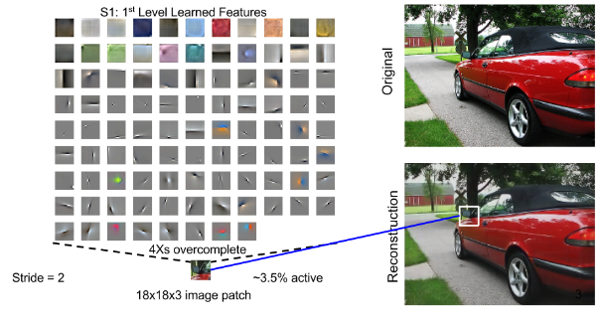
Image Reconstruction
Goal: reconstruct an image
Break the image into patches.
Represent those patches by linear combinations of their features.
Layer the features to reconstruct the image
Distribution C - Distribution authorized to U.S Government Agencies and their contractors; Technical content Aug 2, 2017.
Notes:
Presenter: Do not speak to agenda.
‹#›

Slide 6
Sparse Coding
Sparse approximation of: ɸα=I
I is the input image, D is the dictionary, and α is the sparse signal to estimate.
ɸ is much larger than I (over complete)
Captures patterns inherent in the data better
Problem: infinitely many reconstructions possible
Solution: decompose I into as few linear combinations of vectors in ɸ as possible
NP-Hard
Common sparse approximation methods: convex relaxation, greedy algorithms.
Distribution C - Distribution authorized to U.S Government Agencies and their contractors; Technical content Aug 2, 2017.
Notes:
In linear algebra, if D = X, there’s one solution. If D < X, there are no solutions. If D > X, there are infinite solutions, thus why we need a sparse representation
Edit this slide (too busy)

Slide 7
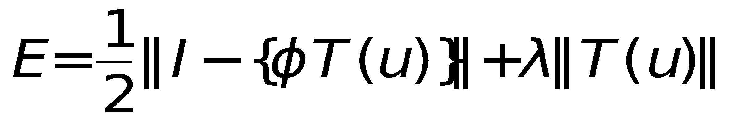
Locally Competitive Algorithm
Locally competitive algorithm (LCA) for reconstruction and prediction:
Neurons compete to represent features.
Cost function favors using minimal set of features to reconstruct original input data.
Local computations make this algorithm largely parallelizable.
Terms
I: input image
ɸ: feature vectors
u: activations
T(u): weighted linear sum of feature vectors
λ: free parameter
I - {ɸT(u)}: residual
λ||T(u)||: sparsity term
Distribution C - Distribution authorized to U.S Government Agencies and their contractors; Technical content Aug 2, 2017.

Slide 8
Experiment
Data generation
Randomly generated 9,096 star phi and theta coordinates with random magnitudes that follow a Gaussian distribution (8.5, 2).
Created sequential frames of stars that fell inside a fixed view.
Data frames
Distribution C - Distribution authorized to U.S Government Agencies and their contractors; Technical content Aug 2, 2017.
Notes:
Presenter: Do not speak to agenda.
‹#›

Slide 9
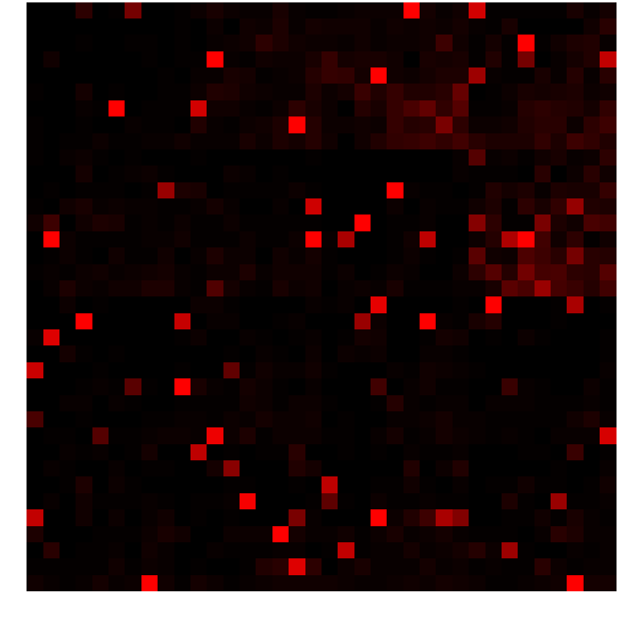
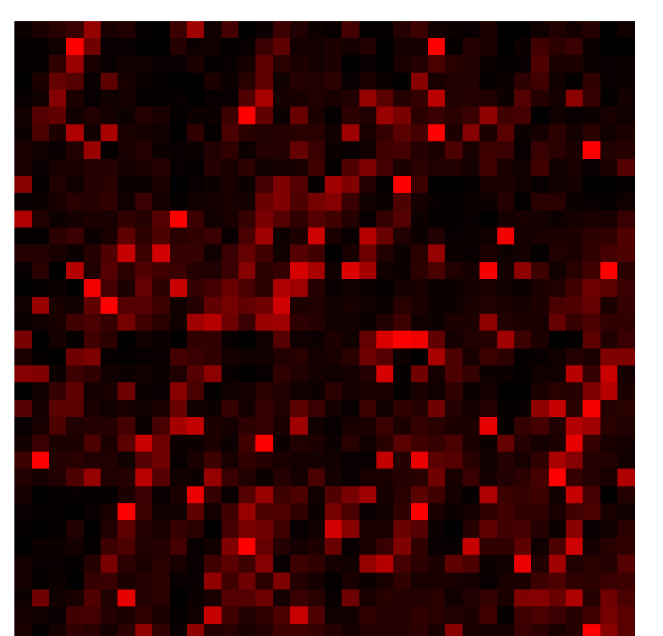
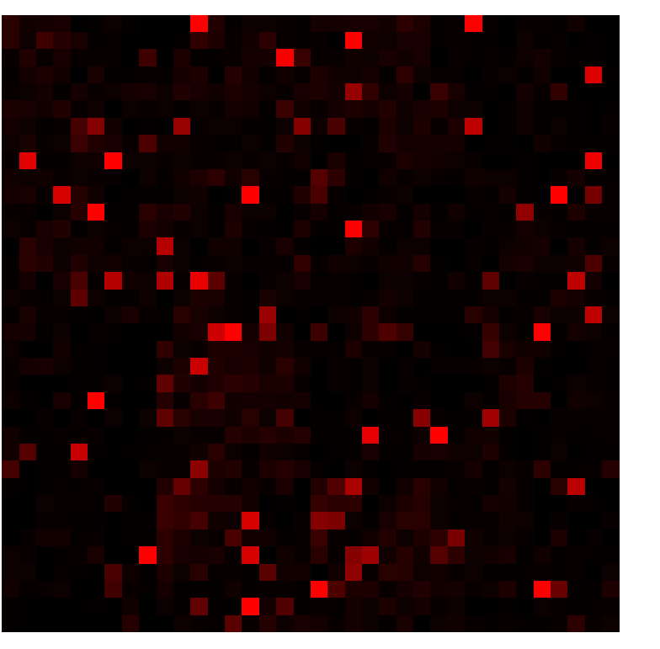
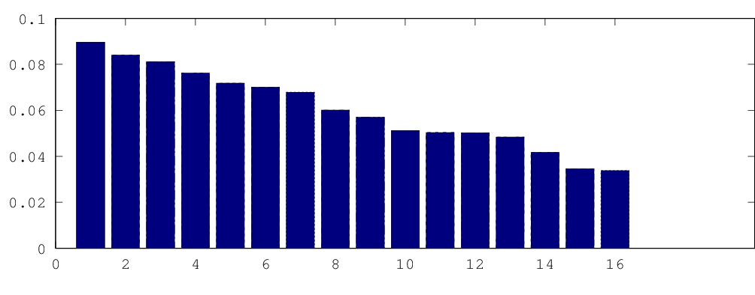
Results
Dictionary elements and activations
Distribution C - Distribution authorized to U.S Government Agencies and their contractors; Technical content Aug 2, 2017.

Slide 10
Results
Original Image Reconstruction
Distribution C - Distribution authorized to U.S Government Agencies and their contractors; Technical content Aug 2, 2017.
Notes:
Make gifs

Slide 11
Results
Original Image Reconstruction

Slide 12
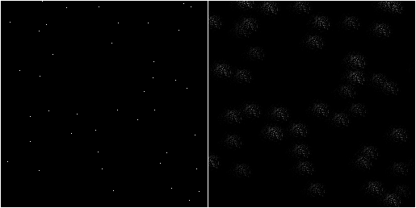
Results
Original Prediction
Distribution C - Distribution authorized to U.S Government Agencies and their contractors; Technical content Aug 2, 2017.
Notes:
Muggle can see 4 frames at a time. The 5th (this one), it predicts

Slide 13
Conclusions and Future Work
Algorithm successfully reconstructs individual frames.
Preliminary evidence of motion encoding
Future Work
Introduce multiple layers in neural network
Interframe motion of stars across multiple pixels (How robust is motion-encoding?)
Look further into the future. How many frames can we predict reliably?
Anomaly detection. Can we detect targets from their motion? (SSA?)
Distribution C - Distribution authorized to U.S Government Agencies and their contractors; Technical content Aug 2, 2017.

Slide 14

Acknowledgments
Grateful thanks Dr. Garrett Kenyon of Los Alamos National Laboratory for invaluable guidance, and for hosting me at the New Mexico Consortium. All simulations performed on NMC high performance workstations.
Distribution C - Distribution authorized to U.S Government Agencies and their contractors; Technical content Aug 2, 2017.

Slide 15
Questions
Thank you!
Distribution C - Distribution authorized to U.S Government Agencies and their contractors; Technical content Aug 2, 2017.

