Slide 1



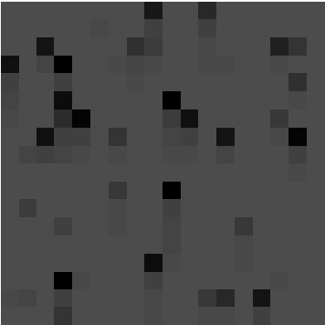
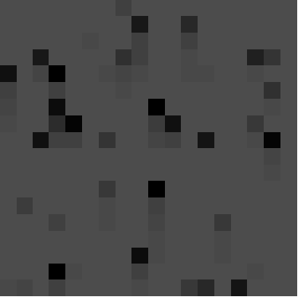

Locally Competitive Algorithm to Predict and Learn Star Field Transformations
UNCLASSIFIED
Savanna Smith Space Vehicles Scholar RVSE Arthur Edwards
Purpose
The goal of this research is to train a model to:
sparsely reconstruct star-field images from learned features efficiently.
predict the next frame in a sequence regardless of the direction and speed the view is changing throughout the star field.
Background
Sparse coding approximates signal α in:
using a linear combination of over-complete bases vectors. Over-completeness means that the number of feature vectors (ɸ) is much greater than the image (I), so there are infinitely many reconstructions possible.
Methodology
The locally competitive algorithm (LCA) described in (1) limits the number of feature vectors in a sparse reconstruction of its input. PetaVision (2) implements a modified version of this algorithm that works by minimizing the energy function:
with respect to ɸ. The dictionary (ɸ) is learned using a Hebbian weight update rule. The computations are done locally, making this algorithm highly parallelizable and efficient.
Data Generation
Randomly generated 9096 star phi and theta values (0-2π) with random magnitudes that follow a Gaussian distribution (8.5,2).
Created sequential frames of stars that fell inside a fixed view.
Results: Image Reconstruction
Experiment 1: Downwards motion at 8 pixels/s with 2 layers
$ɸα=I$
Original Reconstruction
Feature activations capture downward movement
Analysis
Bullet
Experiment 2: Variable direction and speed with 1 layer
Conclusion/Future Work
Information
$\text{E=}\frac{1}{2}\left\|I−\left\{\text{ɸT}\left(u\right)\right\}\right\|\text{+λ}\left\|T\left(u\right)\right\|$
Acknowledgments
Garrett Kenyon, Los Alamos National Lab
Terms
Results: Prediction
References
1. C. Rozell, D. Johnson, R. Baraniuk, B. Olshausen, “Locally Competitive Algorithms For Sparse Approximation,” Image Processing, 2007. ICIP 2007, IEEE International Conference
2. https://petavision.github.io/
Sample input data frame
Distro Statement C
All portions of this poster are UNCLASSIFIED
Notes:
<number>
8/27/2008 Update
Jan Bush 3-6280
SAB Poster Prep Information for Content

