Slide 1

Hotel review analysis for the prediction of business using deep learning approach
CMR COLLEGE OF ENGINEERING & TECHNOLOGY
Kandlakoya, Medchal, Hyderabad - 501401
Department of Computer Science and Engineering
A Project By
Under esteemed guidance of
Ms. P.Sravanthi
19H51A0550 Nakkala Thomas Reddy
19H51A05E4 Poduturi Savan Reddy
19H51A05E4 Puli Shabarish

Slide 2
Abstract
Sentiment analysis is a widely used topic in Natural Language Processing that allows identifying the opinions or sentiments from a given text. Social media is the scope for the customers to share their opinion over the products or services as part of customer reviews. Dissect this review has become an important factor for business analysis since online business is exponentially growing in today’s techno-friendly competitive market.
A large number of algorithms have been found in recent articles. Among those deep learning is an important approach. In the proposed methodology, long short-term memory (LSTM) and Gated recurrent units (GRUs) have been used to train the hotel review data where the accuracy rate of identifying customer opinion is 86%, and 84% respectively. The dataset is also tested by using Naïve Bayes, Decision Tree, Random Forest, and SVM. For Naïve Bayes obtains an accuracy of 75%, for Decision Tree obtains an accuracy of 71%, for Random Forest the accuracy is 82% and for SVM our accuracy result is 71%. Deep learning is used to obtain better business performance and also get the review from customers and also to predict the sentiment about customer review. Our algorithm works properly and gives better accuracy.

Slide 3
Introduction
In the age of modern science, everything is based on online and on the internet. Internet-based shopping has become easier and more popular because of better quality, and fast logistic systems. Internet-based shopping and booking are very comfortable. People can easily make a booking without going outside. The most effective s ide part of online-based work is that people can give a review. Recognizing reviews allows others to easily understand the emotions of others and obtain the rationality result of different products .
In the hotel review, the prediction of business using Deep Learning was analyzed. Many start-up businesses became failure due to lack of analysis and the sentiment of the customer. Sentiment Analysis is the most significant to improve a business site.

Slide 4
from the Hotel Management Website was collected using Unamo tools. And also some supervised and unsupervised data is used to predict the best result. This article will help to improve the business.
At present, online-based opinions can easily analysis with the help of Sentiment Analysis (SA). It is the management of sentiments, different opinions, subjective text, and different emoji used for giving reviews. People can easily get the comprehension information related to people reviews. Mainly Sentiment analysis is one kind of tool that helps to get the public sentiment. By capturing reviews of product or location or person might be found from a different internet-based site like Face book, Amazon. Sentiment Analysis is used to increase the requirement of analyzing and structuring hidden information which comes from social media in the form of unstructured data. A huge amount of data is used due to the capability of automation and can handle a huge amount of data. A different type of font [23] of review are further classified.

Slide 5
Literature Review
Sentiment analysis using probabilistic machine learning(Research Paper)
This work aims at building a classifier able of predicting the polarity of a comment while using Machine Learning (ML) algorithms. Our work is essentially divided into three tasks: data extraction, processing and modelling. In order to build our model, we use the NLTK dataset. Then, we use text mining techniques to generate and process the variables. Based on a supervised probabilistic machine learning algorithm, we tended to create a classifier to classify our tweets into positive and negative sentiments then we opt for two experiments to evaluate the performance of our model.

Slide 6
Many Existing solutions have been use to classify reviews and other forms of text.
The algorithms such as naïve bayes, logistic regression, random forest have achieved considerable accuracies.

Slide 7
Existing Solutions
Review analysis using Naïve Bayes Bernoulli Classifier
Introduction
Naive Bayes Bernoulli is a binary independence model, which generates an indicator for each term of the vocabulary ,either 1 indicating presence of the term in the document or 0 indicating absence. Bernoulli model uses binary occurrence information, ignoring the number of occurrences whereas the multinomial model keeps track of multiple occurrences. It specifies that a review is represented by a vector of binary attributes indicating which words appear in the review or not.
Merits
It is easy and fast to predict class of test data set. It also perform well in multi class prediction
When assumption of independence holds, a Naive Bayes classifier performs better compare to other models like logistic regression and you need less training data.

Slide 8
Demerits
If categorical variable has a category (in test data set), which was not observed in training data set, then model will assign a 0 (zero) probability and will be unable to make a prediction. This is often known as “Zero Frequency”.
Accuracy of Naïve bayes model is 75%.
Challenges
Reviews may contain large number of unseen words and the model will not function as expected.

Slide 9
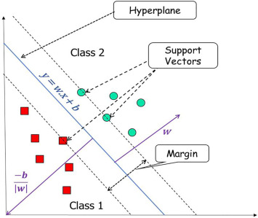
Review analysis using SVM
“Support Vector Machine” (SVM) is a supervised machine learning algorithm that can be used for both classification or regression challenges. However, it is mostly used in classification problems. In the SVM algorithm, we plot each data item as a point in n-dimensional space (where n is the number of features you have) with the value of each feature being the value of a particular coordinate. Then, we perform classification by finding the hyper-plane that differentiates the two classes very well (look at the below snapshot).
Support Vectors are simply the coordinates of
individual observation.
The SVM classifier is a frontier that best segregates
he two classes (hyper-plane/ line).

Slide 10
Merits
It works well with a clear margin of separation
It is effective in high-dimensional spaces.
It is effective in cases where the number of dimensions is greater than the number of samples.
It uses a subset of training points in the decision function (called support vectors), so it is also memory efficient.
Demerits
It doesn’t perform well when we have large data set because the required training time is higher
SVM doesn’t directly provide probability estimates, these are calculated using an expensive five-fold cross-validation

Slide 11
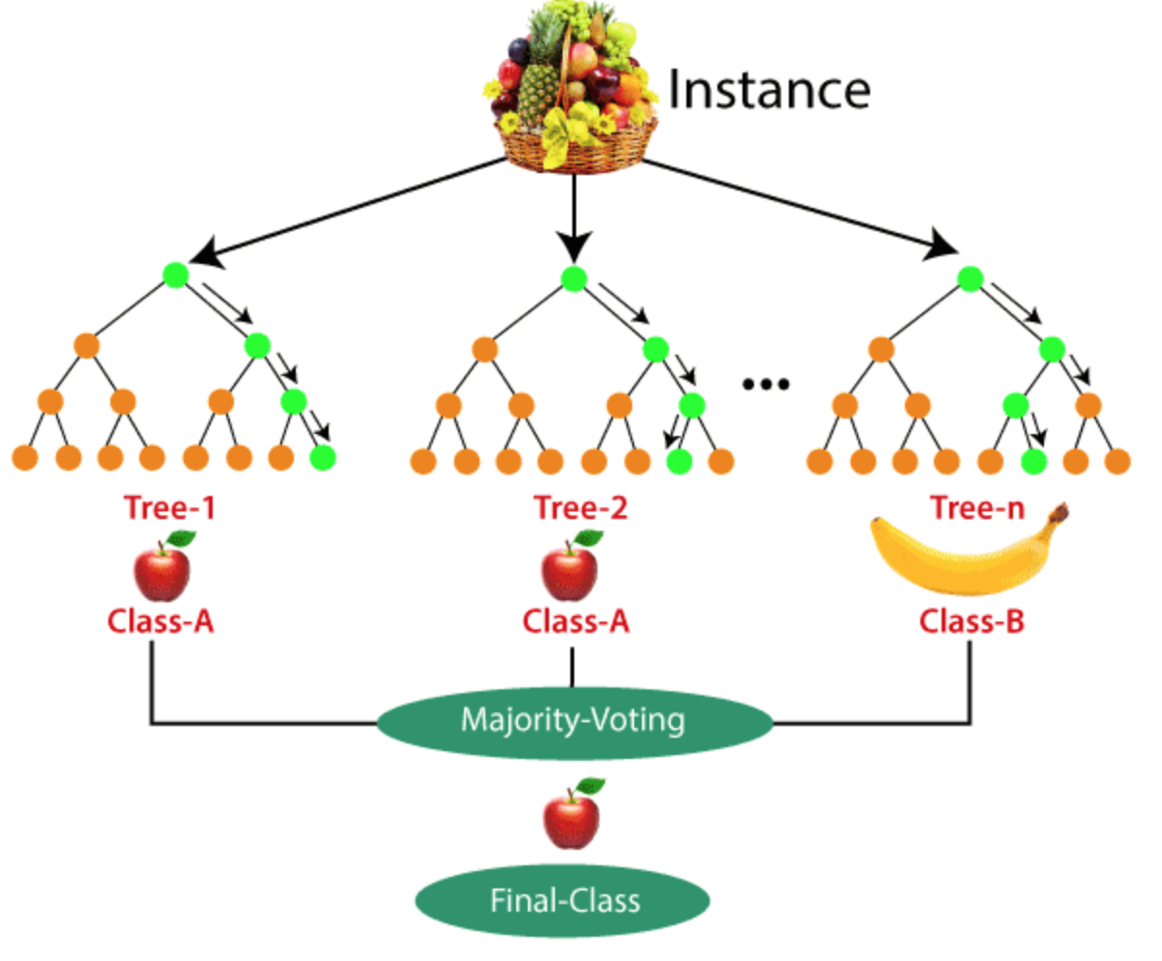
3 Review Analysis Using Decision Tree Classifier
Introduction
The main goal of the classification model for hotel reviews is to classify them as positive or negative, thus determining the opinion of the hotel guests expressed on the websites. Decision tree algorithm is used to generate a classification model for predicting the values of a target attribute (class or label) based on the values of several input attributes in the training data, used for classification of reviews. The attribute with the Label role is the target variable for prediction. It is used for classification of nominal and numeric data types. As a treelike
model, it has root at the top
and it grows downwards.

Slide 12
Merits
Compared to other algorithms decision trees requires less effort for data preparation during pre-processing.
Missing values in the data also do NOT affect the process of building a decision tree to any considerable extent.
Demerits
A small change in the data can cause a large change in the structure of the decision tree causing instability.
Decision tree training is relatively expensive as the complexity and time has taken are more.

Slide 13
Existing systems results
In the existing work, the system did not find sentiment timeline and finds difficulties in topic modeling.
In the existing system the algorithm used is CNN, Naïve Bayes, Decision tree which are less accurate which results in the wrong information.
The existing methods fail to detect feedback for a large amount of data.
If a large amount of data is found then the existing system fails to give accurate results.

Slide 14
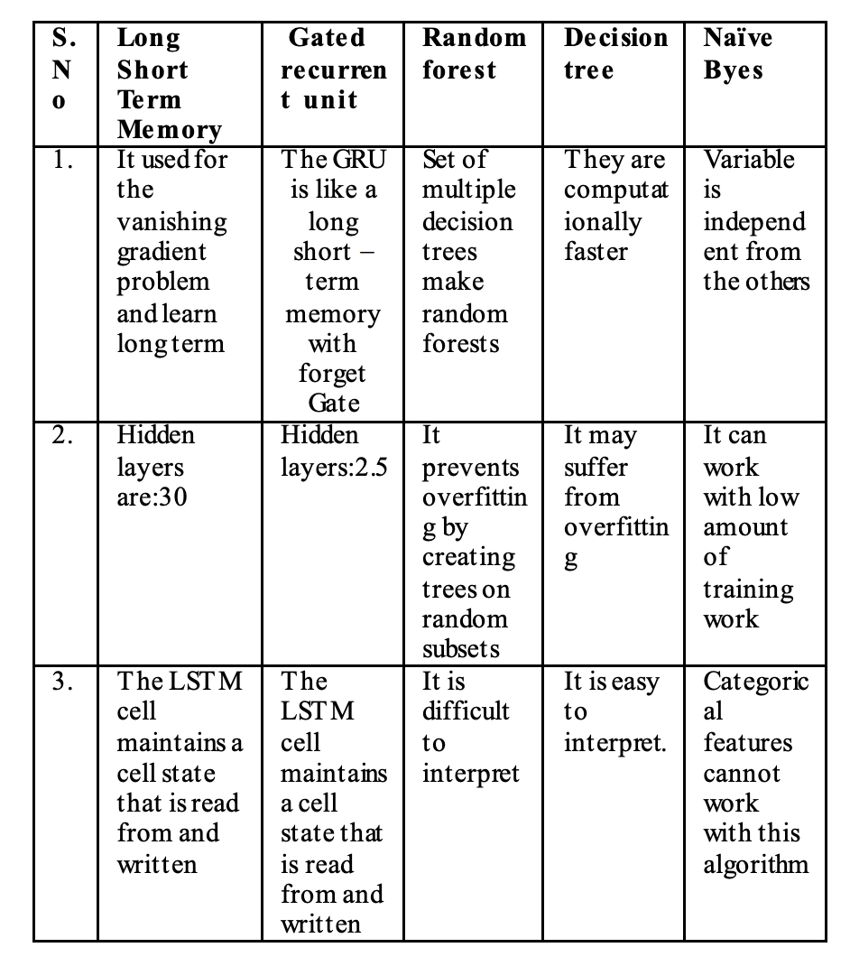
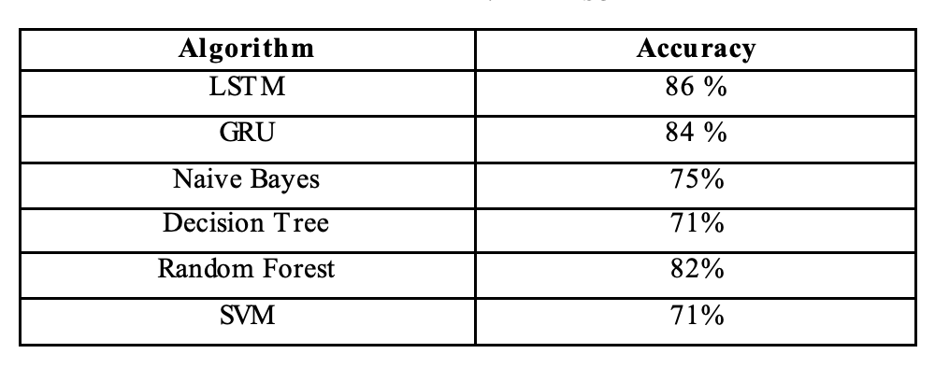
Comparing Different Algorithms

Slide 15
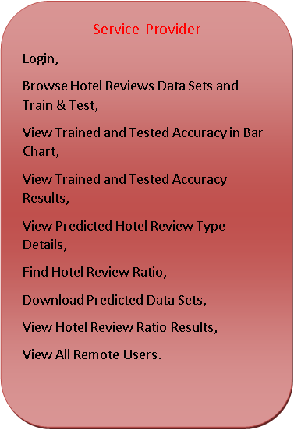


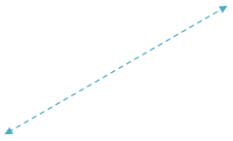


Architecture diagram
Accepting all user Information
View user data details
Authorize the Admin
Process all user queries
Store and retrievals
Registering the User
REGISTER AND LOGIN,
PREDICT HOTEL REVIEW ANALYSIS TYPE,
VIEW YOUR PROFILE

Slide 17
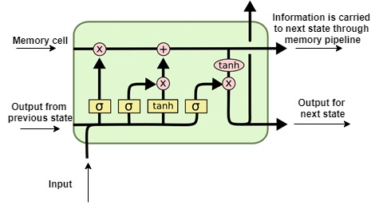
Proposed System
LSTM is an updated version of Recurrent Neural Network to overcome the vanishing gradient problem. Below is the architecture of LSTM with an explanation.
It has a memory cell at the top which helps to carry the information from a particular time instance to the next time instance in an efficient manner. So, it can able to remember a lot of information from previous states when compared to RNN and overcomes the vanishing gradient problem. Information might be added or removed from the memory cell with the help of valves.
LSTM network is fed by input data from the current time instance and output of hidden layer from the previous time
instance.
These two data passes through various
activation functions and valves in the
network before reaching the output.

Slide 18
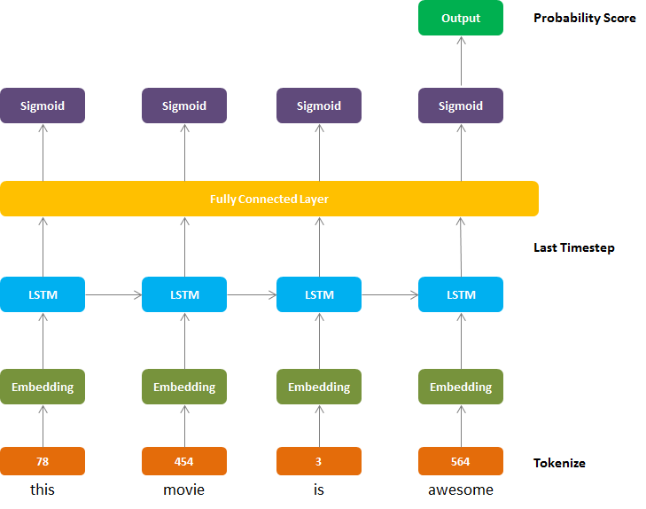
Implementation

Slide 19
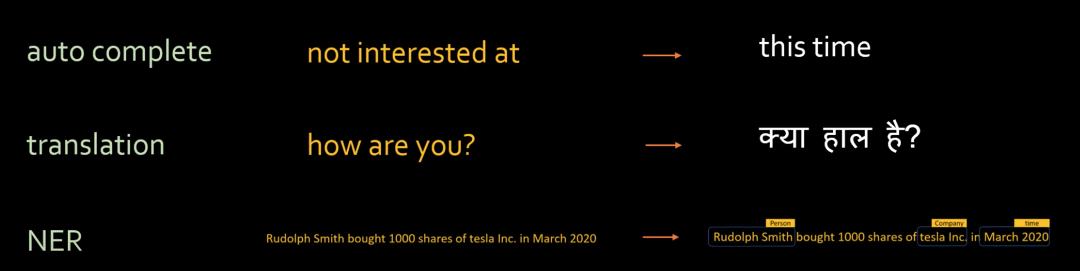
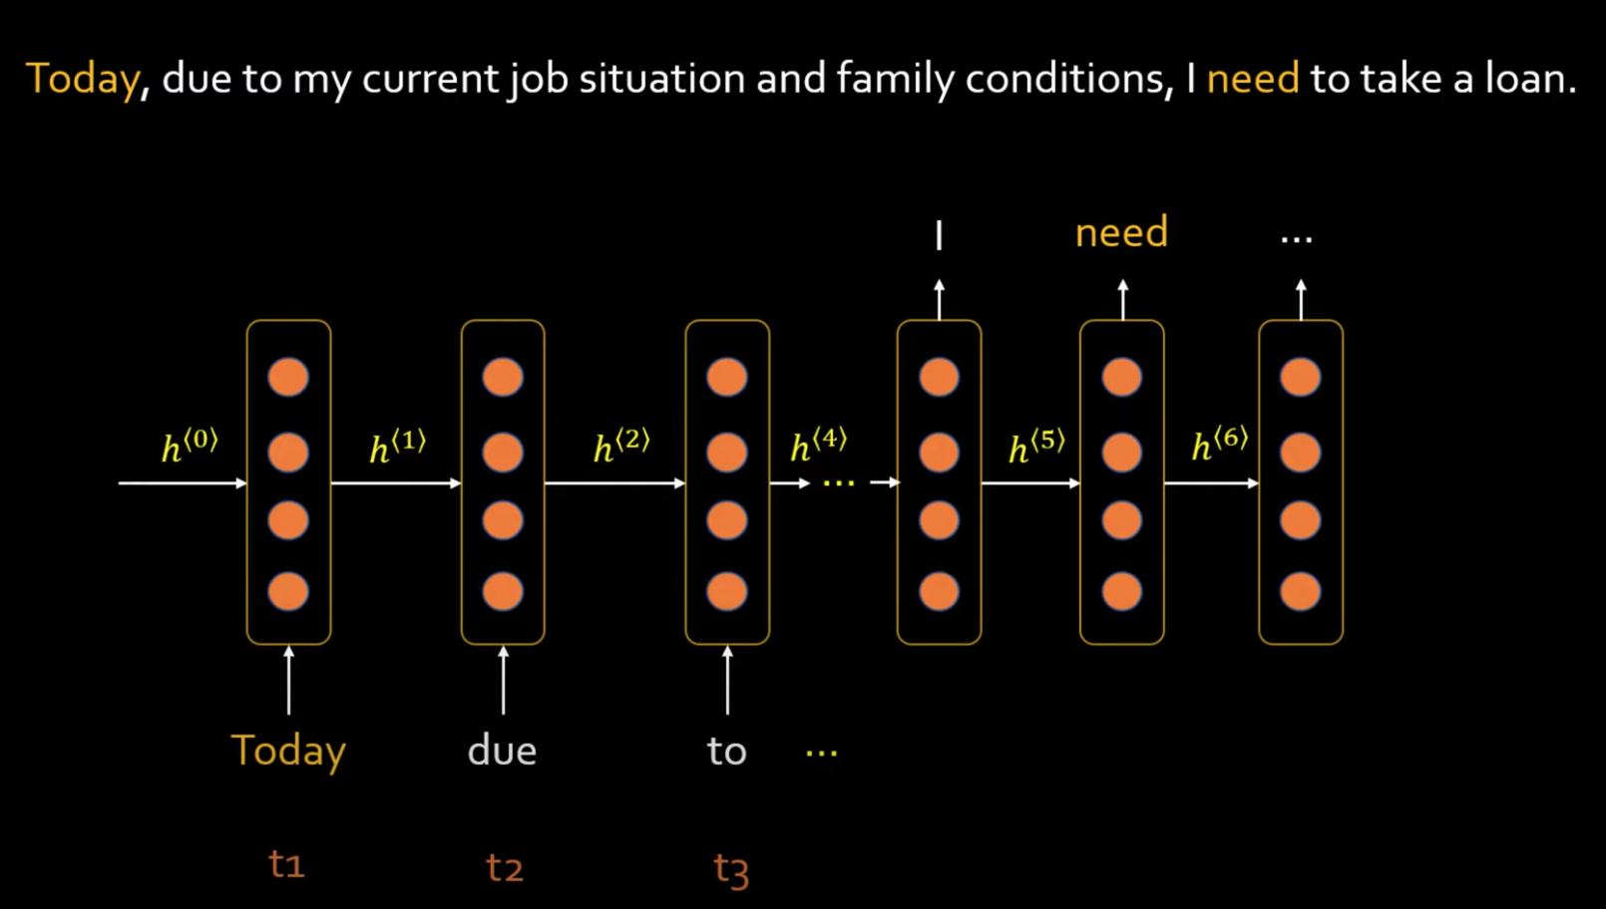
Long short-term memory (LSTM) And Recurrent Neural Network (RNN)

Slide 20
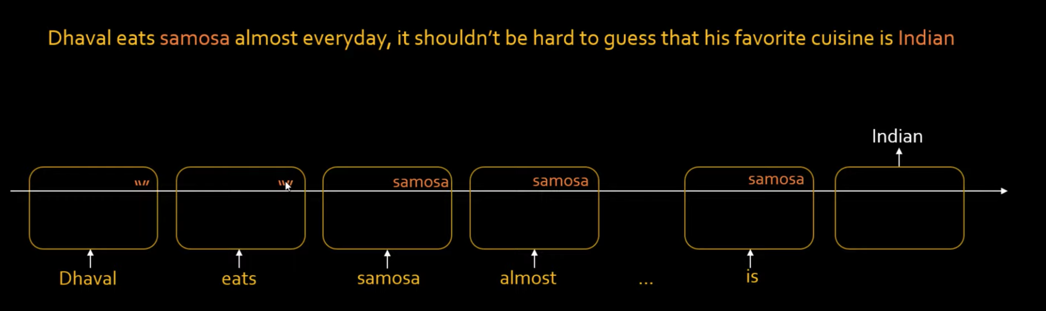
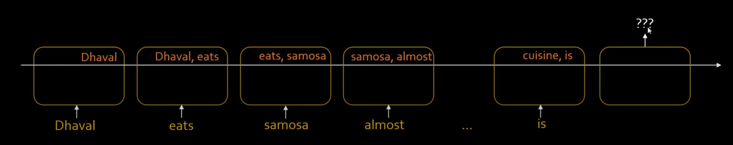

Slide 21
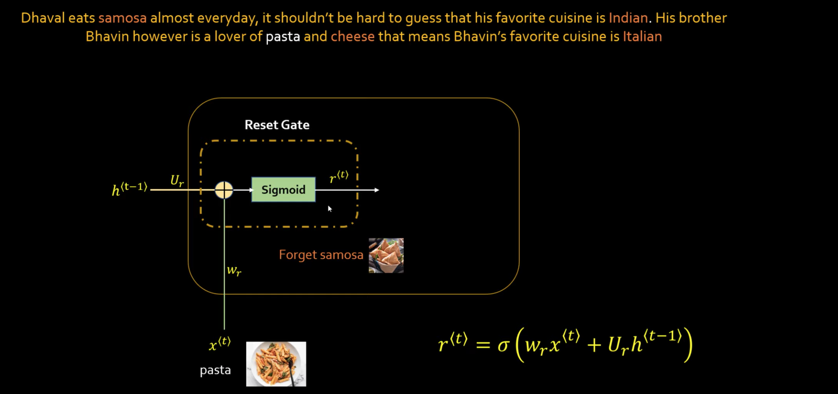
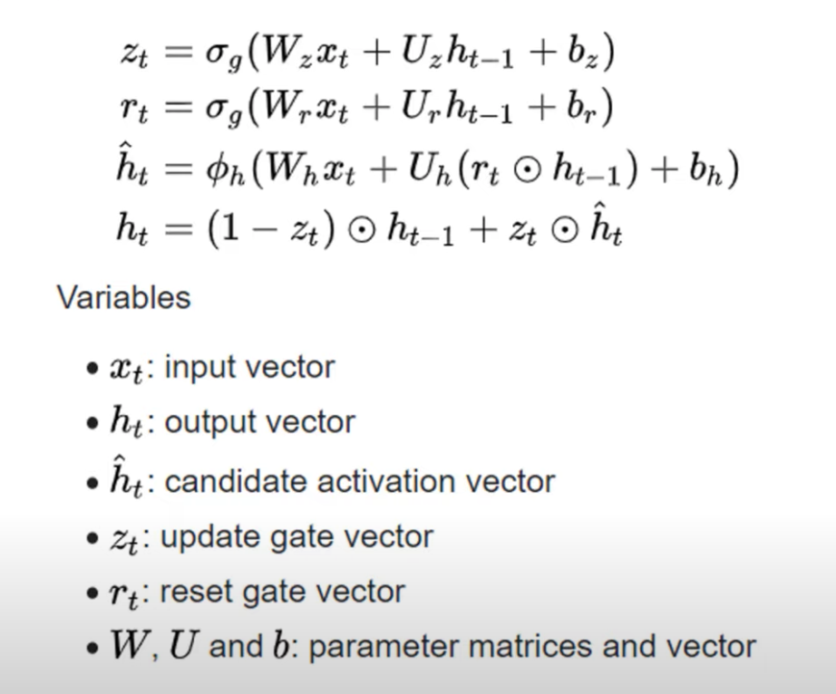
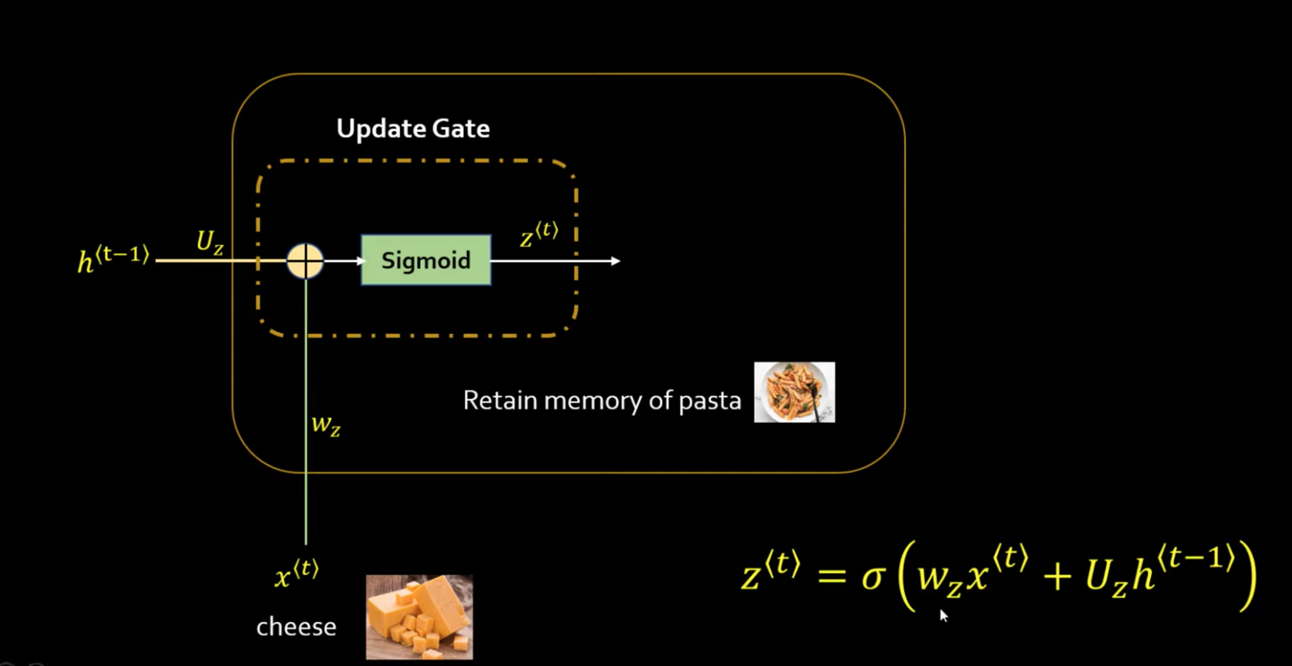

Slide 22
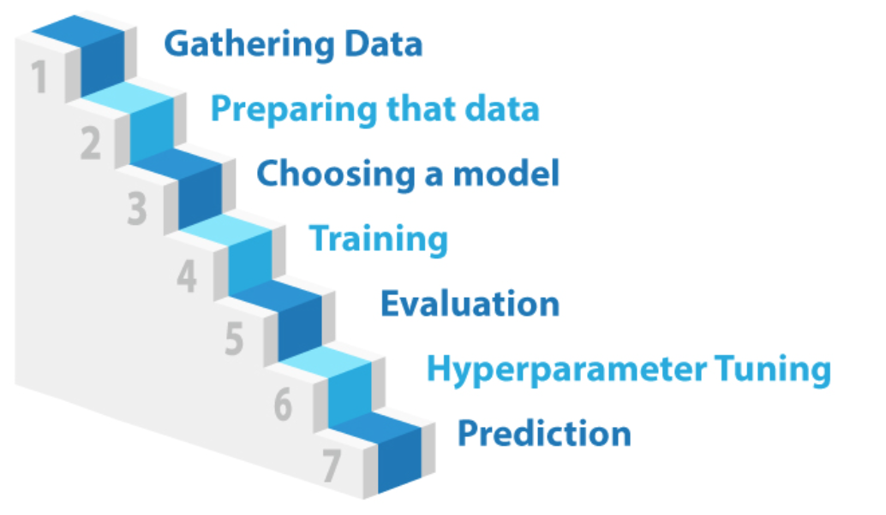
Steps taken to get Accurate Results

Slide 23
ADVANTAGES OF PROPOSED SYSTEM It is the management of sentiments, different opinions, subjective text, and different emoji used for giving reviews. People can easily get the comprehension information related to people reviews. Mainly Sentiment analysis is one kind of tool that helps to get the public sentiment. A huge amount of data is used due to the capability of automation and can handle a huge amount of data. A different type of font of review is further classified

Slide 24
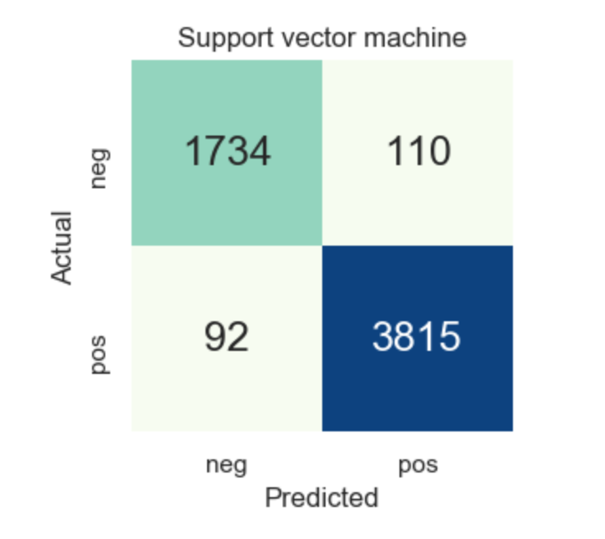
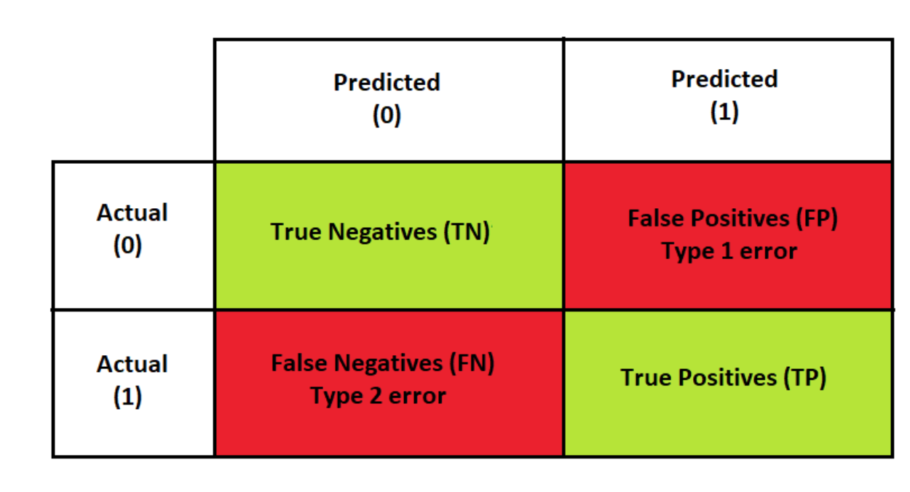
Performance metrics
Performance metrics are used to evaluate the overall performance of Machine learning algorithms and to understand how well our machine learning models are performing on a given data under different scenarios. Choosing the right metric is very essential to understand the behaviour of our model and make necessary changes to further improve the model
Confusion Matrix

Slide 25
Conclusion
In this project, we defined features of Review analysis and we proposed a classification model in order to classification of the reviews. This method is more accurate and overcomes the issues of long text classifications.
We aim to increase the accuracy of the prediction model and produce better analysis using LSTM and GRU.

Slide 26
References
[1] R. K. Bakshi, N. Kaur, R. Kaur and G. Kaur, "Opinion mining and
sent iment analysis," 2016 3rd Internat ional Conference on
Comput ing for Sustainable Global Development (INDIACom),
New Delhi, 2016, pp. 452-455.
[2] L. Yang, Y. Li, J. Wang and R. S. Sherrat t , "Sent iment Analysis
for E-Commerce Product Reviews in Chinese Based on Sent iment
Lexicon and Deep Learning," in IEEE Access, vol. 8, pp. 23522-
23530, 2020, doi: 10.1109/ACCESS.2020.2969854.
[3] H. S. and R. Ramathmika, "Sentiment Analysis of Yelp Reviews
by Machine Learning," 2019 Internat ional Conference on
Intelligent Comput ing and Cont rol Systems (ICCS), Madurai,
India, 2019, pp. 700-704, doi: 10.1109/ICCS45141.2019.9065812.
Z. Singla, S. Randhawa and S. Jain, "Stat ist ical and sent imentanalysis of consumer product reviews," 2017 8th Internat ional Conference on Comput ing, Communicat ion and Networking Technologies (ICCCNT), Delhi, 2017, pp. 1-6, doi: 10.1109/ICCCNT.2017.8203960.
https://ieeexplore.ieee.org/document/9498965

Slide 27
Thank You!

