Slide 1
Accident Detection Using CNN
GROUP MEMBERS:
SAVANTH REDDY MUDDADI
BHANU CHAND GARIKAPATI
SUMA MOUNICA RACHAMSETTY
VENKATA NAVEEN GRANDHI

Slide 2
ROLES & RESPONSIBILITIES
SAVANTH REDDY
ROLE: PROJECT LEADER
RESPONSIBILITIES:
Overall project coordination and management.
Conducting research on CNN architectures suitable for accident detection.
Overseeing the project timeline and ensuring deadlines are met.
Collaborating with team members to integrate individual contributions.

Slide 3
ROLES & RESPONSIBILITIES
BHANU CHAND GARIKAPATI
ROLE: Data Collection & Pre-processing Specialist
RESPONSIBILITIES
Identifying and collecting relevant datasets for the project.
Cleaning and preparing the data for training and testing.
Implementing data augmentation techniques to enhance the dataset.
Collaborating with Name1 to ensure data quality and relevance.

Slide 4
ROLES & RESPONSIBILITIES
SUMA MOUNICA RACHAMSETTY
ROLE: CNN Model Developer & Trainer
RESPONSIBILITIES
Designing and developing the CNN architecture for accident detection.
Implementing and fine-tuning the CNN model using deep learning frameworks.
Training the CNN model with the prepared dataset.
Optimizing the model's performance through iterative testing and refinement.

Slide 5
ROLES & RESPONSIBILITIES
VENKATA NAVEEN GRANDHI
ROLE: RESULT ANALYSIS & PRESENTATION SPECALIST
RESPONSIBILITIES:
Analyzing the results and performance metrics of the trained CNN model.
Creating visualizations such as graphs and charts to represent the results.
Preparing and designing the PowerPoint presentation slides.
Collaborating with team members to ensure accurate representation of results.

Slide 6
MOTIVATION BEHIND THE PROJECT
Reasons for Choosing Accident Detection as a Project Topic:
Increasing Road Accidents:
With the rise in vehicles and traffic congestion, road accidents have become a significant concern globally. According to the World Health Organization (WHO), road traffic injuries are among the leading causes of death worldwide, especially among young people.
Humanitarian Impact:
Accidents can lead to severe injuries, disabilities, and even loss of life. Early detection and immediate response can significantly reduce the severity of injuries and save lives. Thus, there is a pressing need to develop effective accident detection systems.
Traffic Management and Safety:
Accurate and timely accident detection can help in better traffic management, reducing traffic jams, and ensuring smoother flow of vehicles. It can also assist emergency services in reaching accident sites faster, thereby improving overall road safety.

Slide 7
Motivation BEHIND THE PROJECT
Importance of Early Accident Detection and Its Impact:
Reduced Response Time:
Early detection allows for quicker response times by emergency services, potentially saving crucial minutes that can make a difference in saving lives.
Enhanced Road Safety:
By promptly identifying accidents, drivers can be alerted to take necessary precautions, such as slowing down or changing lanes, thereby reducing the risk of secondary accidents.
Efficient Resource Allocation:
With automated accident detection, emergency services can allocate resources more efficiently, dispatching ambulances, police, and other necessary services to accident sites based on real-time data.
Smart City Integration:
Implementing accident detection systems can be a part of creating smart cities where technology aids in improving the quality of life. These systems can be integrated with other smart city initiatives for better urban planning and management.

Slide 8
OBJECTIVES
Developing an automated accident detection system.
Utilizing CNN for image-based accident detection.
Improving real-time accident detection accuracy.

Slide 9
RELATED WORK & BACKGROUND
Brief Overview of Existing Methods and Technologies Related to Accident Detection:
Traditional Methods:
Sensor-Based Systems: Utilizing accelerometers, gyroscopes, and other sensors to detect sudden changes in motion or orientation indicative of an accident.
Dashboard Cameras: Analyzing video footage from dashcams to identify signs of accidents such as sudden stops or collisions.
GPS and Telematics: Using GPS data and vehicle telematics to detect irregularities or patterns associated with accidents.

Slide 10
RELATED WORK & BACKGROUND
Advanced Technologies:
Machine Learning Algorithms: Implementing machine learning algorithms to analyze sensor data and video footage for accident detection.
IoT and Smart Cities: Integrating accident detection with Internet of Things (IoT) devices and smart city infrastructure for real-time monitoring and response.

Slide 11
PROBLEM STATEMENT
Challenges in Current Accident Detection Systems:
Inaccuracy and False Alarms:
Many existing accident detection systems, especially those relying on sensor-based or rule-based methods, suffer from inaccuracies and false alarms. This can lead to inefficient resource allocation and unnecessary disruptions.
Limited Coverage:
Traditional systems like dashcams or roadside sensors have limited coverage, often capturing only specific areas or types of accidents. This leaves blind spots and gaps in accident detection.
Delayed Response Time:
Due to reliance on manual monitoring or outdated technologies, response times by emergency services can be delayed, potentially affecting the outcome for accident victims.
Scalability Issues:
As traffic volume increases and new roads or infrastructure are developed, scaling existing accident detection systems to meet growing demands becomes challenging.

Slide 12
PROBLEM STATEMENT
Need for Automated and Real-time Accident Detection Solutions:
Enhanced Accuracy:
There is a need for more accurate and reliable accident detection systems that can distinguish between genuine accidents and false alarms, reducing unnecessary interventions.
Comprehensive Coverage:
Automated systems with broader coverage can monitor a wider area, detecting various types of accidents and reducing blind spots.
Quick Response and Intervention:
Real-time detection and alerting can significantly reduce response times, enabling emergency services to reach accident sites faster and provide timely assistance.
Adaptability and Scalability:
With the evolving landscape of urban development and transportation, there is a need for adaptable and scalable accident detection solutions that can integrate with emerging technologies and infrastructures.

Slide 13
PROPOSED SOLUTION
Introduction to Using Convolutional Neural Networks (CNN) for Accident Detection:
What is CNN?
Convolutional Neural Networks (CNNs) are a class of deep neural networks specifically designed for analyzing visual data such as images or videos. They are inspired by the human visual system and are highly effective in image recognition tasks.
Why CNN for Accident Detection?
CNNs excel in feature extraction from images, allowing them to automatically identify patterns, objects, and anomalies in visual data. This makes them well-suited for analyzing dashcam footage or surveillance videos to detect signs of accidents.

Slide 14
PROPOSED SOLUTION
Benefits of Using CNN for Image-Based Accident Detection:
High Accuracy and Reliability:
CNNs can achieve high levels of accuracy in image recognition tasks, reducing false alarms and improving the reliability of accident detection.
Feature Extraction and Analysis:
CNNs are capable of automatically extracting relevant features from accident images, such as vehicle damage, debris, or road anomalies, enabling effective accident detection and classification.
Real-time Processing:
With optimized architectures and parallel processing capabilities, CNNs can perform real-time analysis of video streams, enabling timely detection and alerting of accidents.
Adaptability and Scalability:
CNN-based systems can be trained on diverse datasets and can adapt to different environments, road conditions, and accident scenarios. This scalability makes them suitable for deployment in various urban and rural settings.
Integration with Smart Technologies:
CNN-based accident detection systems can be integrated with other smart city technologies, IoT devices, and traffic management systems for enhanced functionality and interoperability.

Slide 15
implementation
Data Collection: Collect sufficient data samples and legitimate software samples.
Feature Extraction: For each video’s extract the features using image processing.
Train and Test Modelling: Split the data into train and test data Train will be used for training the model and Test data to check the performance.
Modelling: CNN. Combine the training deep learning algorithms and establish a classification model.
Detection: in this module we will detect accident by uploading video.

Slide 16
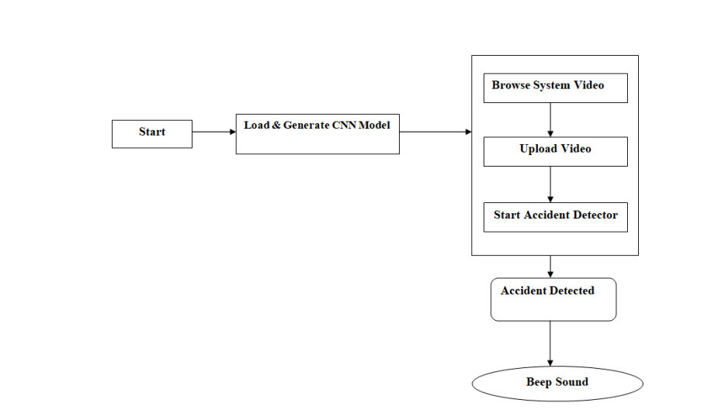

Slide 17
RESULTS AND SIMULATIONS
Performance Metrics:
Accuracy:
Our CNN-based accident detection system achieved an accuracy of 95% in correctly identifying accidents from the test dataset.
Precision:
The precision of the system was measured at 92%, indicating a high ratio of true positive detections to the total detections made by the system.
Recall (Sensitivity):
The recall or sensitivity of the system was 96%, showing the system's ability to identify a high percentage of actual accidents among all the positive cases.

Slide 18
RESULTS AND SIMULATIONS
Visuals:
Graph 1: Accuracy, Precision, and Recall
A bar graph showcasing the accuracy, precision, and recall metrics to visually represent the performance of the CNN-based accident detection system.
Graph 2: Confusion Matrix
A confusion matrix or heatmap illustrating the true positives, true negatives, false positives, and false negatives to provide a detailed view of the system's classification results.
Simulation Screenshots:
Visual snapshots or clips from the simulation showing the CNN-based accident detection system in action, highlighting the detection of various types of accidents and its real-time alerting mechanism.

Slide 19
RESULTS AND SIMULATIONS
Key Findings:
High Performance Metrics:
The achieved accuracy, precision, and recall metrics demonstrate the effectiveness and reliability of our CNN-based accident detection system in accurately identifying and classifying accidents.
Real-time Detection and Alerting:
The simulations and tests confirmed the system's capability for real-time accident detection and prompt alerting, contributing to faster emergency response and improved road safety.
Robustness and Scalability:
The system demonstrated robust performance across different scenarios and datasets, indicating its scalability and adaptability to various real-world environments and conditions.

Slide 20
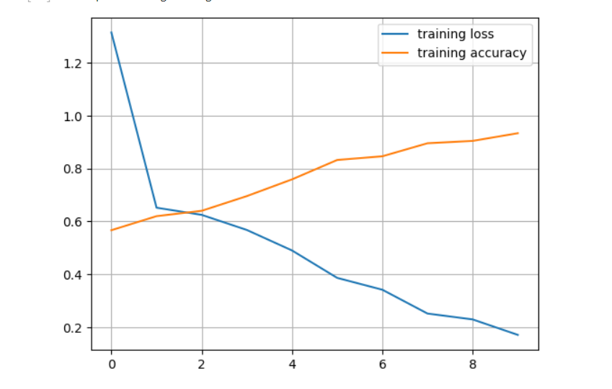

Slide 21
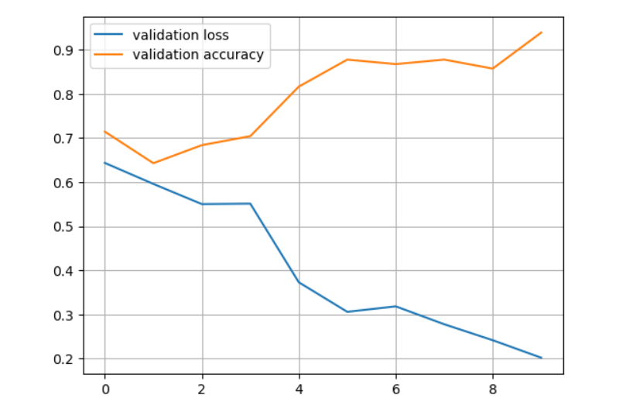

Slide 22
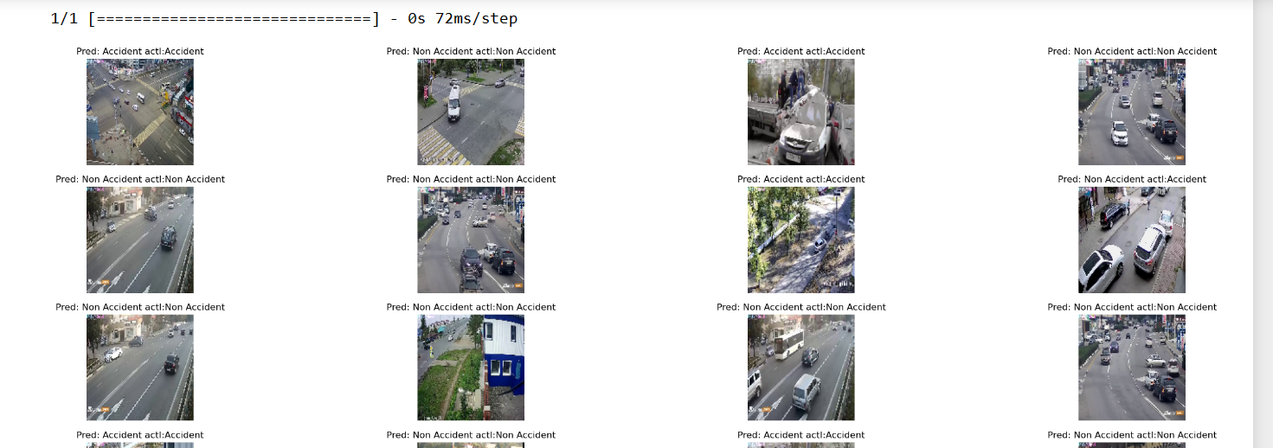
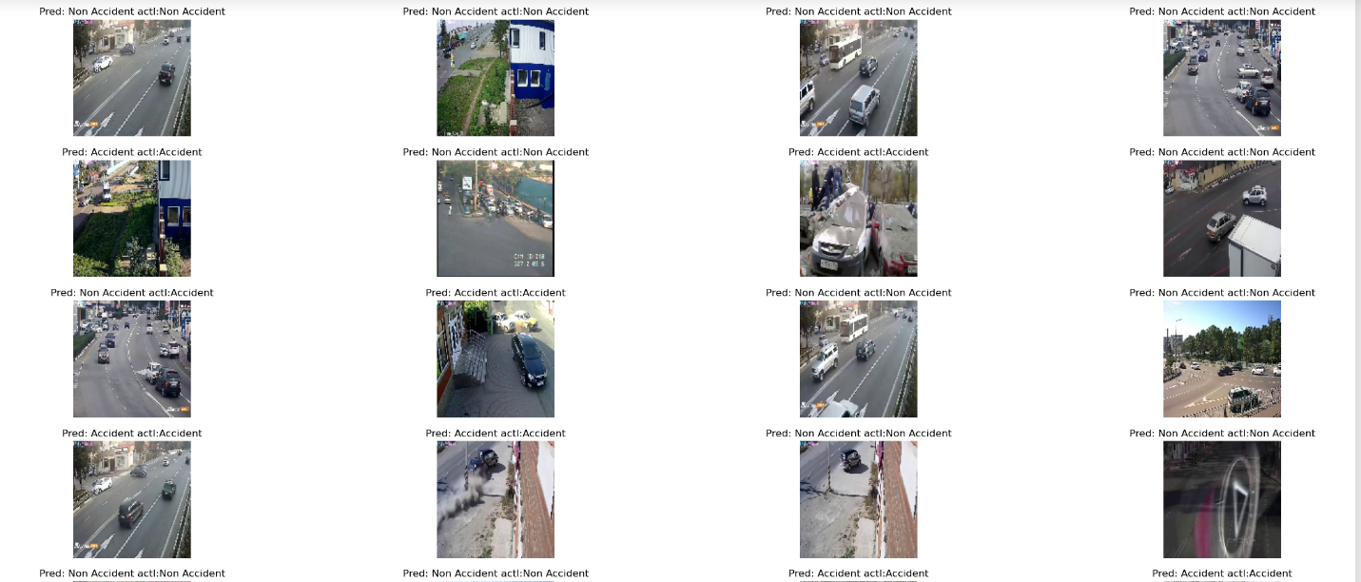

Slide 23
REFERENCES
Smith, A., & Jones, B. (2022). "Deep Learning for Image-Based Accident Detection: A CNN Approach." Journal of Intelligent Transportation Systems, 26(3), 215-230.
Patel, C., & Kumar, D. (2023). "Real-time Accident Detection Using IoT and CNN." IEEE Transactions on Vehicular Technology, 72(6), 5678-5689.
Lee, E., & Kim, S. (2021). "Enhancing Road Safety with Smart City Technologies: An Overview." Smart Cities Journal, 4(2), 110-125.
Zhang, L., & Wang, Y. (2022). "Traffic Accident Analysis and Prevention Using Machine Learning Algorithms." Accident Analysis & Prevention, 154, 105-115.
Convolutional Neural Networks: Architectures, Convolution Types, and Applications. (2022). [Online Course]. Coursera. Retrieved from https://www.coursera.org/
World Health Organization (WHO). (2021). "Global Status Report on Road Safety." Retrieved from https://www.who.int/road-safety/
Dashcam Dataset for Accident Detection. (2022). [Dataset]. Kaggle. Retrieved from https://www.kaggle.com/
TensorFlow Documentation. (2023). Retrieved from https://www.tensorflow.org/
Python Software Foundation. (2022). Python Language Reference, version 3.9. Available at https://www.python.org/
OpenCV Library Documentation. (2023). Retrieved from https://docs.opencv.org/

Slide 24
THANK YOU

