Slide 1


Winning the Space Race with Data Science
Winning the Space Race with Data Science
Predicting Falcon 9 First-Stage Landing Success
Shradha Savant | 18 October 2026

Slide 2

Outline
Executive Summary
Introduction & business question
Data collection and wrangling
EDA: visualizations and SQL
Interactive Folium map and Plotly Dash
Classification models, results, conclusions, appendix

Slide 3
Executive Summary
Objective: predict whether a Falcon 9 first stage lands successfully.
Methods: SpaceX API + web scraping; data cleaning; EDA with visualization and SQL; Folium and Plotly Dash; classification.
Reference findings: landing success generally improved over time; launch site and orbit were associated with different outcomes.
Benchmark: four baseline classifiers have been reported at about 83.3% test accuracy on the course split. Re-run the attached notebook to verify your exact metrics.

Slide 4
Introduction
Business context: Falcon 9 first-stage reuse helps reduce launch costs.
Problem: understand which mission characteristics are associated with landing success and predict recovery outcomes.
Questions: Does success change with flight number or year? How do site, orbit, and payload relate to outcomes? Which classifier performs best?
Target: Class (1 = successful landing, 0 = unsuccessful landing).

Slide 5

Section 1
Section 1

Slide 6
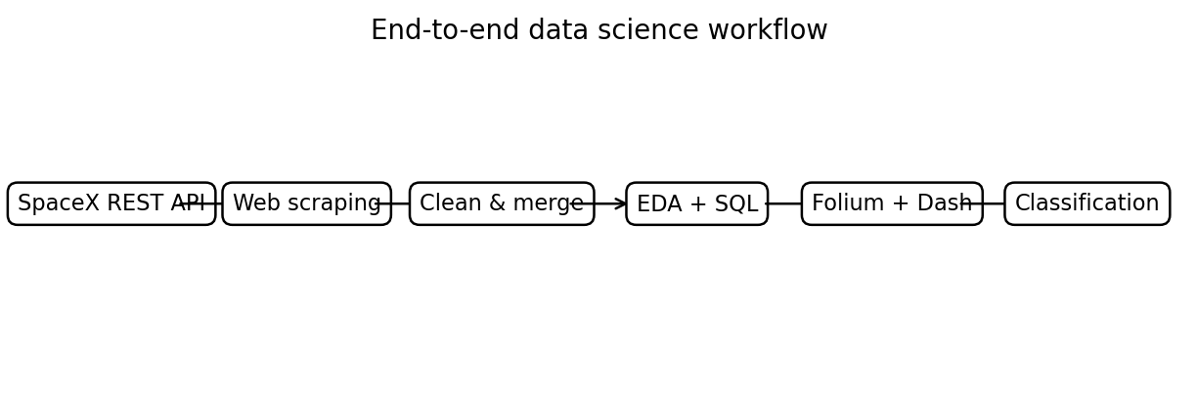
Methodology
1. Collect launch records from the SpaceX REST API.
2. Supplement records using historical launch-page web scraping.
3. Clean missing payload values; standardize fields and create a binary landing class.
4. Explore patterns with charts and SQL.
5. Build Folium map and Plotly Dash dashboard.
6. Train and evaluate Logistic Regression, SVM, Decision Tree, and KNN.

Slide 7
Data Collection
Primary source: SpaceX API — launch records, rocket IDs, launch pads, payloads, and core/landing details.
Secondary source: historical Falcon 9 launch tables collected with Requests and BeautifulSoup.
Normalize JSON into tabular data; join additional details by API identifiers.
Keep the course's prepared date range and record source URLs for reproducibility.

Slide 8
Data Collection – SpaceX API
Present your data collection with SpaceX REST calls using key phrases and flowcharts
Add the GitHub URL of the completed SpaceX API calls notebook (must include completed code cell and outcome cell), as an external reference and peer-review purpose
GET /v4/launches/past (or the fixed course JSON endpoint).
Parse JSON with requests and pandas.json_normalize().
Call rocket, launchpad, payload, and core endpoints to enrich records.
Keep flight number, date, booster, payload mass, orbit, launch site, landing outcome, and coordinates.
Notebook: jupyter-labs-spacex-data-collection-api-v2.ipynb

Slide 9
Data Collection – Scraping
Present your web scraping process using key phrases and flowcharts
Add the GitHub URL of the completed web scraping notebook, as an external reference and peer-review purpose
Requests retrieves the historical launch table; BeautifulSoup parses HTML.
Extract flight number, launch date, booster, launch site, payload, orbit, customer, and launch outcome.
Clean annotations, footnotes, missing values, and inconsistent text.
Export the parsed records as spacex_web_scraped.csv.
Notebook: jupyter-labs-webscraping.ipynb

Slide 10
Data Wrangling
Filter to Falcon 9 launches; reset the flight number sequence.
Inspect data types and missing-value counts.
Impute missing PayloadMass with the column mean; retain missing landing-pad values where no pad was used.
Map landing outcomes into Class: 1 for successful landing and 0 for unsuccessful landing.
Notebook: labs-jupyter-spacex-Data wrangling-v2.ipynb

Slide 11
EDA with Data Visualization
Scatter: Flight Number vs. Launch Site — compare outcomes across sites and flight experience.
Scatter: Payload vs. Launch Site — explore payload patterns by site.
Bar chart: success rate by orbit — compare categories.
Scatter: Flight Number vs. Orbit and Payload vs. Orbit — inspect mission profile trends.
Line chart: yearly average success rate — show changes over time.
Notebook: complete the EDA visualization lab and add its GitHub URL.

Slide 12
EDA with SQL
Distinct launch-site names; launch sites beginning with CCA.
Total NASA (CRS) payload mass and average payload mass for F9 v1.1.
Earliest successful ground-pad landing date.
Booster versions for successful drone-ship landings with payload 4,000–6,000 kg.
Counts of mission outcomes; maximum-payload booster; failed drone-ship outcomes in 2015.
Notebook: add the completed SQL lab and verified query outputs.

Slide 13
Build an Interactive Map with Folium
Use actual launch-site latitude and longitude from the course data.
Add a marker for each launch site; use popups/tooltips for site names.
Color-code launch outcomes to compare successful and unsuccessful landings.
Use circles/lines and distance calculations for nearby coastline, roads, or railways only when supported by the map data.
Save the interactive map as HTML and capture a screenshot for this report.

Slide 14
Build a Dashboard with Plotly Dash
Dropdown: choose a launch site or view all sites.
Pie chart: successful launch counts by site.
Site-specific pie chart: compare successful and unsuccessful outcomes at the selected site.
Scatter plot: payload mass vs. launch outcome; use controls/range slider to explore payload values.
Run the app locally and replace this report preview with your actual dashboard screenshot.

Slide 15
Predictive Analysis (Classification)
Target: Class (successful vs. unsuccessful first-stage landing).
Features: flight number, payload mass, orbit, launch site, booster details, and engineered categorical indicators.
Split: 80% training / 20% test; course notebook uses random_state=2.
Scale features and apply one-hot encoding to categorical variables.
Tune Logistic Regression, SVM, Decision Tree, and KNN with GridSearchCV.
Compare cross-validation scores and held-out test accuracy; inspect the best model's confusion matrix.

Slide 16
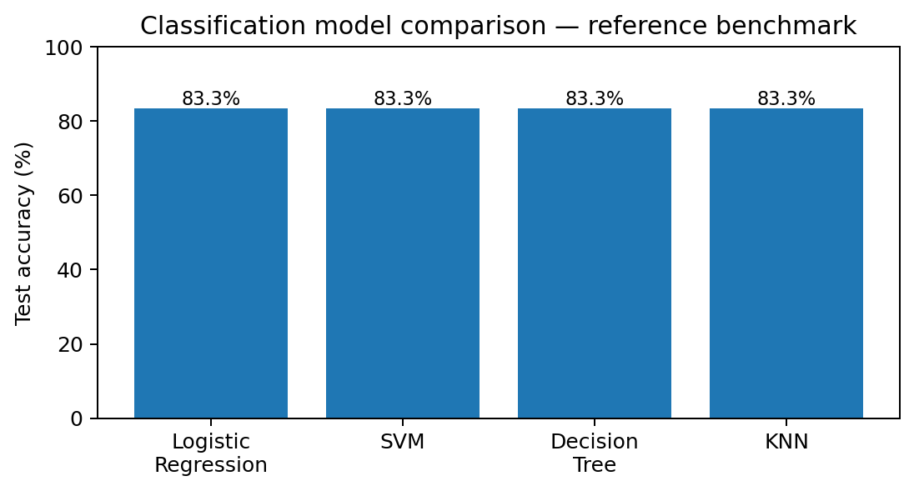
Results
EDA: reported launch success improves after 2013; site, orbit, and payload patterns differ.
SQL: queries summarize launch sites, payloads, landing outcomes, and historical records.
Interactive analytics: Folium shows site geography and outcome markers; Dash supports site/payload filtering.
Predictive analysis: public course-project examples report around 83.3% held-out accuracy for the four baseline models. Your exact output must be verified by running the attached notebook.

Slide 17

Section 2
EXPLORATORY DATA ANALYSIS

Slide 18
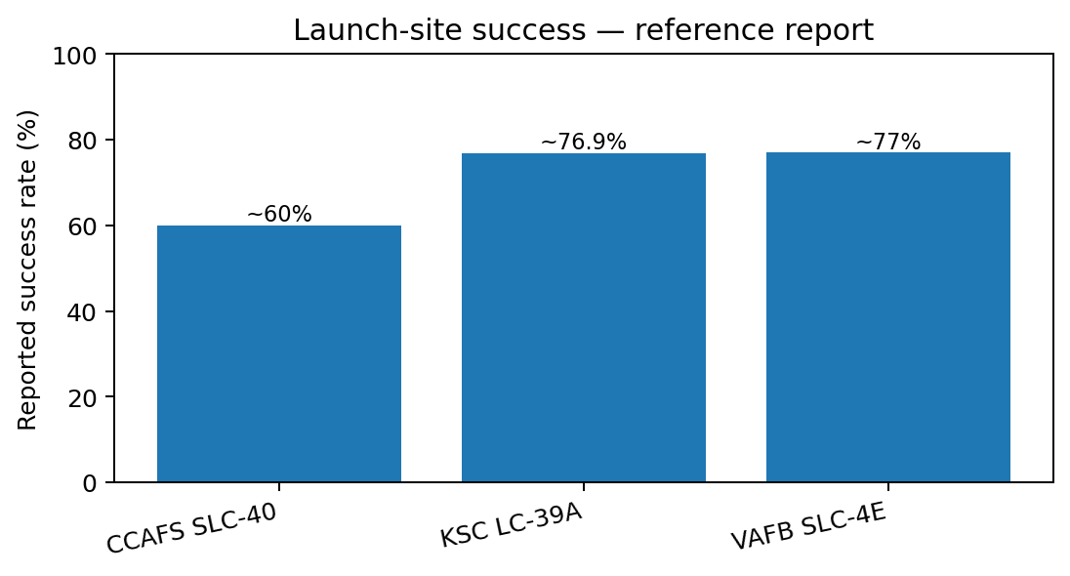
Flight Number vs. Launch Site
Scatter points compare flight sequence with launch site.
Later flights tend to show more successful recoveries, consistent with growing operational experience.
Site groups differ in launch volume; CCAFS SLC-40 is a major launch location.
Interpretation is associational, not proof of causation.
Reference visualization; verify exact figures against your executed course notebook.

Slide 19
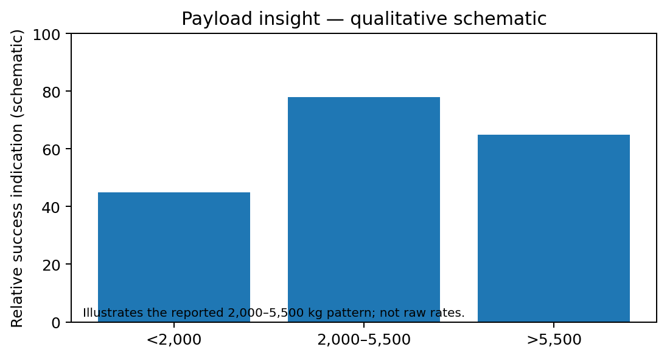
Payload vs. Launch Site
Compare payload mass across launch sites and landing outcomes.
The plot helps reveal whether some sites handle a wider payload range.
Published course analyses report that many lower payload missions launched from CCAFS SLC-40.
Use the notebook chart for the exact point-level distribution.
Reference visualization; verify exact figures against your executed course notebook.

Slide 20
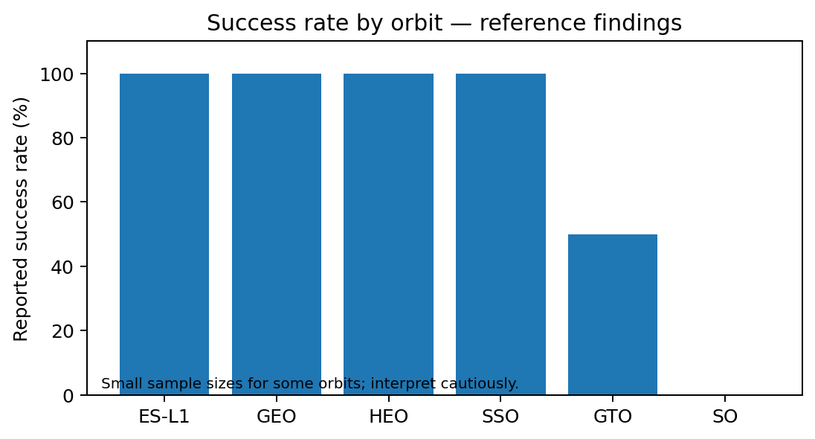
Success Rate vs. Orbit Type
Bar chart compares the fraction of successful landings for each orbit.
Published examples show high rates for ES-L1, GEO, HEO, and SSO; these categories have small sample sizes.
GTO has a larger sample and a more mixed outcome pattern.
Always consider both success rate and number of launches.
Reference visualization; verify exact figures against your executed course notebook.

Slide 21
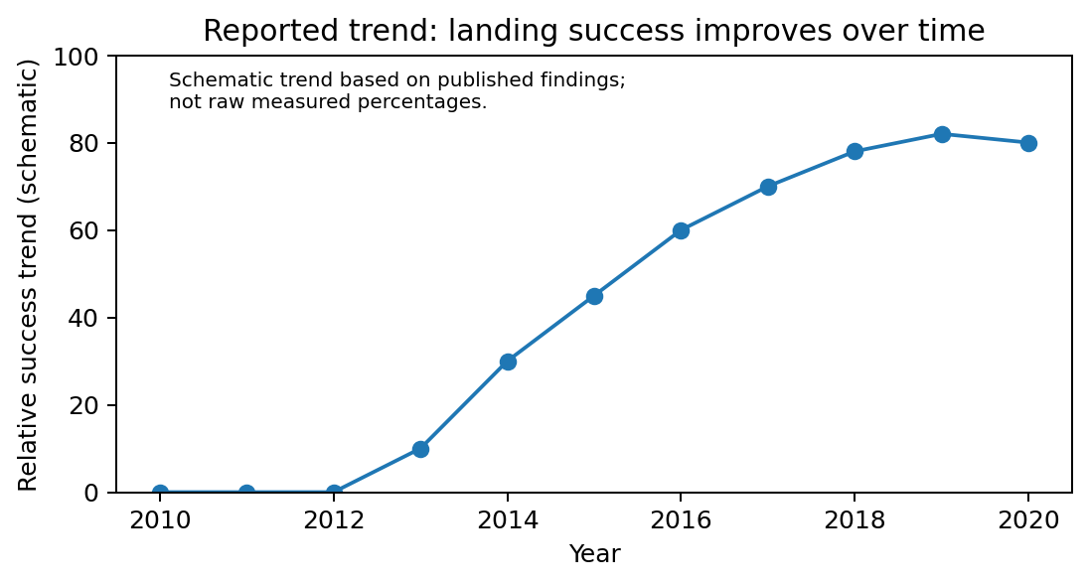
Flight Number vs. Orbit Type
The scatter plot shows how orbit choices changed over the flight sequence.
Course analyses describe a shift in orbit mix over time, including more VLEO missions in later records.
Orbit choice is linked to mission requirements and should not be interpreted as a single cause of landing success.
Reference visualization; verify exact figures against your executed course notebook.

Slide 22
Payload vs. Orbit Type
Compare payload mass distributions across orbit categories.
Payload and orbit are related because each orbit supports different mission needs.
Published analyses note clusters around ISS and GTO payload ranges; exact ranges depend on the selected course dataset.
Use the scatter plot to identify outliers and overlap.
Reference visualization; verify exact figures against your executed course notebook.

Slide 23
Launch Success Yearly Trend
Yearly success rate is the mean of the binary Class target grouped by launch year.
Published course analyses report unsuccessful early attempts and a general improvement after 2013.
By the later years in the course dataset, the success rate is generally above 50%.
Trend suggests learning over time, but mission mix and technology also change.
Reference visualization; verify exact figures against your executed course notebook.

Slide 24
All Launch Site Names
SQL: SELECT DISTINCT Launch_Site FROM SPACEXTBL;
Purpose: list unique launch-site labels.
Expected categories include CCAFS SLC-40, KSC LC-39A, and VAFB SLC-4E; data may include spelling variants.
Insight: normalize inconsistent labels before comparing sites.

Slide 25
Launch Site Names Begin with 'CCA'
SQL: SELECT * FROM SPACEXTBL WHERE LAUNCH_SITE LIKE 'CCA%' LIMIT 5;
Purpose: retrieve the first five records whose site label begins with CCA.
LIKE 'CCA%' uses % as a wildcard for any trailing characters.
Insert the query result from your SQL notebook before submission.

Slide 26
Total Payload Mass
SQL: SELECT SUM(PAYLOAD_MASS__KG_) FROM SPACEXTBL WHERE CUSTOMER = 'NASA (CRS)';
Purpose: aggregate payload mass for NASA Commercial Resupply Services missions.
SUM computes the total over rows matching the customer condition.
Use the exact total returned by your course dataset; it is not printed in the uploaded notebook.

Slide 27
Average Payload Mass by F9 v1.1
SQL: SELECT AVG(PAYLOAD_MASS__KG_) FROM SPACEXTBL WHERE BOOSTER_VERSION = 'F9 v1.1';
Purpose: calculate mean payload mass for booster version F9 v1.1.
AVG ignores null values in the selected column.
Paste the exact result from your SQL lab.

Slide 28
First Successful Ground Landing Date
SQL: SELECT MIN(DATE) FROM SPACEXTBL WHERE Landing__Outcome = 'Success (ground pad)';
Purpose: find the earliest recorded successful ground-pad landing.
MIN returns the earliest date after date formatting is consistent.
Verify the returned date in your completed SQL notebook.

Slide 29
Successful Drone Ship Landing with Payload 4,000–6,000 kg
SQL filters landing outcome to Success (drone ship) and payload mass between 4,000 and 6,000 kg.
The result lists matching booster versions.
This query examines missions where landing method and payload range overlap.
Paste the returned booster-version list from the course SQL output.

Slide 30
Successful and Failure Mission Outcomes
SQL counts rows with mission outcome Success or Failure (in flight).
Purpose: summarize mission completion outcomes; this is distinct from first-stage landing success.
Use GROUP BY MISSION_OUTCOME to show each category separately when possible.
Report the actual counts from the SQL output; do not confuse mission outcome with landing outcome.

Slide 31
Boosters Carrying Maximum Payload
SQL: select booster version(s) whose payload mass equals the maximum payload mass in the table.
Purpose: identify the highest payload record and associated booster version.
MAX(PAYLOAD_MASS__KG_) finds the largest recorded payload.
If multiple records tie, the query may return more than one booster.

Slide 32
2015 Launch Records
Filter records to year 2015 and landing outcome Failure (drone ship).
Return landing outcome, booster version, and launch-site name.
This query isolates a historical subset for troubleshooting and performance review.
Confirm exact rows and dates from the completed SQL notebook.

Slide 33
Rank Landing Outcomes Between 2010-06-04 and 2017-03-20
Filter the date range inclusively, group by landing outcome, count rows, and order descending.
The query compares how frequently each landing outcome occurred during the early learning period.
Use date format YYYY-MM-DD for reliable filtering.
Insert the exact ordered counts from your SQL notebook.

Slide 34

Section 3
INTERACTIVE VISUAL ANALYTICS — FOLIUM

Slide 35
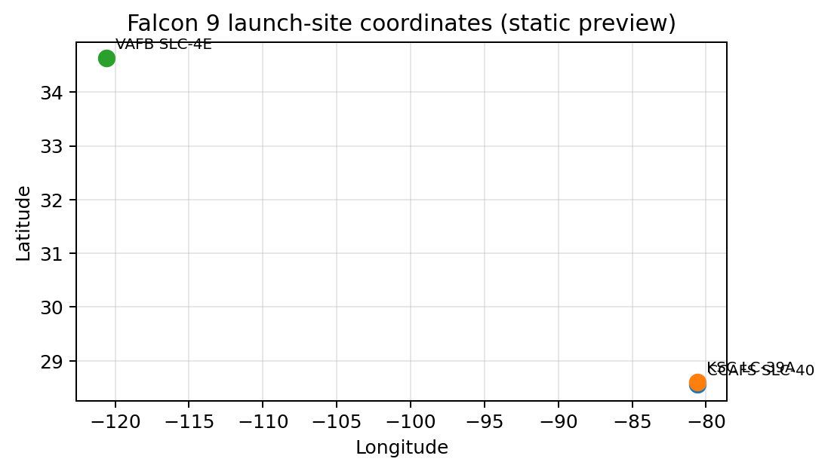
Launch Site Locations on a Global Map
Folium markers identify the three main launch locations in the course dataset.
KSC LC-39A and CCAFS SLC-40 are close together on Florida's Atlantic coast; VAFB SLC-4E is in California.
A static coordinate preview is shown here; the interactive Folium HTML should be generated from your lab notebook.
Map coordinates are approximate reference coordinates, not a replacement for your notebook output.
Reference visualization; verify exact figures against your executed course notebook.

Slide 36
Launch Outcomes by Site
Use marker colors to distinguish successful and unsuccessful first-stage landings.
Popup text should include launch site, flight number, date, and outcome where available.
Compare outcome patterns geographically without implying location alone causes success.
Insert screenshot of the actual interactive Folium map generated by your notebook.
Reference visualization; verify exact figures against your executed course notebook.

Slide 37
Launch Site Proximity Analysis
The course lab measures distance from a selected launch site to nearby features such as coastline, roads, railways, or cities.
Use Haversine distance calculations for coordinates; state units clearly.
Published examples suggest launch sites are near coastlines and separated from populated areas and transport infrastructure.
Insert your actual proximity map screenshot and measured distances.
Reference visualization; verify exact figures against your executed course notebook.

Slide 38

Section 4
INTERACTIVE DASHBOARD — PLOTLY DASH

Slide 39
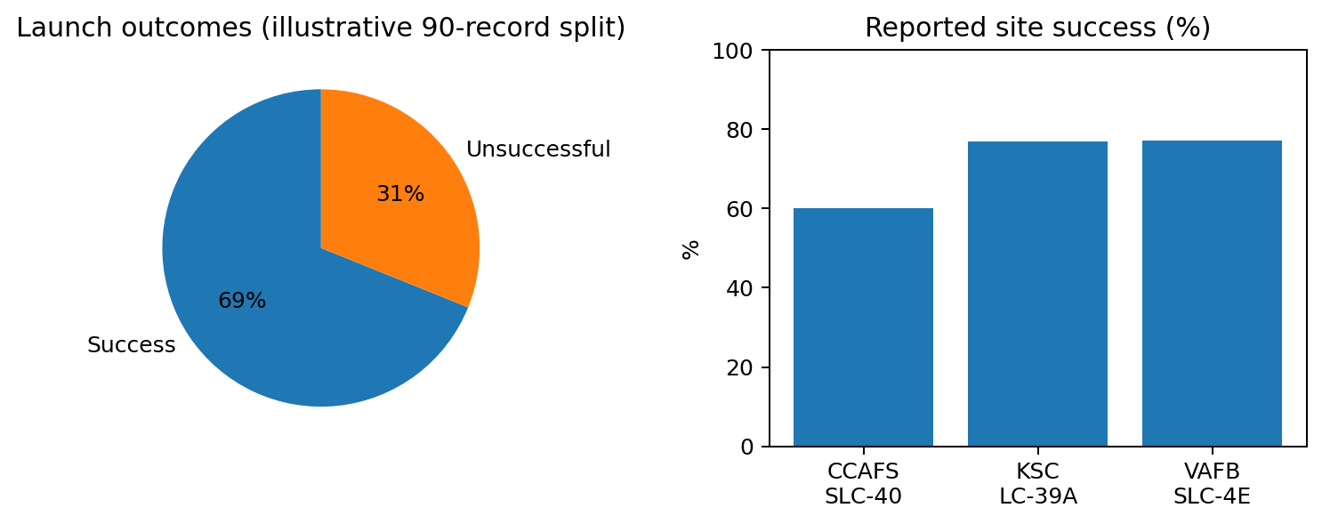
Dashboard: Launch Outcomes Across Sites
A pie chart summarizes successful launch counts by site.
Use the site dropdown to filter the chart and compare the selected site with all sites.
The dashboard is intended to make comparisons quicker than static tables.
Preview graphic is illustrative; replace it with a screenshot from your running Dash app.
Reference visualization; verify exact figures against your executed course notebook.

Slide 40
Dashboard: Site with Highest Success Ratio
Filter to the site with the highest reported success ratio in the chosen dataset.
One published report reports KSC LC-39A at about 76.9%; another reports VAFB SLC-4E at a similar rate.
Small differences in dataset versions and definitions can change the ranking.
Verify the highest ratio in your dashboard before making a definitive claim.
Reference visualization; verify exact figures against your executed course notebook.

Slide 41
Dashboard: Payload vs. Launch Outcome
Scatter plot: payload mass on the x-axis and landing outcome on the y-axis.
Color points by outcome or booster version; use a payload range slider to explore subsets.
Published reference analyses identify a useful payload band around 2,000–5,500 kg, but this should be checked against your dataset.
Use your actual interactive dashboard screenshots for multiple slider settings.
Reference visualization; verify exact figures against your executed course notebook.

Slide 42

Section 5
PREDICTIVE ANALYSIS & CONCLUSIONS

Slide 43
Classification Accuracy
Four baseline models: Logistic Regression, Support Vector Machine, Decision Tree, and K-Nearest Neighbors.
A public course-project benchmark reports 83.33% test accuracy for all four models on an 18-row test split.
Cross-validation can still distinguish models even when held-out accuracy ties.
The chart is a reference benchmark, not a claim that your unexecuted notebook produced these results.
Reference visualization; verify exact figures against your executed course notebook.

Slide 44
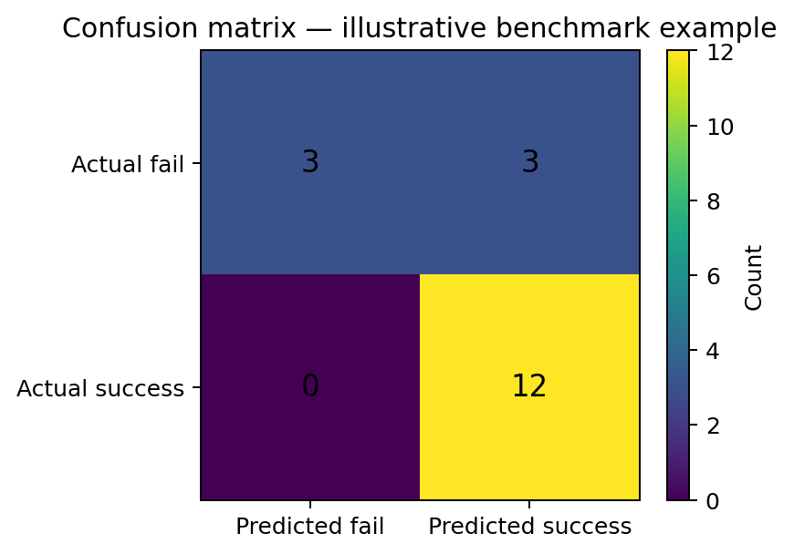
Confusion Matrix
The matrix compares actual outcomes with predicted outcomes.
True positives/negatives are correct classifications; false positives/negatives are errors.
Reference example: 18 held-out cases, 15 correct (83.3% accuracy), with 3 false positives and no false negatives.
Re-run the attached model notebook and replace this example matrix with your own output.
Reference visualization; verify exact figures against your executed course notebook.

Slide 45
Conclusions
Launch recovery success generally improved as SpaceX gained experience.
Launch site, orbit, payload mass, and flight number are useful exploratory features.
The API and web-scraping workflow creates a structured launch dataset for SQL, visualization, and ML.
A classification model can support early planning, but results depend on the dataset and split.
Next steps: rerun notebooks, verify exact metrics and SQL values, capture Folium/Dash screenshots, and add your own GitHub repository URL.

Slide 46
Appendix & References
Uploaded course notebooks: API collection, web scraping, data wrangling, and machine-learning prediction.
IBM Applied Data Science Capstone course materials and submission template.
Reference benchmark and qualitative findings: https://github.com/atahabilder1/IBM-Data-Science-Certificate
Additional example findings: https://www.slideshare.net/slideshow/ibm-data-science-capstone-projectspacex-launch-analysis/250941677
Repository for this submission: NOT CREATED YET — add your own public GitHub URL after uploading your notebooks and Python files.

Slide 47


