Slide 1
Propositional Approaches to First-Order Theorem Proving
David A. Plaisted
UNC Chapel Hill
May 2004

Slide 2
History of AI
Early emphasis on general methods
  Newell Shaw Simon GPS
  Robinson 1965 resolution
  Cordell Green question answering
Shift to specialized techniques
  Feigenbaum Expert Systems
Is logic a suitable basis for AI?

Slide 3
Approaches to AI
Weak vs. strong methods in AI
Declarative vs. procedural knowledge
My interest: general logic-based approaches

Slide 4
Aristotle on Deduction
A deduction is speech (logos) in which, certain things having been supposed, something different from those supposed results of necessity because of their being so. (Prior Analytics I.2, 24b18-20)

Slide 5
Proof
Proof is the idol before whom the pure mathematician tortures himself.
-- Sir Arthur Eddington
You may prove anything by figures. --Thomas Carlyle
What is now proved was once only imagined. -- William Blake

Slide 6
Proof
You cannot demonstrate an emotion or prove an aspiration. -- John Morley
Prove all things; hold fast that which is good. -- Bible, I Thessalonians

Slide 7
Logic
No, no, you're not thinking; you're just being logical. -- Niels Bohr
Logic is one thing and commonsense another. -- Elbert Hubbard, The Note Book, 1927

Slide 8
Theorem Proving
Potentially a key technology for AI
  Brittleness problem for expert systems
An unsolved problem
Weak versus strong methods
Problems with resolution
  Impact on entire field
Importance of space versus time

Slide 9
Theorem Proving on a Computer
Speed and accuracy of computers
People get tired and make mistakes
How do people prove theorems?

Slide 10
Potential applications
Hardware verification
Software verification
AI and expert systems
Robots
Deductive Databases
Semantic web and query answering
Mathematics research
Education

Slide 11
Current theorem provers
Largely syntactic
Resolution or ME (tableau) based
First-order provers are often poor on non-Horn clauses
Rarely can solve hard problems
Human interaction needed for hard problems

Slide 12
How do humans prove theorems?
Semantics
Case analysis
Sequential search through space of possible structures
Focus on the theorem

Slide 13
People versus computers
In a few areas computers are faster
  Propositional calculus
  Equational logic
  Geometry
  More to come in the future
In general people are much better. Why?
  Humans use semantics
  Computers use syntax in most cases

Slide 14
The future
Will provers soon be much more powerful than they are now?
Will they ever be much more powerful than humans?

Slide 15
Organization of the talk
History of ATP
  Contributions of Martin Davis
  Contributions of Alan Robinson
  Achievements of Provers
Propositional Calculus
  Propositional Resolution
  Horn Clauses
  Davis and Putnam’s Method
  The Satisfiability Threshold

Slide 16
Propositional Calculus (continued)
  Performance Obtained
  Applications
Semantics in Theorem Proving
First Order Logic
Clause form and Herbrand’s theorem
Criteria for evaluating provers
Resolution
Otter

Slide 17
Model elimination
Matings
Propositional approaches to first order logic
Clause Linking
Disconnection Calculus
Disconnection Calculus Theorem Prover
First-Order DPLL Method
Replacement Rules
Definitions

Slide 18
OSHL with semantics
Comments on CADE system competition

Slide 19
David Hilbert
Hilbert’s goal was to mechanize mathematics. “Hilbert’s Program.”
Goedel showed that this is impossible.
Automatic theorem proving tries to mechanize what can be mechanized.

Slide 20
Martin Davis
Theorem Proving on Computers
Davis and Putnam’s Method
Clause Form Refutational Theorem Proving
Foreshadowing of Resolution

Slide 21
Alan Robinson
Resolution in First-Order Logic
Unification in a Clause Form Refutational Prover
  Many non-resolution methods are still in this tradition
First reasonably powerful theorem prover for first-order logic

Slide 22
Achievements of Provers
Robbins Problem Solution
Hardware Verification
Prolog
Constraints
Quasigroup existence and nonexistence
Equivalential calculus axiom systems
Euclidean and non-Euclidean geometry

Slide 23
Achievements of Provers
Verification of communication networks
Basketball scheduling
Planning
RRTP and description logic

Slide 24
Propositional Calculus
Formulae are composed of Boolean variables p,q,r, … and Boolean connectives:
∧ (conjunction, “and”)
∨ (disjunction, “or”)
¬ (negation, “not”)
⊃ (implication, “if then”)
≡ (equivalence, “if and only if”)

Slide 25
Example formula
  p ∧ q ⊃ p
Interpretation:
  “It is raining” and “It is Tuesday” implies “It is raining.
Another interpretation:
  “All birds are green” and “All fish are purple” implies “All birds are green.”
Both interpretations make the formula true.
The formula is valid (true in all interps.)

Slide 26
Another example formula:
  p ∧ q ⊃ ¬ p
Interpretation:
  2=2 ∧ 3=3 ⊃ 2 ≠ 2
Another interpretation:
  2=2 ∧ 3 ≠ 3 ⊃ 2 ≠ 2
The first interpretation makes the formula false.
The second makes it true.
The formula is not valid.

Slide 27
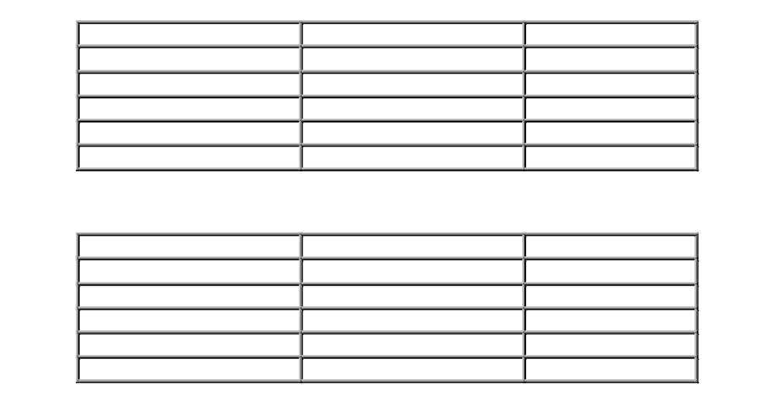
Truth Tables

Slide 28
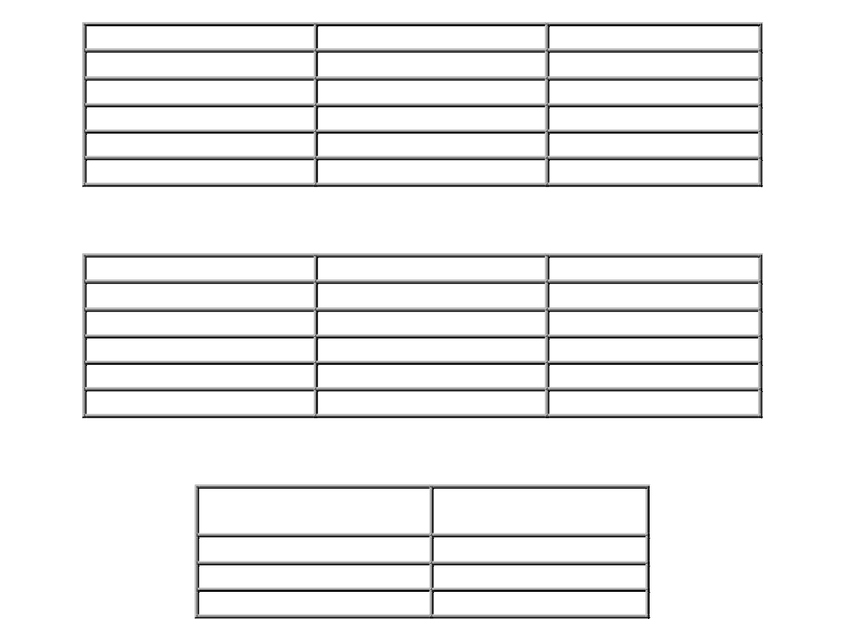

Slide 29
Interpretations assign meanings to symbols.
In Boolean logic interpretations assign truth values (true, false) to the symbols.
An interpretation in Boolean logic is called a valuation.
Thus a valuation I is an assignment of truth values (true or false) to each variable in a formula

Slide 30


A valid formula
A satisfiable invalid formula

Slide 31

An unsatisfiable formula: P ∧ ¬P

Slide 32
Testing Validity
Using truth tables is exponential
Resolution
Davis and Putnam’s Method
Local Search Methods

Slide 33
Hsiang’s Method
Test satisfiability using Boolean ring operations
Express formulas using “exclusive or” instead of ordinary disjunction
Each formula has a unique canonical form
Leads to a different style of theorem proving

Slide 34
Conjunctive Normal Form
Any propositional formula can be put into conjunctive normal form (clause form).
Example:
(p ∨ q ∨ ¬r) ∧ (¬p ∨ r) ∧ (¬q ∨ r)
Represent as sets:
{p, q, ¬r}, {¬p, r}, {¬q, r}
{
{
{
clause
clause
clause

Slide 35
Conjunctive Normal Form
A formula in conjunctive normal form is unsatisfiable if for every interpretation I, there is a clause C that is false in I.
A formula in cnf is satisfiable if there is an interpretation I that makes all clauses true.

Slide 36
Binary Resolution Step
  For any two clauses C₁ and C₂, if there is a literal L₁ in C₁ that is complementary to a literal L₂ in C₂, then delete L₁ and L₂ from C₁ and C₂ respectively, and construct the disjunction of the remaining clauses. The constructed clause is a resolvent of C₁ and C₂.
Examples of Resolution Step
  C₁=a ∨ ¬b, C₂=b ∨ c
    Complementary literals : ¬b,b
    Resolvent: a ∨ c
  C₁=¬a ∨ b ∨ c, C₂=¬b ∨ d
    Complementary literals : b, ¬b
    Resolvent : ¬a ∨ c ∨ d

Slide 37
Resolution in Propositional Logic
  1. a ← b ∧ c a ∨ ¬b ∨ ¬c
  2. b b
  3. c ← d ∧ e c ∨ ¬d ∨ ¬e
  4. e ∨ f e ∨ f
  5. d ∧ ¬ f d
  ¬ f

Slide 38
Resolution in Propositional Logic (continued)
  First, the goal to be
  proved, a , is negated
  and added to the
  clause set.
  The derivation of []
  indicates that the
  database of clauses
  is inconsistent.
¬a a ∨ ¬b ∨ ¬c
¬b ∨ ¬c b
¬c c ∨ ¬d ∨ ¬e
e ∨ f ¬d ∨ ¬e
d f ∨ ¬d
f ¬f
[]

Slide 39
Horn clauses
At most one positive literal
Basis of Prolog
Satisfiability can be tested in linear time
Resolution is fast for Horn clauses
Resolution is very slow for non Horn clauses
Horn clauses: ¬p ∨ ¬q ∨ r, ¬p ∨ ¬q ∨ ¬ r, r
Non Horn clause: ¬p ∨ q ∨ r

Slide 40
DPLL (Davis and Putnam’s Method)
(Purity rule omitted)
If no clauses in KB, return T (Satisfiable)
If a clause in KB is empty (FALSE), return F (Unsatisfiable)
If KB has a unit clause C with prop. p, then return DPLL(KB,p←polarity(p,C))
Choose an uninstantiated variable p
If DPLL(KB, p←TRUE) returns T, return T
If DPLL(KB, p←FALSE) returns T, return T
Return F

Slide 41
DPLL Example
{p,r},{¬p,¬q,r},{p,¬r}
p=T
p=F
{T,r},{¬T,¬q,r},{T,¬r}
{F,r},{¬F,¬q,r},{F,¬r}
SIMPLIFY
SIMPLIFY
{¬q,r}
{r},{¬r}
SIMPLIFY
{}

Slide 42
DPLL Viewed Abstractly
The call DPLL(KB, p←TRUE) is testing interpretations where p is TRUE
The call DPLL(KB, p←FALSE) is testing interpretations where p is FALSE
In this way, interpretations are examined in a sequential manner
For each interpretation, a reason is found that the formula is false in it
Such a sequential search of interpretations is very fast

Slide 43
DPLL (Davis and Putnam’s method), contiued
DPLL does a backtracking search for a model of the formula
DPLL is much faster than propositional resolution for non-Horn clauses
Very fast data structures developed
Popular for hardware verification
Local search can be much faster but is incomplete

Slide 44
“Systematic methods can now routinely solve verification problems with thousands or tens of thousands of variables, while local search methods can solve hard random 3SAT problems with millions of variables.”
(from a conference announcement)

Slide 45
NP Complete but Easy
How can the satisfiability problem be so easy when it is NP complete?
If there are many clauses the proof is likely to be short and can be found quickly
If there are few clauses there are likely to be many interpretations and one is likely to be found quickly
The hard problems are in the middle at the “satisfiability threshold”

Slide 46
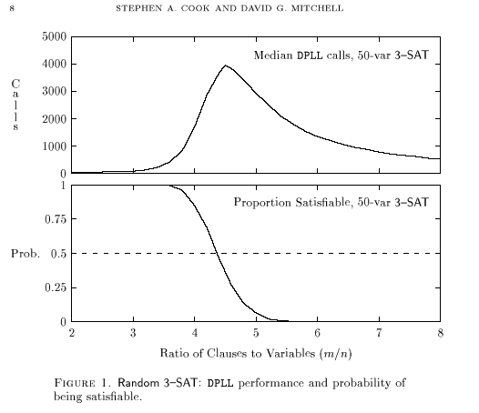

Slide 47
First Order Logic
Formulae may contain Boolean connectives and also variables x, y, z, …, predicates P,Q,R, …, function symbols f,g,h, …, and quantifiers ∀ and ∃ meaning “for all” and “there exists.”
Example: ∀x(P(x) ⊃ ∃yQ(f(x),y))

Slide 48
Individual Constants
Formulae can also contain constant symbols like a,b,c which can be regarded as functions of no arguments.
Example: ∀x(P(x) ⊃ Q(x,c))

Slide 49
Consider the formula ∃y∀xP(x,y) ⊃ ∀x∃yP(x,y). Let the domain be the set of people, and let P(x,y) be “x loves y”.
The formula then is interpreted as “if there exists y such that for all x, x loves y, then for all x, there exists y such that x loves y.” In other words, if there is someone that everyone loves, then everyone loves someone.
The formula is true under this interpretation.

Slide 50
In fact this formula is true under all interpretations, and is a valid formula.
Consider this formula: ∀x∃yP(x,y) ⊃ ∃y∀xP(x,y). Under the same interpretation, this formula becomes “If for all x, there exists y such that x loves y, then there exists y such that for all x, x loves y.”
In other words, if everyone loves someone, then there is someone that everyone loves.
This formula is false under this interpretation and is not a valid formula.

Slide 51
Clauses
An atom is a predicate symbol followed by arguments, as, P(a, f(x)).
A literal is an atom or its negation, as, ¬P(a,f(x)).
A clause is a disjunction of literals, often written as a set.
Example: {¬p(x), p(f(x))} for ¬p(x) ∨ p(f(x))
A conjunction of clauses is also written as a set, as, {C1, C2, C3} signifying C1 ∧C2 ∧ C3.

Slide 52
Substitutions
A substitution Θ is an assignment of terms to variables.
If C is a clause then C Θ is C with the substitution applied uniformly.
Thus {P(x)}{x ← f(a)} is {P(f(a))}.
C Θ is called an instance of C. If C Θ has no variables, it is called a ground instance of C.

Slide 53
Semantics
Gelernter 1959 Geometry Theorem Prover
Adapt semantics to clause form:
An interpretation (semantics) I is an assignment of truth values to literals so that I assigns opposite truth values to L and ¬L for atoms L.
The literals L and ¬L are said to be complementary.

Slide 54
Semantics
╨
We write I C (I satisfies C) to indicate that semantics I makes the clause C true.
If C is a ground clause then I satisfies C if I satisfies at least one of its literals.
Otherwise I satisfies C if I satisfies all ground instances D of C. (Herbrand interpretations.)
If I does not satisfy C then we say I falsifies C.

Slide 55
Example Semantics
Specify I by interpreting symbols
Interpret predicate p(x,y) as x = y
Interpret function f(x,y) as x + y
Interpret a as 1, b as 2, c as 3
Then p(f(a,b),c) interprets to TRUE but p(a,b) interprets to FALSE
Thus I satisfies p(f(a,b),c) but I falsifies p(a,b)

Slide 56
Obtaining Semantics
Humans using mathematical knowledge
Automatic methods (finite models)
Trivial semantics

Slide 57
Herbrand’s Theorem
A set S of clauses is unsatisfiable if there is a finite unsatisfiable set T of ground instances of S.
The basis of uniform proof procedures.
Example: S = {{p(a)},{¬p(x), p(f(x))}, {¬p(f(f(a)))}}
T = {{p(a)},{¬p(a), p(f(a))}, {¬p(f(a)), p(f(f(a)))}, {¬p(f(f(a)))}}

Slide 58
{p(a)} {¬p(x), p(f(x))} {¬p(f(f(a)))}
{p(a)}
{¬p(a), p(f(a))}
{¬p(f(a)), p(f(f(a)))}
{¬p(f(f(a)))}

Slide 59
Criteria to evaluate provers
Don’t know versus don’t care nondeterminism
Clauses generated by need or possibility
Instantiation by unification or by semantics or neither
Clauses selected by semantics
Goal sensitivity
Space versus time

Slide 60
Resolution Principle
Steps for resolution refutation proofs
  Put the premises or axioms into clause form.
  Add the negation of what is to be proved, in clause form, to the set of axioms.
  Resolve these clauses together, producing new clauses that logically follow from them.
  Produce a contradiction by generating the empty clause.
  This is possible if and only if the theorem is valid. (Completeness)

Slide 61
Prove that “Fido will die.” from the statements “Fido is a dog.”, “All dogs are animals.” and “All animals will die.”
  Changing premises to predicates
    ∀(x) (dog(X) → animal(X))
    dog(fido)
  Modus Ponens and {fido/X}
    animal(fido)
    ∀(Y) (animal(Y) → die(Y))
  Modus Ponens and {fido/Y}
    die(fido)

Slide 62
Equivalent Reasoning by Resolution
  Convert predicates to clause form
  Predicate form Clause form
  1. ∀(x) (dog(X) → animal(X)) ¬dog(X) ∨ animal(X)
  2. dog(fido) dog(fido)
  3. ∀(Y) (animal(Y) → die(Y)) ¬animal(Y) ∨ die(Y)
  Negate the conclusion
  4. ¬die(fido) ¬die(fido)

Slide 63
Equivalent Reasoning by Resolution(continued)
¬dog(X) ∨ animal(X)
¬animal(Y) ∨ die(Y)
{Y/X}
dog(fido)
¬dog(Y) ∨ die(Y)
{fido/Y}
die(fido)
¬die(fido)
Resolution proof for the “dead dog” problem

Slide 64
Skolemization
  Skolem constant
    (∃X)(dog(X)) may be replaced by dog(fido) where the name fido is picked from the domain of definition of X to represent that individual X.
  Skolem function
    If the predicate has more than one argument and the existentially quantified variable is within the scope of universally quantified variables, the existential variable must be a function of those other variables.
    (∀X)(∃Y)(mother(X,Y)) ⇒ (∀X)mother(X,m(X))
    (∀X)(∀Y)(∃Z)(∀W)(foo (X,Y,Z,W))
    ⇒ (∀X)(∀Y)(∀W)(foo(X,Y,f(X,Y),W))

Slide 65
Resolution on the predicate calculus
  A literal and its negation in parent clauses produce a resolvent only if they unify under some substitution σ. σ is then applied to the resolvent before adding it to the clause set.
  C₁ = ¬dog(X) ∨ animal(X)
  C₂ = ¬animal(Y) ∨ die(Y)
  Resolvent : ¬dog(Y) ∨ die(Y) {Y/X}
  C₁ = ¬p(X) ∨ q(f(X)) C₂ = ¬q(Y) ∨ r(g(Y))
  Resolvent: ¬p(X) ∨ r(g(f(X)))

Slide 66
“Lucky student”
  1. Anyone passing his history exams and winning the lottery is happy
    ∀X(pass(X,history) ∧ win(X,lottery) → happy(X))
  2. Anyone who studies or is lucky can pass all his exams.
    ∀X∀Y(study(X) ∨ lucky(X) → pass(X,Y))
  3. John did not study but he is lucky
    ¬study(john) ∧ lucky(john)
  4. Anyone who is lucky wins the lottery.
    ∀X(lucky(X) → win(X,lottery))

Slide 67
Clause forms of “Lucky student”
  1. ¬pass(X,history) ∨ ¬win(X,lottery) ∨ happy(X)
  2. ¬study(X) ∨ pass(Y,Z)
  ¬lucky(W) ∨ pass(W,V)
  3. ¬study(john)
  lucky(john)
  4. ¬lucky(V) ∨ win(V,lottery)
  5. Negate the conclusion “John is happy”
  ¬happy(john)

Slide 68
Resolution refutation for the “Lucky Student” problem
¬pass(X, history) ∨ ¬win(X,lottery) ∨ happy(X) win(U,lottery) ∨ ¬lucky(U)
{U/X}
¬pass(U, history) ∨ happy(U) ∨ ¬lucky(U) ¬happy(john)
{john/U}
lucky(john) ¬pass(john,history) ∨ ¬lucky(join)
{}
¬pass(john,history) ¬lucky(V) ∨ pass(V,W)
{john/V,history/W}
¬lucky(john) lucky(john)
{}

Slide 69
Evaluating resolution
Clauses generated by possibility (bad)
Don’t care nondeterminism (good)
Unification based (good?)
No semantics (bad)
Uses a large amount of space (bad)
Often not goal sensitive (bad)

Slide 70
Refinements
Many refinements of resolution have been developed in an attempt to improve its performance
Set of support
Hyper resolution
Ancestry filter form
Unit preference
…

Slide 71
Semantics and Resolution
Bonacina and Hsiang idea : Lemmas
Maria Paola Bonacina and Jieh Hsiang. On semantic resolution with lemmaizing and contraction and a formal treatment of caching. New Generation Computing, 16(2):163--200, 1998.

Slide 72
Otter
PROBLEM SEC CLAUSES KEPT
LCL064-1.in 0.14 1080844 8604
LCL064-2.in 0.00 9448 1954
LCL065-1.in 0.00 2992 653
LCL066-1.in 0.00 1452 306
LCL067-1.in 0.14 492984 9283
LCL068-1.in 0.29 569577 9593
LCL069-1.in 0.00 3577 288
LCL070-1.in 0.14 427166 8840
LCL071-1.in 0.29 449389 8941
LCL072-1.in 0.00 161139 6280

Slide 73
Model Elimination (Loveland)
Much like resolution but constructs trees
Typically goal sensitive (good)
Unification based
Clauses generated by need (good)
Don’t know nondeterminism (bad)
Probably space inefficient

Slide 74
Matings (Andrews)
Unification done globally on the entire set of clauses in an attempt to make them unsatisfiable, not locally as in resolution
Clauses generated by need (good)
Space efficient (good)
Unification based
Does not use semantics
Don’t know nondeterminism (bad)

Slide 75
Hyper Linking
Separates instantiation and inference
Given S, selects clauses C and D in S and literals L in C and M in D, and generates instances C’ and D’ so that L’ and M’ are complementary. Then C’ and D’ are added to S.
Periodically S is tested for unsatisfiability using DPLL.

Slide 76
Hyper Linking

Slide 77
Evaluating Hyper Linking
Don’t care nondeterminism (good)
Clauses generated by possibility (bad)
Uses unification (good?)
Can be goal sensitive
Somewhat space efficient

Slide 78
Eliminating Duplication with the Hyper-Linking Strategy, Shie-Jue Lee and David A. Plaisted, Journal of Automated Reasoning 9 (1992) 25-42.

Slide 79
Later propositional strategies
Billon’s disconnection calculus, derived from hyper-linking
Disconnection calculus theorem prover (DCTP), derived from Billon’s work
FDPLL

Slide 80
Performance of DCTP on TPTP, 2003
First in EPS and EPR (largely propositional)
Third in FNE (first-order, no equality) solving same number as best provers
Fourth in FOF and FEQ (all first-order formulae, and formulae with equality)
Not tuned to 50 categories!

Slide 81
Definition Detection

Slide 82
Replacement Rules with Definition Detection, David A. Plaisted and Yunshan Zhu, in Caferra and Salzer, eds., Automated Deduction in Classical and Non-Classical Logics, LNAI 1761 (1998) 80-94.

Slide 83
Structure of OSHL
Goal sensitivity if semantics chosen properly
  Choose initial semantics to satisfy axioms
Use of natural semantics
  For group theory problems, can specify a group
Sequential search through possible interpretations
  Thus similar to Davis and Putnam’s method
  Propositional Efficiency
Constructs a semantic tree

Slide 84
Ordered Semantic Hyperlinking (Oshl)
Reduce first-order logic problem to propositional problem
Imports propositional efficiency into first-order logic
The algorithm
  Imposes an ordering on clauses
  Progresses by generating instances and refining interpretations
I0 I1 I2 I3 …
D0 D1 D2 T
  unsatisfiable

Slide 85
OSHL
I₀ is specified by the user
D_{i} is chosen so that I_{i} falsifies D_{i}
D_{i} is an instance of a clause in S
I_{i} is chosen so that I_{i} satisfies D_{j} for all j < i
Let T_{i} be {D₀,D₁, …, D_{i-1}}.
  I_{i} falsifies D_{i} but satisfies T_{i}
  When T_{i} is unsatisfiable OSHL stops and reports that S is unsatisfiable.

Slide 86
Rules of OSHL
(C₁,C₂, …, C_{n}), D minimal contradict I
(C₁,C₂, …, C_{n},D)
(C₁,C₂, …, C_{n}), C_{n} not needed
(C₁,C₂, …, C_{n-1},D)
(C₁,C₂, …, C_{n},D), max resolution possible
(C₁,C₂, …, C_{n-1},res(C_{n},D,L))

Slide 87
Example
()
({-p1,-p2,-p3})
({-p1,-p2,-p3},{-p4,-p5,-p6})
({…},{…},{-p7})
({…},{…},{-p7},{p3,p7})
({…},{-p4,-p5,-p6},{p3})
({-p1,-p2,-p3},{p3})
({-p1,-p2})

Slide 88
Number of Clauses Generated
Problem #clauses, Otter Oshl+semantics
GRP005-1 57 3
GRP006-1 62 7
GRO007-1 85 22
GRP018-1 266 16
GRP019-1 267 15
GRP020-1 265 18
GRP021-1 264 19
GRP023-1 79 22
GRP032-3 83 14
GRP034-3 141 30
GRP034-4 222 6
GRP042-2 21 15
GRP043-2 80 81
GRP136-1 0 8
GRP137-1 0 8

Slide 89
Engineering Issue
OSHL generates about 10 clauses per second
Otter generates more than a million clauses per second
A factor of 100,000 in engineering!
Need to look at search space sizes rather than times

Slide 90
Evaluating OSHL
Clauses generated by need (good)
Don’t care nondeterminism (good)
Instantiates using semantics (good)
Goal sensitive (good)
Space efficient (good)
No unification (bad?)
Need for more engineering

Slide 91
TPTP library by Geoff Sutcliffe & Christian Suttner
  Thousands of problems for theorem provers
  Used to benchmark first order theorem provers
  Contains 6973 theorems at present
CASC competition by Sutcliffe et al.
  Every year: who has the fastest/most accurate first order theorem prover on the planet?
  Uses blind test from the TPTP library
  Current chamption: Vampire
    By Voronkov and Riazonov in Manchester

Slide 92
CADE System Competition
The issue of 50 categories
The 300 seconds issue

Slide 93
Summary
Efficiency of DPLL
First-Order Theorem Proving
Resolution
Propositional Approaches
Clause Linking
DCTP and the CADE Competition
Semantics
OSHL

