Slide 1


P. R. Pote (Patil) College of Engineering & Management, Amravati (An Autonomous Institute) Department of Computer Science & Engineering
Mini Project Presentation on
“Project Monitoring System”
Presented By
Miss. Pranjali Bobade Miss. Prapti Tembhurne
Miss. Pratiksha Daberao Miss. Rani Hingawe
Miss. Rutuja Khandekar Miss. Sai Kadu
Miss. Savari Sable Miss. Shradha Parihar
Miss. Shrushti Pandit Miss. Srushti Bhokare
Guided By
Prof. A. D. Chokhat
Year 2026-27

Slide 2
Contents
Introduction
Literature Survey
Methodology
Application
Advantages and Disadvantages
Implications
Limitations and Future Scope
References

Slide 3
1. Introduction
Traditional project tracking depends on paper records and spreadsheets, which can result in lost submission history, delayed feedback, and manual errors.
Management and HODs often lack centralized visibility into project milestones, student progress, guide reviews, and pending activities.
The Project Monitoring System is a role-based web application that connects the Project Head, Guides, and Students on a single platform.
It manages the complete project lifecycle: Guide Allocation → Synopsis Submission → Guide Review → Project Development → Progress Reports → Presentations → Final Report → Completion.
The system enables real-time status updates, feedback, and notifications across all stakeholders.
It is developed using React.js, HTML, CSS, JavaScript, Spring Boot, and MySQL.

Slide 4
2. Literature Survey
Existing system | Limitations
Manual/Paper-Based Systems | Records are maintained physically, with no proper backup, real-time visibility, or centralized access.
Spreadsheet-Based Tracking | Improves organization but lacks role-based access, automation, and validation, resulting in manual errors.
Generic LMS/ERP Platforms | Platforms such as Moodle and Google Classroom support content sharing but lack guide allocation, milestone review, and presentation scheduling features.
Existing Academic Portals | Usually support only students or administrators and do not connect the Project Head, Guide, and Student in one workflow.

Slide 5
3. Methodology
Architecture: React.js → REST API → Spring Boot → MySQL.
Design: Layered structure using Controller, Service, Repository, and Entity for maintainability.
Workflow: Project Head allocates guides; students submit reports; guides review and verify submissions.
Tracking: Students and guides receive updates on submissions, reviews, corrections, and project progress
Security: Spring Security with BCrypt password hashing and role-based access.
Database: MySQL stores users, projects, milestones, submissions, and presentations
Development: Setup → Authentication → Dashboards → Core Modules → Testing → Deployment.

Slide 6
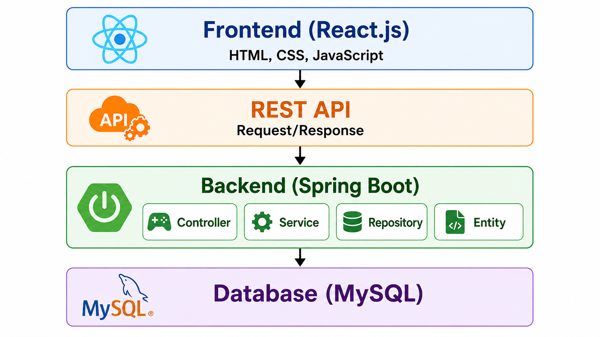
Methodology - System Architecture

Slide 7
4. Application
Engineering and Technical Colleges: Manage mini and major projects, synopsis submissions, and guide–student coordination.
Department Monitoring: Help HODs track project progress, milestones, deadlines, and guide workload.
Guide–Student Collaboration: Centralize feedback, corrections, notifications, and communication without relying on email or manual follow-up.
Institutional Reporting: Maintain structured project records for accreditation and academic audits.
Extendable Model: Adapt the role-based structure for internship tracking, research supervision, and other academic activities.

Slide 8
5. Advantages and Disadvantages
Advantages | Disadvantages
Centralized records — replaces scattered paperwork and spreadsheets | No public registration — accounts must be pre-created by management
Online and offline submission tracking with proof of submission | No email/SMS/OTP integration — password recovery needs manual intervention
Guide verification with correction history and version tracking | Requires stable internet access to use the system
Role-based access ensures data visibility only where needed | File storage needs regular maintenance
Real-time notifications and in-app communication | Users need initial training to adopt the new system
Reports and analytics support better decision-making

Slide 9
6. Implications
For Institutions: Shifts project evaluation from a manual, paper-driven process to a transparent, digitally governed one — a model other departments could adopt
For Guides: Reduces informal, ad-hoc tracking (WhatsApp/email/verbal updates) with a structured, accountable review process
For Students: Encourages timely submissions and better documentation habits, since every action is recorded and visible
For Software Practice: Demonstrates practical application of role-based access control and layered architecture in a real academic use case
Broader Relevance: Reflects a growing shift toward digital, ERP-style systems in education — relevant beyond just project monitoring

Slide 10
7. Limitations and Future Scope
Limitations
Requires pre-created accounts — no self-registration for new users
Password recovery depends on manual intervention by management (no OTP/email reset)
System functionality depends on stable internet connectivity
Uploaded files require ongoing storage management and maintenance
New users require basic training to adopt the system

Slide 11
Limitations and Future Scope
Future Scope
Mobile Application — extend access beyond desktop/web
AI-Assisted Insights — predictive tracking of delays and student performance trends
Visual Project Timelines — Gantt-style charts for milestone planning
Plagiarism Detection — automated originality checks on submitted reports
ERP/LMS Integration — connect with existing institutional systems
Digital Signatures — enable formal, paperless approvals

Slide 12
8. References
React – Official Documentation, https://react.dev
Spring Boot – Official Documentation, https://spring.io/projects/spring-boot
Spring Security – Reference Documentation, https://spring.io/projects/spring-security\
MySQL – Reference Manual, https://dev.mysql.com/doc
Ferraiolo, D. F., Kuhn, D. R., Chandramouli, R. — Role-Based Access Control, Artech House, 2007\
"Design of Web-Based Project Management System with Multi-Level Role-Based Access Control," Journal of Computer Science and Informatics Engineering, 2024

Slide 13
Thank You

