Slide 1

Does the Castle Doctrine Affect Robberies?
Group 10
Sumit Kumar | Lydia Savatsky | Yujun Wang | Pranav Chakradhar

Slide 2



What is castle doctrine and stand your ground?
Permit deadly force in self-defense in their homes
STAND YOUR GROUND is an extension of castle doctrine
Permit deadly force in self-defense in public

Slide 3
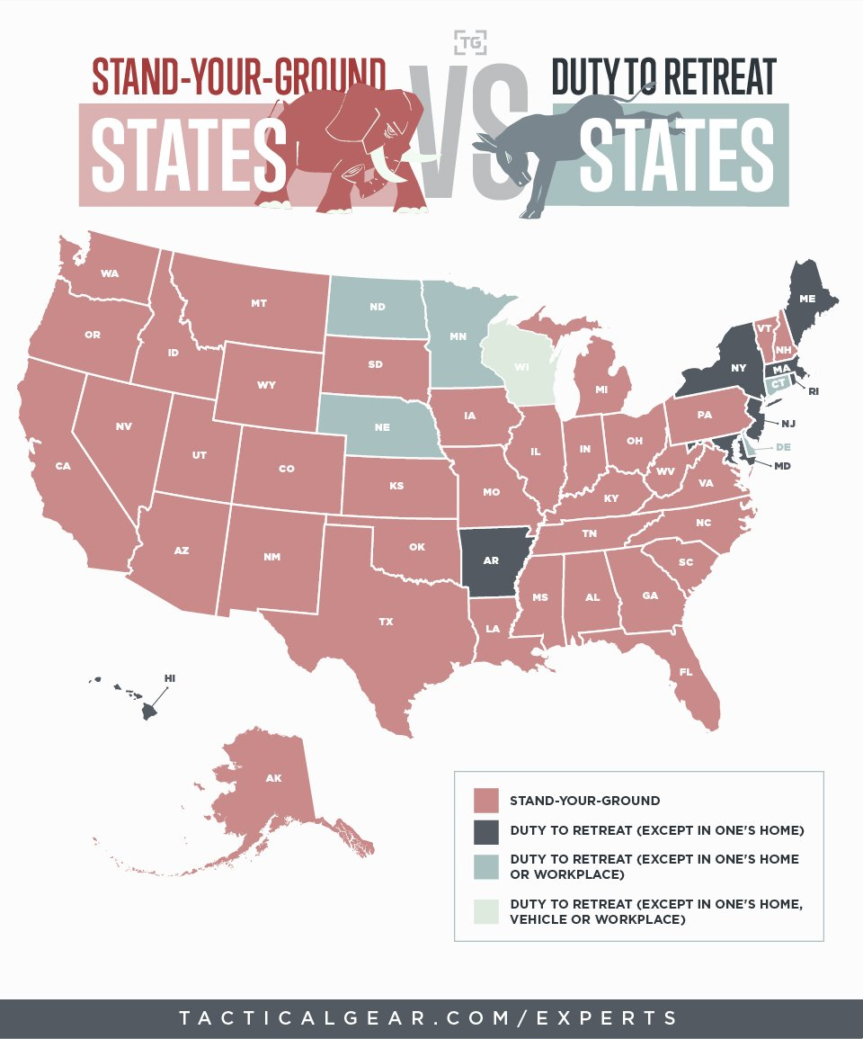
We are interested in…
We want to discover how the implementation of Stand Your Ground affected robberies in the United States, specifically Florida.

Slide 4
Effects of Castle Doctrine on Crimes
After the Stand Your Ground legislation, overall number of crimes (homicide, robbery, assault, burglary, larceny, murder) started increasing from 2006-2008 in Florida, but there was a decreasing trend in the long run
Robberies increased in the first two years but dramatically decreased to normal level in 2010 after the Stand Your Ground law was implemented in Florida in 2006
It took about a year for the law to impact the number of crimes

Slide 5



Overview
Explore dataset
Threats to causality
Our Approach

Slide 6
Dataset Exploration
Panel Data: Crime rates for years 2000-2010 for 50 states (from FBI)
Treatment Group: Florida
Control Group: States which did not pass the Stand Your Ground Law until 2010(30 states)
Output Variable: Robbery per 100,000 state population
Important Features:
- Unemployment rate
- Poverty
- % of black male aged 15-24 and 25-44
- % of white male aged 15-24 and 25-44

Slide 7
Overview
Explore dataset
Threats to causality
Our Approach

Slide 8
Threats to causality
Stand Your Ground and robberies are uncorrelated
Free from endogeneity
Omitted variables bias
Measurement error bias
Simultaneity bias

Slide 9
Overview
Explore dataset
Threats to causality
Our Approach

Slide 10
Our Approach
Assumptions:
Parallel Trends
No interference
Synthetic Control Method to estimate effect of intervention at aggregate level by averaging over set of unaffected states
Placebo Test: To check Anticipation Effect, we moved the treatment a few years earlier than it really was

Slide 11
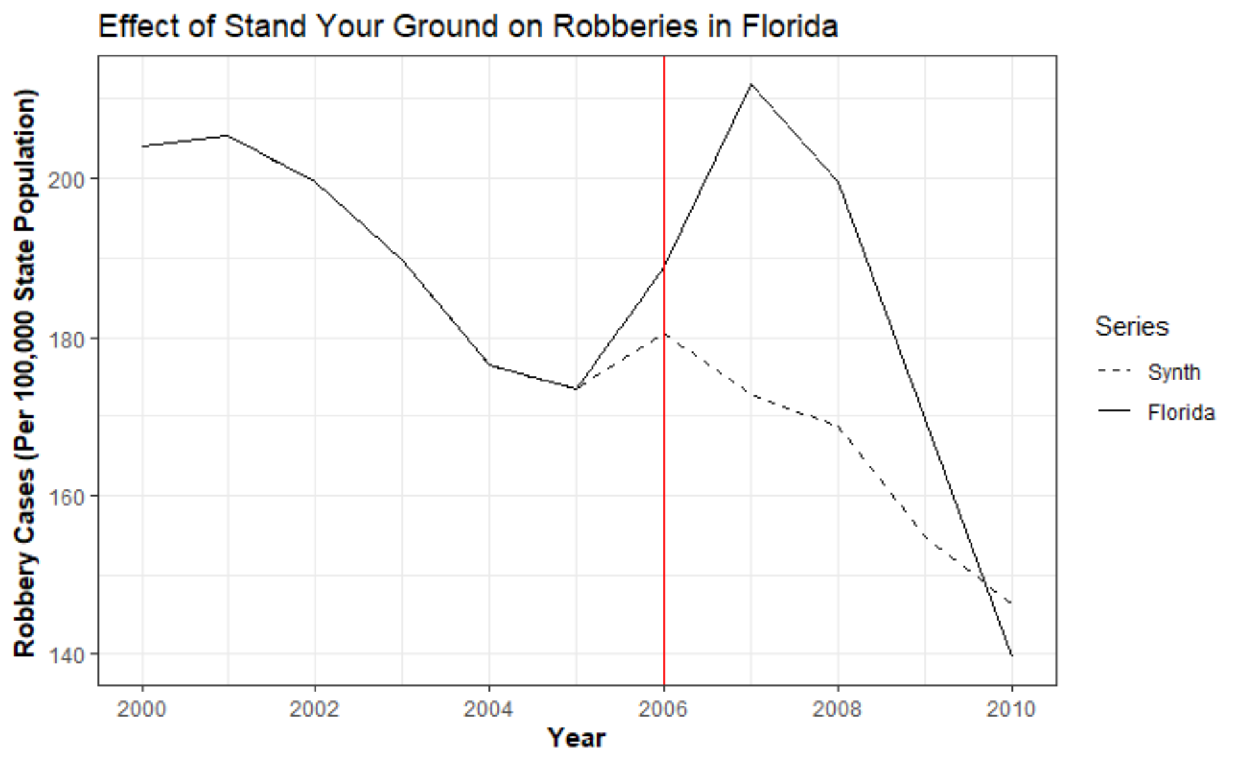
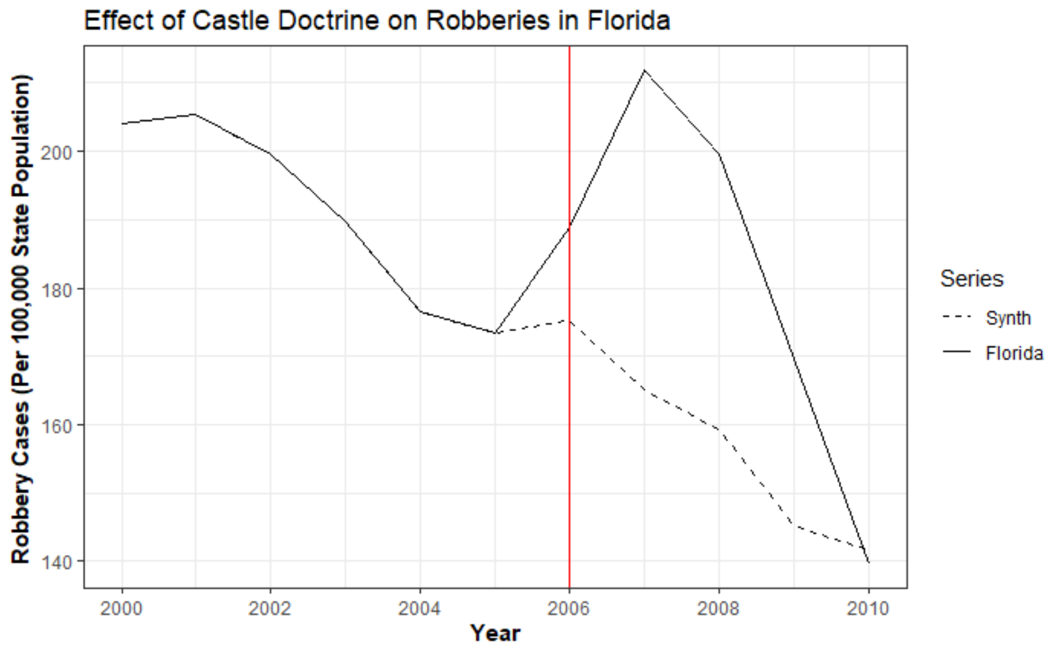
Decreasing Trend on Robberies
- States for Synthetical trend:
Arkansas
Idaho
Illinois
Nebraska

Slide 12
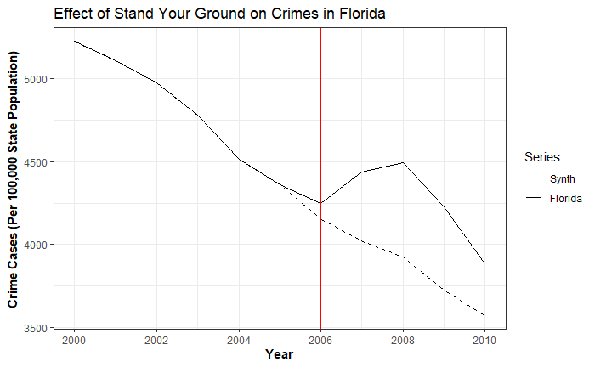
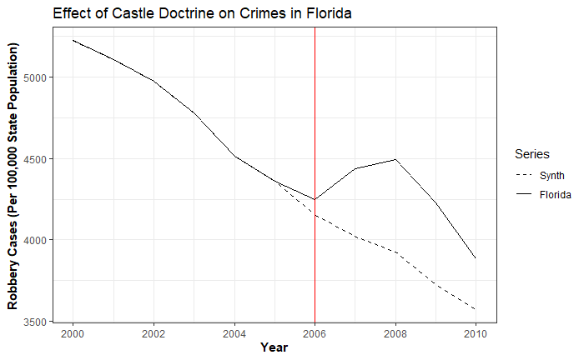
Decreasing Trend on Overall Crime Rates

Slide 13
Summary
For a law to have an impact on crime rate, there is a primacy effect which accounts for the increasing trend from 2005-2007 before the sharp decrease for Florida
Although robbery increased for first 2 years, it decreased more dramatically from 2007 in Florida after the law released. In 2010, the robbery back to a relative low level
Florida should continue to use synthetic control method to determine if the new policies that they implement affect crimes

Slide 14
Limitations
If we had the data after year 2010, we would want to check if the trend continues to decrease to be sure that robberies do decrease after Stand Your Ground
If we had more granular data, we would look into
- Location and time of crime
- Income data
- Education rate
- Homelessness rate

Slide 15
Questions?

