Slide 2
THE FOLLOWING PRESENTATION HAS BEEN APPROVED FOR
ALL AUDIENCES
BY SOMEONE WHO REALLY LIKES VISIO
THE FILM ADVERTISED HAS BEEN RATED
V
VISUAL
UNDER 17 REQUIRES ACOMMPANYING PARENT OR ADULT GUARDIAN

Slide 3
PRESENTER’S NOTE
The original presentation took place during the PowerShell Summit 2014 in Bellevue Washington.
This is a video has been re-mastered from the original to enhance your viewing experience.

Slide 4
PowerShell + Visio = Crazy Delicious
PowerShell Summit 2014
April 28th- 30th Bellevue, WA
Saveen Reddy
saveenr@microsoft.com
saveenr@live.com

Slide 5
About Me

Slide 6
I am not on the Visio team
I just really like it a lot
How I use Visio
I don’t use fancy Stencils
Conceptual Diagrams
Simple Charting / Posters
Software Design & Architecture
User Interface Design
Basic Shapes > Rectangle

Slide 7
Walk away with two things
A New Appreciation for Visio
How using PowerShell will save you time with Visio

Slide 8
How did I end up writing a PowerShell module for Visio?

Slide 9
It began with this diagram
Sent in a daily email
Can’t I just get Visio to draw it for me?

Slide 10
Understanding Visio

Slide 11
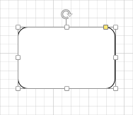
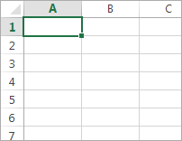
Which application is most like Visio?
Word
Excel
PowerPoint
Publisher
Outlook
Visio Shapes are like Excel Spreadsheets
Visio Terminology:
ShapeSheets

Slide 12
Unfortunately, no one can be told what the ShapeSheet is. You have to see it for yourself.
- Chris Roth

Slide 13

Chris Roth, “The Visio Guy”
Author of “Using Visio 2010”
http://visguy.com

Slide 14
VISIO SHAPESHEET DEMO

Slide 16

ShapeSheet enables more expressivity
Background created in Visio 2007

Slide 17



You can create something fanciful….
Created in Visio 2007

Slide 18


Or be practical
Created in Visio 2013
No bitmaps, no imported content. Everything drawn in Visio.
Total time to draw
8 Hours

Slide 19
VisioPS A PowerShell module for Visio

Slide 20
Scenarios
Automate basic tasks / Time Savers
Diagram Analysis (Shape connectivity, Shape Data)
Drawings from data
Directed graphs / Flowcharts
Trees & Org-Charts
Data Import/Export
Reporting & Simple Graphing

Slide 21
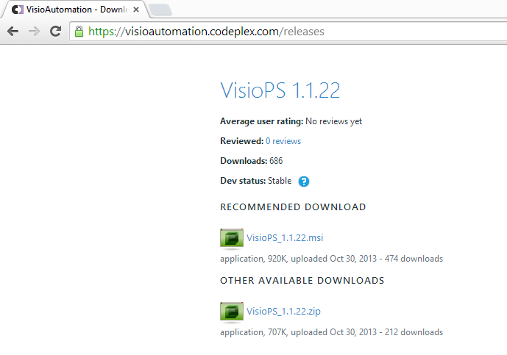
Where to get it
Download link
https://visioautomation.codeplex.com/releases
On CodePlex
Part of the VisioAutomation Project
MSI
ZIP

Slide 22
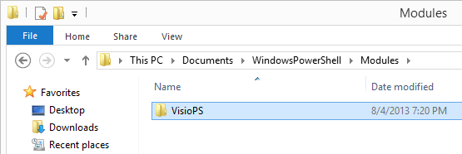
Installation Information
The MSI places the contents here

Slide 23
What are People Doing with it
Transform Data -> Diagrams
Creating Diagrams from Data (SQL, etc.)
Diagrams -> Data & Actions
Creating Deployment scripts
Configuring System Center
Validating Models

Slide 24
A Note on Visio Versions
Visio 2010
VisioPS works best with Visio 2010
Visio 2013
VisioPS mostly works with Visio 2013.
I am still sorting out some issues.

Slide 25
VISIOPS DEMO

Slide 27
Architecture

Slide 28
Directed Graph Layout
MSAGL.dll
Core library
VisioAutomation.dll
PowerShell Module
VisioPS.dll
PowerShell.exe
VisioAutomation.Scripting.dll
Simplifies Writing Clients

Slide 29
How it Works
VisioPS
Thin layer over VisioAutomation.Scripting.DLL
Deals with PowerShell-specific work
VisioAutomation
Dramatically simplifies common developer tasks when automation Visio from .NET applications
VisioAutomation.Scripting
Simplifies writing interactive tools that control Visio
VisioPS
Visio Power Tools 2010
High-Performance – uses more advanced (harder) Visio object APIs
Context-Sensitive (Application, Current Document, Current Selection)

Slide 30
Contact Information
Blogs
Personal http://viziblr.com
Work: http://blogs.msdn.com/saveenr
Dev communities
https://github.com/saveenr
https://www.codeplex.com/site/users/view/saveenr
Email
Personal: saveenr@live.com
Work: saveenr@microsoft.com

Slide 31
References
Drawing the iOS 7 User Interface with Microsoft Visio 2013
http://viziblr.com/news/2013/10/29/drawing-the-ios-7-user-interface-with-microsoft-visio-2013.html

Slide 32
Thank You!

Slide 34
Backup

Slide 35
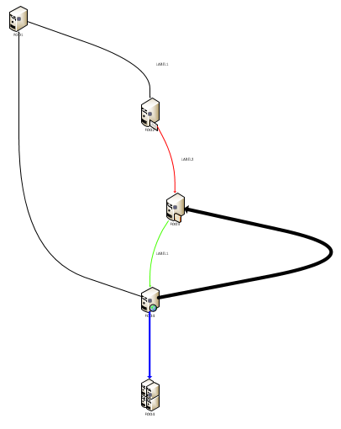
Directed Graphs

Slide 36
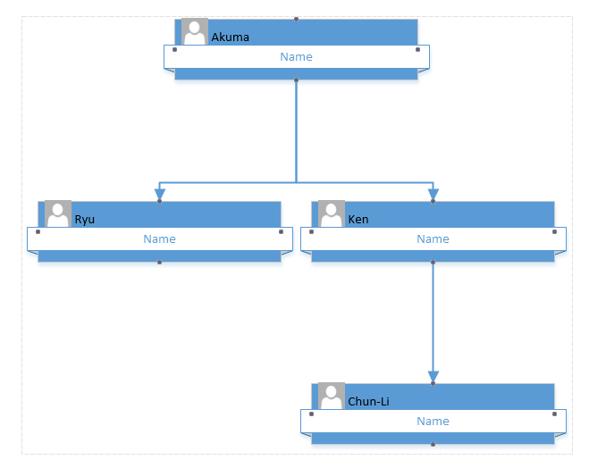
Org Charts Visio 2013
Notice that the Person’s name is in the wrong place

