Slide 1
PHYS 298
Spring 2017
Week 10:
Conservation of angular momentum
Static equilibrium
Simple harmonic motion and NSL
Simple harmonic motion and energy
For week 10:
Videos: Conservation of angular momentum
Static equilibrium
Simple harmonic motion
Reading: 11.4, 12.1 – 12.3, 13.1 – 13.5
Announcements:
Hand-in homework #9 is due at noon on Tuesday, March 21
Recitation sections will not meet this week. You will still turn in your quiz before class on Thursday. The quiz will be posted to Blackboard after class on Tuesday.
Objectives:
By the end of week 10, students should be able to…
Apply conservation of angular momentum to situations where the net external torque equals zero or has a component equal to zero.
Define mechanical equilibrium for an object and use the definition to solve for unknown forces or torques acting on an object.
Recognize the form of the equation for the displacement of a simple harmonic oscillator as a function of time.
Relate the angular frequency of a simple harmonic oscillator to its period and frequency.
Calculate the period and angular frequency of a spring-and-mass system and a simple pendulum.
Determine the total mechanical energy for a spring-and-mass system and use conservation of energy to relate the speed of the mass to its displacement.

Slide 2
PHYS 298
Spring 2017
EX1:
A 3.0-m-diameter merry-go-round with a rotational inertia of 10 kg m² is spinning at a rate of 0.50 rev/s. A 25-kg child jumps on the edge of the merry-go-round. What is the new angular speed if the child…?
(a) sits straight down
(b) runs and jumps onto the merry-go-round with a speed of 3.0 m/s in the direction the merry-go-round is spinning
(c) runs and jumps onto the merry-go-round with a speed of 3.0 m/s in the opposite direction as the one the merry-go-round is spinning

Slide 3
PHYS 298
Spring 2017
GW1:
The figure below shows the overhead views of a series of uniform rods on which forces act perpendicularly to the rod. If the magnitudes of the forces are adjusted properly (but kept non-zero), which of the rods can be in static equilibrium?
1
2
3
4
5
6

Slide 4
PHYS 298
Spring 2017
EX2:
A diver of weight 500 N stands at the end of a diving board of length L = 4 m and negligible mass. The board is fixed to two pedestals separated by distance d = 1.5 m. What are the magnitudes and directions of the forces exerted on the board by the two pedestals?

Slide 5
PHYS 298
Spring 2017
EX3:
A uniform ladder of length L = 12 m and mass m = 15 kg leans against a frictionless wall at an angle of 30° with the wall. A firefighter of mass M = 72 kg climbs the ladder until he is at a point L/3 from the top of the ladder. What are the magnitudes of the forces on the ladder from the wall and ground?

Slide 6
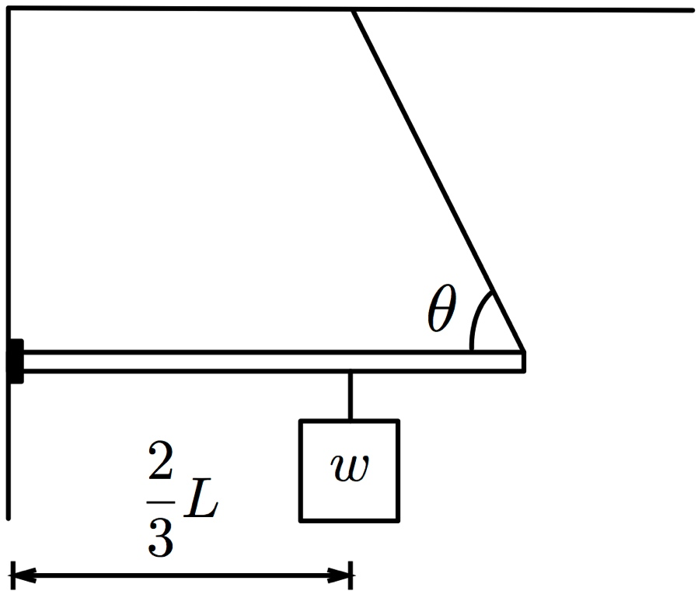
PHYS 298
Spring 2017
EX4:
A beam with a weight of 100 N is attached on one end to a wall with a hinge. The other end of the beam is connected to a cable that makes an angle of 60.0° with the beam as shown in the figure below. A sign with a weight of 150 N hangs from a cable that is attached to the beam at a point two-thirds of its length away from the wall.
What is the tension in the cable?
What is the magnitude and direction of the force exerted on the beam by the hinge?

Slide 7
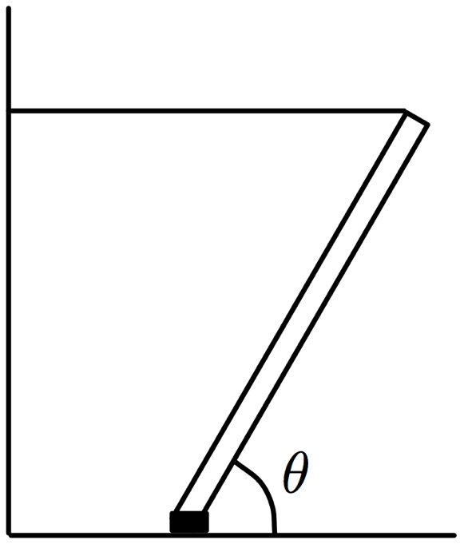
PHYS 298
Spring 2017
GW2:
A beam with a weight of 500 N is connected to the ground with a hinge. The beam makes an angle of θ = 60.0° with the ground and is held in place by a horizontal cable that is tied off to a wall.
What is the tension in the cable?
What is the magnitude and direction of the force exerted on the beam by the hinge?

Slide 8
PHYS 298
Spring 2017
Linear SHOs
Angular SHOs
Equations of motion for SHM
Maximum values

Slide 9
PHYS 298
Spring 2017
For all SHOs:
For specific SHOs:
Angular frequency
Period
Spring-and-mass system
Simple pendulum
Physical pendulum

Slide 10
PHYS 298
Spring 2017
t

Slide 11
PHYS 298
Spring 2017
GW1:
A mass is attached to a spring, pulled away from equilibrium, and then released at time t = 0 s. After it has been released, the mass undergoes simple harmonic motion. In terms of the period T of the motion of the mass, how long after t = 0 would you need to wait for the first two times for each of the following to occur?
The speed of the mass is a maximum
The mass returns to its original position
The mass comes to a stop
All of the energy of the mass is in kinetic energy
All of the energy of the mass is in potential energy

Slide 12
PHYS 298
Spring 2017
GW2:
A SHO oscillates back and forth on a frictionless surface with a maximum displacement from equilibrium of 30 cm. Over a complete period, where does the oscillator spend more time?
Less than 15 cm away from equilibrium
More than 15 cm away from equilibrium
It spends the same amount of time less than 15 cm away from equilibrium as it does more than 15 cm away

Slide 13
PHYS 298
Spring 2017
Notes:
13

Slide 14
PHYS 298
Spring 2017
Notes:
14

Slide 15
PHYS 298
Spring 2017
GW3:
A SHO oscillates back and forth on a frictionless surface with a maximum displacement from equilibrium of 30 cm. At what position does the kinetic energy of the oscillator equal the potential energy stored in the spring?
Less than 15 cm away from equilibrium
Exactly 15 cm away from equilibrium
More than 15 cm away from equilibrium

Slide 16
PHYS 298
Spring 2017
EX1:
A 0.50-kg block is attached to one end of a spring with a constant k = 200 N/m. The spring is mounted horizontally so that the block slides back and forth on a frictionless surface. The block is pulled a distance of 0.40 m away from equilibrium and released.
What is the maximum speed of the block?
How long after it is released is the block traveling at half its maximum speed?
What is the maximum acceleration of the block?
What is the speed and magnitude of the acceleration of when the block has moved half of the way back to equilibrium?
What is the kinetic, potential, and total energy of the block at the halfway point?

Slide 17
PHYS 298
Spring 2017
Notes:
17

