Slide 1
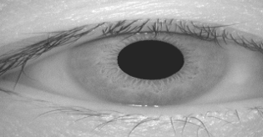
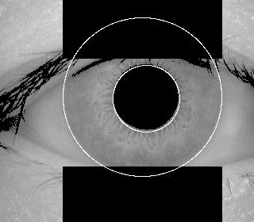
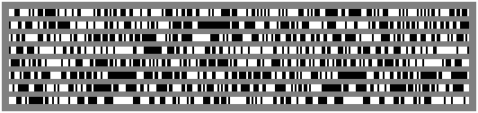
Iris Recognition System
Input Image
Segmentation
Sclera
Iris
pupil
Image
Normalization
Feature
Extraction
Data base of iris Blue print
Matching of
Blue print
Authentication
Basic blocks of iris recognition system

Slide 2
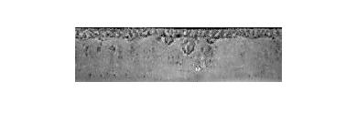
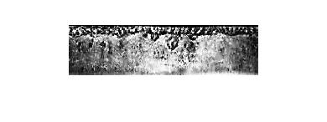
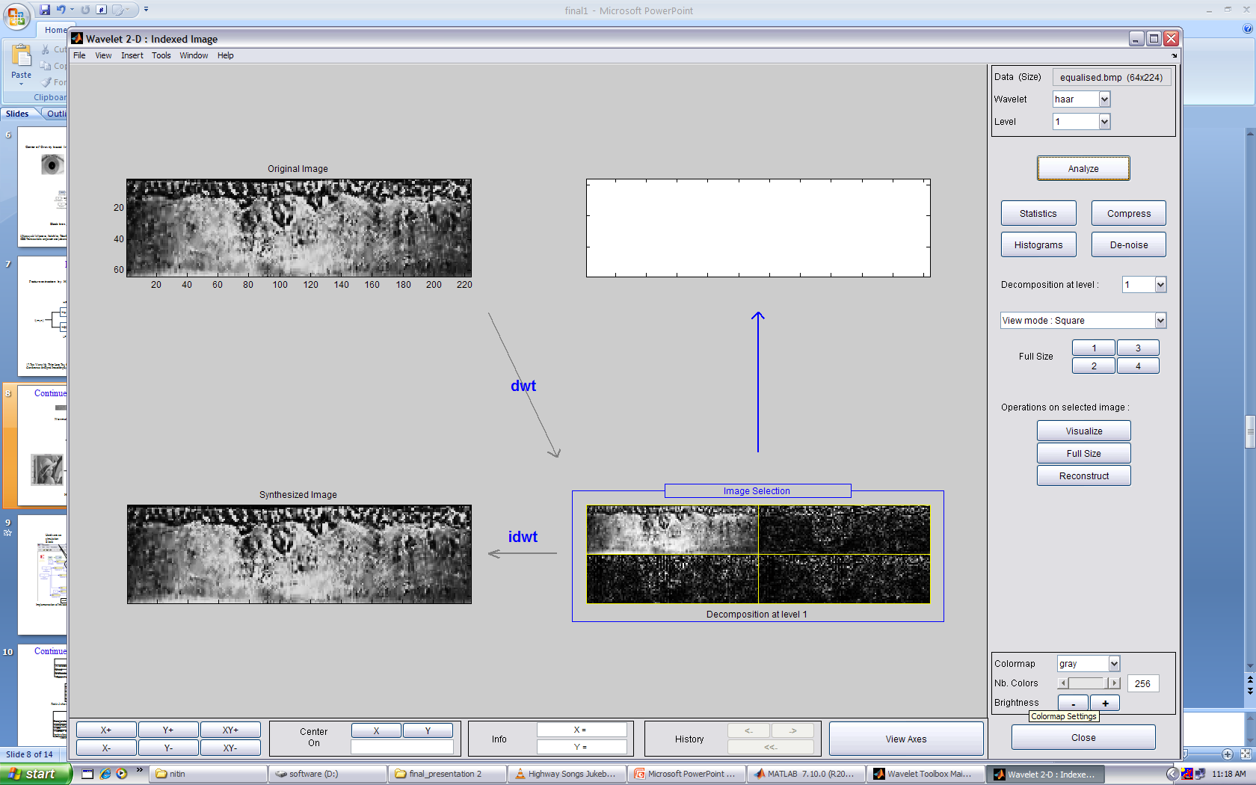
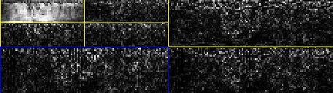
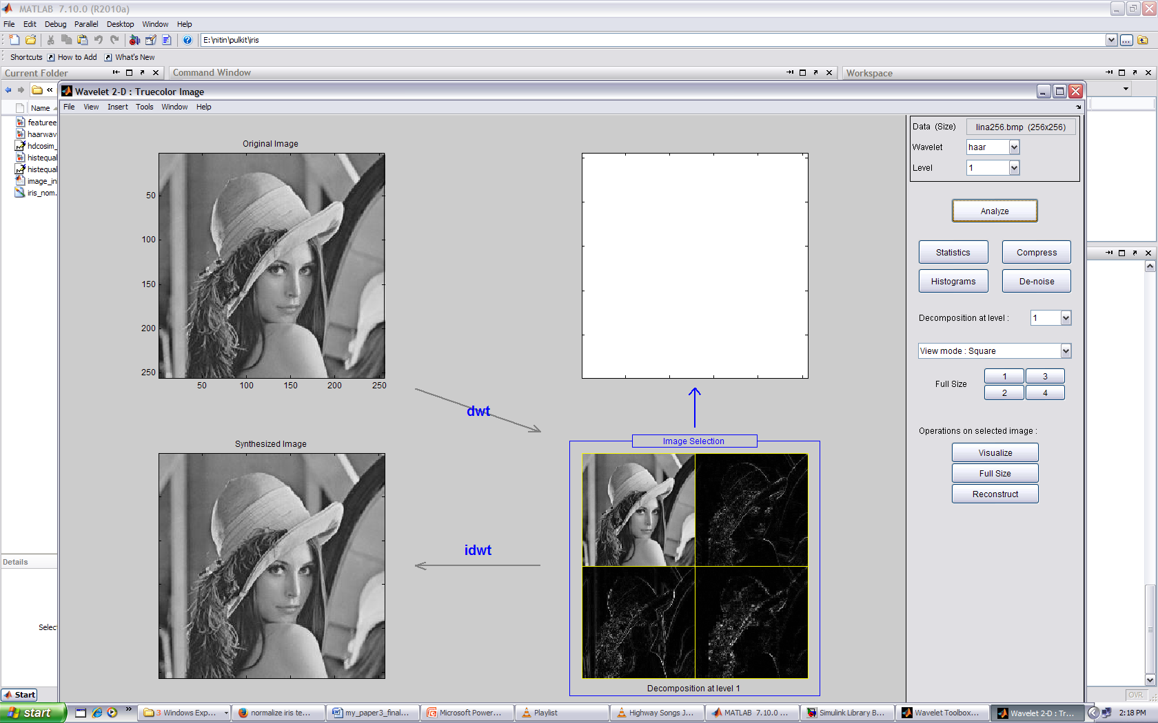
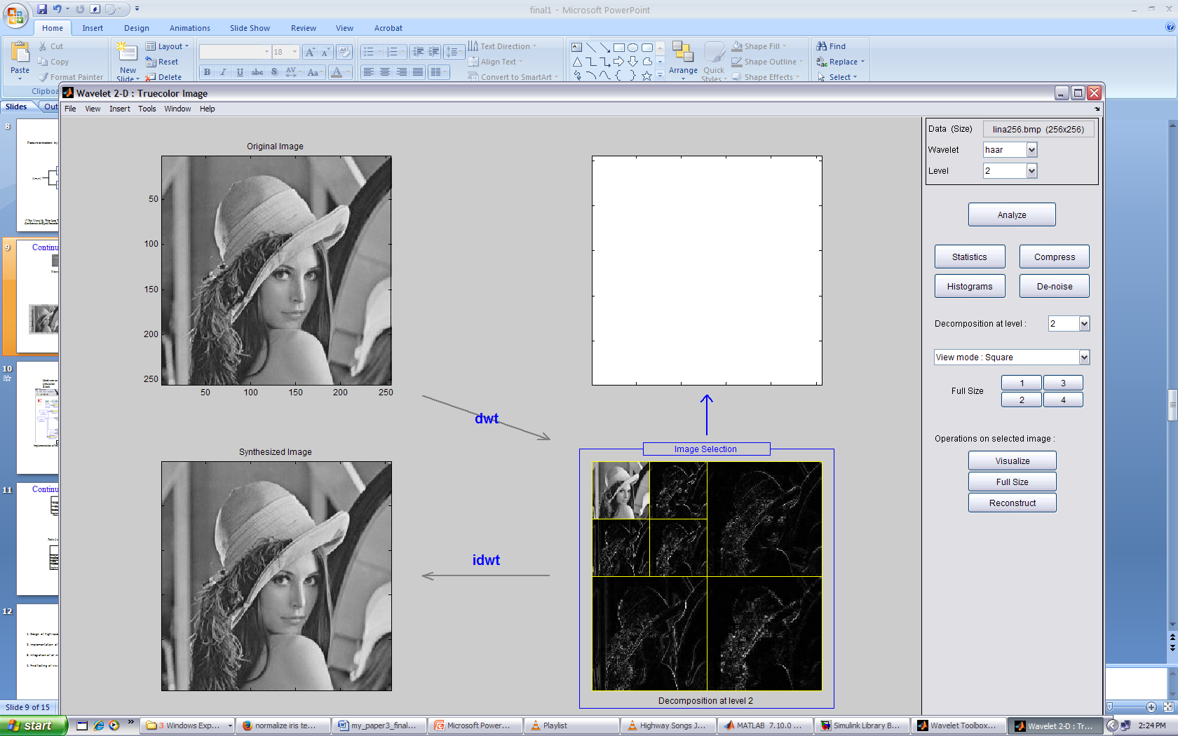
Haar Wavelet..
Normalize Iris template
Equalize Iris template
64x320 fixed size
LL
LH
Overall 20400 feature
HL
HH
Normalized and Equalized iris
First level Haar wavelet decomposition
Second level Haar wavelet decomposition
LL
LH
HL
HH
Haar wavelet two level decomposition

Slide 3
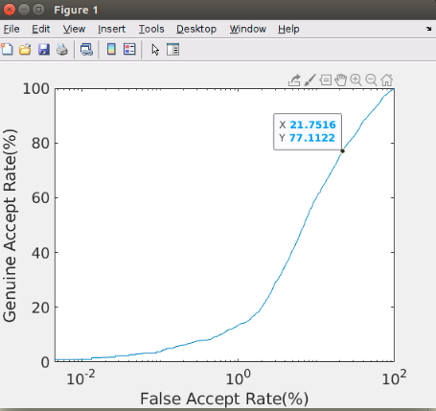
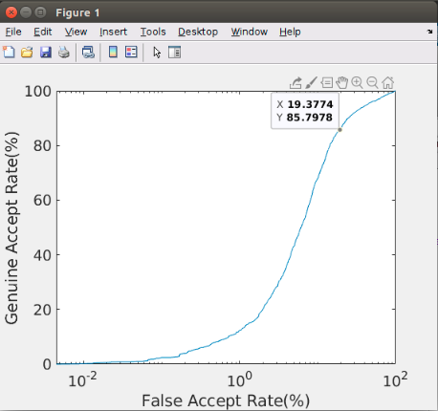
ROC Plot IITD data set..
accurate_iris EER = 22.20
gravity_based_iris EER = 16.60
Positve samples : 4450
Negative sample: 22294

Slide 4
IITD and UBIRIS data set..

Slide 5


