Slide 1
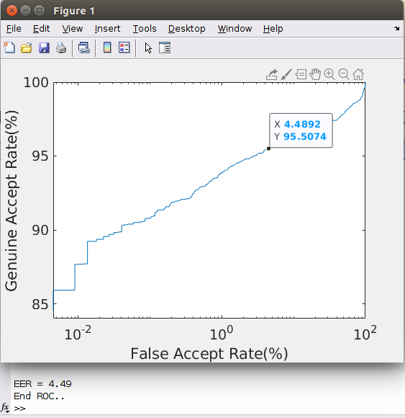
ROC _curves
Gravity based Method:

Slide 2
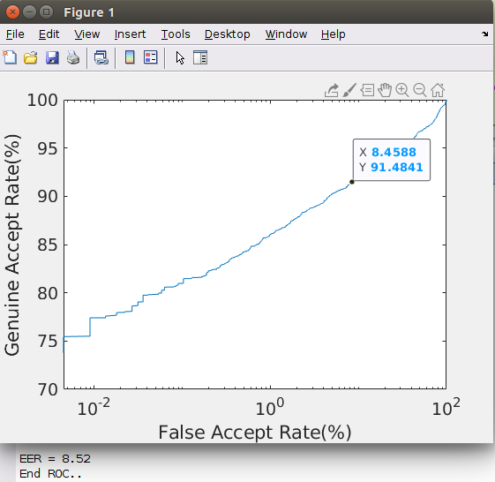
Accurate_iris_segment:

Slide 3
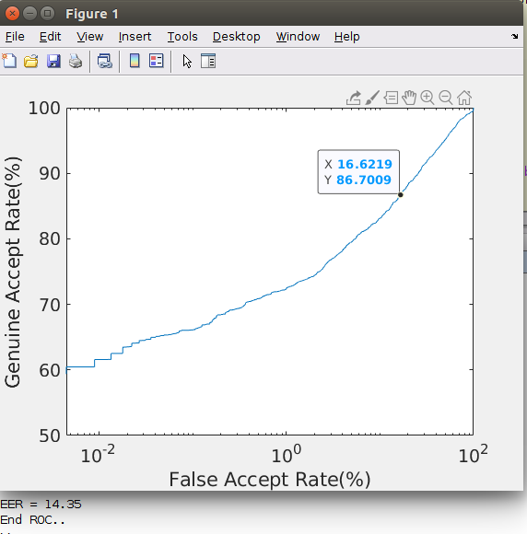
Hough_transform:

Slide 4


