Slide 1
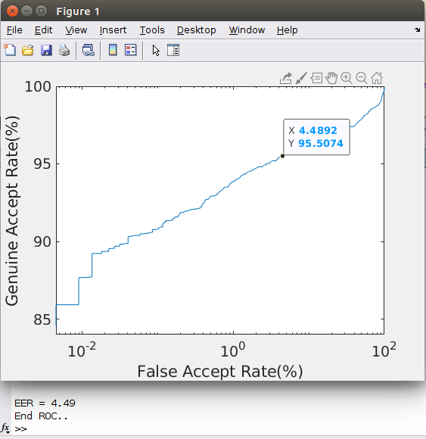
ROC _curves
Gravity based Method:

Slide 2
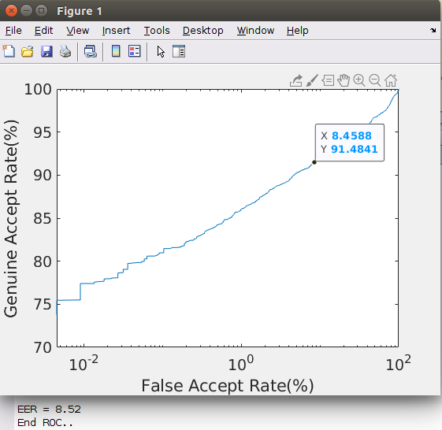
Accurate_iris_segment:

Slide 3
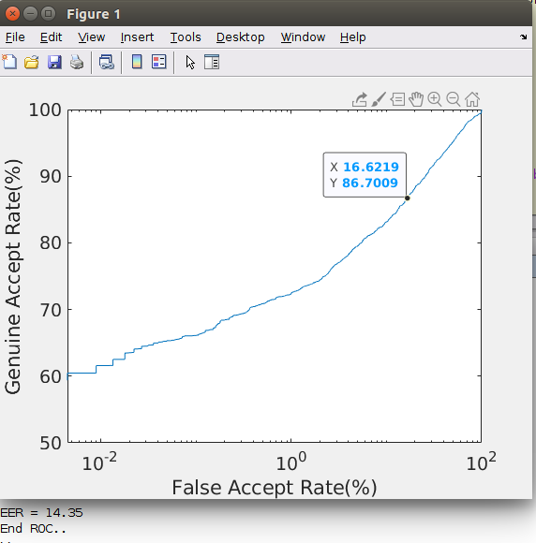
Hough_transform:

Slide 4
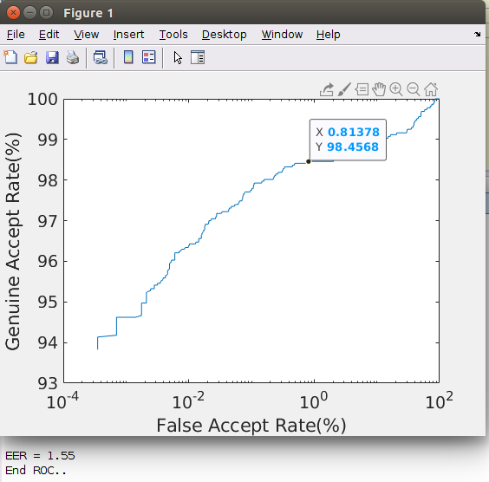
Dougman Casia Version 1:

Slide 5
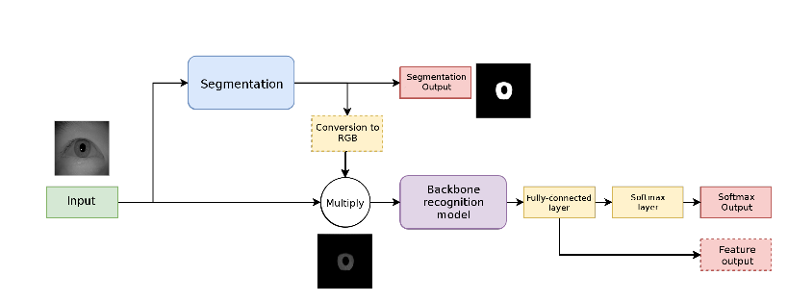
Influence of segmentation on deep iris recognition
Performance:
Casia 1000 data set :
220 images are used to train the segmentation part of our pipeline, and are further split between the actual training (154 images) and the validation data (66 images)
SBVPI 110 data set:
332 image are use for training the segmentation part of our pipeline and 58 these are used for validation.

Slide 6
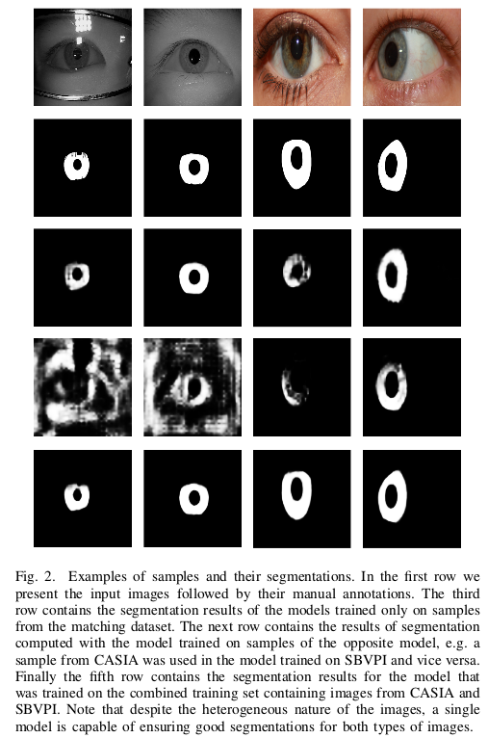
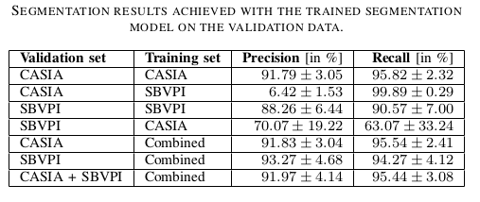

Slide 7
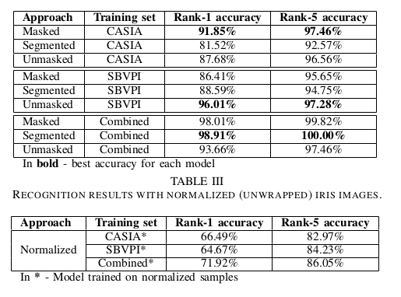
We report results in terms of rank-1 and rank-5 identification accuracy and also plot Cumulative Match Characteristic (CMC) curves to provide more detailed insight into the experiments.

Slide 9


