Slide 1
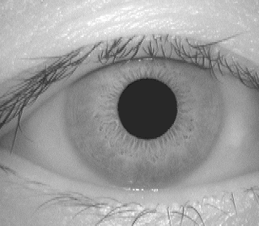
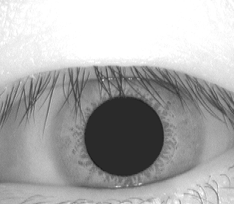
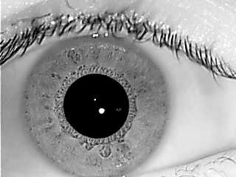
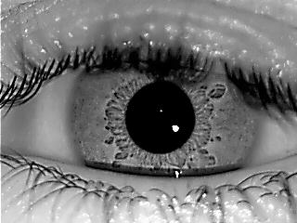
Data Sets of Iris:
Casia V1 and IIT D data set IR scan images
Scalra vains are not visible but images are have ich iris textures.

Slide 2
Continue. . .
UBIRIS v2 data set :
IRIS visible range images. Vains are visible.

Slide 3
GT of segmentation available :
http://islab.hh.se/mediawiki/index.php/Iris_Segmentation_Groundtruth
The EP dataset contains ground truth data of:
Casia Iris v4 Interval Database (2639 iris images)
IIT Delhi Iris Database version 1.0 (2240 iris images)
Notre Dame IRIS-0405 Database (837 iris images)
UBIRIS v2 Iris Database (2250 iris images)

Slide 4
Future approaches :
1. Basic segnet model (FCN based) to segment the iris.
2. Supervised eye segmentation with scalera and correct the view angle by projection, as we know for staight view iris should be in middle in the eye.
3. Unsupervied way to segment eye first and check the possibilities for iris segmentation also.
Where are we :
Writing the own code of segnet from scratch in tensorflow. It should be done in 2 to 3 days.
Start studying abou unsupervised deep learning.

Slide 5


