Slide 1


Iris Recognition (Literature Survey)
Period : May 11th, 2018 to May 17th, 2018
Under the guidance
Dr. Anoop Namboodiri
Professor IIIT H
Presented By
Nitin kandpal
CVIT Lab IIIT Hyderabad

Slide 2
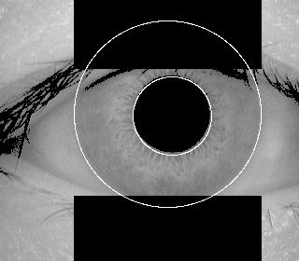
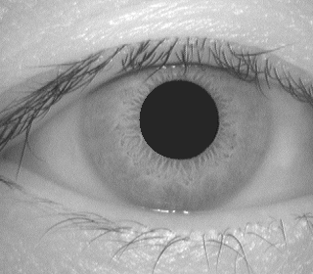
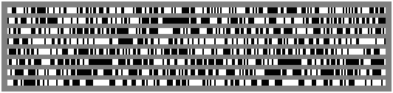
Introduction
Input Image
segmentation
Image
Normalization
Feature
Extraction
Data base of iris Blue print
Matching of
Blue print
Output
1. Anik k Jain, Arun A Ross, K Nand Kumar,” Introduction to Biometrics”, Chapter 4 Springer Publication

Slide 3
LITERATURE SURVEY

Slide 4

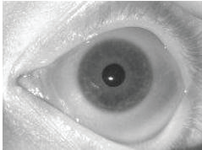
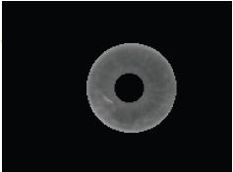
[2]John Daugman, “How Iris recognition Work”, IEEE Transactions on circuits and systems for video technology, vol. 14, no. 1, January 2004
In this paper the author introduce the idea of iris recognition system and mentioned method to implement the system
Key features are integro-differential operator ,rubber sheet model, gabor wavelet and hamming distance.
Integrodifferential Operator

Slide 5
ADVANTAGE
Paper present the result of 9.1 million comparisons among the eye images which gives the 99.9 % accurate result.
COMMENT
Method discussed above is a conventional method and used many international companies for iris recognition .

Slide 6
[3]Kazuyuki Miyazawa, Koichi Ito, Takafumi Aoki, Kobayashi, “An effective approach for iris recognition using phased based image matching”, IEEE Transactions on pattern analysis and machine intelligence, vol. 30, no. 10, october 2008.
Gravity based method is proposed for iris segmentation.
Paper introduce the idea of 2D Fourier Phase Code (FPC) for representing iris image.
Normalize iris image1
2-D Fourier
transform
output
Phase information
Phase Correlation
2-D Fourier
transform
Normalize iris image2
ADVANTAGE
The performance of feature extraction depend less number of parameters as compare to conventional method. Reduces computational complexity.
DISADVANTAGE
Matching algorithm some times gives the value very close to threshold value.

Slide 7

[4]Chia Te CHU and Ching-Han “High Performance Iris Recognition Based on LDA and LPCC”, ICTAI’05 IEEE.
To reduce the system complexity paper suggest use a 2D wavelet to obtain low resolution image. Iris texture streched into 1-D array and become 1-D signal. LPC is used for feature extraction.
If S[n] is 1-D iris image
S[n] =
akS [n-k]
S[n]
_
e[n]
Ŝ[n]
ak z^{-k}
e[n] = S[n] -
akS [n-k]
where ak is LPC filter coefficient and p is order of filter

Slide 8
ADVANTAGE
The complexity reduces at initially itself by 1/4.
Converted 2-D iris texture to 1-D is less computation.
DISADVANTAGE
Accuracy is 99% at best performance
PNN for classification is like anomaly detection.

Slide 9
[5]Kwanghyuk Bae, Seungin Noh and Jaihie Kim “Iris Feature extraction using independent component analysis”, Audio- and Video-Based Biometric Person Authentication, Volume 2688, 2003, pp 838-844 Springer.
Paper introduce the idea of basis vector of independent component analysis to extract the feature code of iris image. To match the iris code hamming distance is used.
ADVANTAGE
Propose method have similar error rate as conventional method.
Size of an iris code and processing time of feature extraction are significantly reduced as compare to gabor wavelet.
COMMENT
Feature extraction by Independent component analysis perform well on non ideal iris images

Slide 10
[6]Li Ma, Yunhong Wang, “Iris recognition using circular symmetric filter”, Pattern recognition 414- 417 vol.2 IEEE2002.
Author used edge detection and hough transform to segment the iris image. Majority of useful information is in specific frequency band of iris paper discuss a bank of symmetric filters to extract the feature.
X[n]
H0(z)
R
Extracted
Feature
H1(z)
R
Hn-1(z)
R
N channel bank of filter

Slide 11
ADVANTAGE
Implementation of hough transform to detect the eyelids as a ellipse.
Used filters for different frequency for different region.
DISADVANTAGE
Accuracy is around 98% .

Slide 12
[7]Mayank Vasta, Richa Singh and P. Gupta “ Comparison the iris recognition algorithm”, ICSIP’04 IEEE.
The paper presents the accuracy of iris recognition algorithms and concluded that Daugman’s algorithm gave the highest accuracy of 99.9 %.
Methods Accuracy
Daugman 99.9%
Lima 98.00%
Avila 97.8 %
Tisse 89.37%

Slide 13
[8]Z.Zainal Abidin, M.Manaf, A.S.Shibghatullah, S.H.A.Mohd Yunos, S.Anawar, and Z.Ayop1“Iris segment analysis using Integro-differential operator and Hough transform in Bio metric system”, Journal of Telecommunication, Electronic and Computer Engineering Vol. 4 No. 2 July - December 2012 .
Author describe the implementation of Hough transform and integro-differential operator. Comparing the two segment method paper concluded that Hough transform gives the better segmentation result 98.9% as compare to integro-differential method 98.6%.

Slide 14
[9]Namrata P. Joshi, Roopal K. Lamba, Devang U. Shah, Bhargav V. Ghadia“Implementation of various approaches for iris image normalization”, Engineering (NUiCONE) International confrence, 2011 IEEE.
The author talked about the implementation of different normalization techniques like rubber sheet model, Rubber sheet model of lower half of iris and Sector based normalization. Paper concluded that the rubber sheet model gives the better result and simple to implement.

Slide 15
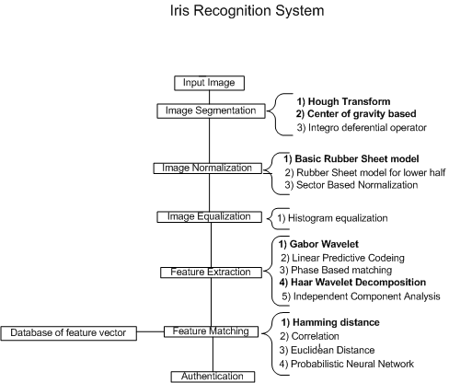

Slide 16
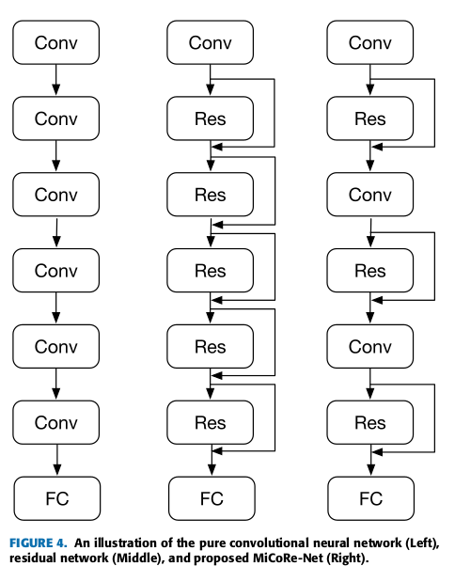
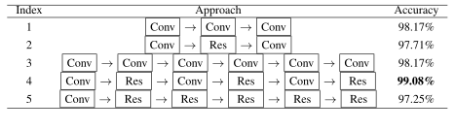
Eye Recognition With Mixed Convolutional and Residual Network (MiCoRe-Net) IEEE Open Access 2018

Slide 17
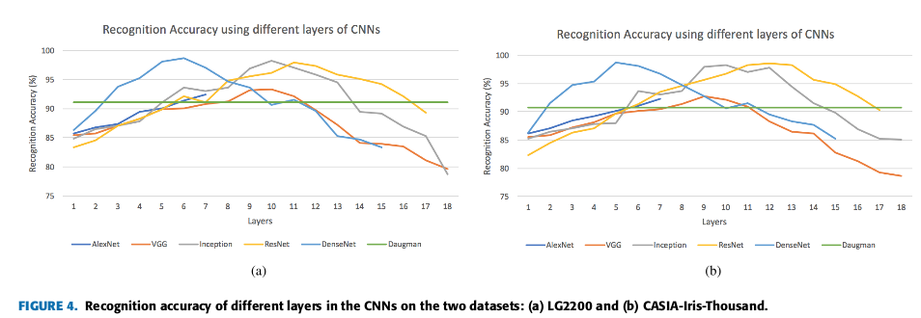
Iris Recognition With Off-the-Shelf CNN Features:A Deep Learning Perspective, IEEE Access 2018

Slide 18
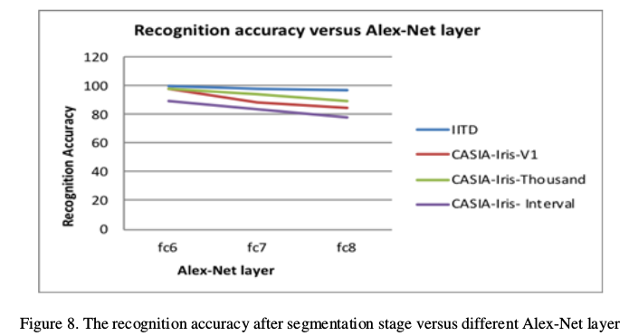
CONVOLUTIONAL NEURAL N ETWORK BASED FEATURE EXTRACTION FOR IRIS RECOGNITION, (IJCSIT) Vol 10, No 2, April 2018.

Slide 19
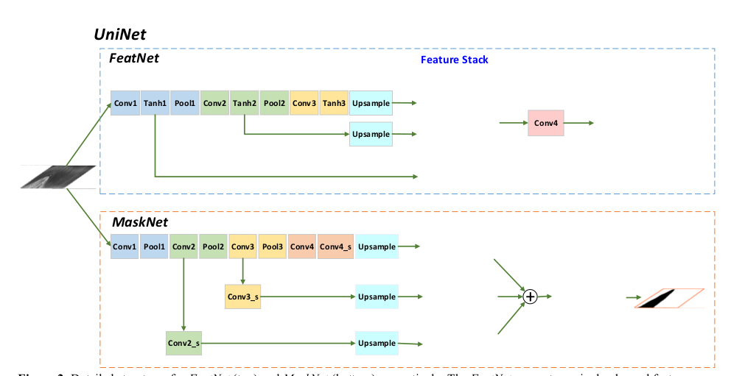
Zijing Zhao, Ajay Kumar, “Towards More Accurate Iris Recognition Using Deeply Learned Spatially Corresponding Features”, ICCV IEEE 2017.

Slide 20
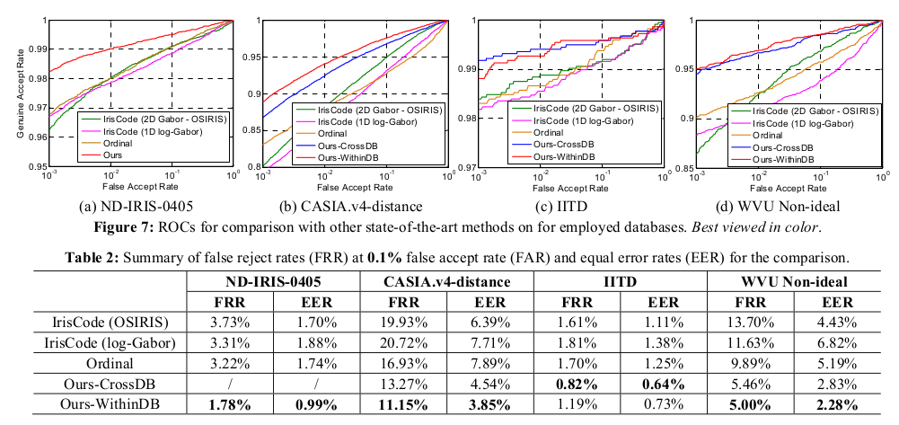

Slide 21
Z. Zhao and A. Kumar, "An Accurate Iris SegmentationFramework under Relaxed Imaging Constraints Using Total Variation Model." in Proceedings of the IEEE International
Conference on Computer Vision (ICCV), 2015, pp. 3828-3836
This paper proposes a novel and more accurate iris segmentation framework to automatically segment iris region from the face images acquired with relaxed imaging under visible or near-infrared illumination.
The proposed framework is built on a novel total-variation based formulation which uses l1 norm regularization to robustly suppress noisy texture pixels for the accurate iris localization.

Slide 22
REFERENCES
[1] Anik k Jain, Arun A Ross, K Nand Kumar,” Introduction to Biometrics”, Chapter 4 Springer Publication
[2] John Daugman, “How Iris recognition Work”, IEEE Transactions on circuits and systems for video technology, vol. 14, no. 1, January 2004
[3] Kazuyuki Miyazawa, Koichi Ito, Takafumi Aoki, Kobayashi, “An effective approach for iris recognition using phased based image matching”, IEEE Transactions on pattern analysis and machine intelligence, vol. 30, no. 10, october 2008
[4] Chia Te CHU and Ching-Han, “High Performance Iris Recognition Based on LDA and LPCC”, ICTAI’05 IEEE.
[5] Kwanghyuk Bae, Seungin Noh and Jaihie Kim, “Iris Feature extraction using independent component analysis”, Audio- and Video-Based Biometric Person Authentication, Volume 2688, 2003, pp 838-844 Springer.
[6] Li Ma, Yunhong Wang, “Iris recognition using circular symmetric filter”, Pattern recognition 414- 417 vol.2 IEEE2002.
[7] Mayank Vasta, Richa Singh and P. Gupta,“Comparison the iris recognition algorithm”, ICSIP’04 IEEE.
[8] Z.Zainal Abidin, M.Manaf, A.S.Shibghatullah, S.H.A.Mohd Yunos, S.Anawar, and Z.Ayop1,“Iris segment analysis using Integro-differential operator and Hough transform in Bio metric system”, Journal of Telecommunication, Electronic and Computer Engineering Vol. 4 No. 2 July - December 2012

Slide 23
Continue….
[9] Namrata P. Joshi, Roopal K. Lamba, Devang U. Shah, Bhargav V. Ghadia“Implementation of various approaches for iris image normalization”, Engineering (NUiCONE) International confrence, 2011 IEEE.
[10] Mark S. Nixon, Alberto S. Aguado“Feature Extraction And Image Processing”, Academic Press an imprint of Elsevier.
[11] RICHARD P. WILDES “Iris Recognition: An Emerging Biometric Technology”, IEEE, Vol. 85, no. 9, september 1997
[12] Javier R. Movellan. Tutorial on Gabor Filters Copyright c 1996,2002
[13] Judith Liu-Jimenez ª, Raul Sanchez-Reilloª , Carmen Sanchez-Avila,” Full hardware solution for processing iris biometrics”, Security Technology, IEEE 2005.
[14]. Lecture note on computational analysis University of Washington: www. Coursera.org
[15]. Rafael C. Gonzalez ‘Digital Image processing’.
[16]. Aapo Hyvarinen, ‘Independent component analysis’ , A volume on wiley series.
[17]. CASIA iris image data base version.1

Slide 24
Thank you

