Slide 1
Real-Time Air Quality Index (AQI) Prediction System
10Pearls Internship Task: Data Sciences

Slide 2
Project Overview
Problem: Air pollution is a major health and environmental challenge in rapidly urbanizing cities like Karachi.
Solution: This project presents a real-time Air Quality Index (AQI) prediction system.
Technology Stack:
  Data Source: OpenWeather Air Pollution API
  Machine Learning: Gradient Boosting, Random Forest, XGBoost
  Deployment: Hopsworks
  Automation: GitHub Actions
  Frontend: Streamlit

Slide 3
Objectives
Fetch live air pollution data (PM₂.₅, PM₁₀, CO, NO₂, SO₂, O₃).
Compute AQI using EPA standards.
Train and predict AQI using machine learning models.
Automate data fetching, preprocessing, and model retraining.
Compare predicted vs. actual AQI in real-time.
Display results on an interactive Streamlit dashboard.

Slide 4
Data Fetching and Preprocessing
Data Fetching
Data Preprocessing
  Handles missing values, outliers, and negative values.
  Calculates AQI using pollutant data, as the default OpenWeather scale is not suitable for precise modeling.
  Engineers around 26 new features, including temporal features and pollutant interactions.
Fetched the last two years of data from the OpenWeather API.
Data is resampled into 3-hour intervals and saved as a CSV file.
A GitHub Actions workflow automatically updates this data every 3 hours.

Slide 5
Model Development and Frontend
Model Development
Frontend
The data is split into training (70%), validation (10%), and test (20%) sets.
Three models are trained: Random Forest, Gradient Boosting, and XGBoost Regressors.
Models are automatically retrained every 6 hours with the latest data to ensure accuracy.
A Streamlit application provides a user-friendly dashboard.
Users can select any of the three trained models to see predictions.
The dashboard displays both the real-time actual AQI (calculated using the EPA formula) and the predicted AQI from the selected model.

Slide 6
Models Used
Random Forest
Gradient Boosting
XGBoost
The random forest is an ensemble learning algorithm that combines many decision trees on different subsets of data and features. The final output is the average of all trees’ predictions.
Gradient boosting builds decision trees sequentially. Each tree learns from the mistakes of the previous tree.
Extreme Gradient Boosting is the optimized faster and more regularized version of Gradient Boosting. It performs regularization to prevents overfitting and deals wih missing values.

Slide 7
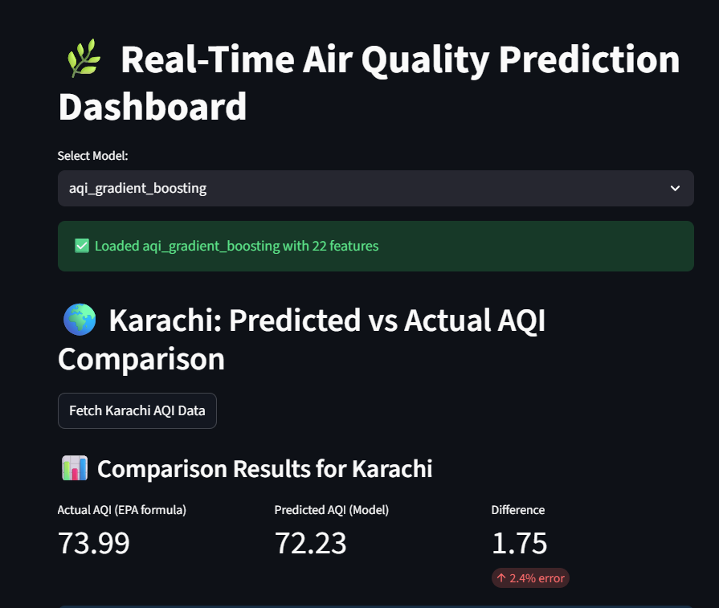
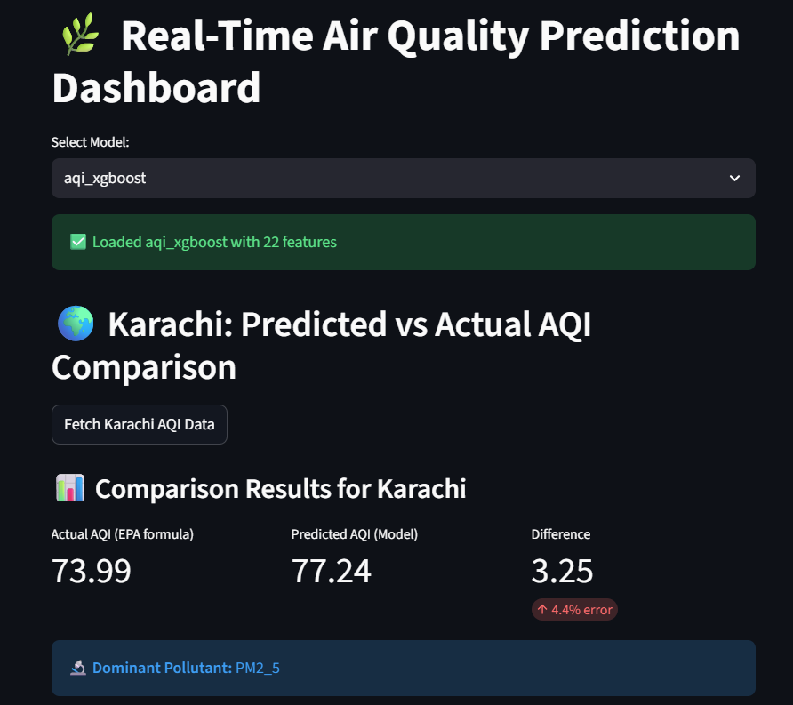
Results

Slide 8
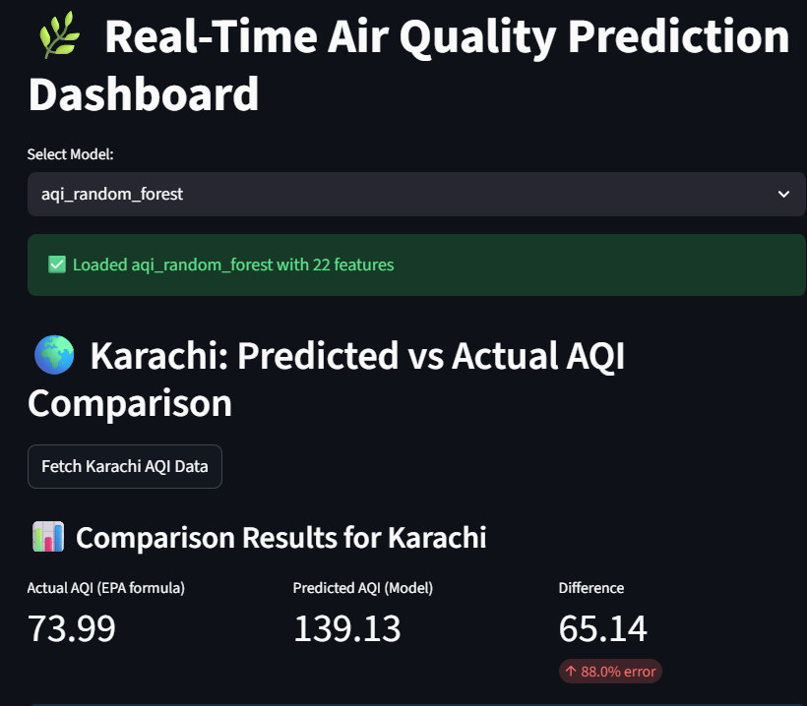

Slide 9
Thanks

