Slide 1
Concurrent Implementation of the Fast Fourier Transform in Kotlin
Benjamin W. Amato

Slide 2
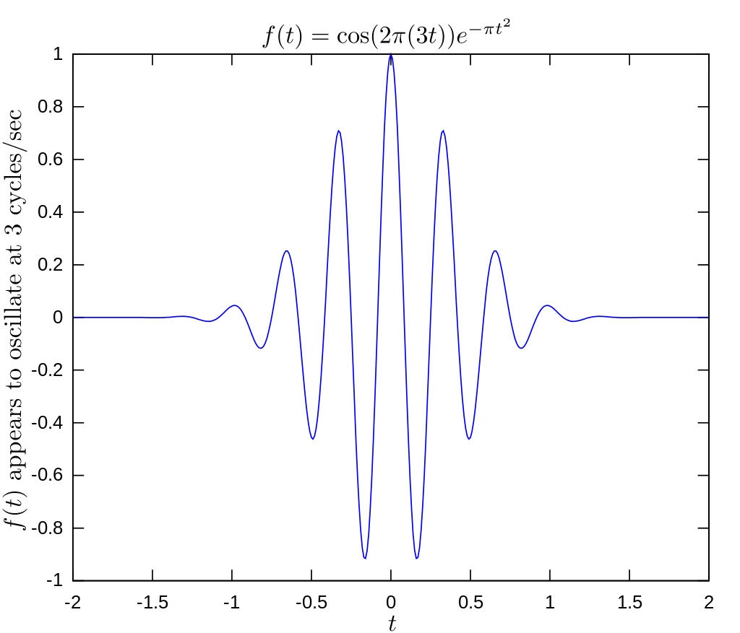
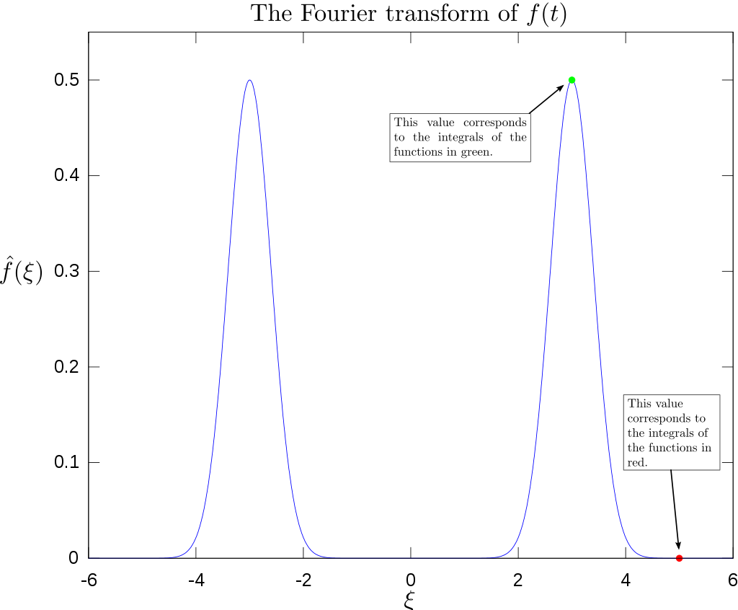

The Discrete Fourier Transform
Convert between time and frequency domain
Operates on periodic signals
Can decompose periodic signals into a sum of sine waves because of the sum-of-sines property
O(N^2) Computational Complexity
Can be expressed by the equation:

Slide 3
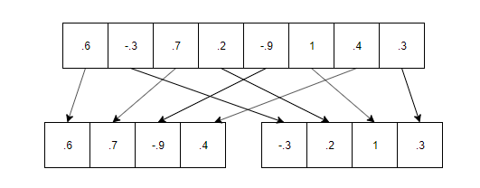
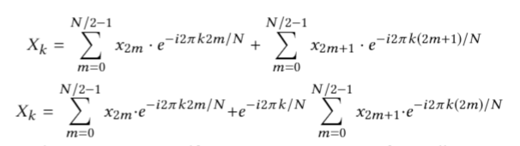
Fast Fourier Transform
Algorithm uses here is the Cooley-Tukey FFT
Separates the FFT into parts, every other element and uses divide and conquer
Computational Complexity of O(Nlog(N))
Only works on even inputs
Relies on standard DFT for odd inputs

Slide 4
Why Kotlin?
Wanted to use one of the languages learned in class
Swift, miniKanren, Idris were not reasonable
Already lots of implementations in lisp / haskell
Concurrency seemed simpler in Kotlin than F#
Use of async / await
Data classes good for quick development
Infix operator overloading for Complex numbers
Java interoperability allowed use of Java WavFile and JFreeChart libraries

Slide 5
Result Analysis
Size | DFT (ms) | FFT (ms)
64 | 0 | 1
128 | 2 | 1
256 | 6 | 3
512 | 24 | 4
1024 | 114 | 8
2048 | 397 | 17
4096 | 1664 | 36
8192 | 6798 | 72
16384 | 27354 | 145
32768 | 113108 | 295
DFT is much slower for large Lists
Similar for speed for list of 64 length
700 times faster for list of 32768 length

Slide 6
Results Continued
Size | Non-Concurrent (ms) | Concurrent (ms)
1024 | 9 | 9
2048 | 17 | 29
4096 | 36 | 37
8192 | 75 | 76
16384 | 154 | 90
32768 | 299 | 152
65536 | 626 | 180
131072 | 1326 | 311
262144 | 2688 | 805
Concurrent faster at large list sizes
Gain less than DFT vs FFT
Small sizes have similar values because cutoff
Run on 4 core-8 thread machine
Actual improvement is 2-4x for larger sizes

Slide 7
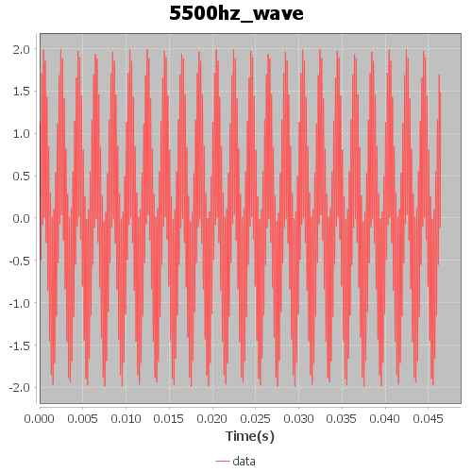
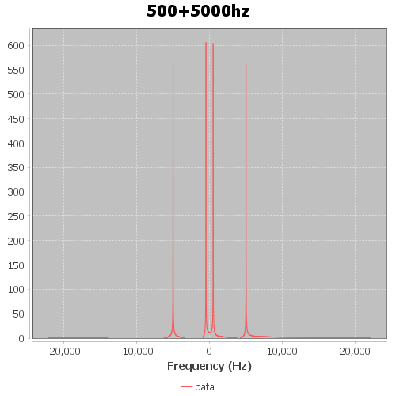
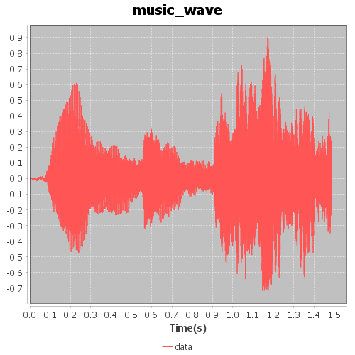
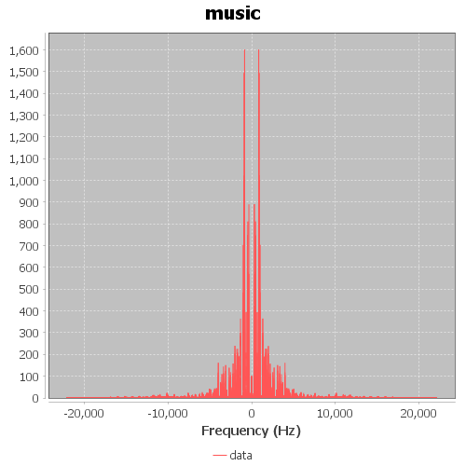
Output Analysis
Sum of two sine wave results in two spikes
Music looks somewhat random prior to fft
After FFT, almost all sound is less than 10,000hz, primarily less than 5000hs

Slide 8
Image Sources
https://en.wikipedia.org/wiki/File:Function_ocsillating_at_3_hertz.svg
https://en.wikipedia.org/wiki/File:Fourier_transform_of_oscillating_function.svg

