Slide 1
ML Concepts
Ayal Gussow
03/15/2018

Slide 2
Some Announcements
Absence: 3/18-3/27
Definitions
Ames Housing
A couple of words on outliers (source? flowers example)
Scraping
Preprocessing -> p-values

Slide 3
A quick word on – p-values…
https://projects.fivethirtyeight.com/p-hacking/
Data structure, empirical p-values

Slide 4
Today’s Outline
Conceptual ML
Linear regression
More conceptual ML

Slide 5
ML
Machine learning is a field of computer science that gives computer systems the ability to "learn" (i.e., progressively improve performance on a specific task) with data, without being explicitly programmed.
(Wikipedia)

Slide 6
ML Process
Training data:
Features + Outcome
Model
(or algorithm, or method, etc)
Trained Model
Data:
Features
Predict

Slide 7
ML Process
Training data
Outcome: Housing price
Features: Sqr feet, location, etc
Model
Linear regression
Trained LR Model
Sqr feet, location, etc
Predict

Slide 8
ML Process: Evaluation!

Slide 9
ML Process
Training data:
Features + Outcome
Model
(or algorithm, or method, etc)
Trained Model
Test data:
Features
(Hidden Outcome)
Predict
Evaluation
Data:
Features
Predict on unknown

Slide 10
ML Motivations
Predict!
Describe
Other

Slide 11
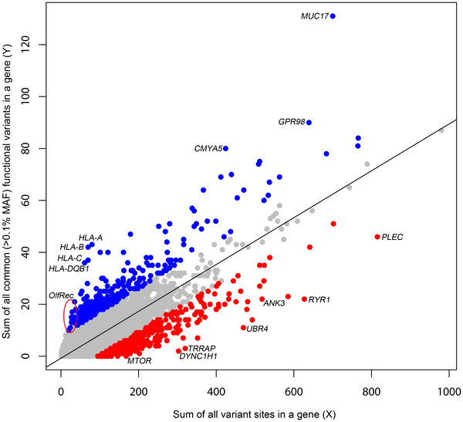

Figure 1. A regression plot illustrating the regression of Y on X.
Petrovski S, Wang Q, Heinzen EL, Allen AS, Goldstein DB (2013) Genic Intolerance to Functional Variation and the Interpretation of Personal Genomes. PLOS Genetics 9(8): e1003709. https://doi.org/10.1371/journal.pgen.1003709
http://journals.plos.org/plosgenetics/article?id=10.1371/journal.pgen.1003709

Slide 12
Some concepts
X / Y, features / response, predictors / target…
Regression vs Classification
Note: logistic regression is poorly named.
Supervised vs Unsupervised

Slide 13
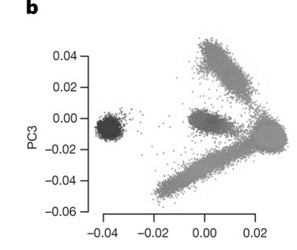
Patterns of genetic variation in 60,706 humans
M Lek et al. Nature 536, 285–291 (2016) doi:10.1038/nature19057

Slide 14
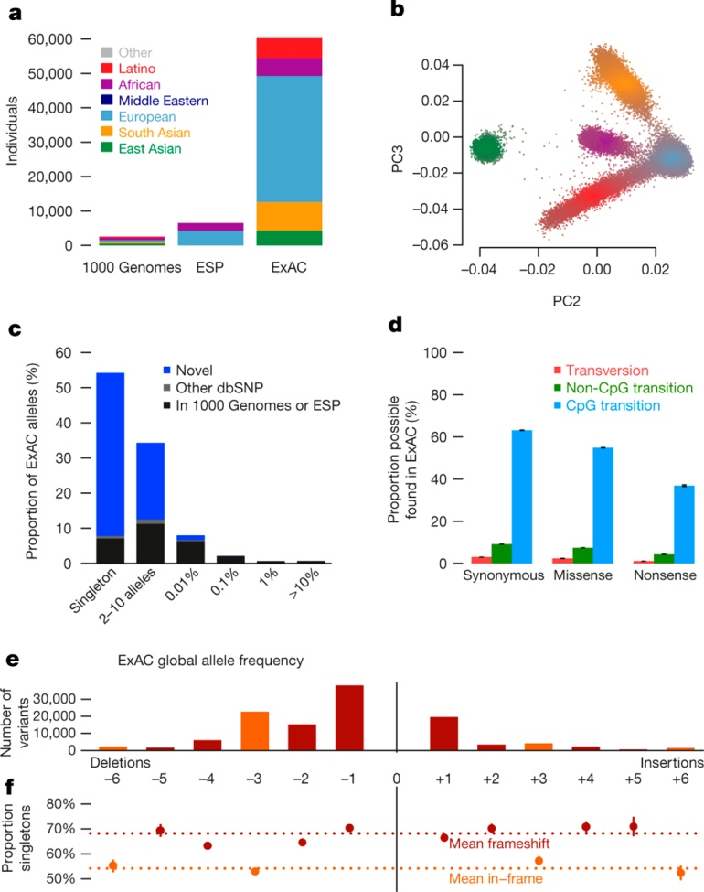
Patterns of genetic variation in 60,706 humans
M Lek et al. Nature 536, 285–291 (2016) doi:10.1038/nature19057

Slide 15
Patterns of genetic variation in 60,706 humans
M Lek et al. Nature 536, 285–291 (2016) doi:10.1038/nature19057

Slide 16
Today’s Algorithm
Linear regression
Supervised, regression.
Evaluation with RMSE (“cost function”).

Slide 17
So, what is linear regression?
“In statistics, linear regression is a linear approach for modelling the relationship between a scalar dependent variable y and one or more explanatory variables (or independent variables) denoted X.”
(Wikipedia)

Slide 18

So, what is linear regression?
$$y=Xβ+ε$$

Slide 19
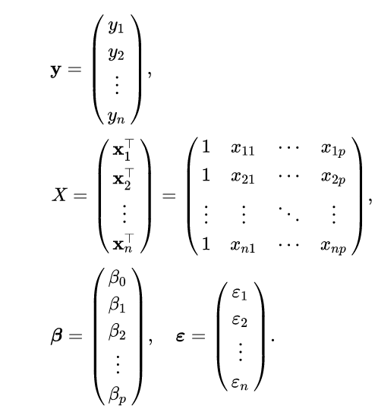

So, what is linear regression?
$$y=Xβ+ε$$
y = beta_1 * <sqr feet> + beta_2 * <# fireplaces> + …
y = prices on house.
X = features, such as sqr feet.
Beta = coefficient, a multiplier.
Epsilon = error.
Intercept = beta_0 (if all is 0…)

Slide 20
So, what is linear regression?
$$y=Xβ+ε$$
y = beta_1 * <sqr feet> + beta_2 * <# fireplaces> + …
Least Squares
Gradient Descent
…
True y is closest to predicted y (on average).

Slide 21
A word on training, testing, validation and leakage
Basic workflow:
Split data into training, test
Train model on training.
Evaluate on testing.

Slide 22
A word on training, testing, validation and leakage
Leakage: when training influences test set, or optimization, or evaluation. (e.g. biological data)
Cross-validation.
Common pitfalls:
Training and testing on the same set.
Optimizing on test set (validation set).

Slide 23
A note on software
Numpy
Sklearn

Slide 24
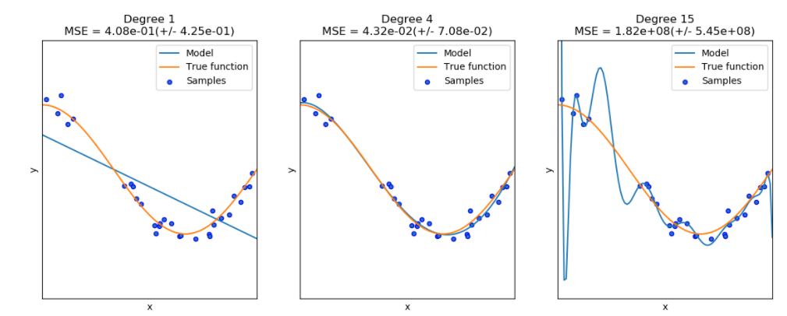
Overfitting and Underfitting (sklearn, n vs m)

