Slide 1
Clustering
Ayal Gussow
03/29/2018

Slide 2
Today’s Outline
Clustering: Conceptual Overview
K-means
Common pitfalls
Implementation (in Jupyter Notebook)

Slide 3
Unsupervised Learning
Unlabeled dataset
May or may not know how many categories there are
Usual motivation: Underlying patterns in data
Examples include:
Clustering! (most common, and our focus today)
Anomaly detection (e.g. network intrusions)
Others

Slide 4

Scikit-Learn Cheat Sheet

Slide 5
Clustering Real-World Applications
Social network microtargeting (e.g. FB, from likes to politics)
Netflix recommendations
Genomes for disease, ancestry
Many, many more

Slide 6
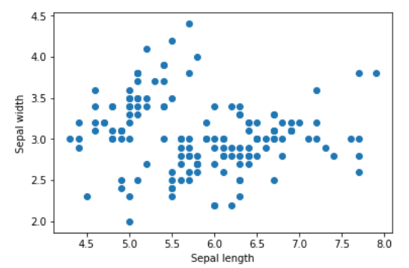
Real-World Example: Iris Flowers (unlabeled)
We want to find patterns in the Iris flowers dataset, with the goal of predicting species or sub-species.

Slide 7
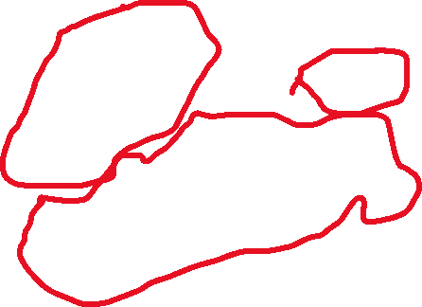
Real-World Example: Iris Flowers (unlabeled)
Since this is two dimensional, in theory we could do this manually.

Slide 8
K-Means
K-Means (most popular) algorithm.
Iterative, multi-step
Step 1: Choose centroids
Step 2: Assign clusters
Repeat until convergence / max iterations

Slide 9
K-Means
Visual explanation (courtesy of Michael Jordan)

Slide 10
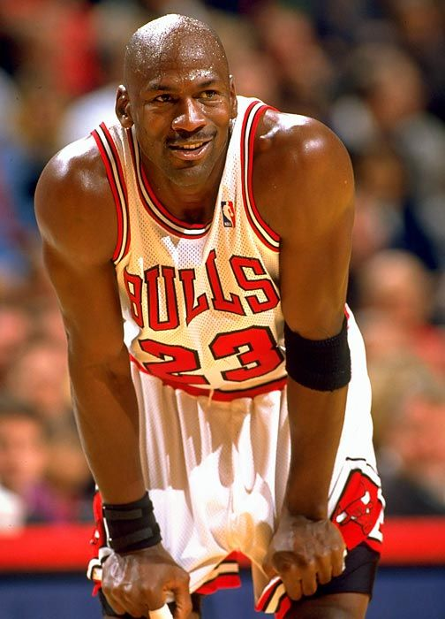
K-Means
No, not that Michael Jordan (basketball GOAT)

Slide 11
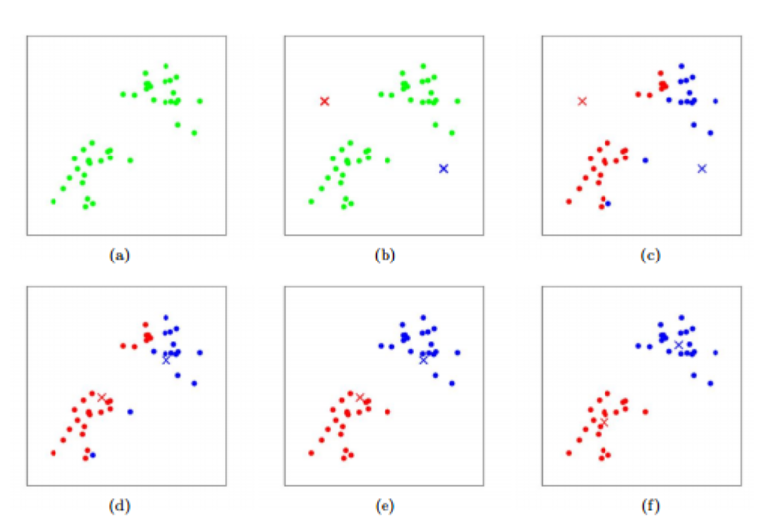
Toy Example

Slide 12
Step 1: Centroids (randomly here)

Slide 13
Step 2: Cluster Assignment (color by distance)

Slide 14
Iteration 2: Assign Centroids By Mean

Slide 15
Iteration 2: Cluster assignment

Slide 16
Final Iteration

Slide 17
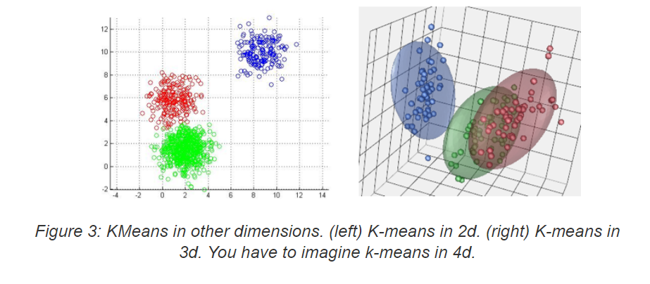
Works the same in multi-dimensional space

Slide 18
K-Means
Parameters:
Number of clusters
Dataset

Slide 19
K-Means
Steps:
Initialize K cluster centroids.
Repeat the following until convergence / max iterations:
Assign each point a cluster based on its closest centroid.
Calculate new centroids based on the average point between all samples in the cluster assigned in (a).

Slide 20
K-Means
What are we trying to optimize?
We are trying to find the set of clusters that minimizes the distances between every point and its cluster centroid.

Slide 21
Minimize the distance

Slide 22
K-Means
Sklearn:
model = sklearn.cluster.KMeans(n_clusters=2)
y = model.fit_predict(X)

Slide 23
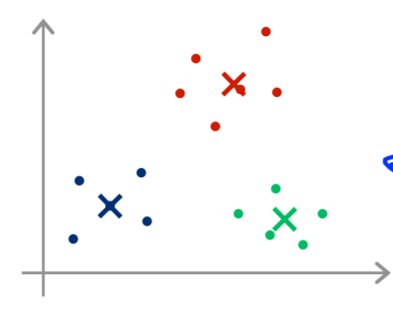
K-Means
Issues:
Can converge to local optima (images from Andrew Ng)

Slide 24
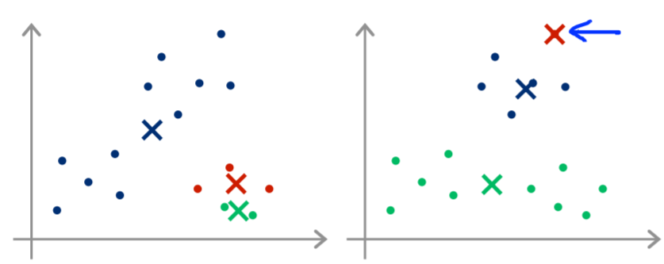
K-Means
Issues:
Can converge to local optima (images from Andrew Ng)

Slide 25
K-Means
Issues:
Can converge to local optima (images from Andrew Ng)
Solution:
Multiple initializations (sklearn: n_init)
model = sklearn.cluster.KMeans(
n_clusters=2,
n_init=10
)

Slide 26
K-Means
Issues:
Can converge to local optima (images from Andrew Ng)
Solution:
Multiple initializations (sklearn: n_init)
model = sklearn.cluster.KMeans(
n_clusters=2,
n_init=10,
init={‘k-means++’, ‘random’, or an ndarray},
)

Slide 27
K-Means
model = sklearn.cluster.KMeans(
n_clusters=2,
n_init=10,
init={‘k-means++’, ‘random’, or an ndarray},
)
K-means++:
Choose random data point as first centroid.
Choose following centroids based on distance.

Slide 28
K-Means
model = sklearn.cluster.KMeans(
n_clusters=2,
n_init=10,
init={‘k-means++’, ‘random’, or an ndarray},
)
To get the sum of squared distances of samples to their cluster center:
model.inertia_

Slide 29
K-Means
model.inertia_
Note: Comparatively meaningful, absolutely meaningless (lower is better).

Slide 30
K-Means
But how to choose number of clusters?
Usually this is done manually and subjectively, by visualization (e.g. in a dim reduced dataset).
There is not a right answer.

Slide 31
K-Means
But how to choose number of clusters?
Can use the elbow method.

Slide 32
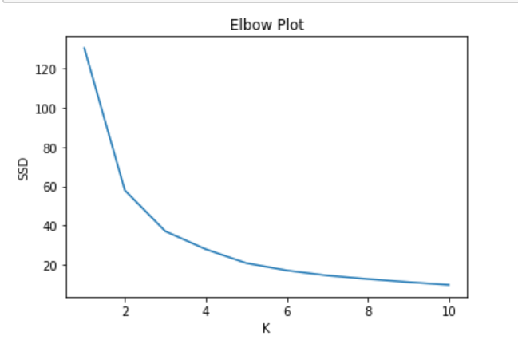
K-Means
But how to choose number of clusters?

Slide 33
How to evaluate clustering
Is evaluation really necessary?
Ultimately, we are looking to gain insight.
Some evaluations:
Case specific: What was your goal? (e.g. ad targeting)
With labels: Can use classification measures, ARI, homogeneity
Without labels: Silhouette Coefficient

Slide 34
What other clustering methods / types?
Agglomerative (hierarchical): Each observation is its own cluster, and pairs are joined (by a given criteria and metric) as you go up the tree.
Metric: Some kind of distance.
Criteria: Distance between sets (max, min, average (UPGMA))

Slide 35
What other clustering methods / types?
Agglomerative (hierarchical): Each observation is its own cluster, and pairs are joined (by a given criteria and metric) as you go up the tree.
Metric: Some kind of distance.
Criteria: Distance between sets (max, min, average (UPGMA)
DBSCAN: find regions of high density and then expands the clusters from there.

