Slide 1

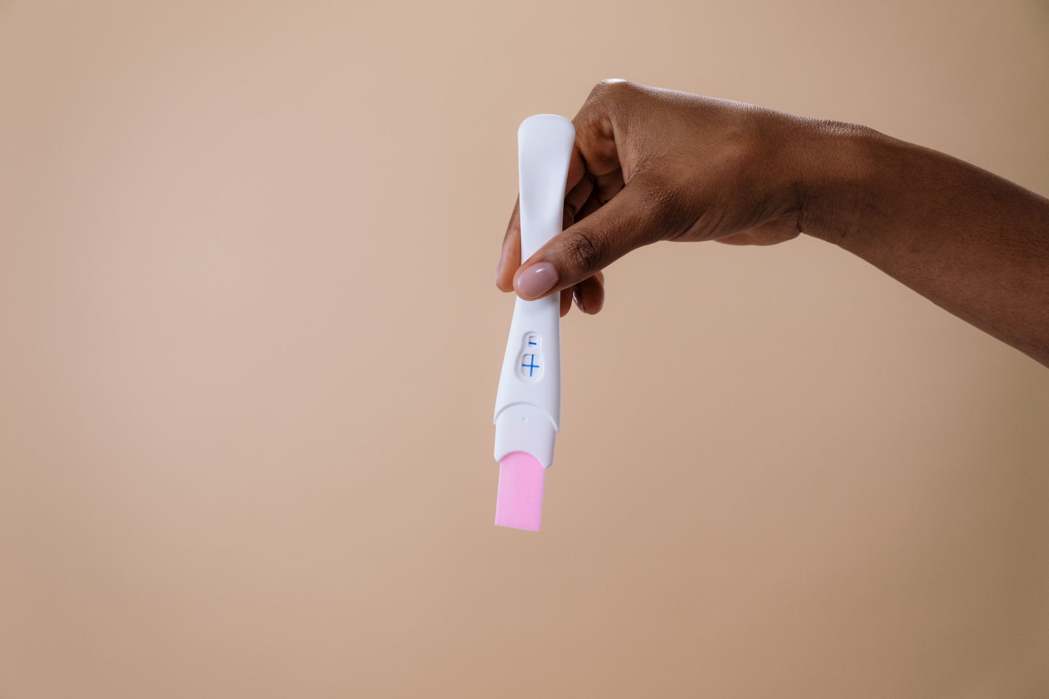

Data Wizards Team
Rwanda Teenage Pregnancy Trends
ea

Slide 2

Aims and objectives
01
Aims:
Identify Contributing Factors: Find out the main reasons causing teenage pregnancies.
Support Targeted Interventions: Provide specific solutions to help prevent teenage pregnancies.

Slide 3

Objectives:
02
User-Friendly Dashboard: Design an easy-to-use display for the data.
Enable Strategic Decision-Making: Help users make smarter, data-driven choices.

Slide 4


03
Intended Audience
Policymakers need actionable data to create targeted interventions.
Professionals analyze the economic and social impacts of teenage pregnancy.
Parents, communities, and individuals seek to understand and address the issue.

Slide 5

04
Collaboration and Teamwork
The team brainstorms and provides feedback to improve dashboard accuracy and usability.
The collaboration focuses on building a platform for visualizing teenage pregnancy trends.
Members contribute specialized expertise to ensure project success.

Slide 6




06
Dashboard Features
Trend Visualization: See changes in teenage pregnancy rates across the Rwanda Demographic and Health Survey periods of 1992, 2000, 2005, 2010-2011, 2014-2015, and 2019-2020.
Active Filtering: Adjust filters to focus on specific demographics or geographic regions for detailed insights.

Slide 7
Cont’s
Map Visualization: Provides an interactive map to visualize district-wise teenage pregnancy rates and regional variations.

Slide 8

Conclusion and recommandation
The project analyzed teenage pregnancy rates using historical data and machine learning, identifying contributing factors to inform targeted interventions. It features trend and map visualizations, allowing regional insights. Recommendations include improving data collection and engaging stakeholders to implement region-specific strategies for reducing teenage pregnancies.

Slide 9


10
THANK YOU!

