Slide 1
g
green
Helping you live a greener lifestyle.
Get Started

Slide 2
g
green
How many people live in your household?
0
Continue

Slide 3
g
green
How many people live in your household?
4
Continue

Slide 4
g
green
The average American produces 4.4 pounds of trash a day.
Apply that average to your household and it equals 17.6 pounds of trash a day!
Continue

Slide 5
g
green
We think you can do better!
Your forest will grow as you log and level up!
Log what you throw out…
…and what you recycle.
Get Started

Slide 6
g
green
We think you can do better!
Your forest will grow as you log and level up!
Accept challenges and earn rewards!
Log what you throw out…
…and what you recycle.
Compete with friends!
Get Started

Slide 7
g
green
We think you can do better!
Your forest will grow as you log and level up!
Spend points at the emporium.
Accept challenges and earn rewards!
Emporium
Compete with friends!
Help earn $$ for worthy environmental causes!
Get Started

Slide 8
g
green
We think you can do better!
Accept challenges and earn rewards!
Spend points at the emporium.
Emporium
Compete with friends!
Help earn $$ for worthy environmental causes!
Get Started

Slide 9
Level 2
Log
Challenges
Achievements
Emporium
My Forest

Slide 10
Close
Edit
John Appleseed
Goals
Settings
Friends
Export Data

Slide 11
September
+
S
M
T
W
T
F
S
23
24
25
26
24
28
29
Thursday, September 24
Recycling even one can makes a difference.
Today’s Log
Paper
Breakfast Leftovers
Coffee grounds
Wrapper
Log
Challenges
Achievements
Emporium
My Forest

Slide 12
September
+
S
M
T
W
T
F
S
23
24
25
26
24
28
29
Thursday, September 24
Recycling even one can makes a difference.
Today’s Log
Paper
Breakfast Leftovers
Coffee grounds
Wrapper
Log
Challenges
Achievements
Emporium
My Forest

Slide 13
Cancel
Trash or Recycling

Slide 14
Cancel
By weight or by item

Slide 15
Cancel
By weight or by item

Slide 16
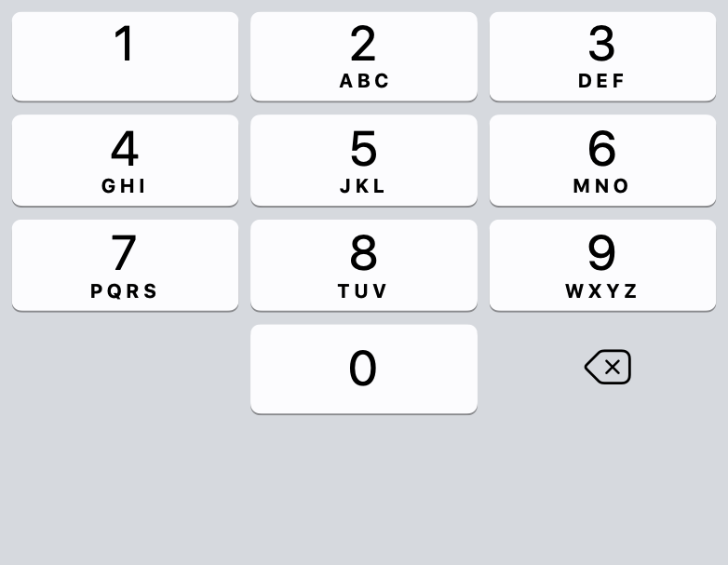
Cancel
Add
By weight or by item
Section Heading
Recycling
Title
September 24, 2020
Date
none
Type
|
Lbs
Remember, a guess is better than nothing.
.

Slide 17
Cancel
Add
How much does your trash weigh?
Section Heading
Trash
Title
September 24, 2020
Date
none
Type
|
Remember, a guess is better than nothing.
.

Slide 18
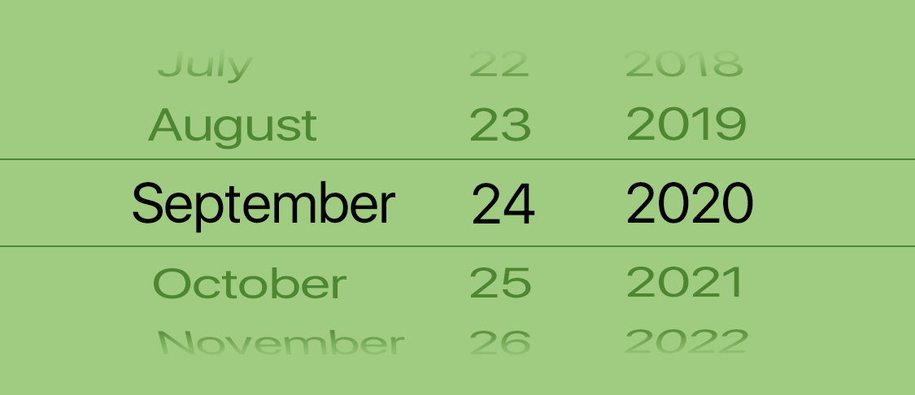
Cancel
Add
How much does your trash weigh?
Section Heading
Trash
Title
September 24, 2020
Date
none
Type
|
Remember, a guess is better than nothing.

Slide 19
Active
Past
Let’s make a difference!
Already have a challenge invite code? Tap the lock below to gain access.
Enter Code
No Straw Challenge
Team Challenge
Ends October 15
Score points by using as few straws as possible
View Challenge
4 participants
Pick Up Trash Challenge
Team Challenge
Ends October 24
Score points by picking up trash and logging it
View Challenge
14 participants
Log
Challenges
Achievements
Emporium
My Forest

Slide 20
Active
Past
No Palm Oil Challenge
Team Challenge
Ended September 5
Great work.
View Challenge
View Results
Plant Something Challenge
Team Challenge
Ended August 24
Congrats!
View Challenge
View Results
Log
Challenges
Achievements
Emporium
My Forest

Slide 21
Achievements
Gold
July 4, 2018
Log
Challenges
Achievements
Emporium
My Forest

Slide 22
Achievements
Gold
You earned a gold medal in a recycling challenge. Awarded on July 4, 2018.
Rewards
Waterway
x 2
Log
Challenges
Achievements
Emporium
My Forest

Slide 23
Spend Points
Contribute
Featured
Pine Tree
genus: Pinus
species: 126
New Items We Love
Goldfish
5 Points
Type: Water
Grass
5 Points
Type: Ground
Rabbit
10 Points
Type: Ground
Log
Challenges
Achievements
Emporium
My Forest

Slide 24
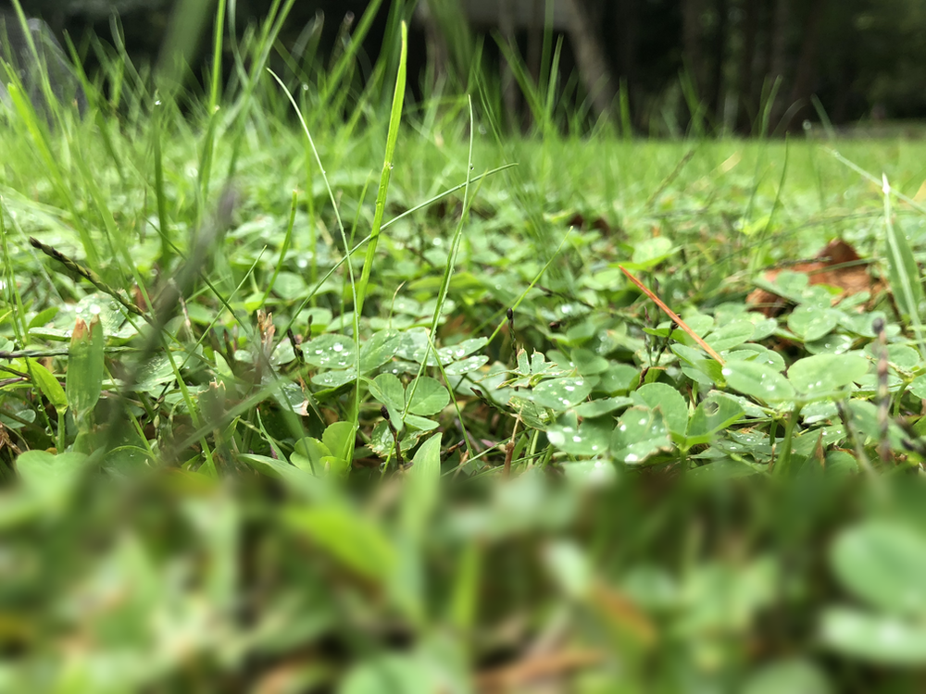
Spend Points
Contribute
Featured Eco-Friendly Products
Eco Ads
See All >
Proceeds from ads support reforestation efforts.
Clean Water
Can coal be clean?
Buy a Hybrid
Vehicle
Ferns and you
Liam - An Innovation Story
Policy Matters
Donate
See All >
Great causes to donate to.
Environmental Defense Fund
Sierra Club
Foundation
Log
Challenges
Achievements
Emporium
My Forest

