Slide 1
Metodologije brzog razvoja softvera
Vežbe br. 2 – Implementacija generatora
Gordana Milosavljević
Katedra za informatiku, FTN, Novi Sad
2022.

Slide 2
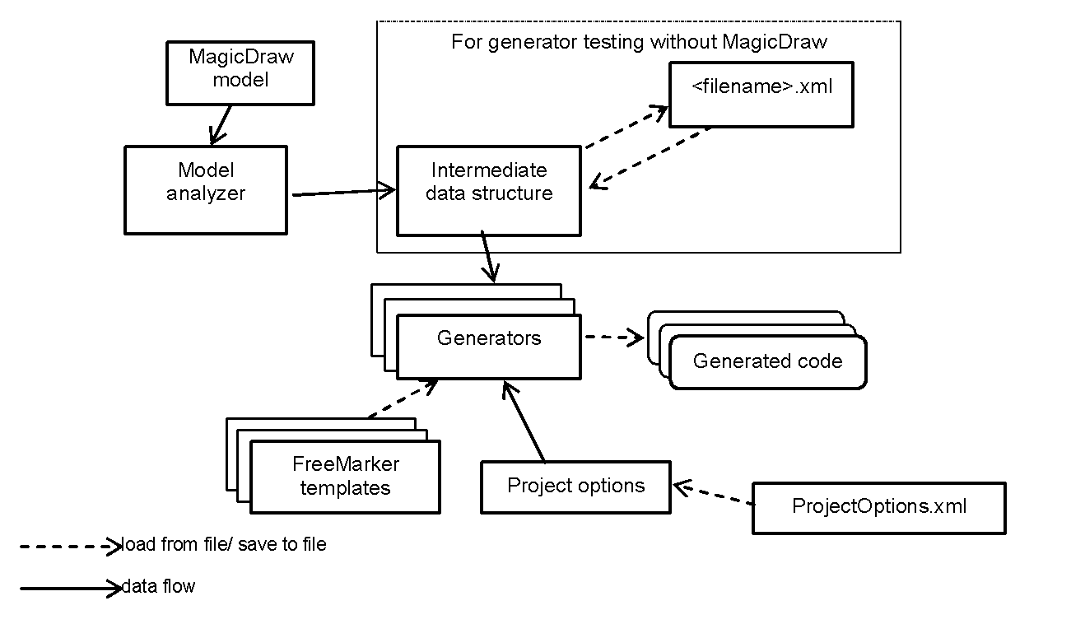
Struktura generatora / Generator structure

Slide 3

Paketi u projektu/ Project packages
Intermediate data structure: myplugin.generator.fmmodel
Model Analizer: myplugin.analizer
generators: myplugin.generator
project options: myplugin.generator.options
tests: testTemplates
freemarker templates: resources/templates
myplugin.MainMenuConfigurator, myplugin.GenerateAction

Slide 4
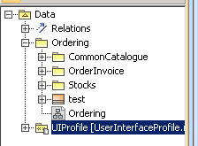
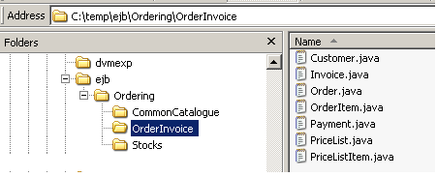
Generisanja paketa/ Package generation
MBRSExample.mdzip
package ejb.Ordering.OrderInvoice;
public class Order {
private Set<OrderItem> orderItem = new HashSet<OrderItem>();
private Set<Payment> payment = new HashSet<Payment>();
private Invoice invoice;
private Integer orderNumber;
......

Slide 5
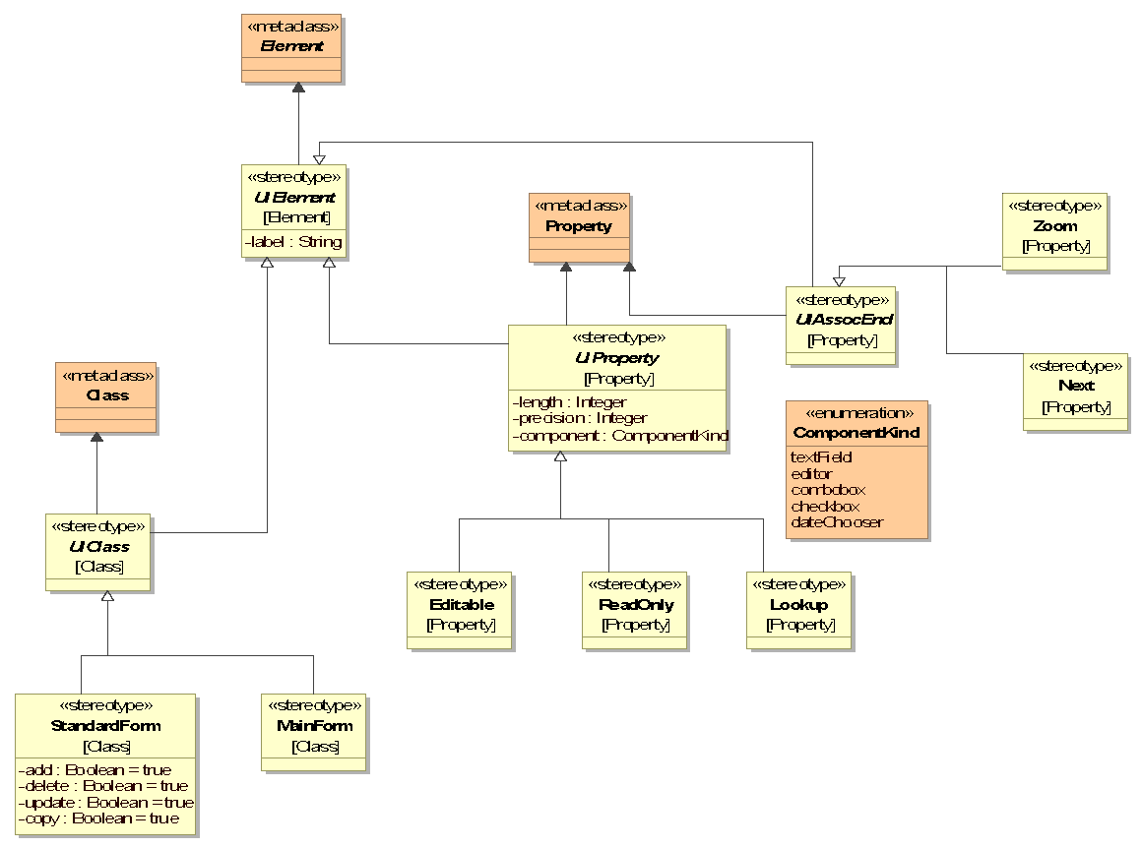
Skica profila za modelovanje korisničkog interfejsa/ User Interface Profile Sketch
UserInterfaceProfile.mdzip

Slide 6
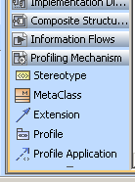
Definisanje UML Profila / UML Profile Definition
UML Profile Definition
  create new MagicDraw project
  create profile elements (stereotypes, tags, constraints...) – Profiling Mechanisam toolbar
  share profile package(s) (File->Share Packages)
Profile Usage:
  open your model
  File->Use module... (choose previously defined profile with shared package(s))

