Slide 1
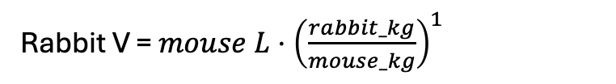
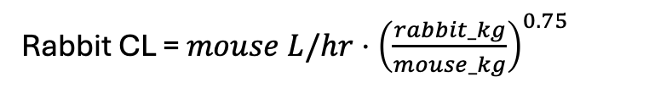
Good alignment between mouse and rabbit from allometric scaling of parameter estimates
Species | Avg wt (kg) | PK parameter | NONMEM estimate | Allo scaling estimate from mouse | Allo scaling estimate from rabbit | Scaled human (60kg) parameter
Mouse | 0.02557 | CL (L/h): | 0.00904 | NA | 0.007429 | 3.05
 |  | V (L): | 0.0669 | NA | 0.052721 | 156.96
Rabbit | 3.4488 | CL (L/h): | 0.294 | 0.3578 | NA | 2.50
 |  | V (L): | 7.11 | 9.0221 | NA | 123.69
(allo scaling for humans to compare w/ linear relationship on next slide)
example equations:
Rabbit CL = $mouse L/hr⋅{\left(\frac{rabbit_kg}{mouse_kg}\right)}^{0.75}$
Rabbit V = $mouse L⋅{\left(\frac{rabbit_kg}{mouse_kg}\right)}^{1}$

Slide 2
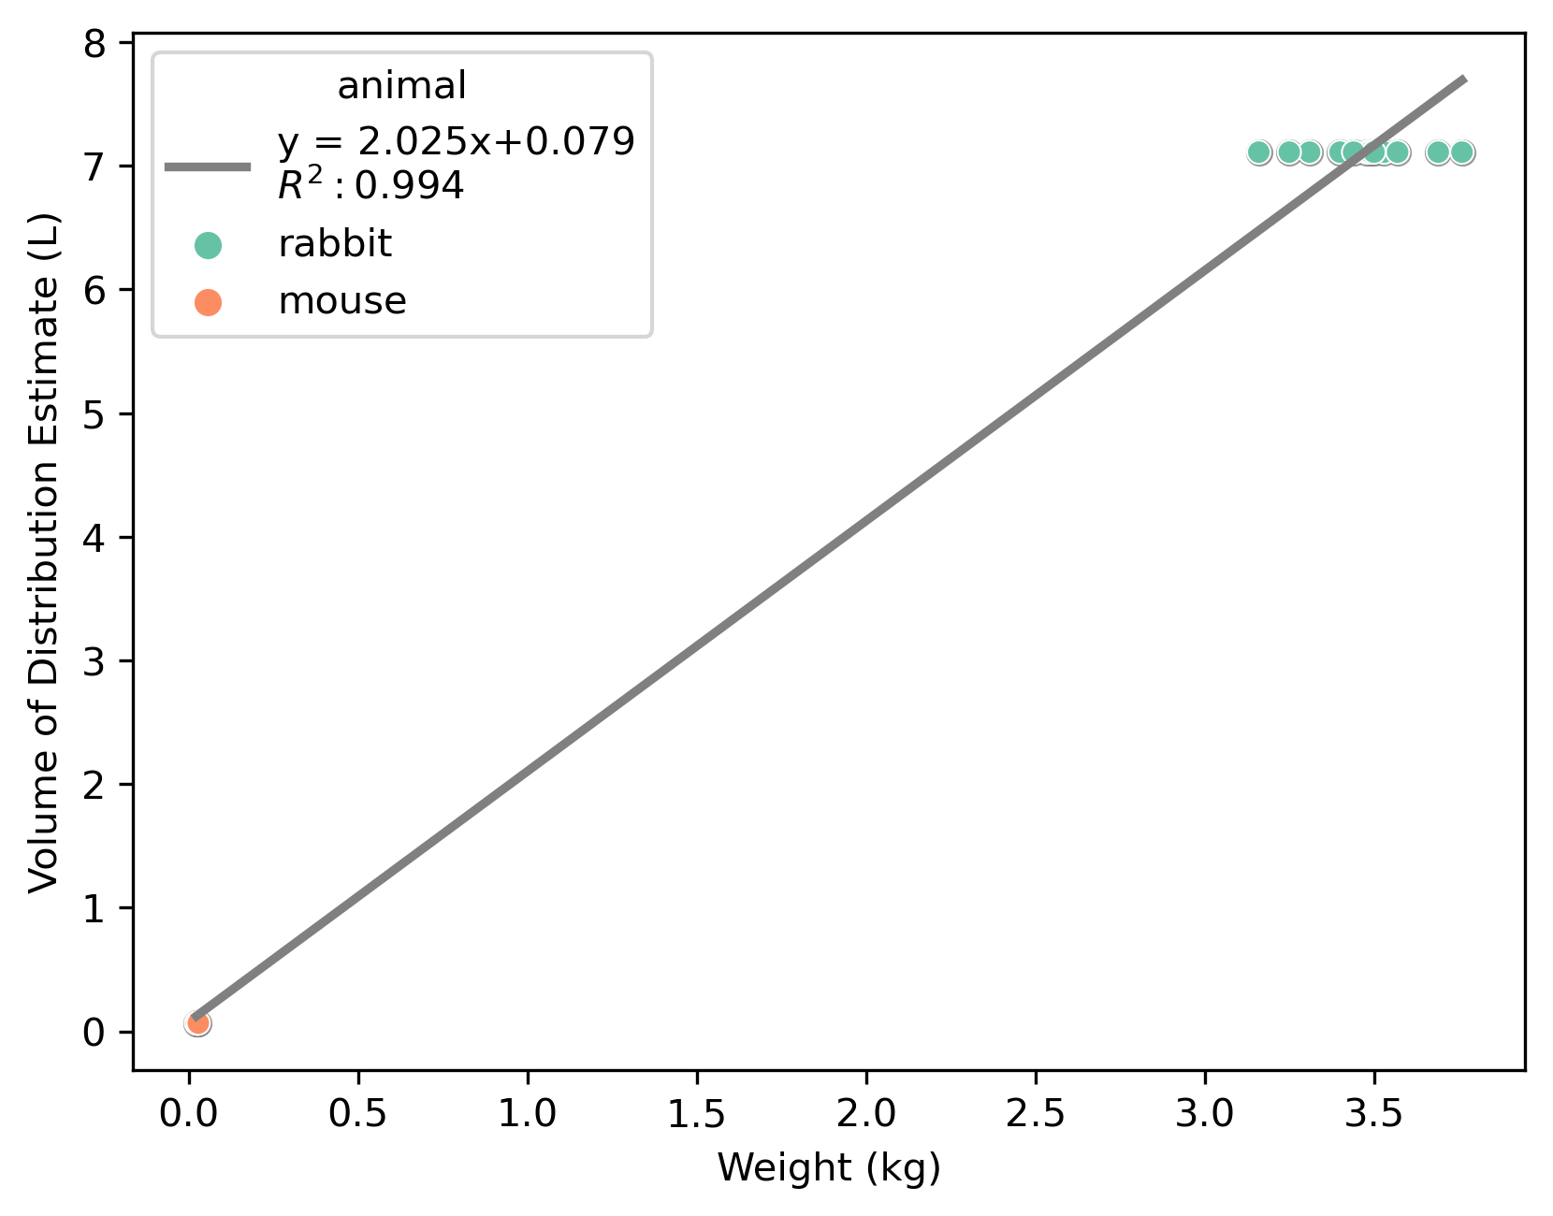
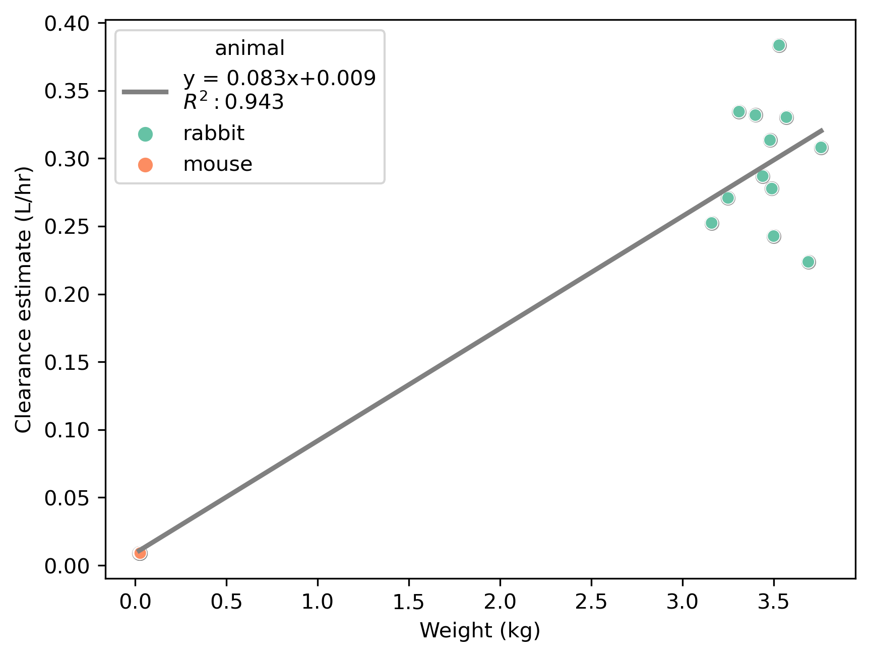
Linear relationship
Predicted from equation Human V (L): 121.56
Predicted from equation
Human CL (L/h): 4.97

Slide 3
For clinical simulations
CL from linear equation (4.97 L/h)
V from linear equation (121.56 L)
Use KA from rabbits
Assume one compartment model
No IIV, no error model

