Slide 1
Graphical Analysis Presentation
Rita Savill
EPPS 6356

Slide 2
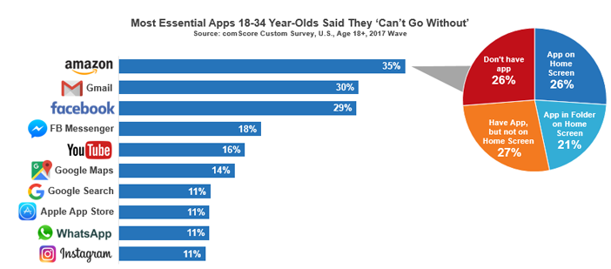
https://www.comscore.com/Insights/Blog/5-Interesting-Facts-About-Millennials-Mobile-App-Usage-from-The-2017-US-Mobile-App-Report

Slide 4
