Slide 1

TUFFY’S TRAPPER KEEPER 2017
CODE SQUAD: JOSE URRUTIA, SAMARTH SHAH,
VANCHIIT KHARE, JUAN SANCHEZ & JOSE UREÑO

Slide 2
VISION AND SCOPE
An organizational tool and planner to help students remain proactive and engaged in their classes.
No need for registering, logging in or creating an online profile to keep track of assignments.
Allow the user to become a monolith of productivity.

Slide 3
FEATURES AND FUNCTIONALITY
Organize classes on a per semester basis.
Create deadlines for completion of assignments.
View calendar with dates for exams and projects.
Input grades for assignments and calculate overall GPA.
Ability to add notes for each course.

Slide 4
LIMITATIONS
Time given for completion of each sprint
Compatibility across different platforms
Support for different versions of development tools used
Learning to work with a team along the way

Slide 5
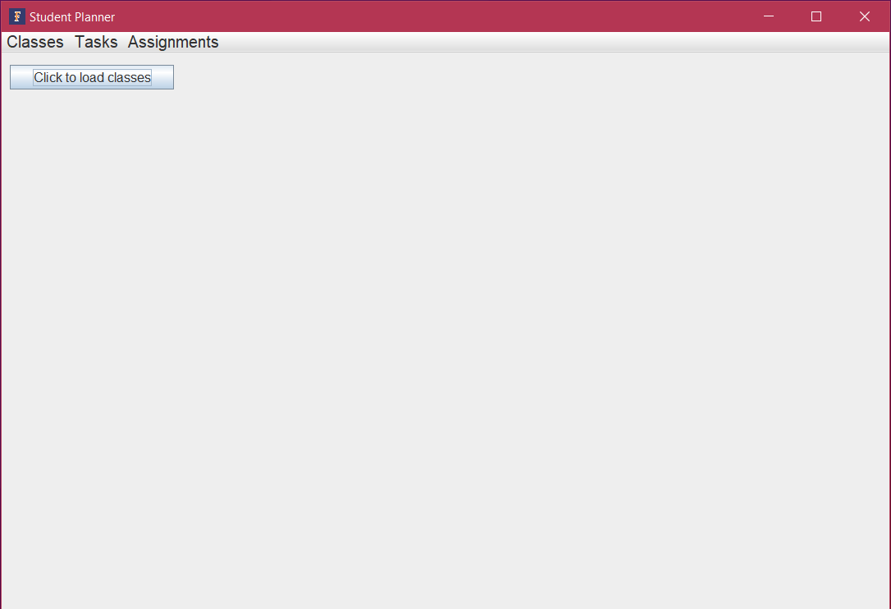
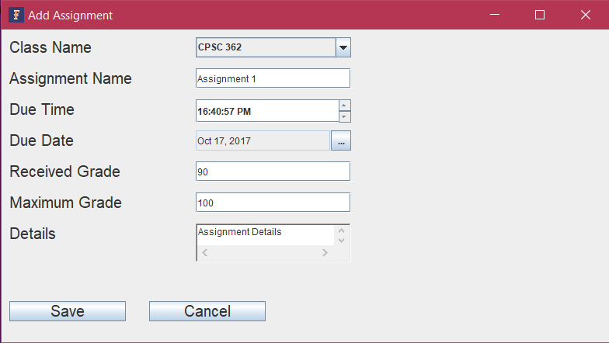
FIRST SPRINT

Slide 6
