Slide 1

Name - Savindu mahasen Ruhunugewa ICBT ID - KD/BSCSE/CMU-03/02 Cardiff ID - st20212770
Dengue Detection System for patients in SriLanka By using Machine learning techniques

Slide 2
Table of content
Introduction
research question
problem statement
objective
litreture review
methodology
testing
conclusion
Recommandation
References

Slide 3
Introduction
Dengue is the most significant threat to sri lanka. the reason is tropical climate
Aedes mosquito—the primary vector for dengue transmission—the country contends with recurrent outbreaks of the disease, precipitating widespread illness, economic strain, and societal (Malavige et al., Changing Epidemiology of Dengue in Sri Lanka—challenges for the future 2021).
Conventional disgonsis methods frequently results in delays in treatment initiation, heightening the risk of severe complications and mortality (Raafat et al., A review of Dengue diagnostics and implications for surveillance and Control 2019).

Slide 4
So machine larning techniques used for detecting the dengue.
The main reason is early detection of dengue, and efficiency
the main aimed of this case study is how predictive models intergrated systems can be used for detecting the patient dengue cases.

Slide 5
Research question
"How machine learning techniques can effectively predict dengue fever cases among patients in Sri Lanka ?"

Slide 6
Research objective
Explore Patient Needs and Challenges in Dengue Diagnosis

Slide 7
Problem statments
Existing applications, and systems are created for doctors, and healthcare professionals
limited labtory facilities for urban area pepole

Slide 8
Litriture review
Dengue diagonisis and prediction application
According to the “A dengue disease prediction and diagnosis model using sentiment analysis and machine learning algorithms” researh paper KNN, decision tree, random forest, naive bayes, and support vector machine.
limitations of this application are data unbalance, scalability

Slide 9
classification of dengue application
According to the “Classification of dengue using machine learning techniques” research paper, Simple Cart, C-4.5, Multi-layer perception algorithms used for classifying the dengue is infected or not
limitation of this application are - overfitting, inbalance dataset, security problem, model accuracy problems

Slide 10
Presumptive diagnosis System for dengue fever
Presumptive diagnosis system used the Decision Tree, Random Forest, Naive Bayes algorithms used for predicting the dengue fever. What ever this Random Forest , Naive Bayes, Decision Tree algorithms use for early detection of dengue in this system
main limitations of this system are - less number of data points available, models accuracy are ver low, sensitivity problems.

Slide 11
Detection of dengue disease application using fused machine learning
in this case used PFDM model
this model has two procedures ANN and SVM
for this mainly use ANN and SVM for detecting the dengue
this fused model is used to predict the dengue is progressive or deductive, and also compare this precition with actuall result.
main limitations of this are computational resource, overfitting, class inbalance(Al Nasar et al., Detection of dengue disease empowered with fused machine learning 2022).

Slide 12
Decision support system for dengue detection
The use of decision support systems (DSS) is essential for the early diagnosis of dengue.
which uses clinical guidelines and historical cases to forecast a patient's present state based on their vital signs and symptom (binti Mohd Zainee & Chellappan, A preliminary dengue fever prediction model based on vital signs and blood profile 2020).
limitations of this system are - complexity, limited data, data inbalance(Lopez et al., An intelligent decision support system to prevent and control of Dengue 2018).

Slide 13
Solution - implementing dengue detection system for patient to detect th dengue or not
reasons
- existing applications issues overfitting, data inbalance dataset, low accuracy models
- existing applications are created only for the doctors, and health care professionals

Slide 14
Methodology
Technology - Flask, python , javascript, HTML, CSS,
bootstrap, pytest for testing purpose
Data collection - data set is recievied from keggle website (Find open datasets and Machine Learning Projects 2024) .
splitting the dataset into the training and testing
data cleaning
libraries - numpy ,sklearn, matplotlib
splitting the training dataset into training and validation set

Slide 15
Machine learning models -
binary logistic regression
- simplycity, and easy of use etc.
decision tree
- easy of use, making them accessible to wide rang of users
random forest
- perform well on unseen data, mitigrate the risk of overfitting, provide robustness, and reliable prediction, scalability

Slide 16
voting classifier( combined model)
- perform well, best solution for overfitting
Techniques - hyper parameter tuning and grid search cv, ensemble technique
- logistic regression best parameters - ‘C’, ‘penalty l2’,
and solver
- decision tree bet parameters - ‘max_depth’, ‘min samples split’

Slide 17
random forest best parameters - max_depth, max_features, min_samples_leaf, min sample split, n_estimator
Ensemble technique - to create the combined model for reducing the overfitting issue

Slide 18
Model deployment
- create the pickel for and store it’s parameter and import it into application. by using flask intergrate this model with backend and allowing to interact with front end or UI.

Slide 19
Design
use case diagram

Slide 20
Activity diagram

Slide 21
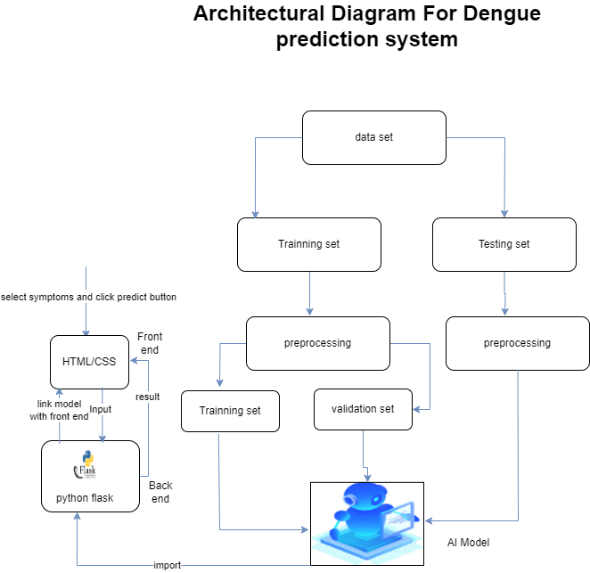
Architectural Diagram

Slide 22
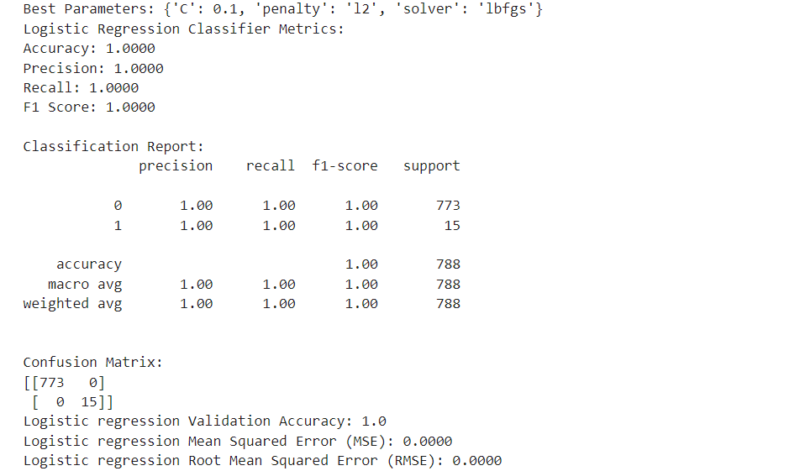
Testing
Final resulta and model evaluation - binary logistic regression

Slide 23
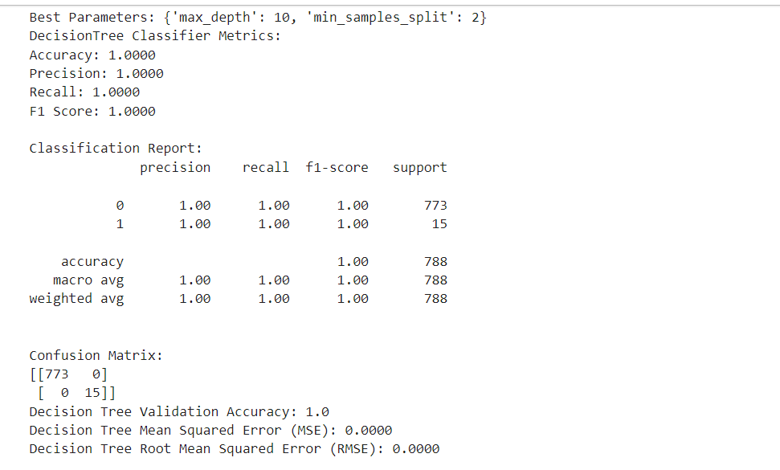
Final results and model evaluation for decision tree

Slide 24
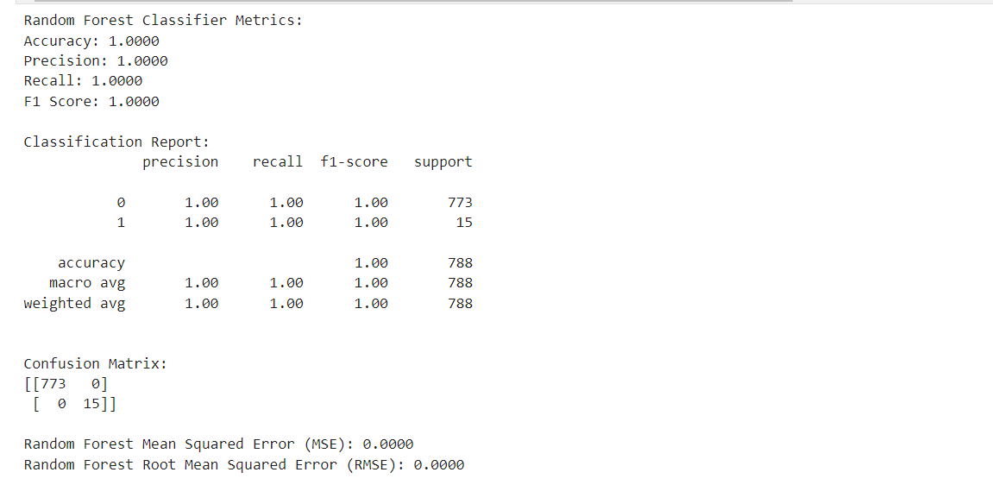
Final results and model evaluation

Slide 25
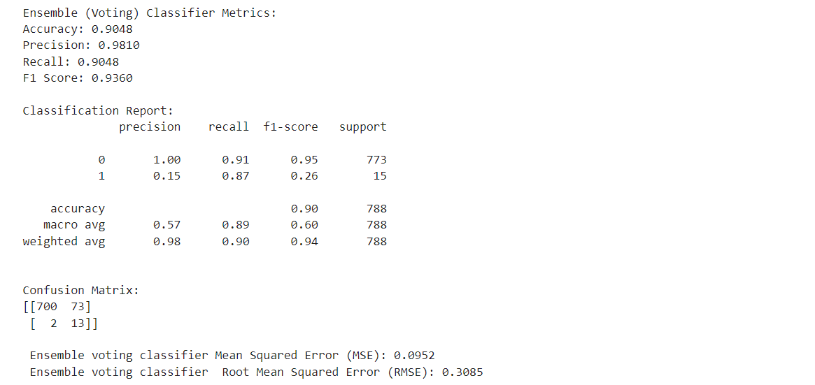
Final results and model evaluvation

Slide 26
Unit testing
- individual software components, and untis are tested
- noramlly used for verifying correctness of function, classes, and modules
Unit testing types
- white box testing
- black box testing
- grey box testing

Slide 27
Benifits of unit testing
- Early detection of bugs
- Regression testing
- improve code quality
unit testing - pytest (python framework)
pytestest belongs to the whitebox testing

Slide 28
key features of pytest
- Simple syntax
- Fixure support
- parameter testing
- plugin

Slide 29
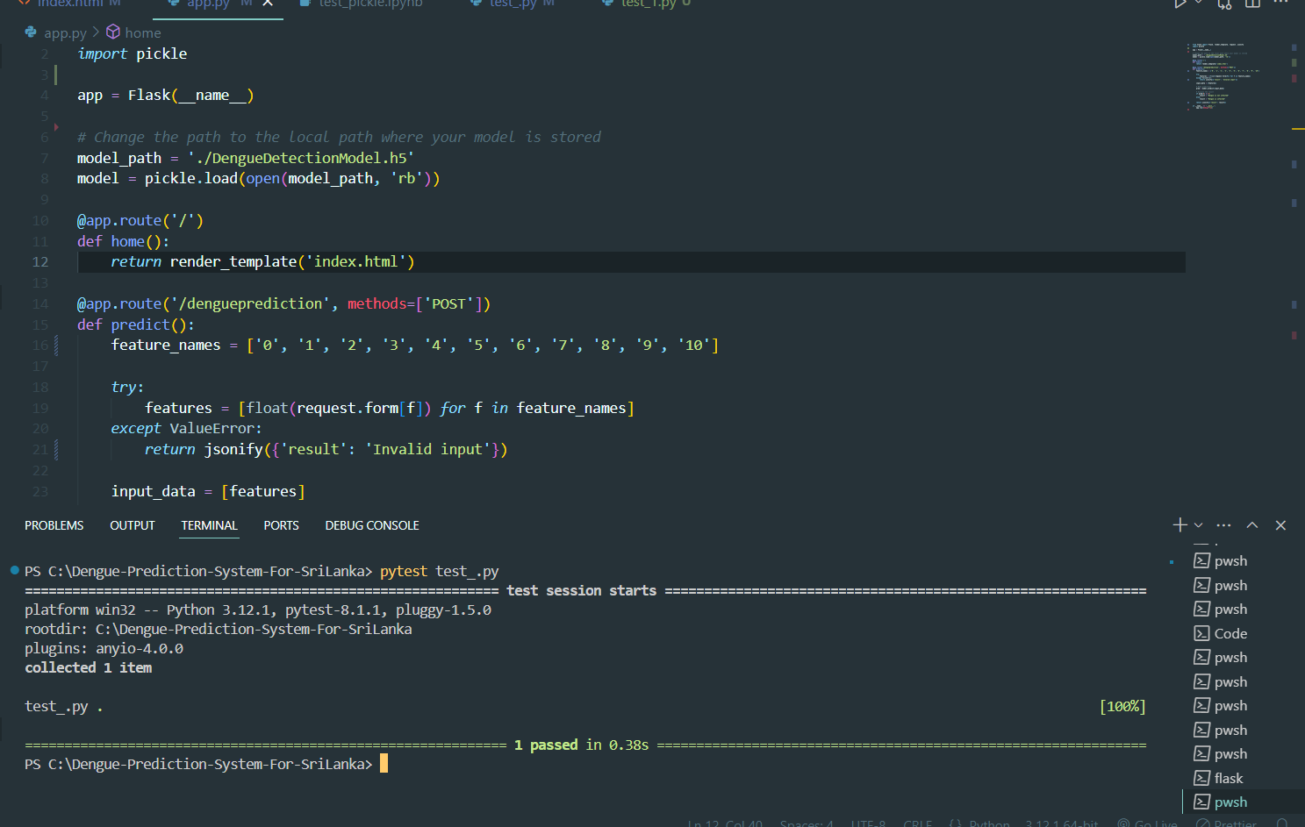

Slide 30
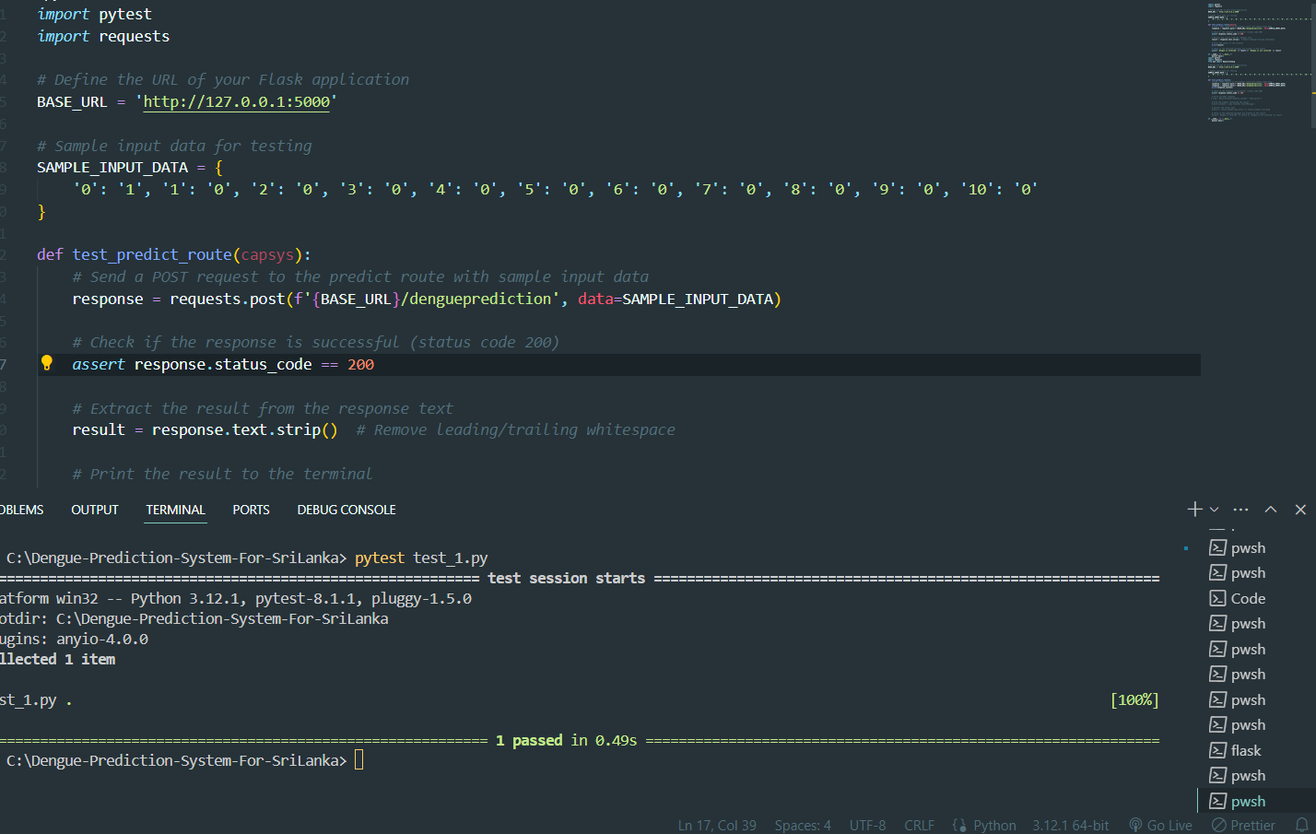

Slide 31
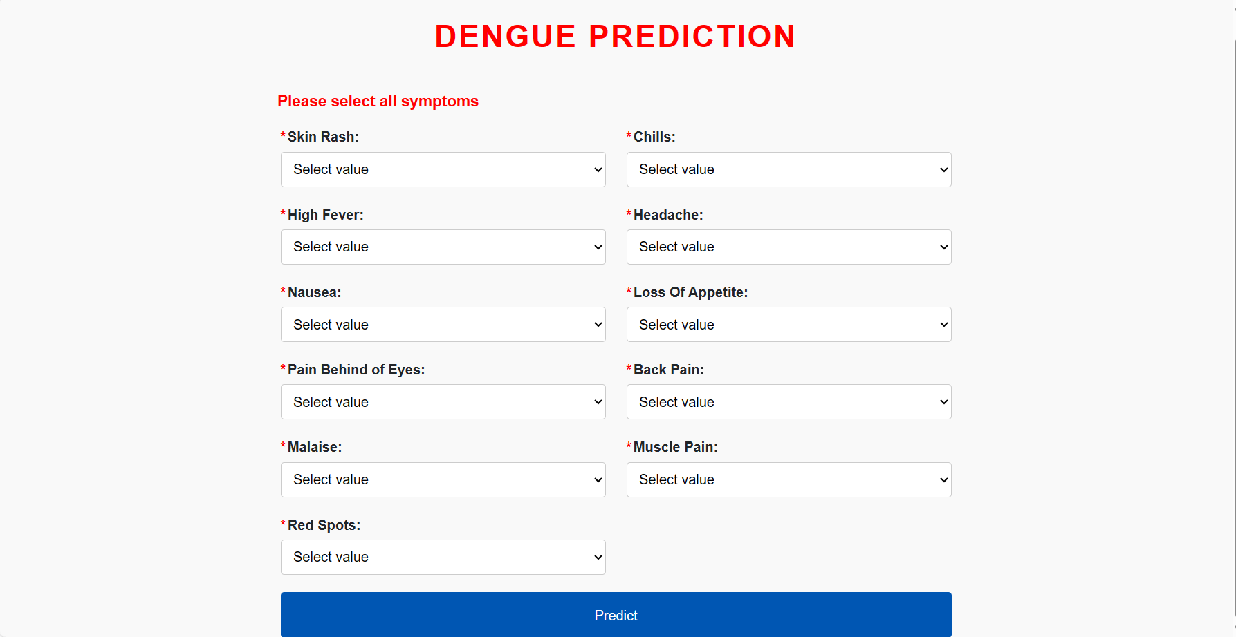
Slide Title
Sample UI images

Slide 32
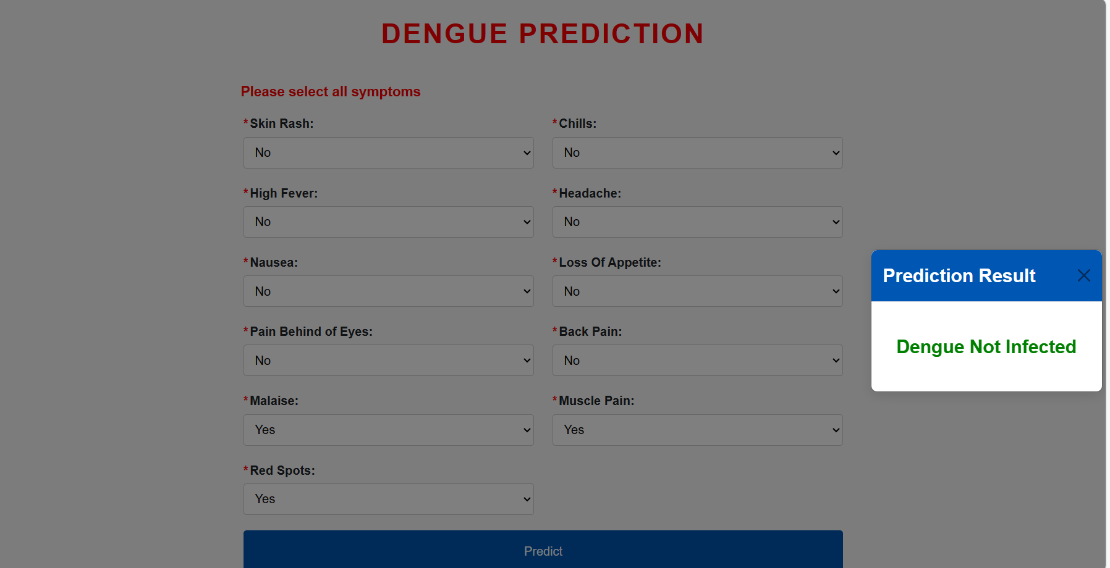

Slide 33
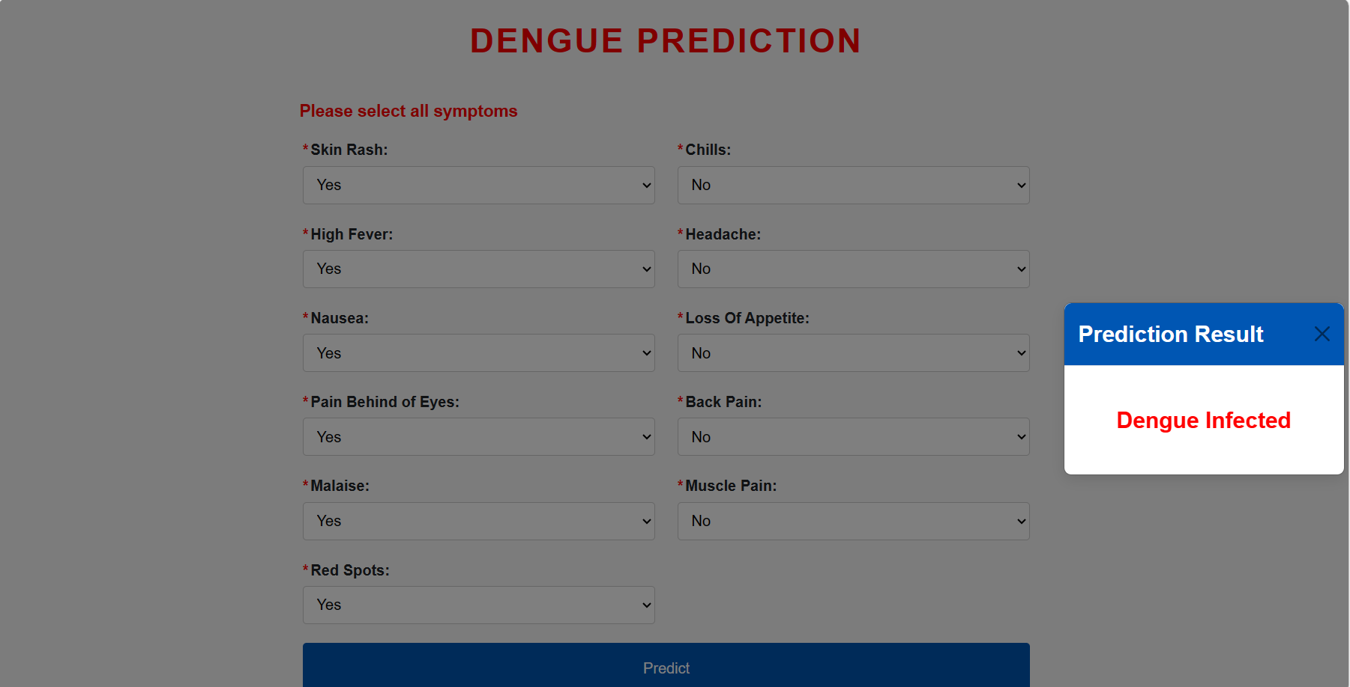

Slide 34
Conclusion
explore the exisiting machine learning application for dengue detection
through the utilization of machine learning techniques classification algorithm main aimde to predict the dengue accuratley
And also using grid search cv and hyperparameter tuning technqiues for identifying best parameters for models
limitations of this course study are data inbalance, data quality and availability etc.
result of this research has significant implications for public health authoritizies and plociymakers

Slide 35
Recommandation
expand this system to detect the dengue catergories
(DENV-1), (DENV-2), (DENV3), (DENV4) (Nature new, 2022).
exapnad this system for users who dont have good english knowledge

Slide 36
References
Malavige, G.N. et al. (2021) ‘Changing Epidemiology of Dengue in Sri Lanka—challenges for the future’, PLOS Neglected Tropical Diseases, 15(8). doi:10.1371/journal.pntd.0009624.
Raafat, N., Blacksell, S.D. and Maude, R.J. (2019) ‘A review of Dengue diagnostics and implications for surveillance and Control’, Transactions of The Royal Society of Tropical Medicine and Hygiene, 113(11), pp. 653–660. doi:10.1093/trstmh/trz068.

Slide 37
Gupta, G. et al. (2023) ‘DDPM: A dengue disease prediction and diagnosis model using sentiment analysis and machine learning algorithms’, Diagnostics, 13(6), p. 1093. doi:10.3390/diagnostics13061093.
Wong, P.-F., Wong, L.-P. and AbuBakar, S. (2020) ‘Diagnosis of severe dengue: Challenges, needs and opportunities’, Journal of Infection and Public Health, 13(2), pp. 193–198. doi:10.1016/j.jiph.2019.07.012.

Slide 38
Sajana, T. et al. (2018) ‘Classification of dengue using Machine Learning Techniques’, International Journal of Engineering &amp; Technology, 7(2.32), p. 212. doi:10.14419/ijet.v7i2.32.15570.
Khan, J.R. and Raza, S.K. (2023) Development and evaluation of a predictive diagnostic system for dengue fever using Machine Learning Techniques [Preprint]. doi:10.21203/rs.3.rs-2473833/v2.
Al Nasar, M.R. et al. (2022) ‘Detection of dengue disease empowered with fused machine learning’, 2022 International Conference on Cyber Resilience (ICCR) [Preprint]. doi:10.1109/iccr56254.2022.9996009.
Hoyos, W., Aguilar, J. and Toro, M. (2021) ‘Dengue models based on machine learning techniques: A systematic literature review’, Artificial Intelligence in Medicine, 119, p. 102157. doi:10.1016/j.artmed.2021.102157.

Slide 39
Jayasundara, S.D.P., Perera, S.S.N. and Rathnayaka, N.S. (2017) ‘Developing a decision support testing algorithm to detect severity level of Dengue’, European Scientific Journal, 13(9). doi:10.19044/esj.2017.v13n9p137.
Rocha, F.P. and Giesbrecht, M. (2022) ‘Machine learning algorithms for dengue risk assessment: A case study for São Luís do Maranhão’, Computational and Applied Mathematics, 41(8). doi:10.1007/s40314-022-02101-z.

Slide 40
Katta, M. et al. (2022) ‘An efficient learning model selection for dengue detection’, Smart Innovation, Systems and Technologies, pp. 439–453. doi:10.1007/978-981-16-9873-6_40.
Find open datasets and Machine Learning Projects (no date a) Kaggle. Available at: https://www.kaggle.com/datasets/ (Accessed: 29 April 2024).
Chakraborty, T., Chattopadhyay, S. and Ghosh, I. (2019) ‘Forecasting dengue epidemics using a hybrid methodology’, Physica A: Statistical Mechanics and its Applications, 527, p. 121266. doi:10.1016/j.physa.2019.121266.

Slide 41
binti Mohd Zainee, N. and Chellappan, K. (2020) ‘A preliminary dengue fever prediction model based on vital signs and blood profile’, 2016 IEEE EMBS Conference on Biomedical Engineering and Sciences (IECBES) [Preprint]. doi:10.1109/iecbes.2016.7843530.
Lopez, D. et al. (2018) ‘An intelligent decision support system to prevent and control of Dengue’, Journal of Ambient Intelligence and Humanized Computing [Preprint]. doi:10.1007/s12652-018-0829-9.

