Slide 1

Master Boot Record Computer Data Forensics CPE-536
- Srinivas Garapati

Slide 2
Operating System: Ubuntu
01
Used Oracle VM virtual box for Ubuntu
02
Programming Language: Java
03
IDE: Eclipse
04

Slide 3
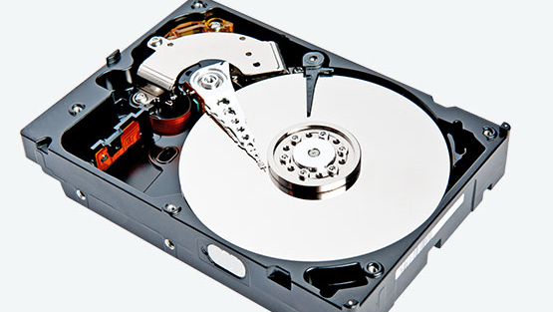
How I extracted the MBR data
Used dd tool to extract the MBR data from the disk.
Extracted only the first 512 bytes i.e. the first sector of the disk.
Since the first 446 bytes of the first sector has boot code, skipped the 446 bytes and got the last 66 bytes only.

Slide 4
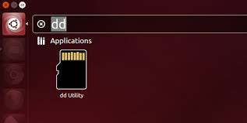
dd commands used:
sudo dd if=/dev/sda of=sda123.mbr count=66 bs=1 skip=446
this command for extracting the mbr data.
xxd sda123.mbr > output.txt
- to save the extracted data into a output file.

Slide 5
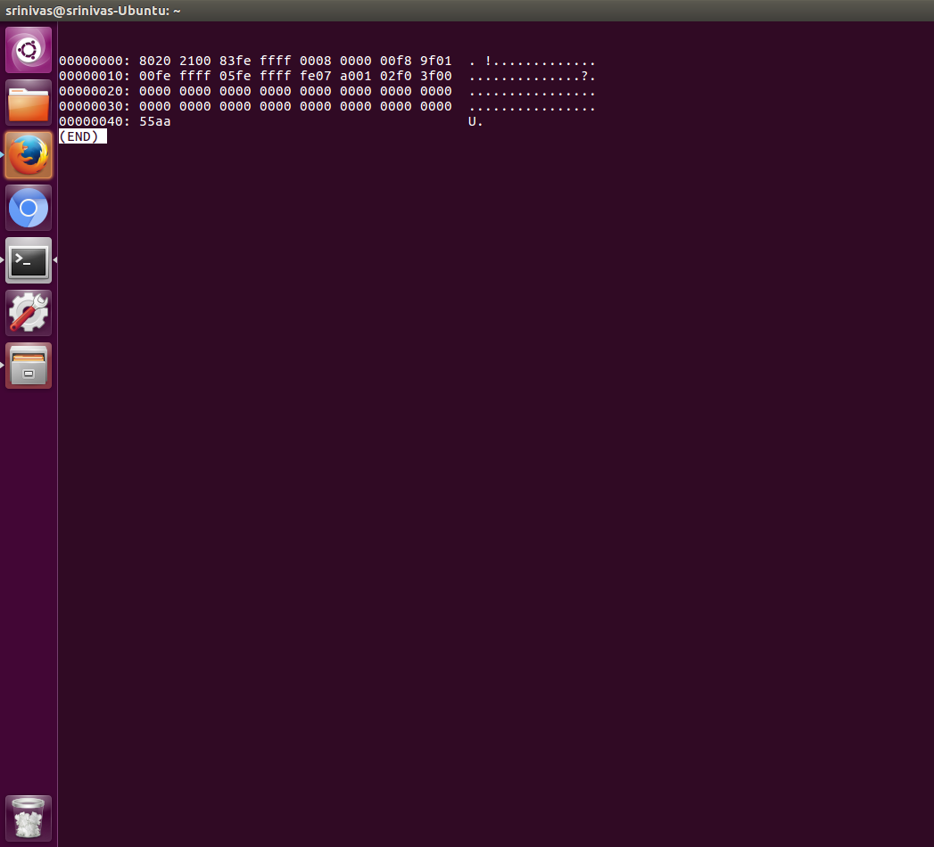
MBR Data
These are the last 66 bytes of the sector.
It represents the partitions offsets in the disk.
If the first byte is 80 it means that this is an active boot partition.

Slide 6
The data after storing into a text file separated the address offsets and got the mbr data bytes into an array.
And separated the four partitions data and classified them separately.

Slide 7
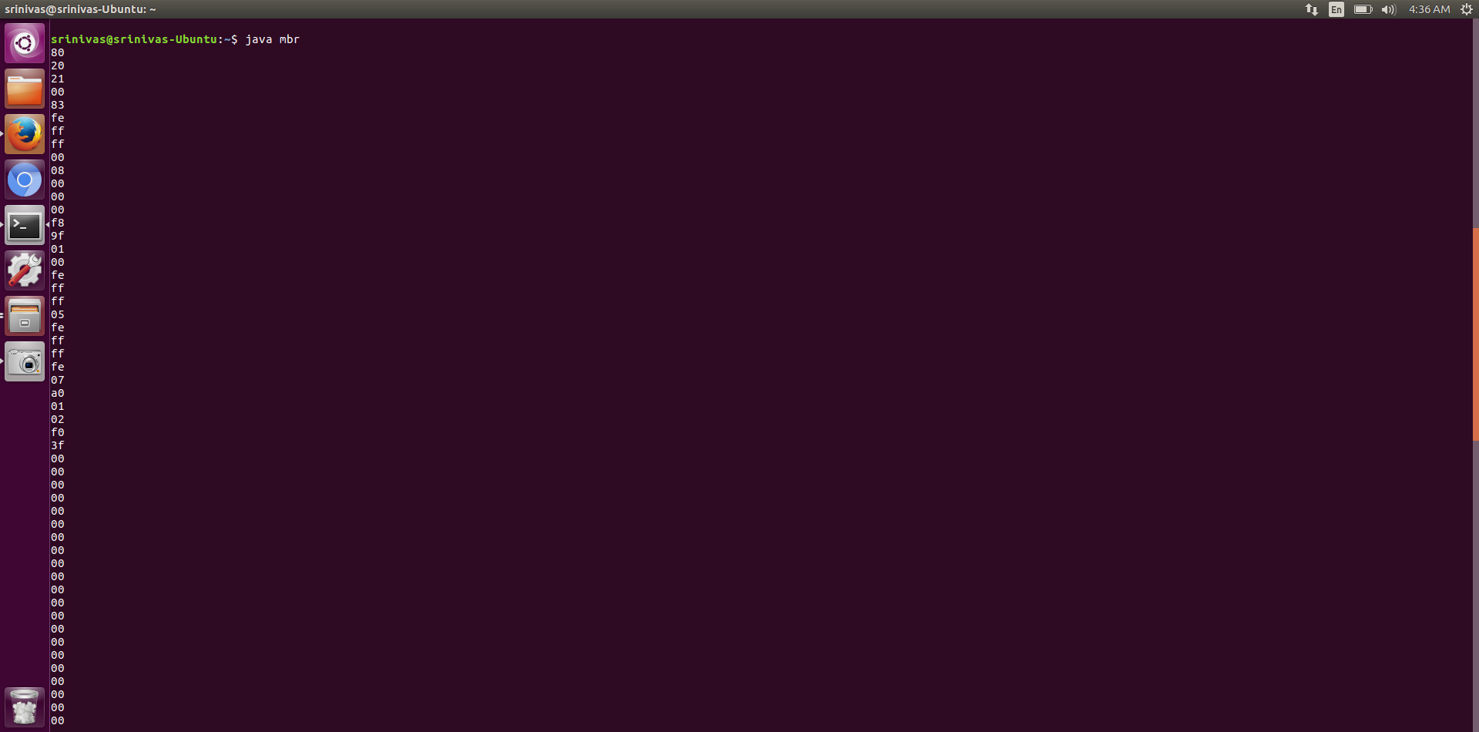

Slide 8
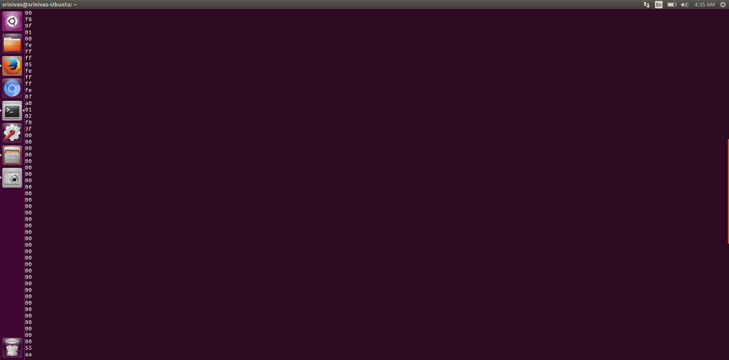

Slide 9
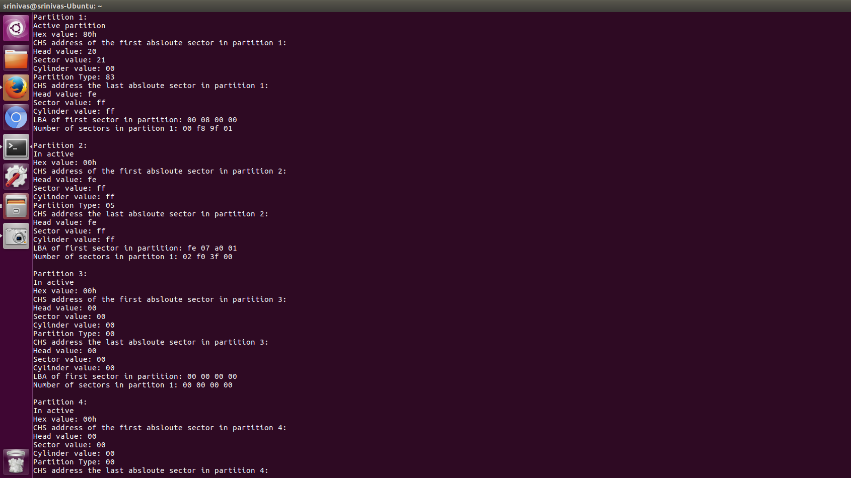

Slide 10

Next Updates…..
Next is to update the code and access the FAT structure on the img file.
Access the root directory from mbr data.
Add small and large files and see how the bytes changes in the directory.

